Slide 1







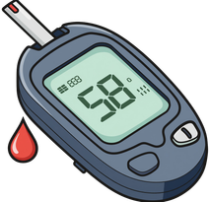







Medicare
PREVENTIVE SERVICES
Stay Healthy. Stay Strong.
Medicare covers many preventive services at no cost to you when you use a doctor or other health care provider that accepts Medicare.
Examples of Medicare Preventive Services
Yearly Wellness Visit
Flu Shot
COVID-19
Vaccines
Pneumonia
Vaccines
Hepatitis B
Vaccine
Glaucoma Screening
Cancer Screenings
Diabetes Screenings
Heart disease Screenings
Depression Screenings
Don’t Forget!
Vaccines protect you, your loved ones, and your community.
Talk to Your Health Care Provider
  Preventive care can help you stay healthy
  Helps find problems early, when they are easier to treat
Ask what vaccines and screenings you need.
They can help you make a plan that is right for you!
For free, unbiased help contact:
<Insert logo here>
Questions about Medicare preventive services?
<Insert contact information here>
We’re here to help!
This flyer was supported by the Administration for Community Living (ACL), U.S. Department of Health and Human Services (HHS) as part of a financial assistance award totaling $1,061,673 with 100 percent funding by ACL/HHS. The contents are those of the author(s) and do not necessarily represent the official views of, nor an endorsement, by ACL/HHS, or the U.S. Government.

