Slide 1

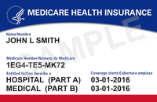

Get Ready For
MEDICARE
October 15
-
December 7
Open Enrollment
Start Preparing Today!
Make a
Medication List
Watch for
Important Mail
Review Your
Health Care Needs
Gather Your
Medicare Information
Mark Your
Calendar
Get Free,
Unbiased Help
FOR FREE, UNBIASED HELP CONTACT:
INSERT YOUR INFORMATION HERE
Insert your logo here
This project was supported by the Administration for Community Living (ACL), U.S. Department of Health and Human Services (HHS) as part of a financial assistance award totaling $1,061,673 with 100 percent funding by ACL/HHS. The contents are those of the author(s) and do not necessarily represent the official views of, nor an endorsement, by ACL/HHS, or the U.S. Government.

