Slide 1

Using the Plan Finder on Medicare.gov
Notes:
This video is brought to you by the WI State Health Insurance Assistance Program, or SHIP – a local public service for people with Medicare. Since all Medicare Part D and Medicare Advantage plans can change their costs and other details each year, it’s important to review your plan and compare it to other plans available to make sure you will have coverage that meets your needs in the new year. In this video you will learn how to use Medicare’s plan comparison tool known as the plan finder.

Slide 2

Disclaimer
This presentation is supported by the Administration for Community Living (ACL), U.S. Department of Health and Human Services (HHS) as part of a financial assistance award totaling $1,061,673 with 100 percent funding by ACL/HHS. The contents are those of the author(s) and do not necessarily represent the official views of, nor an endorsement, by ACL/HHS, or the U.S. Government.

Slide 3
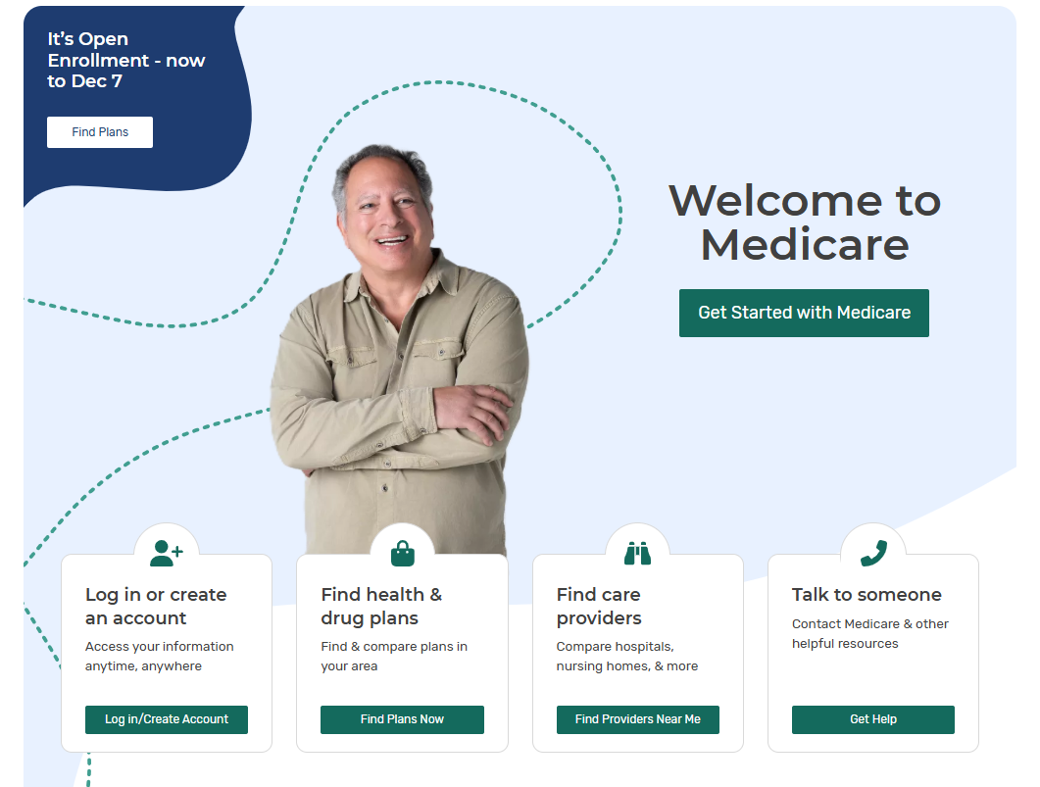
Type Medicare.gov
into your web browser to get to the Medicare home page
Access the
Plan Finder
here.
Notes:
The first step is to type Medicare.gov into your web browser, which will take you to the Medicare home page. The home page should look similar to what you see on this slide, although the pictures and buttons may be updated frequently. To access the plan finder find and click the button that says Find Plans Now

Slide 4

What you will need:
List of prescription drugs
Drug dosage
Quantity
Refill frequency

Slide 5
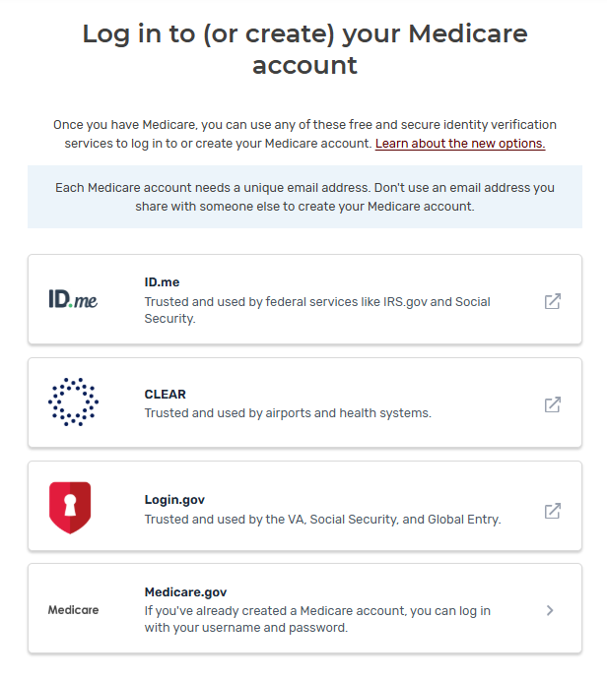
How to create a Medicare Account Demonstration Video
Notes:
If you do not have an online Medicare account, you might want to sign up for one now. We have another video explaining on how to create a Medicare account and the link will be in the description below.

Slide 6
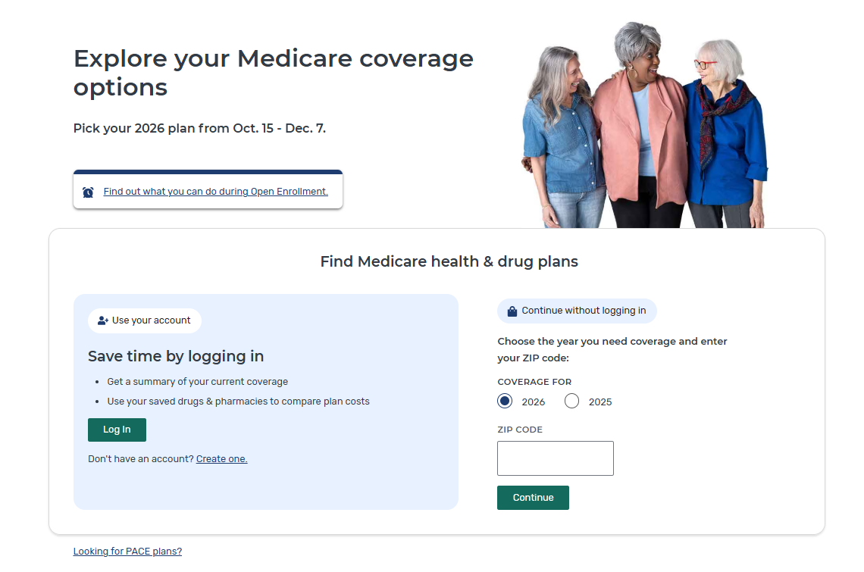
Notes:
If you have an online Medicare account and are already enrolled, your prescription drugs will show up in the plan finder, you’ll be able to edit your drug list once you log in. If your current plan is available next year, you can also see the changes and how it compares to other plans.

Slide 7
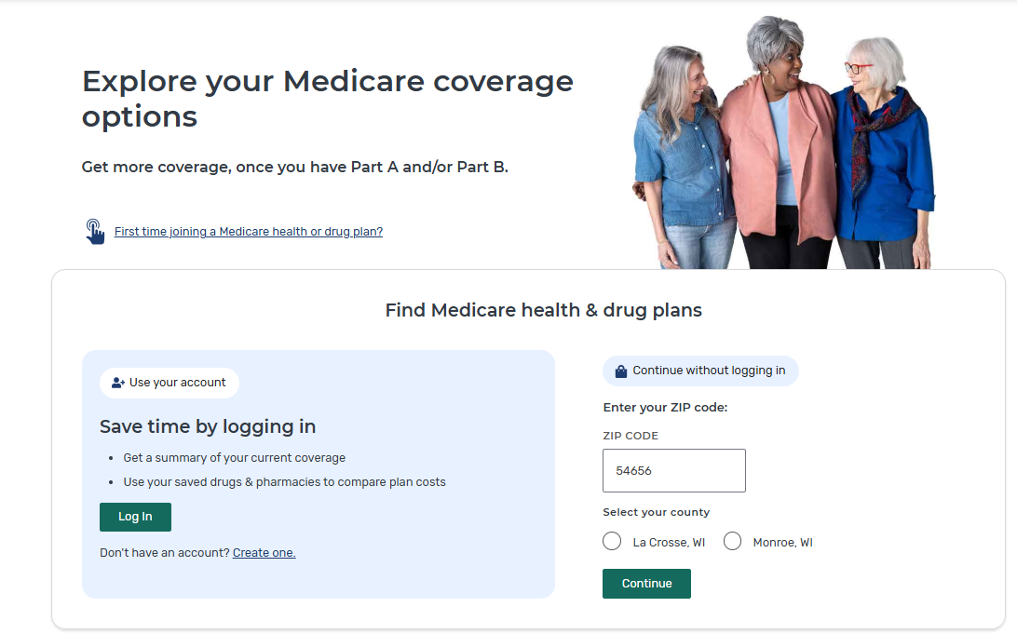
To continue without logging in:
Choose the year you need coverage (if prompted)
Enter Zip Code
If multiple counties appear click the correct county
Click Continue
Notes:
If you don’t have an online account you can continue without logging in,
Choose the year you need coverage (if prompted)
Enter your zip code
If multiple counties appear click on the correct county in which you live.
Then click continue.

Slide 8
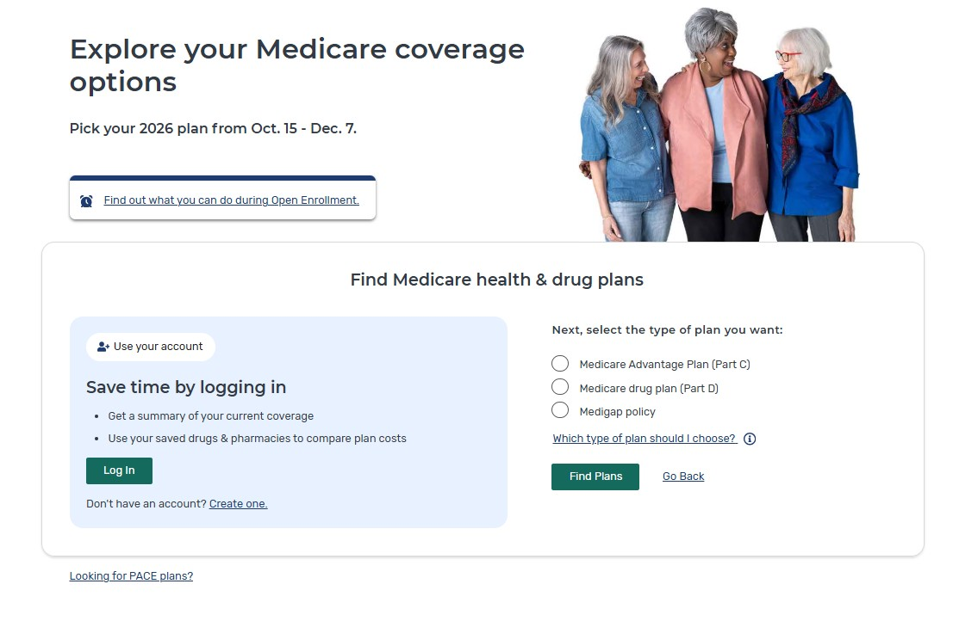
Choose either:
Medicare Advantage Plan
(Part C)
or
Medicare Drug Plan
(Part D)
Notes:
You will then choose either
Medicare Advantage Plan (Part C)
Or
Medicare Drug Plan (Part D)
Click Find Plans

Slide 9
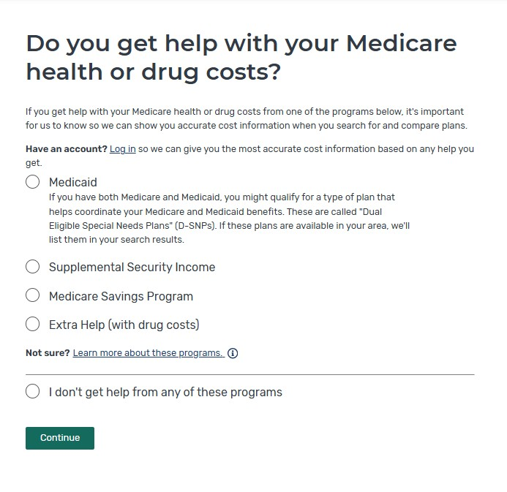
Not sure or have a question?
Call
1-800-MEDICARE
Notes:
You’ll be asked if you get help with your Medicare health or drug costs?
If you have Medicaid in Wisconsin you will have a white forward health card
Supplemental Security Income
Medicare Savings Program means the state is helping pay some of your Medicare costs.
Extra Help means you have lower cost part D drug coverage
If you’re not sure or have a question, call 1-800-MEDICARE

Slide 10
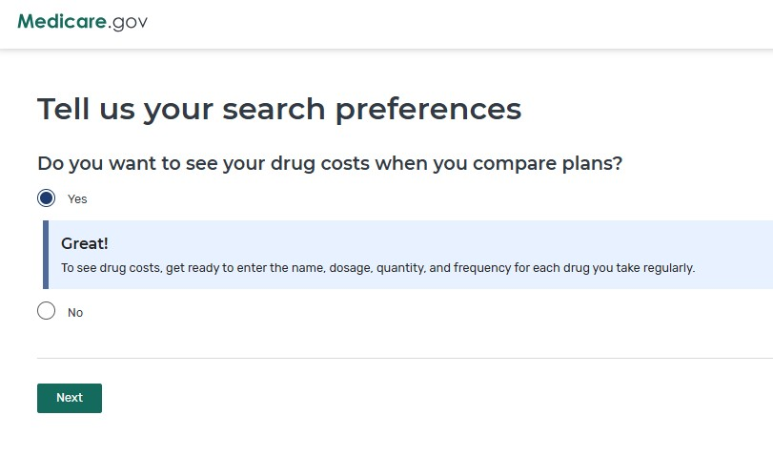
Notes:
You will have the option to click, do you want to see drug costs when you compare plans

Slide 11
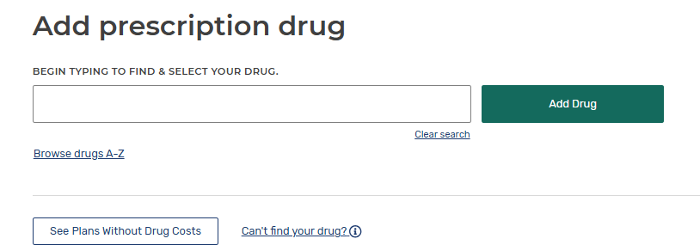
Type your prescription here.
Notes:
Now you will have the option to enter in your prescription drugs.

Slide 12
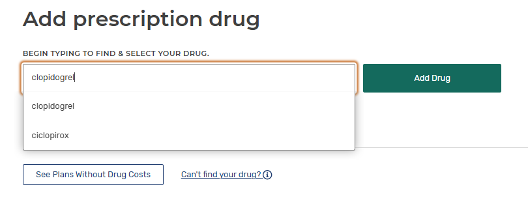
Click on your prescription in the drop-down list.
Notes:
click on your prescription in the drop-down list.
Click Add drug

Slide 13
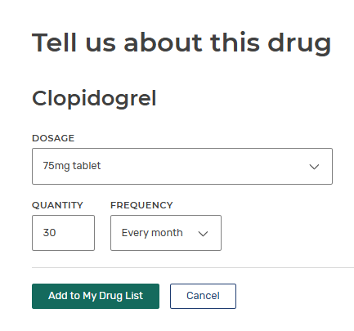
Dosage options
Change quantity
How often do you refill your prescription
Notes:
If you take a different dosage that was is shown you can click the drop-down arrow to choose your dosage.
Depending on how much you take per day and how often you refill your prescription, you can adjust your quantity here
Change how often you refill your prescription by clicking the drop-down arrow.
After you enter the correct information click add to my drug list.

Slide 14
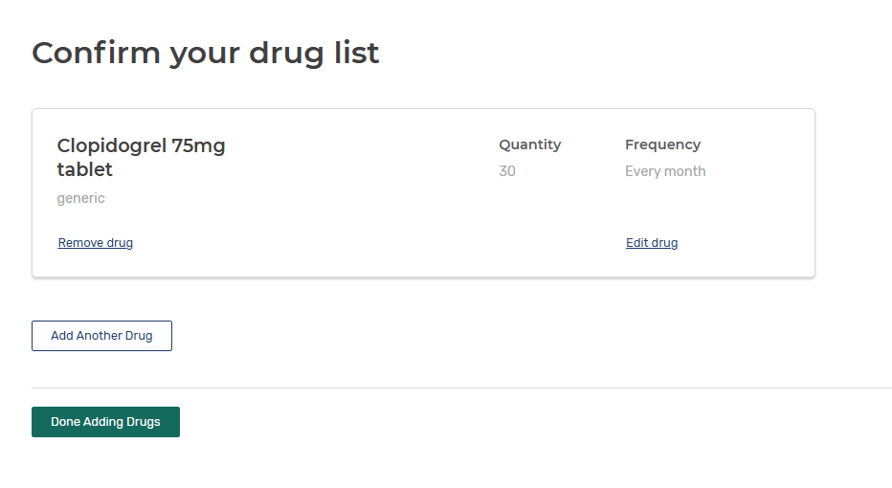
Notes:
Once you add your prescription this is what it will look like
You can now ADD ANOTHER DRUG
You will repeat these steps until you have entered all of your prescriptions

Slide 15
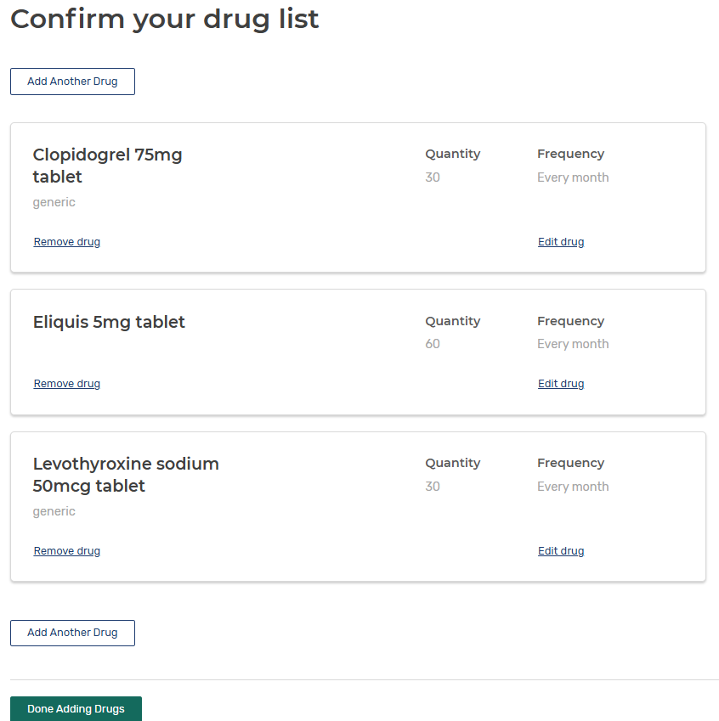
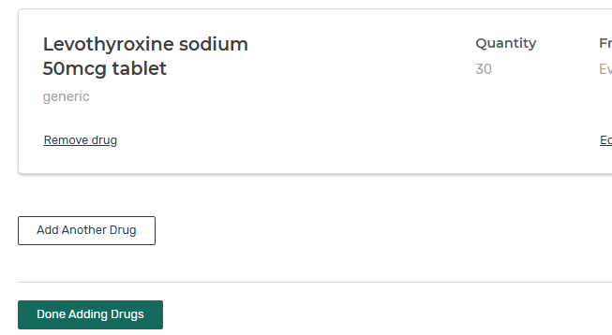
Notes:
Once you have added all of your prescriptions click done adding drugs

Slide 16
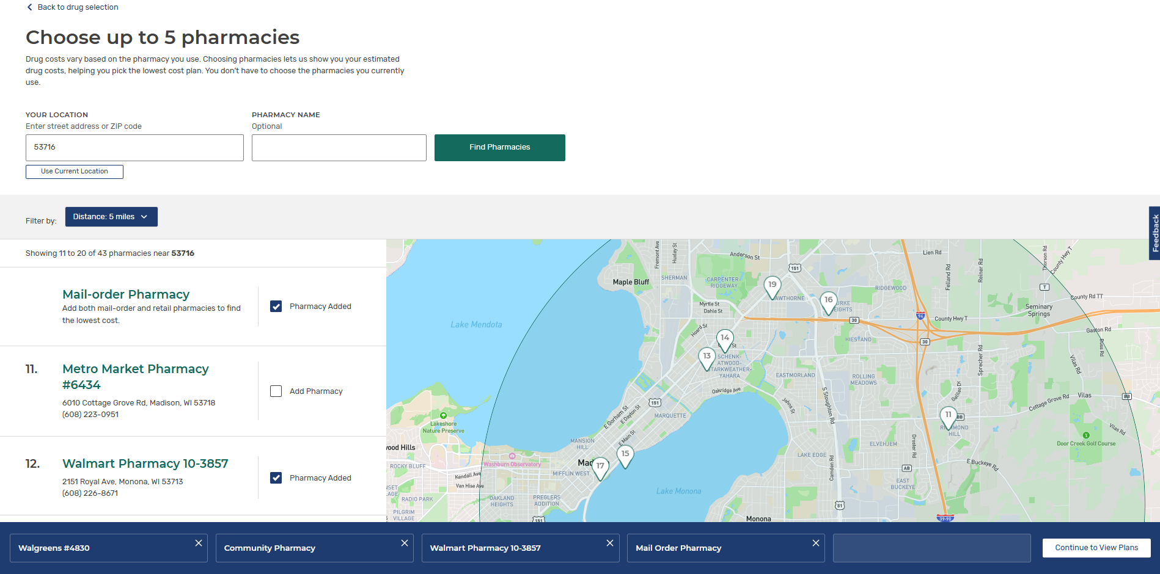
Pharmacies selected shown here
Notes:
You can now choose up to 5 pharmacies to compare
Check the box for mail order and any local pharmacies you use and other pharmacies you might use.
The pharmacies you choose will be listed at the bottom in the blue box. Click continue to view plans when ready.

Slide 17
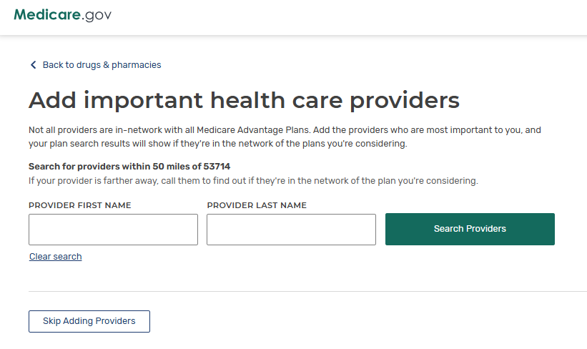
Notes:
You can now narrow your search to include health care providers.

Slide 18
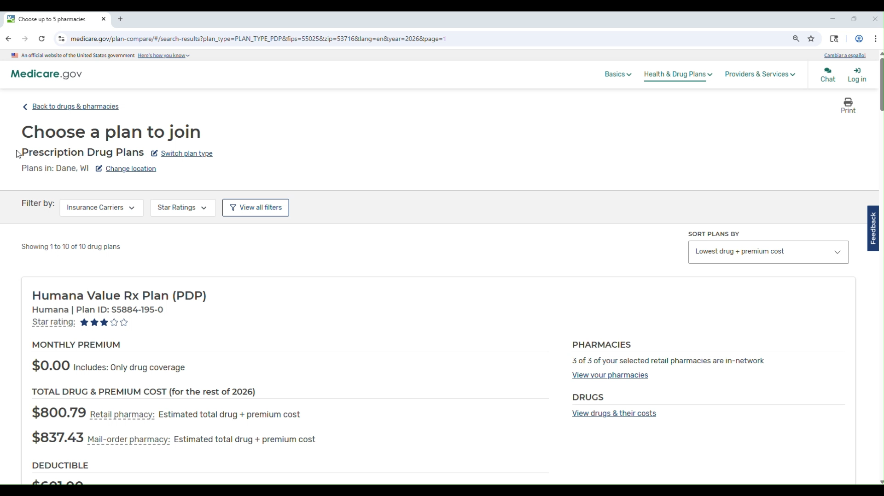

Slide 19

For Assistance:
1-800-Medicare
The Wisconsin Medigap Helpline: 1-800-242-1060, BOALTCMedigap@wisconsin.gov
www.dhs.wi.gov/medicare-help

