Slide 1

Creating a Medicare Account
at Medicare.gov
Notes:
This video is brought to you by the WI State Health Insurance Assistance Program, or SHIP – a local public service for people with Medicare. In this video you will learn how to create a Medicare account with 4 different login options.
A Medicare.gov account will allow you to see your current coverage and view your Medicare claims. It will also make it easier to compare drug plans by pulling up a list of recently filled prescriptions.

Slide 2

Disclaimer
This presentation was supported by the Administration for Community Living (ACL), U.S. Department of Health and Human Services (HHS) as part of a financial assistance award totaling $1,061,673 with 100 percent funding by ACL/HHS. The contents are those of the author(s) and do not necessarily represent the official views of, nor an endorsement, by ACL/HHS, or the U.S. Government.
Notes:
This presentation was supported by the Administration for Community Living.

Slide 3
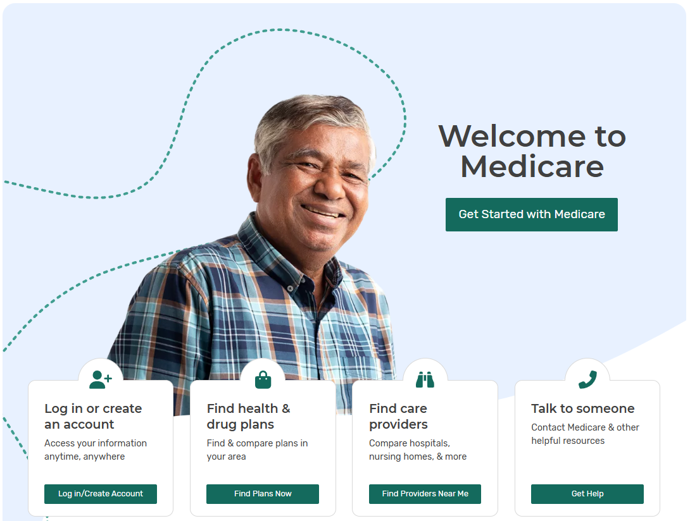
To create an account, visit the
Medicare.gov
home page and click: Log in/Create Account
Notes:
The first step is to type Medicare.gov into your web browser, which will take you to the Medicare home page. The home page should look similar to what you see on this slide, although the pictures and buttons may be updated frequently. Find and click the button that says Log in/Create account.

Slide 4
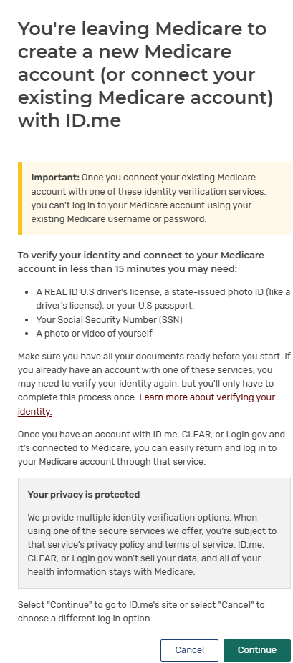
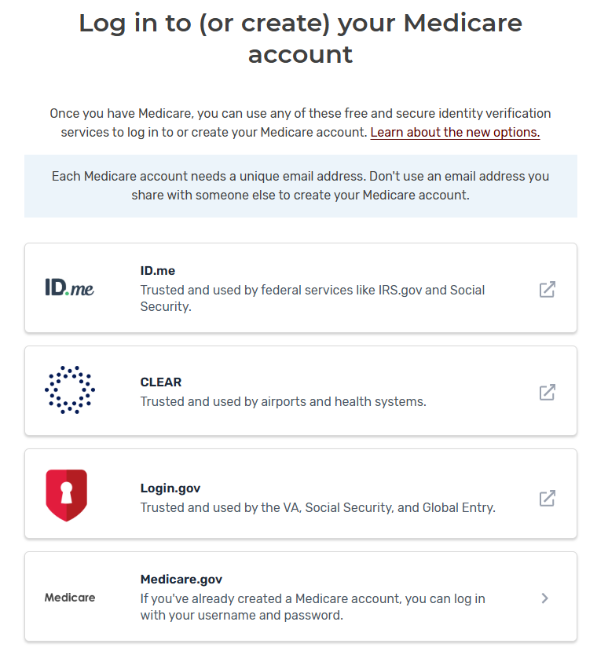
Notes:
You will now see the different login options. These are free and secure identity verification services to log in to or create your Medicare account.
The options include
ID.me
Clear
Login.gov
Or
Medicare.gov
If you click on ID.me, Clear or Login.gov this box will pop up stating that you are leaving Medicare to create a new Medicare account (or connect your existing Medicare account). You will want to read thru the information and then click continue.
We will now go over the different login options in more detail.

Slide 5
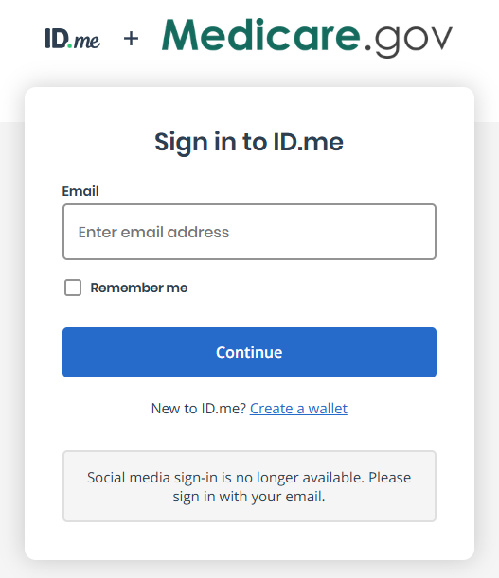

Click on create a wallet
Notes:
To create an account with ID.me click on create a wallet.

Slide 6
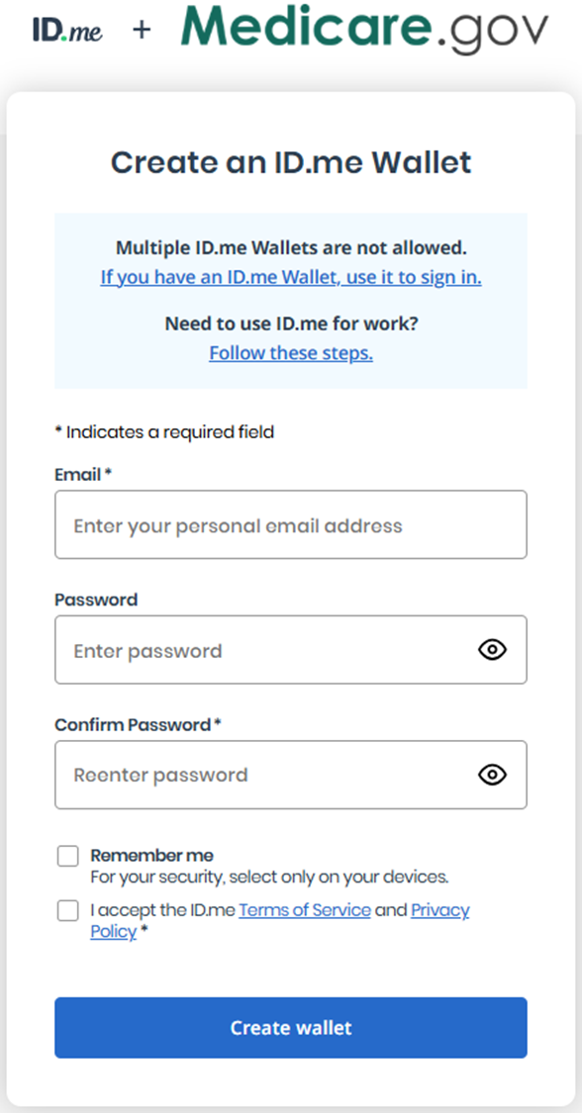

Enter your personal email address
Enter password
Reenter password
Only select this box on your own device
Click to accept
Notes:
You will enter your personal email address
Enter the password you create
Reenter the password
You can click the Remember me box but for your security, on select this on your personal device (not on a public device or someone else’s device)
To accept the ID.me Terms of Service and Privacy Policy click here. You can read the terms of service and Privacy policy by clicking the blue links.
Click Create Wallet
Once you click Create Wallet – you will need to follow any additional steps that are required.

Slide 7
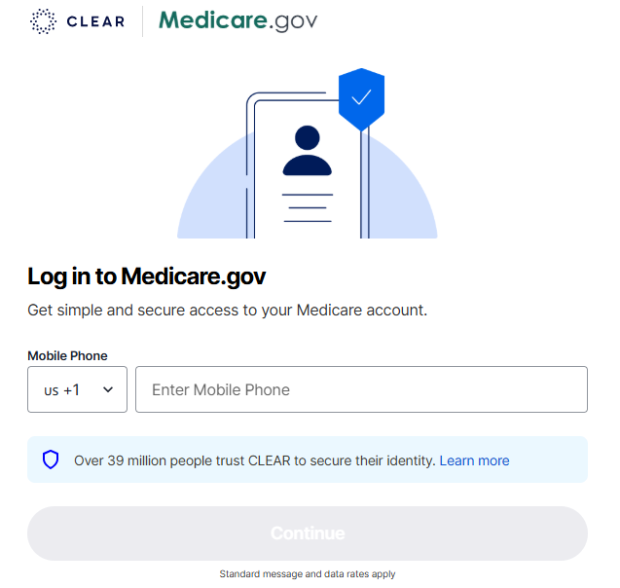



Enter Cell Phone Number
Click Continue
Notes:
To create account with CLEAR,
Enter you cell phone number
Then click continue

Slide 8

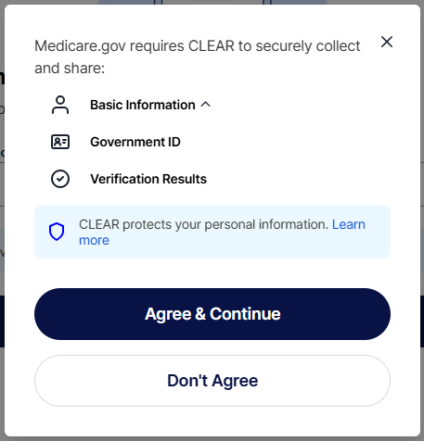
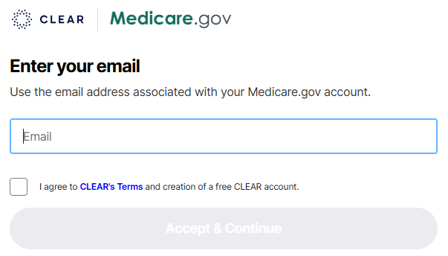
Click Agree and Continue
Enter email
Click Accept and Continue
Click I Agree
Notes:
Medicare.gov requires CLEAR to securely collect and share: Basic Information, Government ID and Verification Results.
Click Agree and Continue
You will then enter your email address associated with your Medicare.gov account.
Click I agree to CLEAR’s Terms and creation of a free CLEAR account
Click Accept and Continue
You will then need to follow any additional steps that are required.

Slide 9
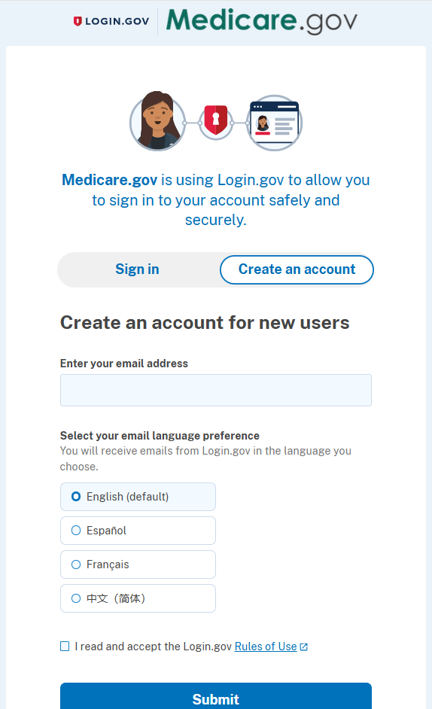

Enter your email address
Select preferred language
Accept Login.gov Rules of use
Click Submit
Notes:
To create an account on LOGIN.gov
Enter your email address
Select your email language preference
Accept Login.govs Rules of use by clicking the box. You can read the RULES of USE by clicking the blue link
Click Submit

Slide 10
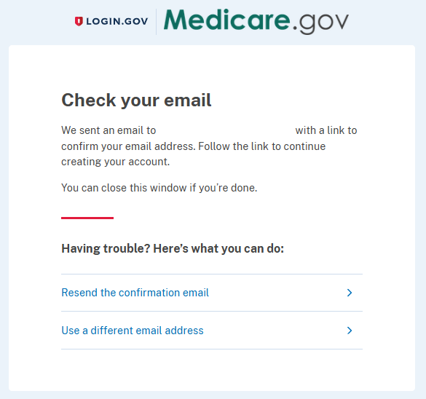

Follow the link in the email from Login.gov to continue creating your account.
Notes:
You will receive an email from LOGIN.gov to confirm your email address. You will need to Follow the link in the email to continue creating your account.
You will need to follow any additional steps that are required.

Slide 11
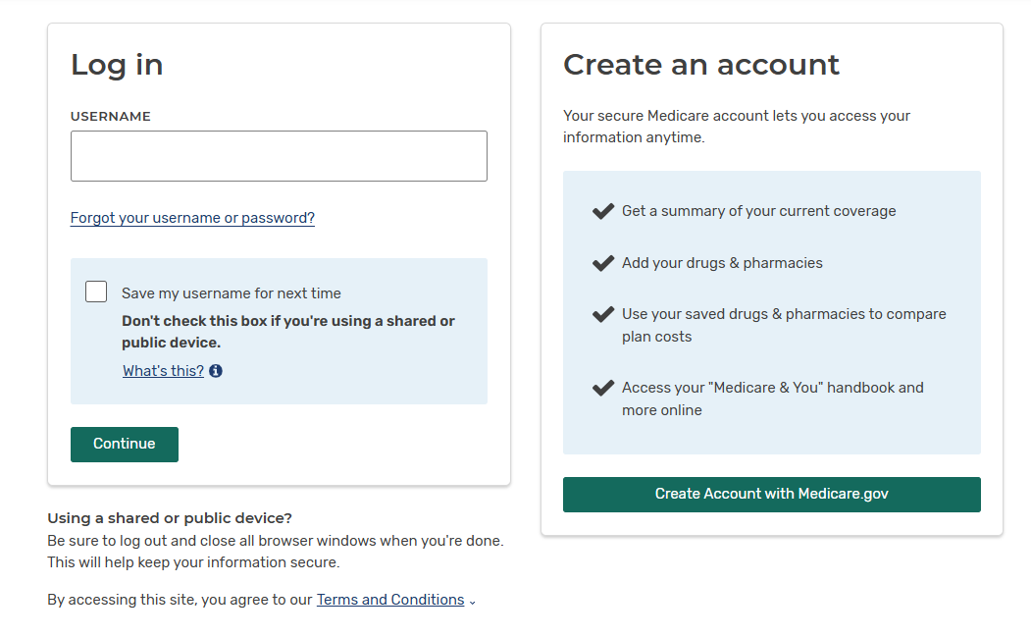
MyMedicare.gov
Click “Create Account with Medicare.gov”
Notes:
To create an account with Medicare, click create account with Medicare.gov

Slide 12
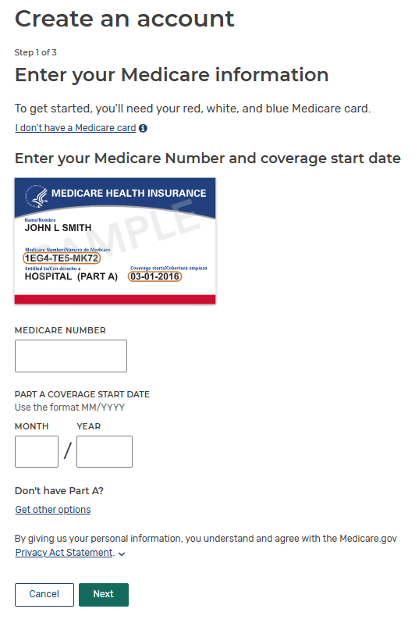
Step 1
Enter your Medicare Number
Enter Part A Coverage Start Date
Click Next when Complete
Notes:
For this step you will want your red, white and blue Medicare card. You will enter your Medicare Number and then enter your Part A coverage start date. Click “Next” when complete.

Slide 13
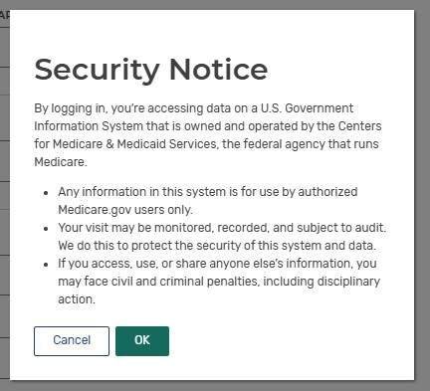
Security Notice
Read the
Security Notice and
click OK to continue.
Notes:
Here is an expanded explanation of the Security Notice that you will need to look over before continuing. Click OK once you have read this notice.

Slide 14
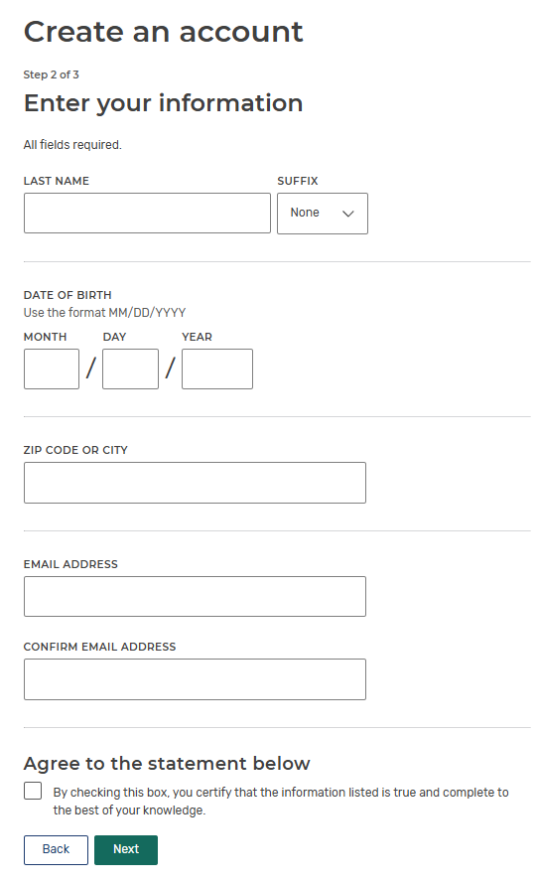

Step 2
Enter the information requested
Email address is now required!
Check box
Click Next when complete
Notes:
In this step you will need to enter your Last name, including any suffix like jr, Date of Birth, zip code or city and an email address.
It is important to note that an email address is now required to create a Medicare account.
You will then need to read and check the box agreeing to the statement below.
Click Next when complete.

Slide 15
Rules for Creating Username and Password
Username Guidelines
Do’s
Must be 8 – 30 characters long with no spaces
Can have letters, numbers, and these special characters: @ ! . - _ $
Must have at least 4 letters
Can be your email address
Don’ts
Can’t include your Medicare Number or Social Security number
Can’t be the same as your password
Can’t have a special character as the first or last character
Password Guidelines
Do’s
Must be 8 – 16 characters long
Must have at least 1 letter
Must have at least 1 number
Must have 1 or more of only these special characters: @ ! $ % “ * ( )
Must be different from your last 6 passwords
Don’ts
Can’t contain your username
Can’t include your Medicare Number or Social Security Number
Notes:
Next you will be asked to create a username and password following the specific rules shown here. It will be important to keep your username and password in a safe place.

Slide 16
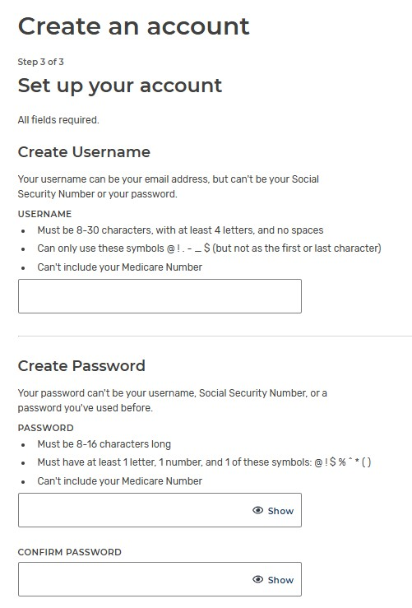
Step 3
Enter your Username
Enter your Password
Notes:
Now you will enter the username and password that you’ve chosen following the rules on the previous slide.

Slide 17
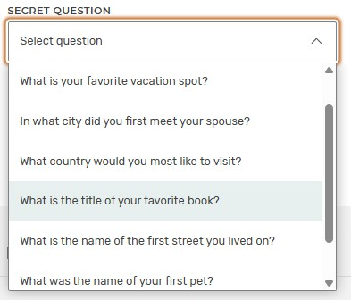
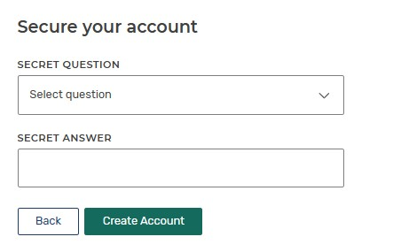
Step 3 Continued
Select a
Secret Question and enter your Answer.
This would be if you forget your username or password.
Then Click
“Create Account”
Notes:
continuing from the previous slide you will need to select a secret question. click the arrow on the secret question box to make your selection. You can choose from several questions such as “What is your favorite vacation spot?” Then enter your answer. This would be used if you forget your username and password, so make sure it is an answer you’ll remember. Then click create account.

Slide 18
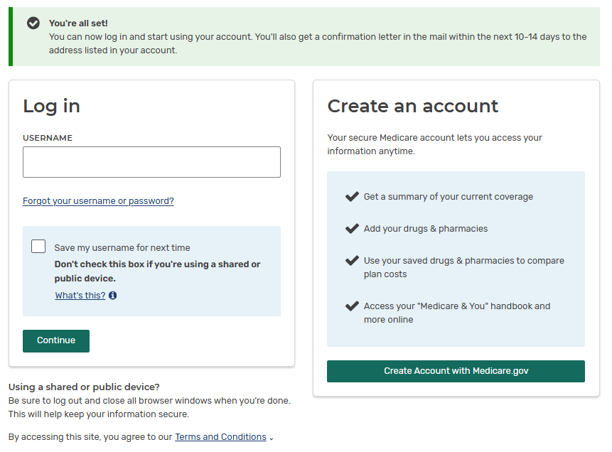
You have now created your Medicare account!
Notes:
IF your username and password are accepted, you will be taken back to the login page where you will see a message that your account has been created and you can now login.

Slide 19
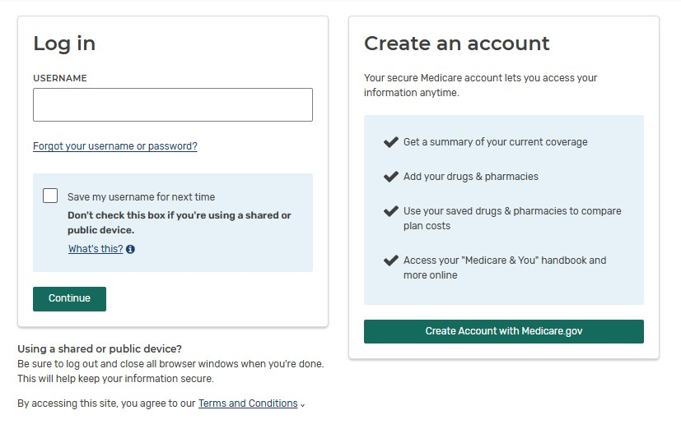
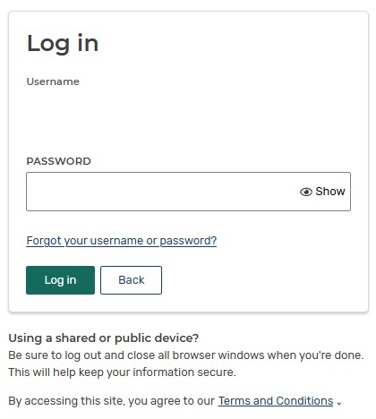
Log in
Enter your Username
Enter your Password
Click Continue
Click Log in
Notes:
To log in to your Medicare account
First enter your username and then click continue.
Then you will enter your password and click Log in.

Slide 20
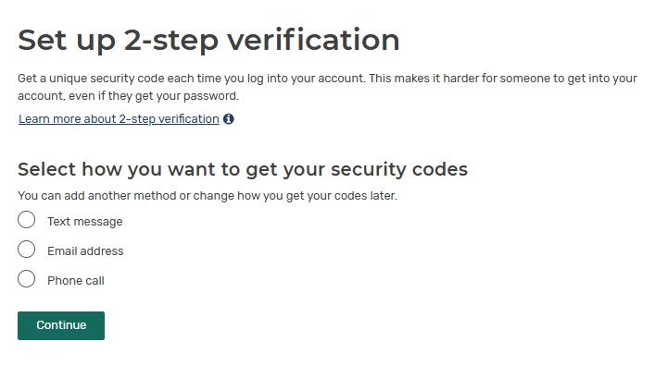
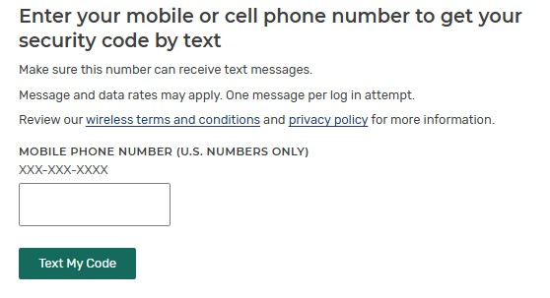
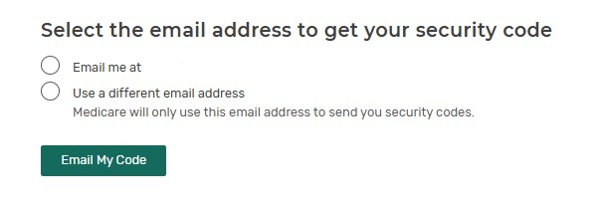
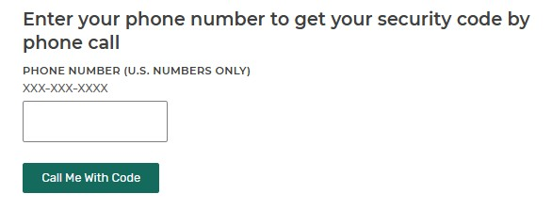
2-Step Verification
Select how you want to receive your security codes.
Click Continue
You will be prompted to enter a phone number or an email address depending on what you selected.
Notes:
You will need to set up 2-step verification.
With a 2-step verification you will get a unique security code each time you log into your account. This makes it harder for someone to get into your account, even if they get your password.
First you will need to select how you want to receive your security code; You can choose from text message, email address or Phone call. Once you chose how you want to receive your security code, you will be prompted to enter either a phone number or your email address click continue.
The boxes on the right hand of your screen will be similar to what you see when going through this process.

Slide 21
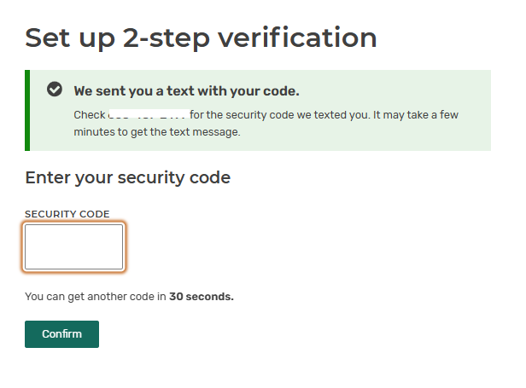
2-Step Verification Continued
You will receive a Security Code by text, email or phone call, depending on what you chose in the step before.
Enter Code
Click Confirm
Notes:
You will then receive a security code by text, email or phone call, depending on what you chose in the step before.
Enter the code in the box that says Security Code and click confirm.

Slide 22
You’re All Set
That’s it!!
You are all set to you use your Medicare.gov account!
Notes:
After setting up your 2-step verification, you will be directed back to the log in page. You are now all set to you use your Medicare account.

Slide 23

Medicare Questions?
Call Medicare at 1-800-633-4227 or visit www.medicare.gov
Wisconsin SHIP Resources:
  Medigap Helpline: 1-800-242-1060
  Medigap Part D Helpline (for ages 60+): 1-855-677-2783
  Find your local Aging and Disability Resource Center on the WI Department of Health Services webpage: https://dhs.Wisconsin.gov/adrc/consumer/index.htm
This publication is supported by the Administration for Community Living (ACL), U.S. Department of Health and Human Services (HHS) as part of a financial assistance award totaling $1,061,673 with 100 percent funding by ACL/HHS. The contents are those of the author(s) and do not necessarily represent the official views of, nor an endorsement, by ACL/HHS, or the U.S. Government.
Notes:
If you have questions, you can call Medicare or visit the medicare.gov website. You can also call one of the Wisconsin SHIP Resources or talk with your local SHIP counselor at your local Aging and Disability Resource Center. Click on the link to the Wisconsin Department of Health Services webpage to find the Aging and Disability Resource Center in your county.

