Slide 1
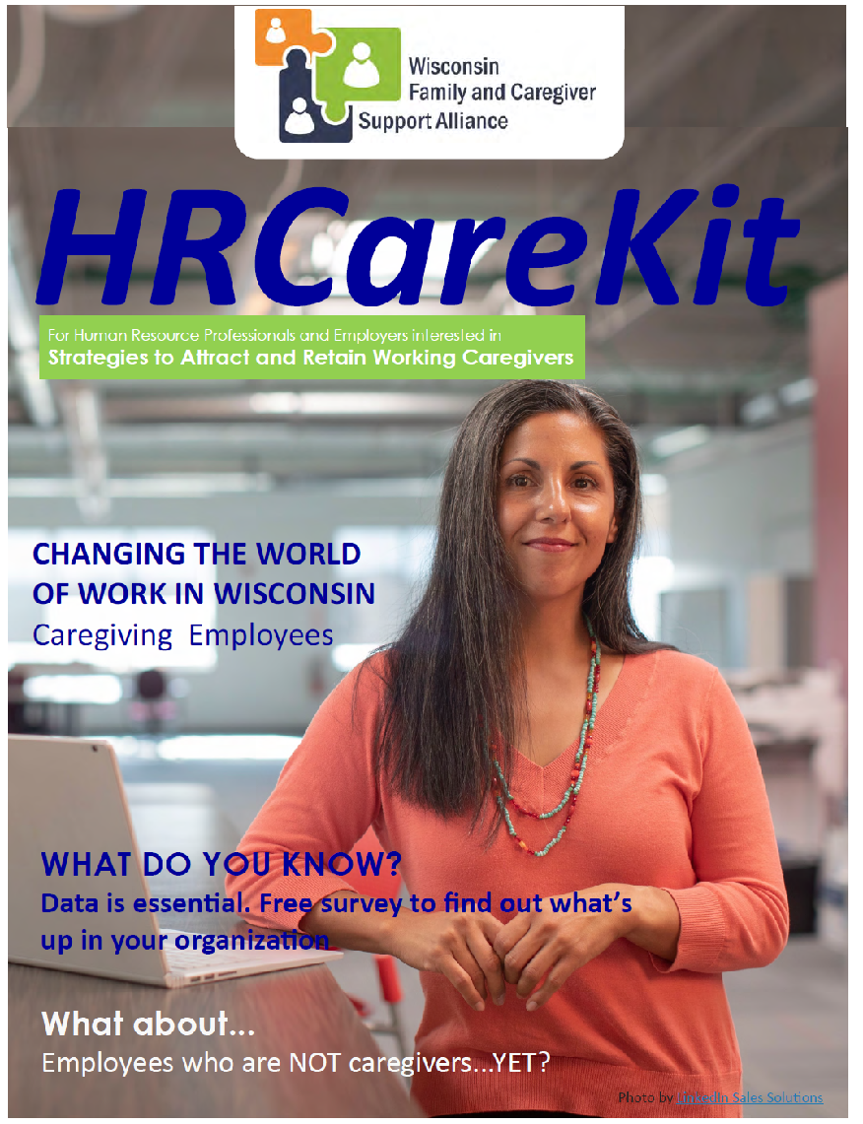

Helping Working Caregivers Keep Their Jobs
Has caregiving responsibilities interrupted your job or your career?
Do any caregivers you support experience financial or job instability due to their caregiving responsibilities?
Could businesses in your area benefit from knowing more about your services?
PRESENTED TODAY BY:
Developed by the WI Family and Caregiver Support Alliance (WFACSA)
Engaging Employers in Support of Working Caregivers Workgroup
Notes:
Before starting slides ask:
Who has an example of when your caregiving responsibilities have interrupted your job…or your career?
Who has worked with a family caregiver who had to make a choice about keeping a job or providing care?
Wisconsin employers tell us that over 8% of the employees that walk out the door are family caregivers. Businesses are realizing that supporting their employees who are trying to balance work with their caregiving responsibilities makes a difference in attracting and retaining valued employees. And with more and more family members taking on caregiving roles, businesses who recognize that NOW is the time to act will gain the most from partnering with you and the local resources you can offer.
Good morning, I’m __________________ and I’m honored to introduce you to one of the newest tools from the Wisconsin Family and Caregiver Support Alliance, the HR Care Kit. You can use to help caregivers advocate for themselves and to encourage employers to create caregiver-friendly strategies the gain and retain employees who are also caregivers.
Use slides from this presentation to construct a presentation to either working caregivers, or employers in your area to introduce them to the HR Care Kit.

Slide 2

What’s this all about?
Working caregivers are trying to balance their caregiving responsibilities with full-time or part-time work. According to a national 2023 survey by AARP and S&P Global, nearly 70% of family caregivers have trouble balancing their caregiving responsibilities and work.
Employers are feeling the impact that unpaid/family caregivers have on the workforce.
Caregiver Coordinators and Dementia Care Specialists can help unpaid/family caregivers remain employed and/or remain financially sustainable?
Notes:
It all comes down to
- You’re in a position that its important you know how the work may impact caregivers
- Likewise, you can also help caregivers by supporting businesses who need to increase retention, lower resignation, and maintain productivity
- You may not find many resources that help you with both, so getting acquainted with the HR Care Kit can help raise the bar on benefits and support for working caregivers.

Slide 3
HRCareKit includes:
National and WI data to support outreach efforts
Real stories from workers impacted by family caregiving
Tips to support working caregivers
https://wisconsincaregiver.org/_data/media/76/hr-carekitr.pdf
Notes:
The WFACSA Employer Engagement workgroup has conducted surveys, outreach to the Society of Human Resource Managers, and education efforts for the past six years. Our HR Care Kit was created to help employers better support employees who are also providing care for family members.
The HR CareKit doesn’t promote any specific benefits or EAP providers. Rather, the HR CareKit focuses heavily on free education and community resources supporting caregivers and already available to all employers and their workforce.
It shares:
National and WI data to support outreach efforts
Real stories from workers impacted by family caregiving
Tips to support caregivers in your own organization
Download the HR Care Kit at hr-carekit.pdf (wisconsincaregiver.org)

Slide 4
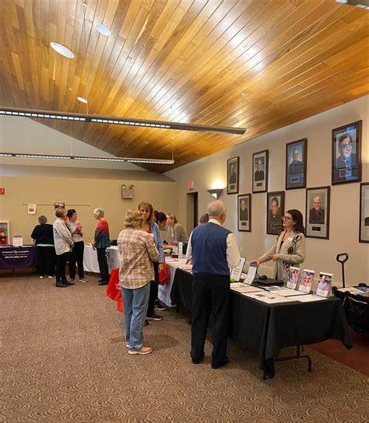
Use as a tool to:
Help advocate for individuals who are currently working caregivers or anticipate becoming working caregivers
Provide solid information to help businesses retain their workforce
Prepare businesses for the reality of changing demographics
Encourage businesses to be family caregiver and dementia friendly
Notes:
Generally, helps CC and DCS do their job by providing tool to
Advocate for individuals
Solid information to present business and retain their workforce
Get out in front of the problem
Further encourages businesses to be dementia friendly
Being confident in the resource HR Care Kit
The HR Care Kit is intended to provide you as Caregiver Coordinators or Dementia Care Specialists a useful tool to share with professionals, employers or caregivers to consider how this information compares to what is happening in their own organizations or life.
We think you’ll see that a little flexibility, a change in the awareness in the workplace, or a couple of hours a week of additional support could do much to ease employee stress, decrease their burden, and increase your attractiveness in the job recruitment arena.

Slide 5

Why?
‘Caregiver’ is the fastest growing employee group*
73% of all employees have some type of current caregiving responsibility
Employees aren’t just caring for their own young children – ‘Sandwich Generation’
Employment dropped almost 8 percent for workers who became caregivers
* https://www.shrm.org/resourcesandtools/hr-topics/people-managers/pages/how-to-support-caregivers.aspx
Notes:
Why is it important to support employees who are caregivers? This ‘Viewpoint’ from the Society for Human Resource Management (SHRM) newsletter spells out the why very simply.
OPTIONAL ACTIVITY:
Let’s take a moment and discuss with 1 or 2 people you’re sitting near.
Think of at least one employee you know who is a caregiver (no names) and discuss two questions:
How is their caregiving having an impact on them or their work?
Has this employee spoken to a manager or HR about it?
How many openings could you fill today with an employee who may also be a family caregiver (Think of all groups: Millennial, woman, hard-working producer, black, Hispanic, or any other underserved population)?

Slide 6

1 in 4
working-age adults in Wisconsin provide care, balancing home and work*
*Study conducted June-October 2021, UW-Madison Division of Extension Employed Caregiver Survey.
*Employed caregiver was defined as “working-age adult providing care or financial assistance to an older family member, an adult child or other loved one with a disability, or a spouse with a long-term illness. This may be in addition to traditional child rearing.”
*Survey was then completed by 564 individuals, of which 447 (79%) had a family caregiving role.

Slide 7
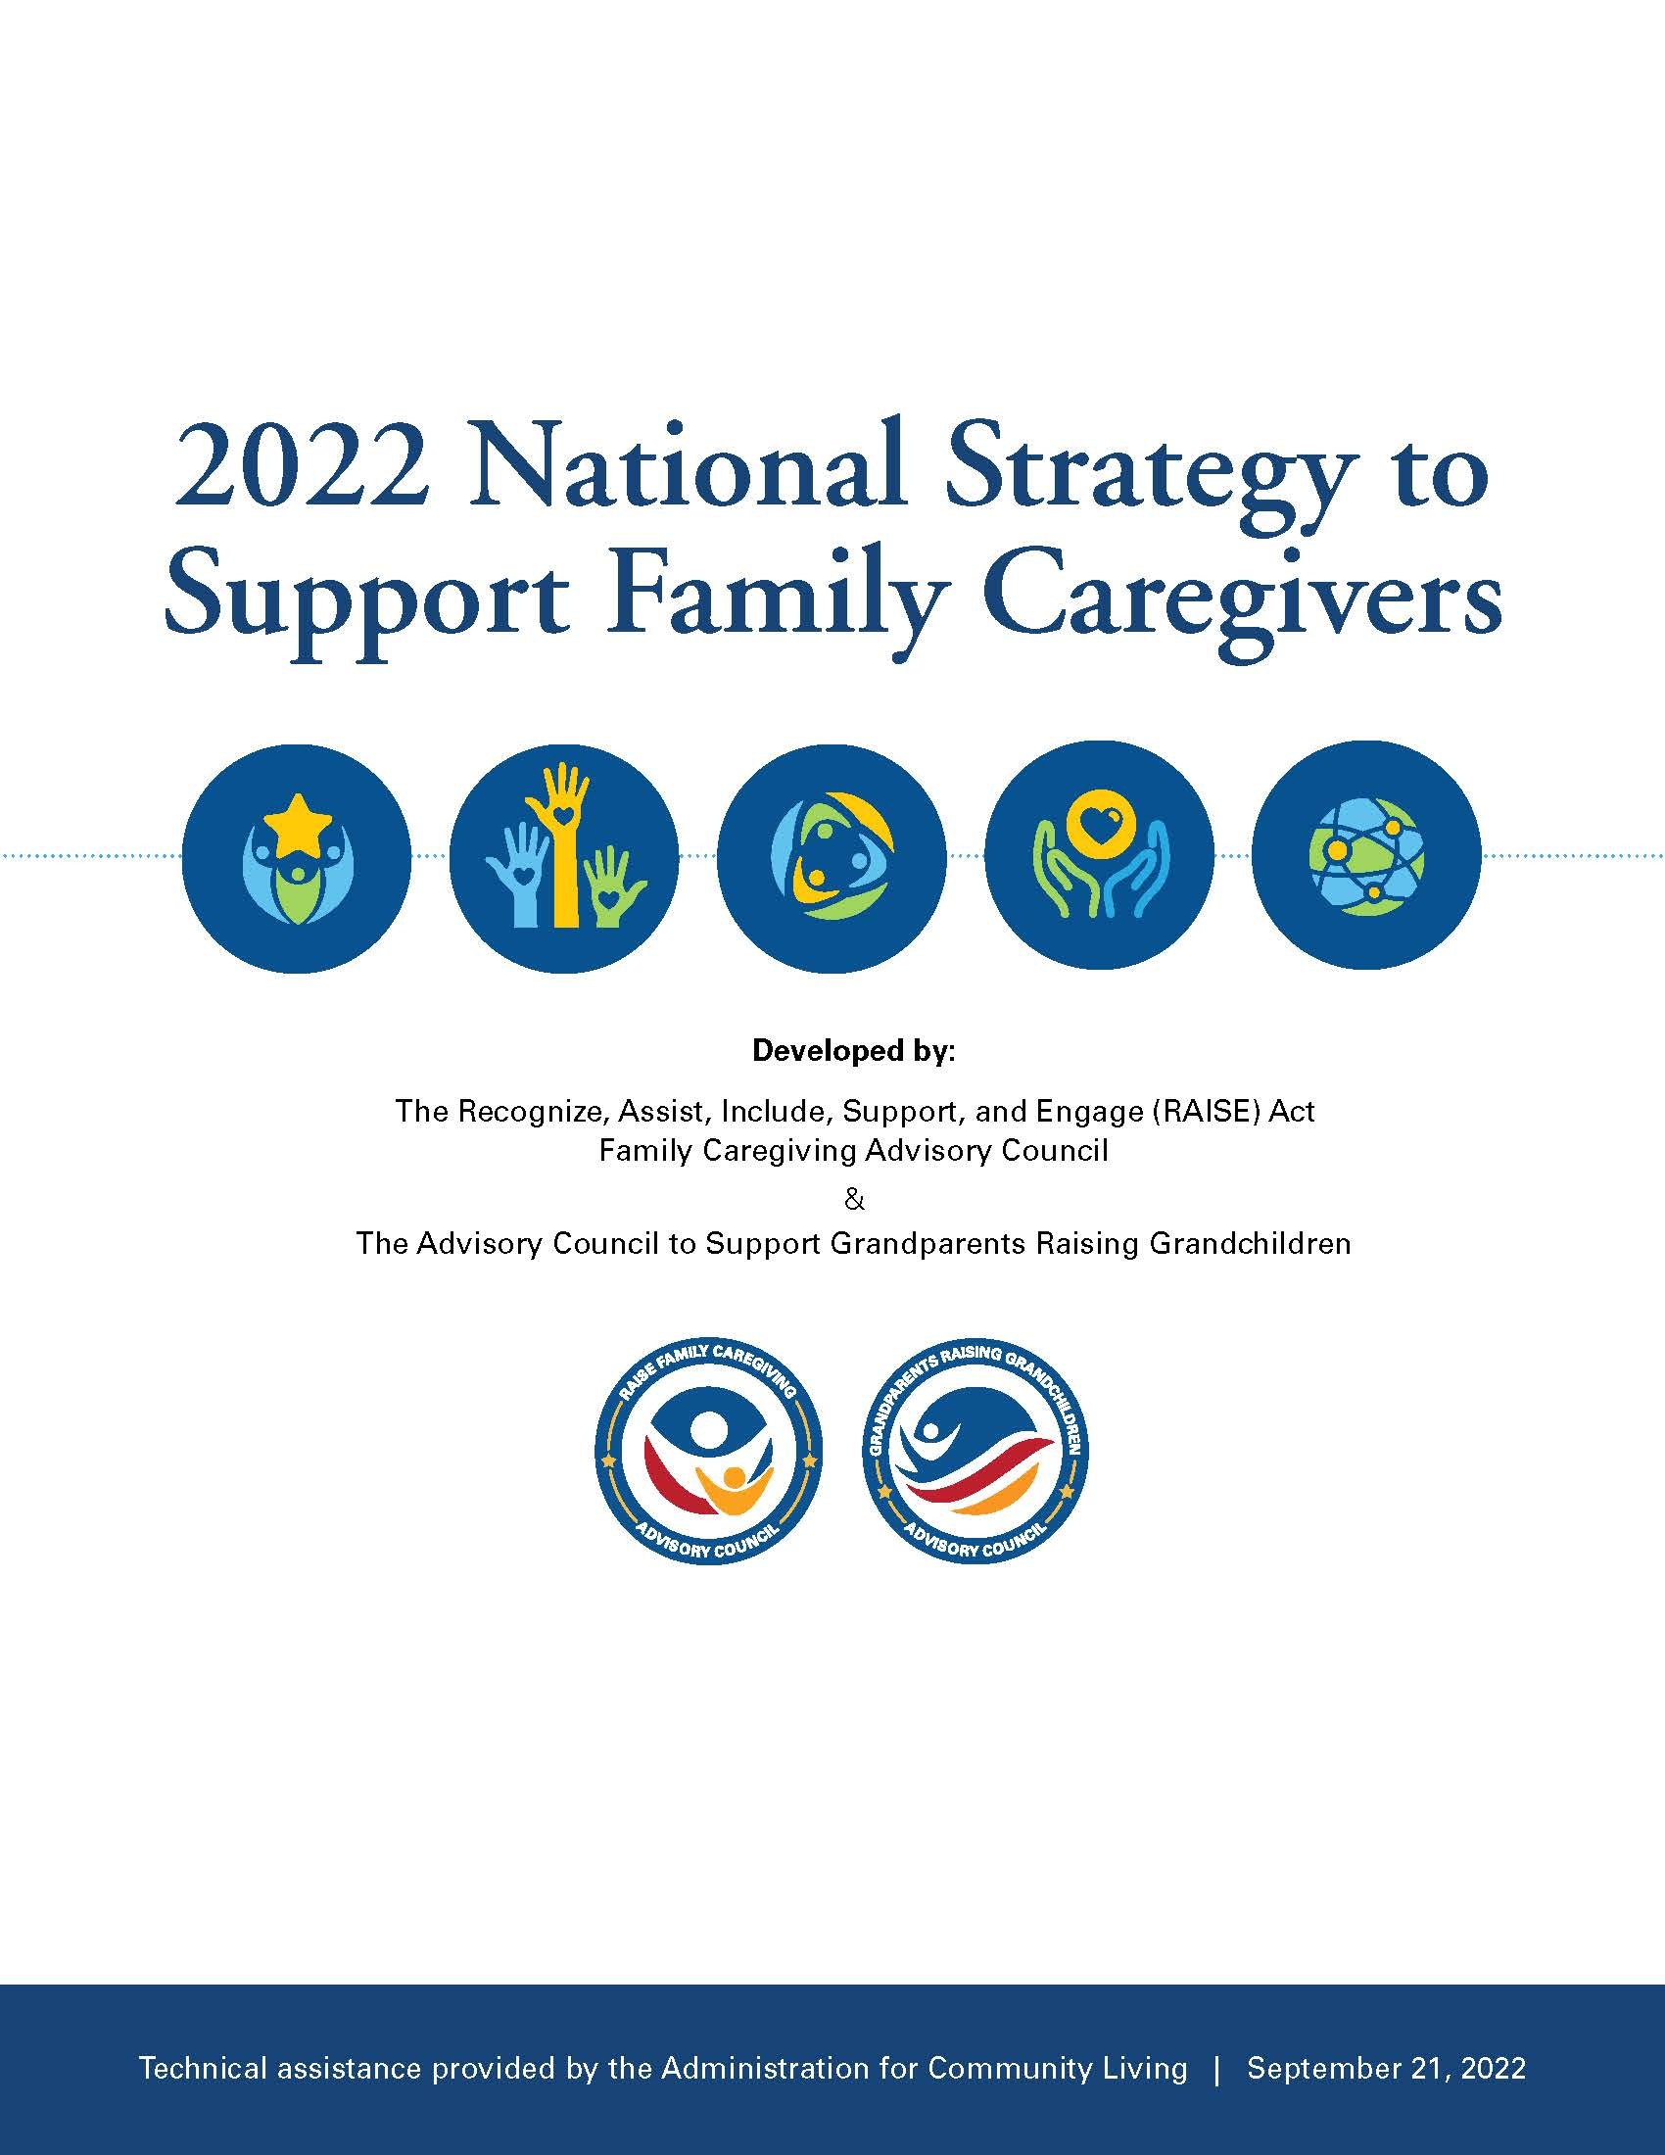
Why now?
Goals of National Strategy to Support Family Caregivers provides approach/vision
  Increase awareness and outreach
  Build partnerships/engagement
  Strengthen services/supports
  Ensure financial and workplace security
  Expand data, research, evidence-based practices
No generation has experienced so great a need
Business faces a ‘caregiving economy’
* https://www.shrm.org/resourcesandtools/hr-topics/people-managers/pages/how-to-support-caregivers.aspx

Slide 8

Sandwich Generation squeezed between aging parents and growing children
Club Sandwich Generation
squeezed between aging parents, growing children, and sibling with disabilities
Result: A growing number of workers caring for more than one person for a longer period of time.

Slide 9
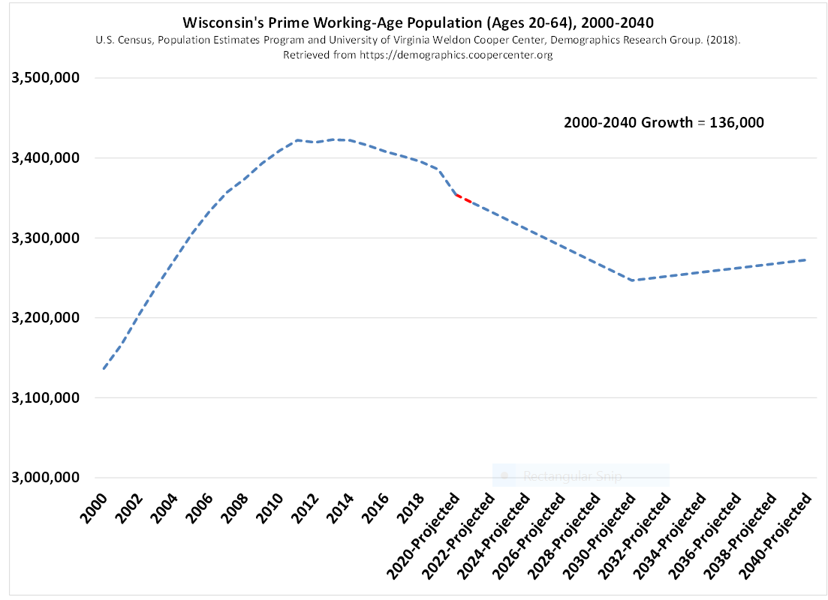
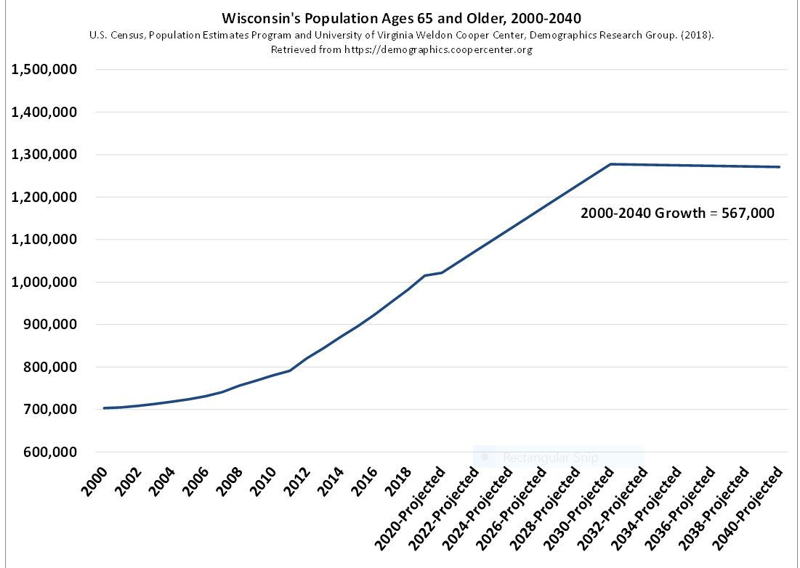
Wisconsin’s Workforce vs. Aging Population
Notes:
As you can see in these graphs, Wisconsin will continue to feel the impact of an aging population for quite some time. The same is true throughout the United States. That means fewer people will be available to care for YOU and ME. Not only does this have an impact on individuals, but also the caregiver shortage will have an impact on most Wisconsin employers.
A lot of people outside of our aging and disability network may not be aware that the changes we are seeing in population growth are going to be with us for many decades. Explaining this population trend can be strong motivation for every employer and every family caregiver to re-think what they are doing, and to start making plans.

Slide 10
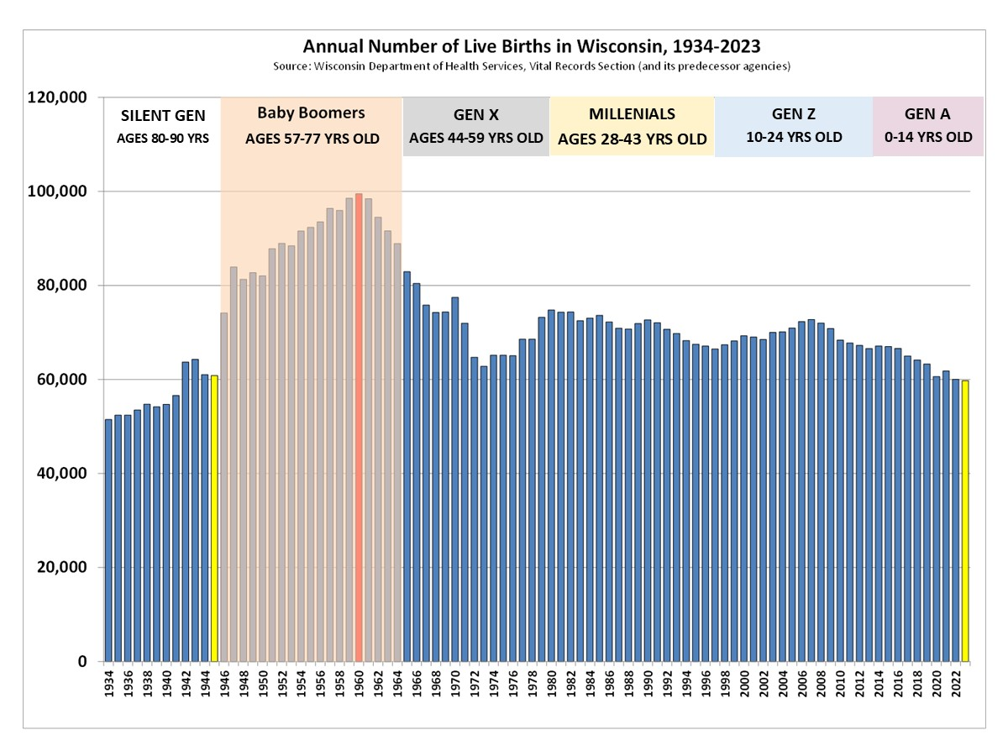
How did that happen?
Notes:
This slide shows the number of live births from 1934-2023. Note the trend of births has been going down 2005. Therefore the next generation of Americans entering the workforce will be smaller than at any time since 1945 while the largest generation (Baby Boomers) will be in their 70s, 80s, and 90s. How do you see this in your community? What changes have you seen?

Slide 11

Average Caregiver Support Ratio
In Wisconsin
YEAR
PERSON IN NEED OF LONG-TERM SUPPORT AGE 80+
NUMBER OF PEOPLE AGES 45 to 64
2020
2030
2040
Source: Eric Grosso, State Office on Aging, Analysis of WI DOA Population Projections
Notes:
Optional slide to illustrate the caregiver burden on workforce
With the Baby Boomers continue to grow older and more become ages 80+, the number of people in the workforce to support care needs of each 80+ individual decreases.
How will this impact working caregivers and their employers who depend on them?

Slide 12

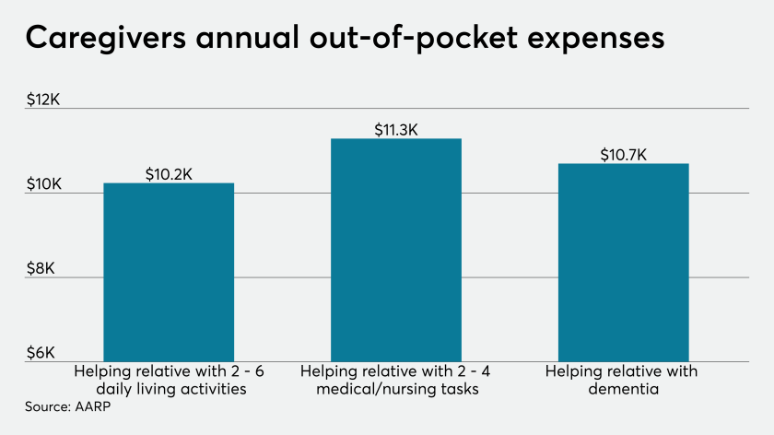
Employees risk their own financial security
https://youtu.be/Ulz3pLQMw0Y
Notes:
Caregiving for a loved one can be one of the most emotionally draining and financially straining experiences that any of us ever goes through.
Many of us here may be working caregivers and have stories from our own caregiving experiences or know the pressures others have experienced.
I want to play a clip of experiences shared by a few different types of family caregiver that highlight the multi-faceted dilemma faced by family caregivers extremely well.

Slide 13
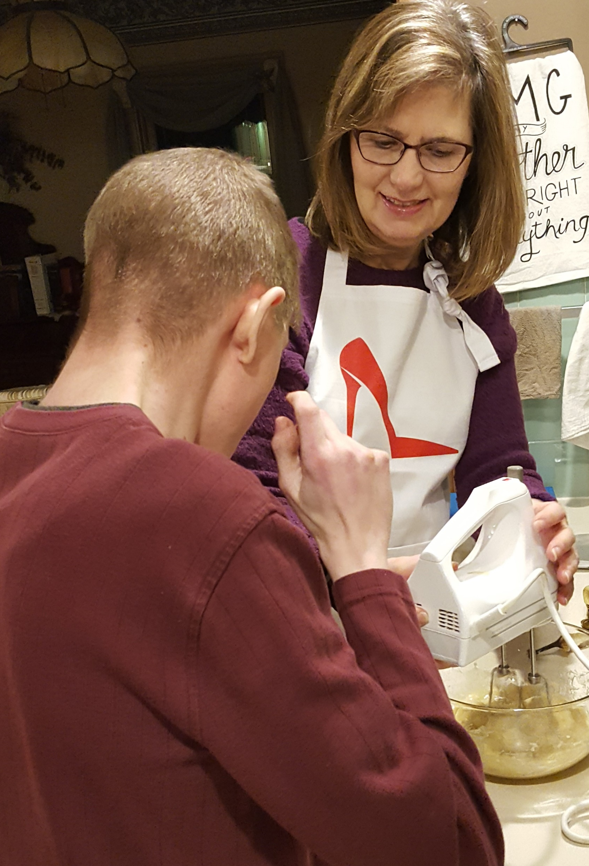
WI Studies show…
Addressing needs of working caregivers can reduce costs for employers and increase productivity, employee retention, and improve recruitment efforts. *Harvard Business School
Assessing needs of caregivers in the workplace and exploring policies and resources to support working caregivers have positive impact on business. *Massachusetts Business Roundtable; New York Office on Aging
Caregivers seldom use FMLA.
*WFACSA study – Feb 2021
With just a little more help, caregivers reported that they felt they could continue meeting their work and home responsibilities for longer.
*WFACSA study – Feb 2021
Notes:
The HR CareKit helps employers better understand their employees’ needs when it comes to family caregiving responsibilities and the benefits of responding to those needs. i.e. reducing turnover costs, loss of institutional knowledge, loss of productivity.
We hope it helps connect local resources with employers to help apply realistic business solutions that benefit both employers and employees.

Slide 14


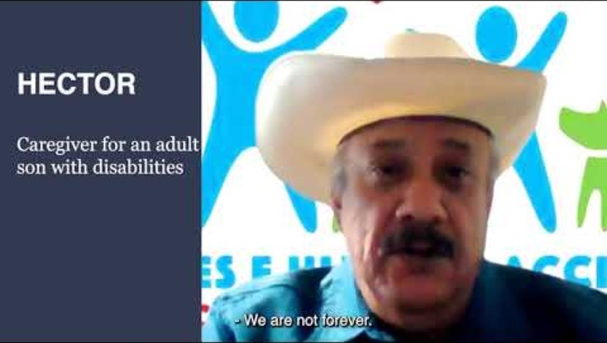
Between now and 2040, the Wisconsin Department of Health Services estimated that the number of people living with dementia in their homes will increase by 86.8%.
Wisconsin’s 580,000 family caregivers provide a combined 540 million hours of unpaid care, a value of nearly $9.2 billion. Nearly 60% also work a paying job. Even more workers are providing care for a child with disabilities or other special healthcare needs.
By 2030, the ratio of informal caregivers to those in most need of care will be at 4 to 1, down from a peak of 7 to 1 in 2010. By 2050 in Wisconsin, there will be fewer than three family caregivers to care for each family member older than 80.
https://www.youtube.com/watch?v=_3-pILaEqaU
Notes:
The facts are clear. More and more people in Wisconsin will be needing care. With fewer people young enough to provide that care, along with a shortage of paid caregivers, the impact on employers is only going to increase.
https://www.youtube.com/watch?v=_3-pILaEqaU

Slide 15

Notes:
Other interruptions included:
Responded to calls or emergencies during working hours (52%)
Miss days of work (44%)
Arrive late for work (32%)
Cut hours of work (24%)
Considered leaving work entirely (23%)
Considered changing employers (19%)
Took leave of absence (12%)
Turn down work-related travel (7%)
Turn down a promotion (5%)
Turn down work relocation (2%)
My work was not impacted by my caregiving role (16%)

Slide 16
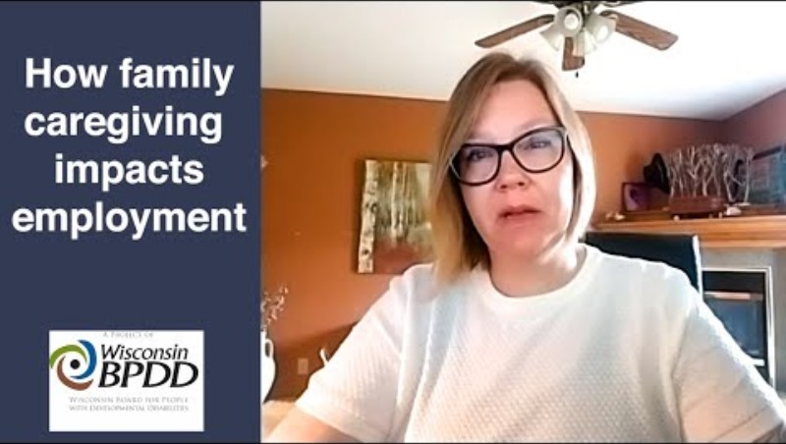
You know you are a caregiver if you…
Phttps://youtu.be/I5g2RiOBgxsto source: The Boston Globe/Getty Images
Notes:
Let’s agree that caregivers often don’t realize that they actually ARE caregivers. They identify as a spouse, a brother or sister, a son or daughter, a grandchild, a parent, a niece or nephew, or even just a friend. However, if they don’t identify as a caregiver, it is difficult for them to get support they need in order to stay healthy, work, or just enjoy life..
And because they don’t self-identify as a caregiver, they rarely approach their employer for support because they think they have an isolated case. They fear there will be negative reactions from employers and consequences for their reputations and careers.
They may not realize that they are part of a larger group of employees who struggle with the same responsibilities. You can help by letting working caregivers know that they are a recognized. This can give employees the self-confidence and permission to speak openly with their organization to find workable solutions that benefit both the employer and employee.

Slide 17

Supporting Working Caregivers is Good for Business
Notes:
Based on studies and work done with caregivers, supporting working caregivers is good for business. However, some businesses may need some help to show them how.
Businesses benefit when they are aware of the needs of their employees, the impact on their business, and being educated about government and community resources available to support their workforce … and by extension their business.
AWARENESS: First: Must understand how many of their employees are caregivers.
Method 1: Do a survey – Free from UW-Madison Extension
Method 2: Offer a benefit and see who responds – Example: Promega
IMPACT: Assess the business’ current strategy and develop a strategy for future

Slide 18

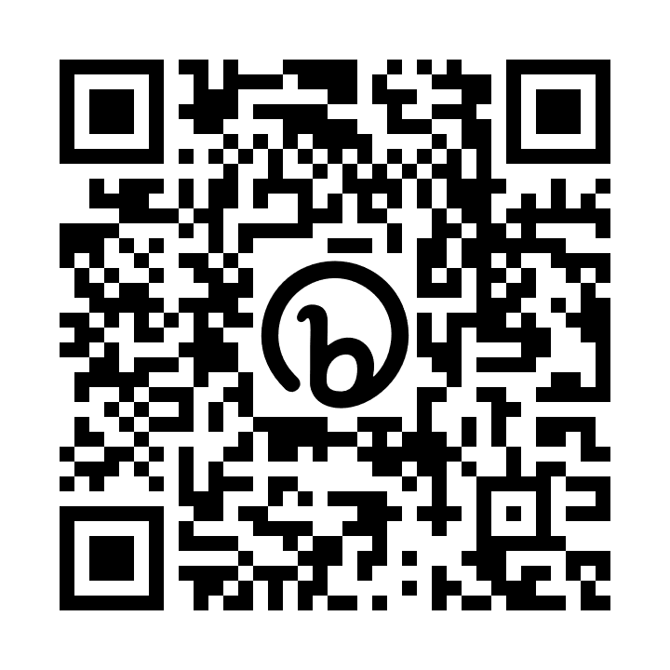
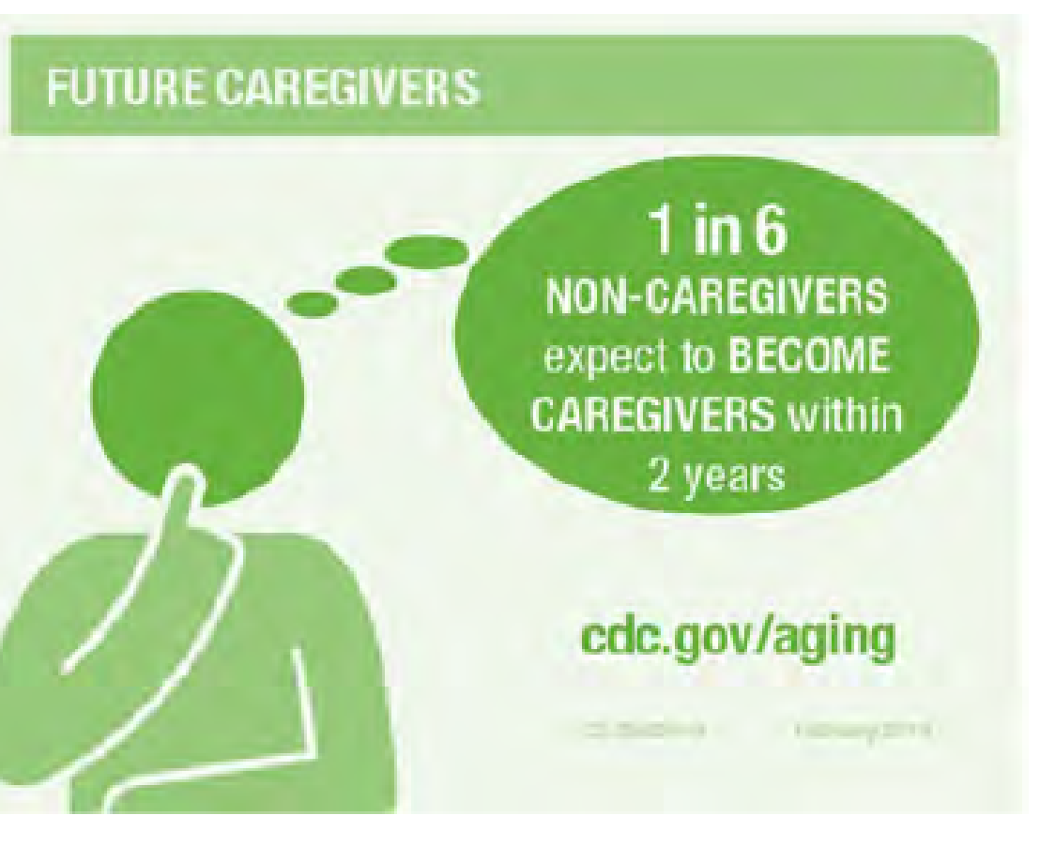

What do you know about your employees?
Use this FREE Employed Caregiver Survey from UW-Extension to learn about the growing needs of employees who have family caregiving responsibilities.
Notes:
Understanding employees and their caregiving roles is vital to building an effective strategy for retaining and attracting employees. Once a company/employer better understands how many working caregivers are in its workforce, AND also how many anticipate becoming a caregiver, managers can begin taking action.
Employers have access to a FREE employee survey from the University of Wisconsin-Madison Extension. The QR code on this slide takes you to the website where you can learn more and get started.
What’s nice about this survey tool is that it allows employees to remain anonymous to their employer, which in turn allows them to be more honest about their situations without fear of retaliation or prejudice in future interactions with their employers.
The UW-Extension Office and Wisconsin Family and Caregiver Support Alliance is also available to help someone get started.
Link to survey: https://fyi.extension.wisc.edu/agingfriendlycommunities/files/2020/03/ECSurvey-instrument-as-of-March-2020-for-web-and-distribution.pdf

Slide 19

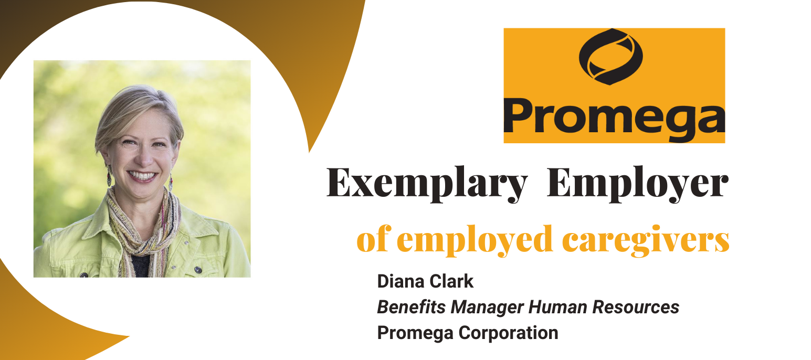
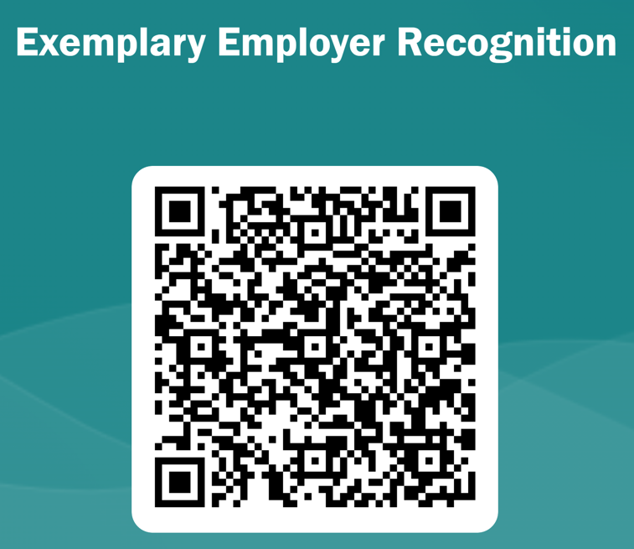
Start small. Be bold. Expect Results.
Notes:
When meeting with an employer or employees, being able to share success stories from other companies that have benefited from making changes in work culture is one of the most powerful advocacy tools we have. Learning that even small, inexpensive modifications in a work environment can have significant benefits is a great motivator for other companies that aren’t convinced that making changes is worth the effort.
We would also appreciate it if you would let us know about companies you find that are doing a good job supporting working caregivers. Our Alliance believes they deserve recognition, and there may be a lot we can learn from them.
Video link - https://youtu.be/FqWbc-vvCjU

Slide 20

https://youtu.be/FqWbc-vvCjU
Start small. Be bold. Expect Results.
Interview with Diana Clark, Benefit Manager, Promega (Madison, WI)
Notes:
Here is a short video interview with Diana Clark who tells us how they got started providing support to their employees who are working while caregiving.
Video link - https://youtu.be/FqWbc-vvCjU

Slide 21
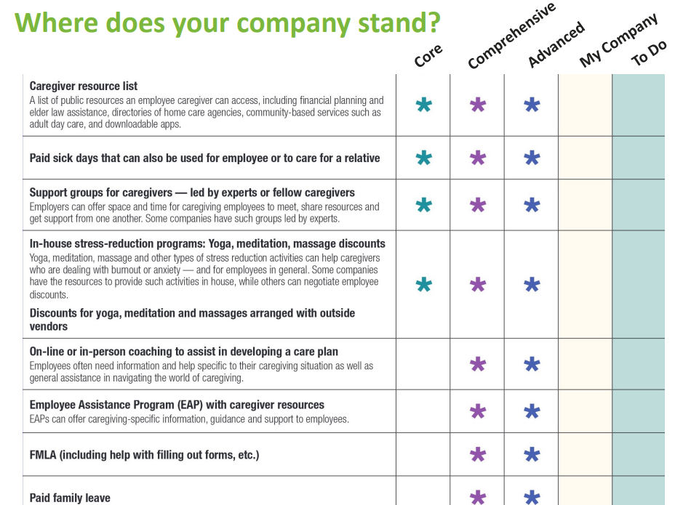
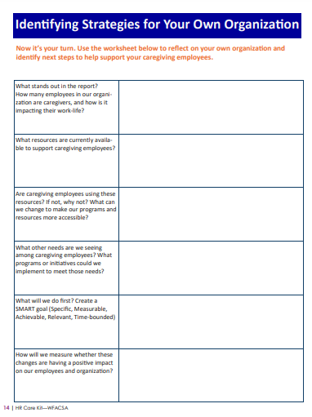
Employers Assess Their Current Status
Employers Identify Strategies for Their Organization
Notes:
The HR CareKit includes two worksheets that help companies take an inventory of its current status and begin planning to make improvements.
This worksheet helps employers gauge where they stand, and begin making a “to-do” list for taking first steps.
The assessment is on page 4 of the HR Care Kit or p19 of this AARP document: https://www.aarp.org/content/dam/aarp/work/employers/2018/11/AARP-NEBGH-EmployerCaregivingToolkit_Practical-Guide-102517.pdf
Initial questions leading to strategies can be found on page 14.

Slide 22
6 Ideas from Wisconsin Employers
1. Offer education
2. Provide a tool (HR Care Kit or
other, free survey, website, etc)
3. Establish a volunteer
‘job board’
4. Contact the Aging and
Disability Resource Center
5. Organize a Resource Fair
6. Start an ERG
(Employee Resource Group)
Notes:
Offer education and brainstorming sessions to solicit ideas from employees.
Provide a tool (newsletter, website, electronic bulletin board) for caregivers to post their needs.
Establish a volunteer ‘job board’ for employees interested in helping fellow employees with caregiving tasks.
Contact the Aging and Disability Resource Center to learn what family caregiver supports are available in the community.
Organize a Resource Fair for all employees and invite local caregiving providers to exhibit.
Start an ERG (Employee Resource Group) for caregivers where they can connect with one another at work.

Slide 23
Take-Aways work on these
Caregiving is an issue that will be with us
for decades to come.
Employees are more productive and stay longer when they
feel valued and safe.
Work-life balance matters.
Model it. Support it. Have a strategy.
Start small. Be bold. Expect results.
Integrate caregiver supports into the
work culture, benefits, and systems.
Notes:
In summary, this is what we hope you take away from our presentation today:
Growth in Family Caregiving responsibilities among the working-age population is an issue that is going to be with us for decades to come.
Employees are more productive and stay longer when they feel safe and valued by the company.
Work-life balance matters – Companies/Employers can model it; support it; have a strategy.
Offer some level of flexibility – even small businesses can do that in some way.
Employers can start small. They should be bold and expect results.
Integrate caregiver supports and considerations into your work culture, benefits, and system.
We encourage you to consider how what we shared with you today compares to what is happening in your own organizations or life.
We also encourage you to share this information with employers, working caregivers, and your other partners supporting family caregivers.
We think you’ll see that a little flexibility in the workplace or a couple of hours a week of additional support could do much to ease employee stress, decrease working caregivers’ daily burden, and increase job retainment.
In the end, helping employees balance caregiving and work is good for business.

Slide 24
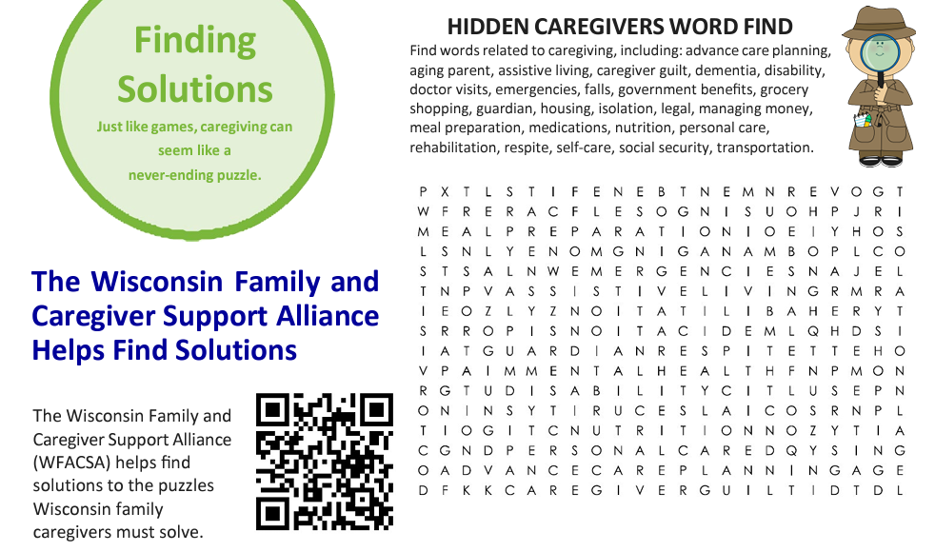

Notes:
Caregivers may be hidden from employers. But they are everywhere and in every business.
Join WFACSA to help find them and bring to them the resources they need in order to thrive.

Slide 25






Plus many, many more.
See wisconsincaregiver.org for more.
Notes:
Wisconsin Family and Caregiver Support Alliance continues to grow. Join us.
More and more employers are also understanding that caregiving, whether child care or broader lifespan care, is important to their workforce and therefore, important to the success of their business. You can be helpful to employers and individual family caregivers.
ONE MORE NOTE - In 2022, SHRM established Generation Cares, a coalition of organizations with diverse missions working to find solutions that improve the quality and quantity of care for children, people with disabilities and older adults. generationcares@shrm.org

Slide 26
Additional slides
Notes:
Ahead are slides that can enhance your presentation. Include them in where you find them most helpful

Slide 27
Growing Number Caring for More than One Person
Notes:
OPTIONAL SLIDE – A GROWING NUMBER OF WORKERS CARING FOR MORE THAN ONE PERSON FOR A LONGER PERIOD OF TIME.

Slide 28
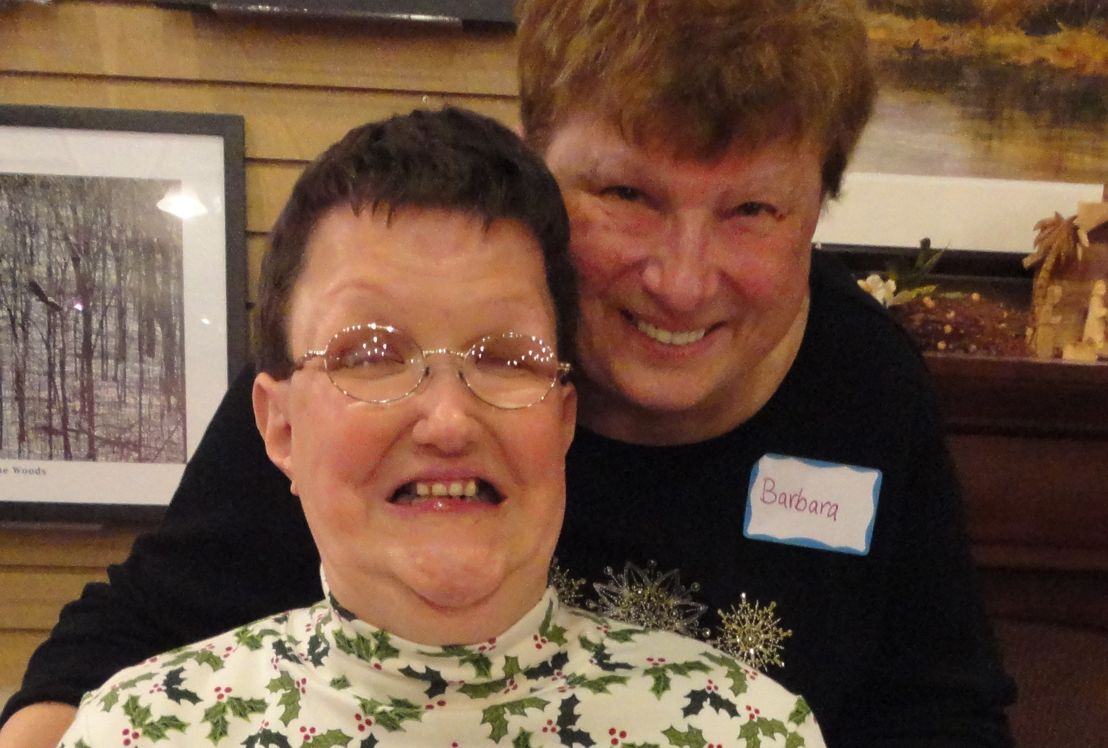
Caregiver Duration Increasing
On average, caregivers of adults age 18-49, spend 26.9 hours per week providing care to their loved one. Top five caregiving tasks are:
Transportation
Housework
Grocery shopping
Preparing meals
Finances AARP NAC report 2015-Caring for Someone Age 18-49
More family caregivers are in need of:
Future planning
Emergency planning
Respite
Home care
Notes:
OPTIONAL SLIDE

Slide 29
Managing my parents has proved to be far more difficult than managing my disabled brother. Where do I turn for help?
-Quote from Sibling
Notes:
Optional slide/quote:
Adults who have a sibling with disabilities are often identified as the “Club Sandwich Generation”, trying to manage care needs of their aging parent (layer 1), their sibling with disabilities (layer 2), and their own growing children or other dependents (layer 3).

Slide 30
Percent of the Projected Population Ages 60 and Older, 2020–2040
2020
2040
Notes:
Projections show clearly that counties are going to be consumed with issues of aging population and shrinking workforce population

