Slide 1
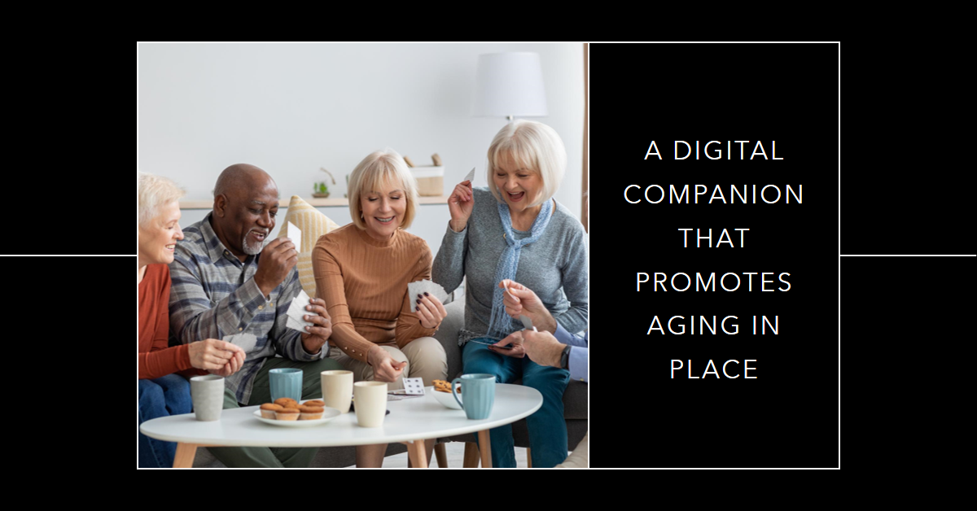
WEARABLE TECHNOLOGIES Deepak Arora, Founder & CEO

Slide 2
ELDERLY >65 YRS OLD
Most impacted by preventable accidents
Challenged with using today’s technology products

Slide 3
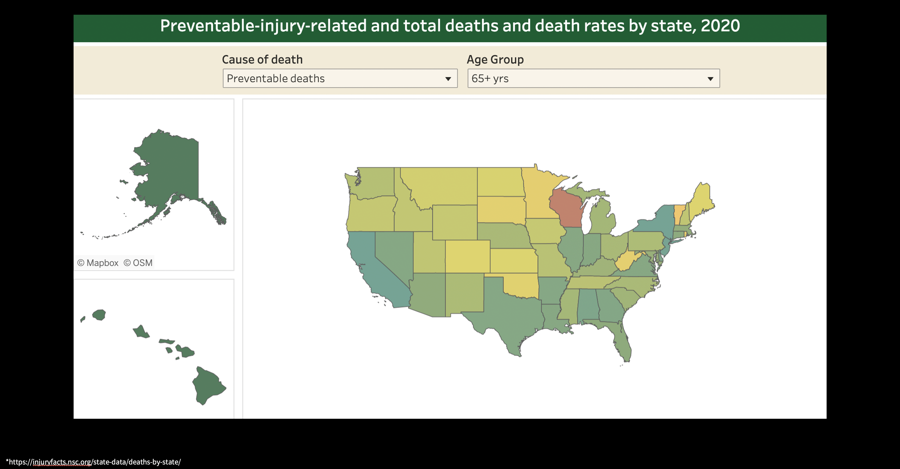
WISCONSIN
Notes:
WISCONSIN is on track to have 1 out of 3 residents over 65 by the year 2030.

Slide 4
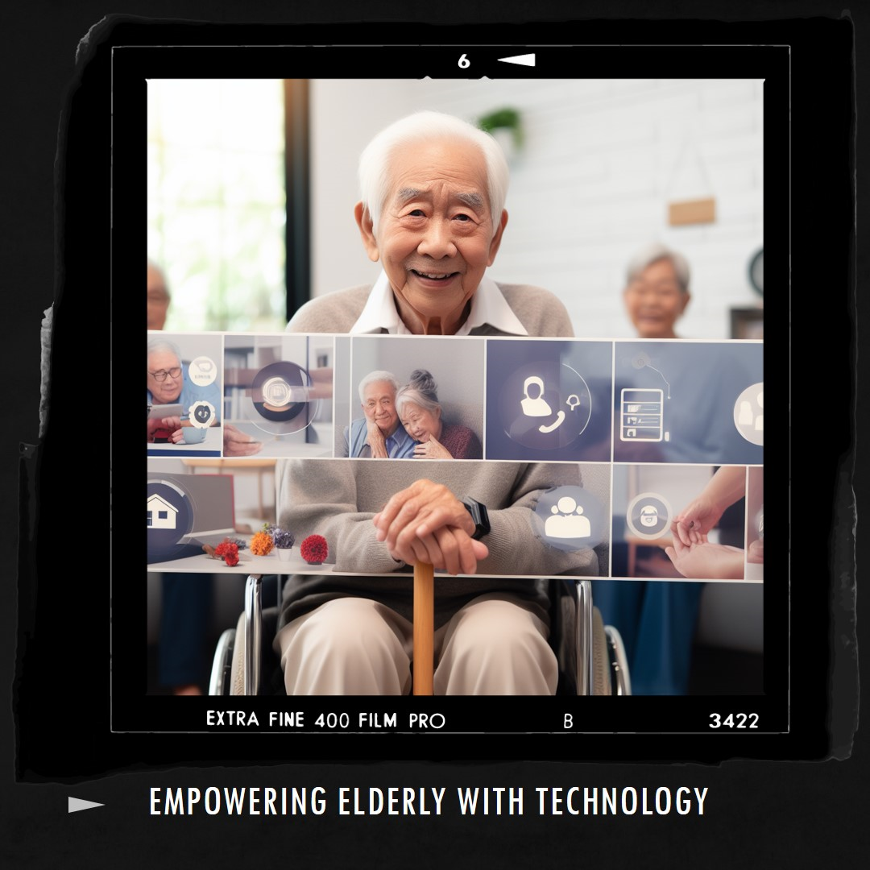

Slide 5
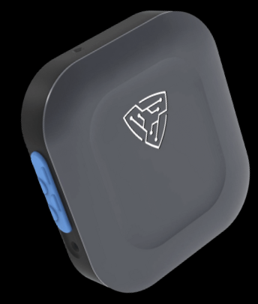
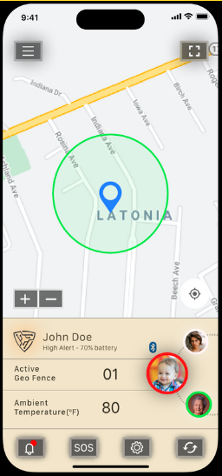
MAHI™
LEARNS - MONITORS - INTERACTS
Digital Companion
NO APPS | NO SCREENS | ALL VOICE
Assistive App
for caregivers

Slide 6
Support Independent Living
Hazard Prediction
Sleep and Activity Tracking
Reduced Physical and Emotional Stress
Location Tracking
Real-time Door and Floor Change Detection
Accurate Fall Detection

Slide 7
Lessening Strain on Community Resources
Preventive Care
Emergency Response Optimization
Early Detection & Intervention
Reduced Hospital Cost
Efficient Resource Allocation
Remote Monitoring

Slide 8
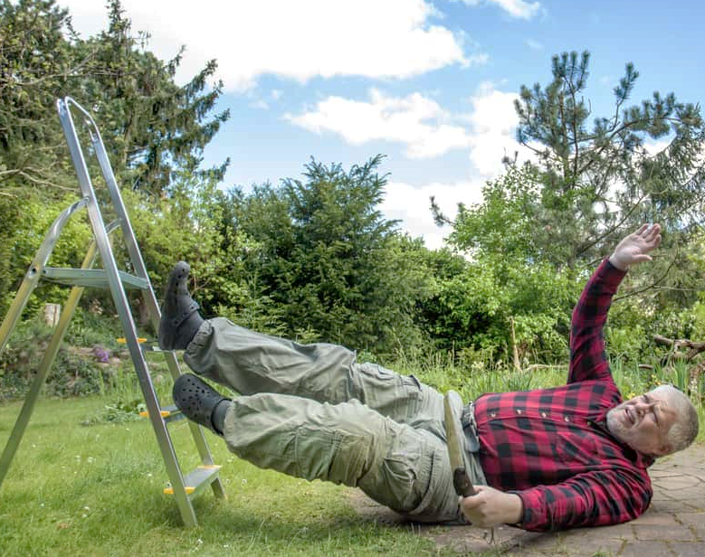
MAHI IN ACTION
“Looks like you have fallen – are you OK?”
“Yes, I’m OK”
“Do you need me to call for help?”
“No”
…
“Looks like you have fallen – are you OK?”
[no response]
[Mahi immediately engages SOS/911 & emergency contacts]

Slide 9
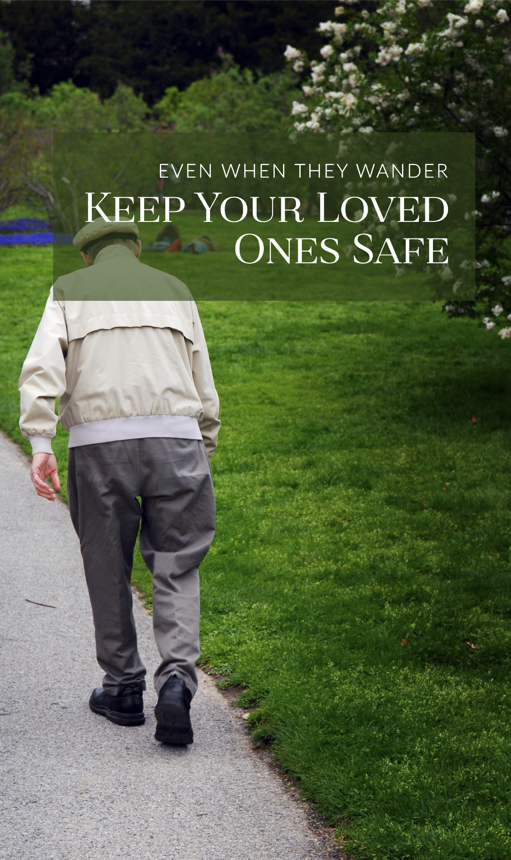
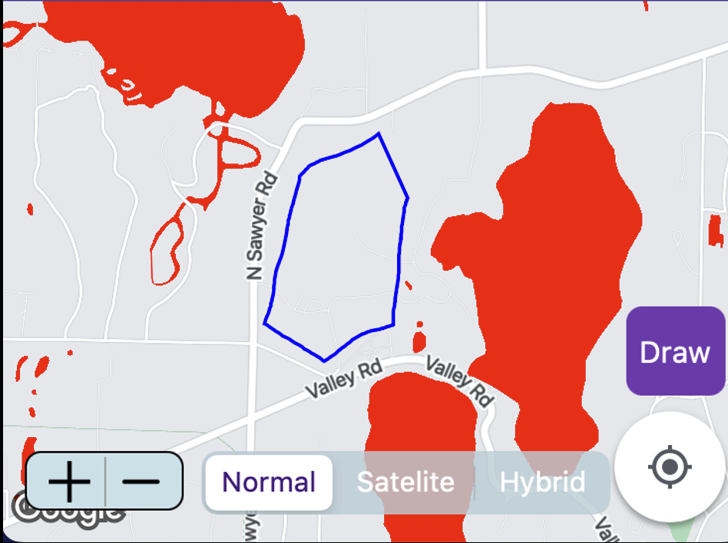
MAHI IN ACTION
Continuous Monitoring and Alerting as soon as the home door or geofence is breached

Slide 10
140M of US population expected with CVD by 2035
Healthcare cost expected to reach 1.1T
Affects vulnerable populations>65 years
MAHI in near future….
“Looks like your heart rate is elevated…. “Yes, I feel a bit out of breath”
“Do you need me to call for help?”
“Yes”
…..
….
…
..
Mahi immediately engages
Chronic Condition Management
(Cardiac)team
Notes:
Over 140M people expected with CVD by 2035 (rapidly expanding population), contributes over 1/3T in annual healthcare costs - expected to reach >1.1T by 2035, AND affects the vulnerable population (particularly people over 65 years) more than anyone else.

