Slide 1
HOW TO READ YOUR PLAN FINDER RESULTS
Add your contact info
This project was supported by the Wisconsin Department of Health Services with financial assistance, in whole or in part, by grant number 90SAPG0091, from the U.S. Administration for Community Living, Department of Health and Human Services, Washington, D.C. 20201. Grantees undertaking projects with government sponsorship are encouraged to express freely their findings and conclusions. Points of view or opinions do not, therefore, necessarily represent official ACL policy.

Slide 2
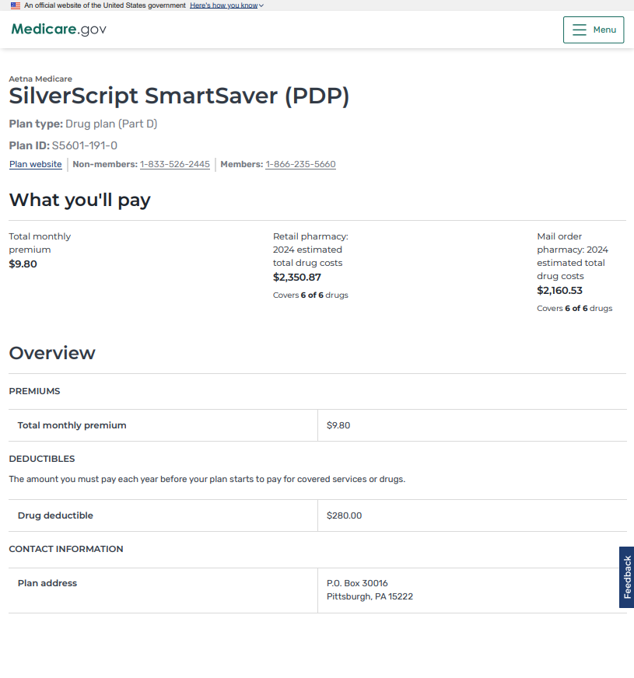
Reviewing the Plan Details
Insurance company and plan name
Plan ID code, link to plans website, and plans phone numbers.
Monthly Premium – this is paid directly to the insurance company
Annual Deductible – this is paid at the pharmacy when you go to pick up your drugs. You pay the full price of your drugs until you have paid this amount.
Contact Information – provides the address for the plan.

Slide 3
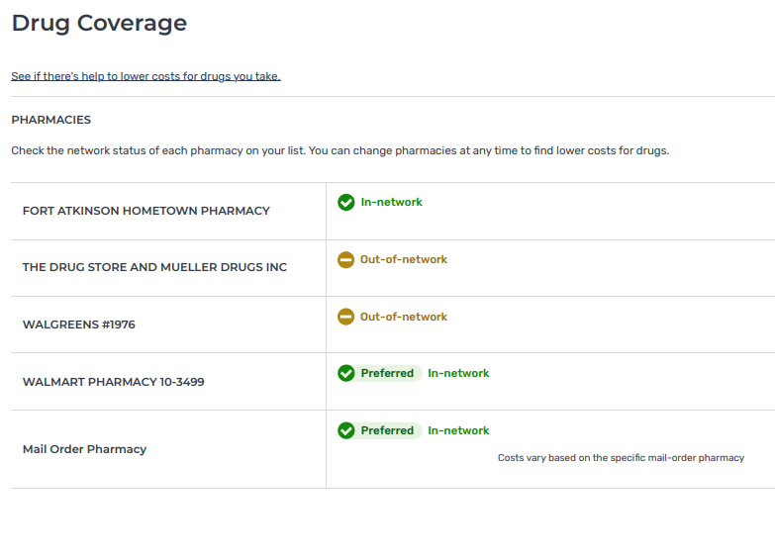
Pharmacies
Pharmacy List – this section tells you if your pharmacy is Out of network, Preferred, Standard, or Mail order.
Pharmacy descriptions:
Out-of-network pharmacy – this plan does not work with this pharmacy. If you use this pharmacy with this plan, you will pay full price from prescriptions.
Preferred in-network pharmacy – this is the pharmacy this plan would prefer you to use. You will have the lowest cost sharing at a preferred pharmacy.
Standard in-network pharmacy – this is a pharmacy you can use with your plan, but you will pay higher copays for your prescriptions.
Mail order pharmacy – Mail order pricing is for a 3-month supply. Sometimes mail order is lower cost than standard or preferred pharmacies, but not always.

Slide 4
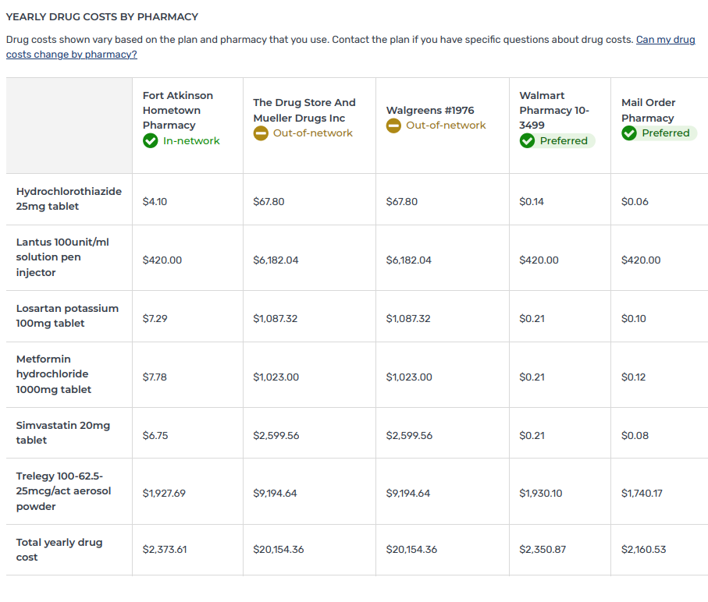
Yearly Drug Costs by Pharmacy
The Yearly Drug Costs by Pharmacy section breaks down the cost of each medication at each pharmacy for the rest of the calendar year.
This pricing DOES NOT INCLUDE the monthly plan premium.
Note: this section may go onto the next page depending on the number of prescriptions listed.

Slide 5
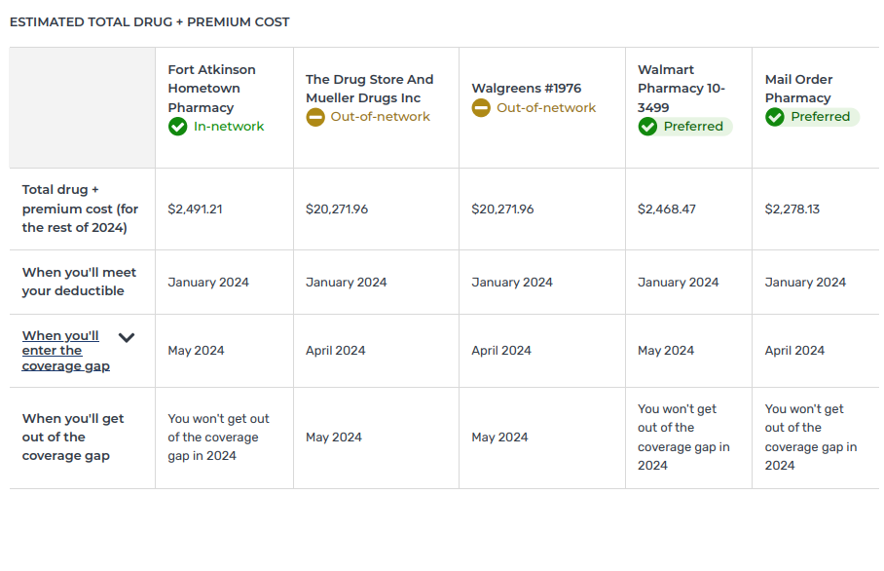
Estimated Total Drug + Premium Cost
Estimated Total Drug + Premium Cost –
This section gives you the total cost for this plan at each pharmacy for the drugs entered for the whole year. When comparing plans this is the number you want to pay attention to! It includes all of your prescription costs including the premium for the plan for the whole year.
This section also tells you:
What month you’ll meet your deductible
What month you’ll enter the coverage gap
What month you’ll exit the coverage gap and will be entering catastrophic coverage
11
11

Slide 6
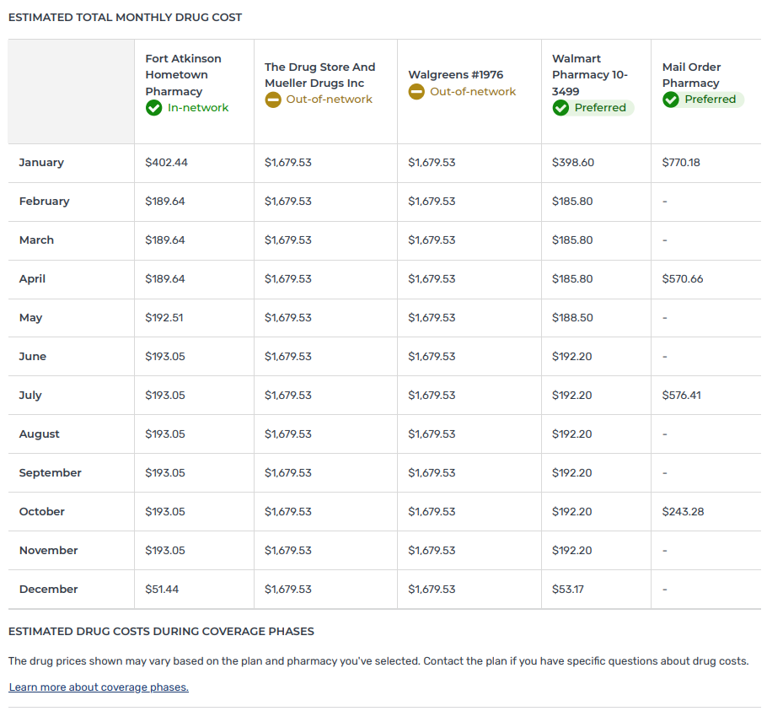
Estimated Total Monthly Drug Cost
12
Estimated Total Monthly Drug Cost -
This section estimates how much you will spend on drugs each month in this plan at each pharmacy included in results.
*Mail order pharmacy is for a 3-month supply.
NOTE: Please note that the Plan Finder is an estimate on currently listed drugs and drug costs can change at any time. Estimates may also change if your doctor adds or removes drugs.
12

Slide 7
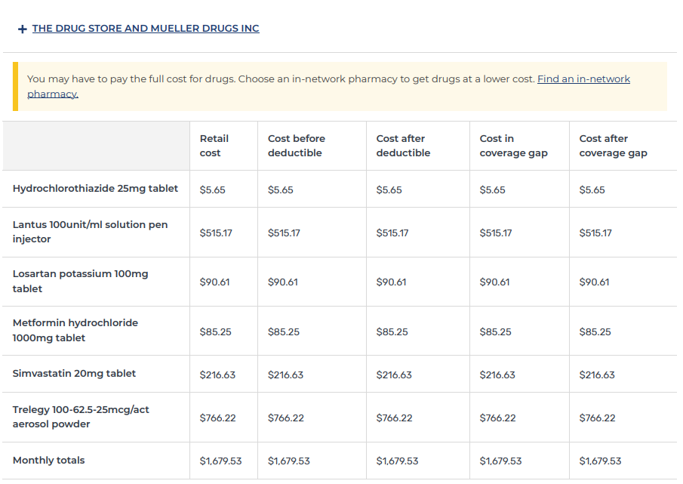
Pharmacy Details
Next you will see estimated cost breakdowns for each pharmacy selected for comparison. Each pharmacy has + before the name.
13
Example of an Out-of-Network Pharmacy:
In this example you can see that the cost of each drug is the same in every column. This means the pharmacy is Out of Network and the plan is not helping pay for these drugs at all.
When you see this… DO NOT use this plan at that pharmacy!
Note: Yellow box also highlights that you would pay full price unless you chose an in-network pharmacy to get the lowest costs.
13

Slide 8
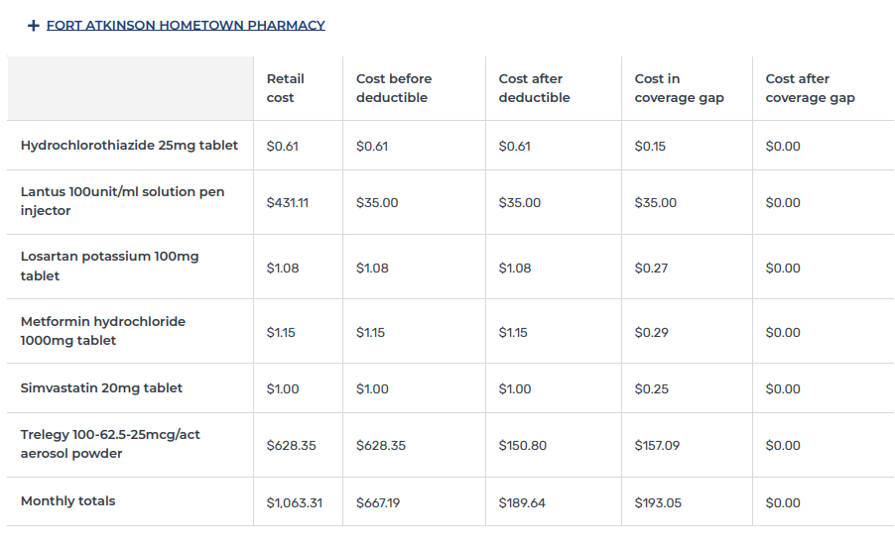
Pharmacy Details
Example of a Standard in-network pharmacy: You will notice that drug pricing is usually higher at a standard pharmacy than a preferred pharmacy.
These pharmacy charts provide drug cost details at each phase of Part D coverage phases.
Deductible phase
Initial coverage Level (Copay) phase (“Cost after deductible”)
Coverage Gap (Donut Hole) phase
Catastrophic Coverage phase
*Coverage phase descriptions on next page*
14
14

Slide 9
Descriptions of Coverage Phases
Retail Cost:
This is a negotiated price between this plan and this pharmacy. This number will be different on a different plan or at a different pharmacy.
Cost before Deductible:
(Deductible) This is the price you pay for your drugs at the pharmacy until you have paid out the deductible amount. Don’t worry if the total at the bottom of this column is more than the deductible. You move to the next phase once you have met the deductible.
Cost after deductible:
(Copay/Initial Coverage) these are the copays you pay for each drug after your deductible has been met; Before you reach the coverage gap. Pricing is based on tiering structure set by the plan.
Cost in coverage gap:
(Donut Hole) the prices you pay in this phase should be 25% of the retail cost for your drugs. Sometimes you will see the prices go up in this phase and sometimes you will see them go down.
Cost after coverage gap:
(Catastrophic Coverage) In this phase you will see your copays go to $0.

Slide 10
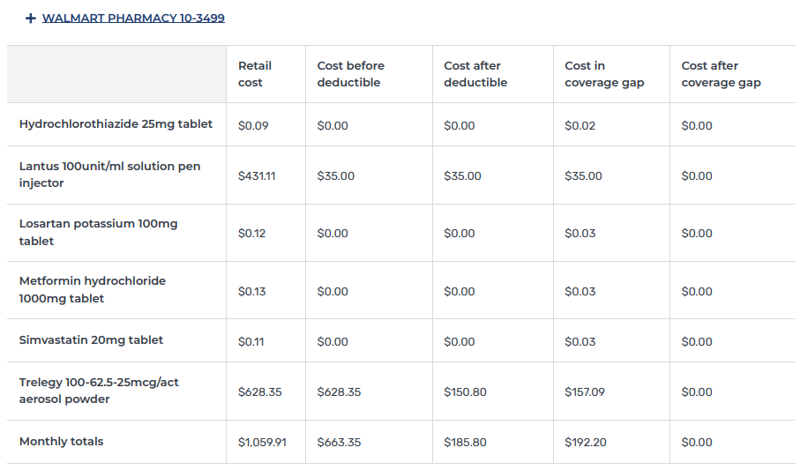
Pharmacy Details
Example of a Preferred in-network pharmacy:
Drug Pricing is usually lower at a preferred pharmacy than a standard pharmacy.

Slide 11
Pharmacy Details
Example of a Mail Order pharmacy: Note:
Mail order is listed in 3 month (90 day) supply of prescriptions. This will increase the “retail cost” for each drug listed.
Pay attention as sometimes mail order costs are less than a local pharmacy, but sometimes they will be higher.
**Always check with the plan directly for the most up to date pricing on prescriptions**

Slide 12
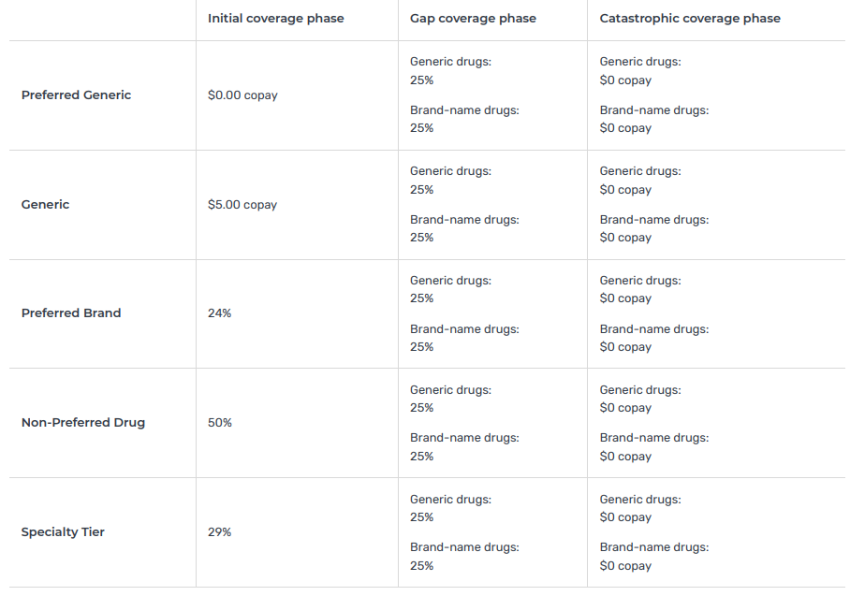
Costs by Drug Tier
This section provides general information about how the plan’s tiering structure works for each of the Medicare Part D phases.
Initial Coverage Phase – (Cost after deductible/Copay) these are the copays you pay for each drug after your deductible has been met; Before you reach the coverage gap. This is the tiering structure set by the plan.
Gap Coverage phase – (Cost in coverage gap/Donut Hole) the prices you pay in this phase should be 25% of the retail cost for your drugs.
Catastrophic Coverage – (Cost after coverage gap) In this phase Medicare limits your cost sharing to $0.
15
16
17
15
16
17

Slide 13
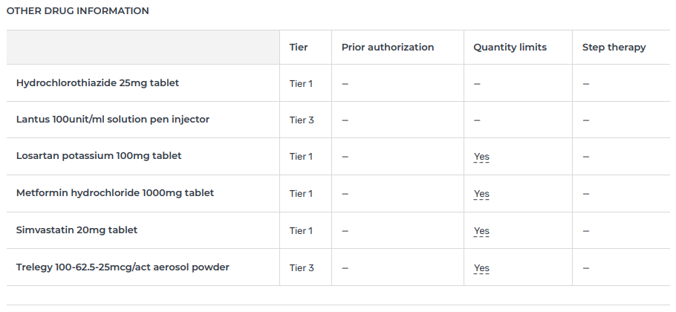
Other Drug Information
18
Tier assignment – this shows what tier this plan assigned your drugs to as this is different from plan to plan. It will also show if your drug is not covered by the plan.
Restrictions – If your plan has placed a restriction on your drug you will see a “Yes” in this chart
Prior Authorization – Your doctor must provide additional paperwork before you can fill this drug.
Quantity Limits – This plan restricts how much of this drug you can pick up each time you fill it.
Step Therapy – This plan would like you to try other drugs instead of the drug your doctor prescribed.
19
19
18

Slide 14
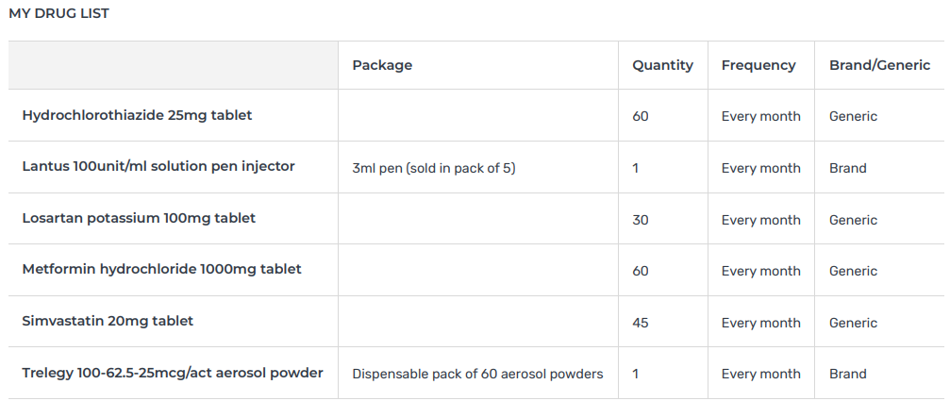
My Drug List
20
Your drugs are listed here with the details of how they were entered into the Plan Finder.
This includes:
Package size
Quantity
Frequency
Brand/generic
NOTE: Make sure that the dosage, quantity, and frequency are correct.
20

Slide 15
Star Ratings
21
Star Ratings – the more stars a plan has the higher they have been rated by Medicare.
21

Slide 16
Contact Information

