Slide 1
Caregiver Support for the LGBTQIA+ Community: Best Practices, Ideas, and Resources Kayla Steinke Caregiver Support Coordinator Milwaukee County Aging & Disabilities Services

Slide 2
Department of Health & Human Services Consists of Aging & Disabilities Services, Behavioral Health Services, Housing Services, Children, Youth & Family Services, Management Services, and Veterans Services
Mission Empowering safe, healthy, and meaningful lives
Vision Together, creating healthy communities
Values Partnership, Respect, Integrity, Diversity, and Excellence (PRIDE)

Slide 3
Aging & Disabilities Services
Empowering safe, healthy, and meaningful lives by connecting older adults and individuals with disabilities to resources that promote independence and inclusion, giving them choices for living in, and giving to our community.

Slide 4
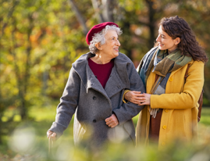
Caregiver Support Program
Milwaukee County Caregiver Support staff provide support services, education, and advocacy to promote the health and wellbeing of Milwaukee County caregivers as they provide crucial support to others.
Supporting Individuals
Respite and Support
Resources and Information
Family Consultation
Supporting Communities
Community Education and Outreach
Advocacy
Caregiver Coordination Council
Kayla Steinke, APSW
Caregiver Support Coordinator
kayla.steinke@milwaukeecountywi.gov
General referrals: (414) 289-6874; Direct: (414) 309-7179

Slide 5
Identity Humility Check-in
Coming to the presentation as a fellow learner who is glad to facilitate a conversation today:
Individuals who identify as LGBTQIA+ and allies: The floor is yours!
Caregiver Support, disability, and aging experts: The floor is yours!
Let’s learn together!

Slide 6
Agenda for Today
Quick Check-in: LGBTQIA+ Terminology and Resources for Learning More
Resiliencies and Challenges Unique to LGBTQIA+ Caregivers and Care Recipients
Resources for Professionals and LGBTQIA+ Care Partners
Organizational Change and Best Practices Discussion
What’s one change you could advocate for at your agency to become more inclusive and affirming for LGBTQIA+ Care Partners?

Slide 7
What if I have more to learn?
We all start somewhere, but it’s important to start!
What does LGBTQIA+ mean?
The Center Defining LGBTQUIA+
The Welcoming Schools: Defining LGBT Terms for Students
LGBTQ 101 from Indian Health Services
LGBTQ Health from Wisconsin Department of Health Services
Any other resources people recommend?

Slide 9
LGBTQIA+ Individuals Receiving Care: Resiliencies and Challenges
Difference in access to “family” caregivers
SAGE Prepare to Care Document
Differences in access to supportive healthcare and service providers
SAGE 10 Tips for Finding LGBT Affirming Services
Exposure to mistreatment and discrimination
Community, chosen family, and creative solutions

Slide 10
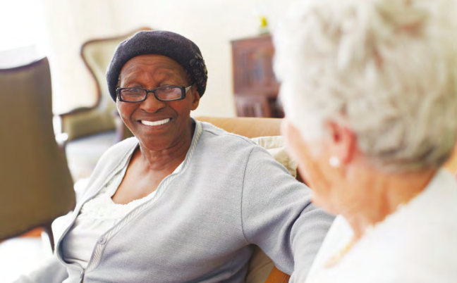
LGBTQIA+ Individuals Providing Care: Resiliencies and Challenges
Often exist “under the radar” but are strong, critical providers of care
Differences in isolation and access to supportive providers
More likely to be in a similar cohort as the care receiver
As a community, have creatively addressed needs through advocacy and creating new models of care

Slide 11
Resources for Caregiver Support Professionals and LGBTQIA+ Care Partners
Resources for Caregivers:
Sage Caregiving Resources
Family Caregiver Alliance
LGBTQ Caregiver Center
Supporting LGBT Young People with Disabilities by Trevor Project
Supporting Your LGBTQ+ Grandchild
Resources for Organizational Change:
SageCare
US Department of Health and Human Services
Child Welfare Information Gateway
The Safe Zone Project

Slide 12
Intersectional Resources for Caregiver Support Professionals and LGBTQIA+ Care Partners
Aging:
National Resource Center for LGBT Aging
Services and Advocacy for Gay, Lesbian, Bisexual & Transgender Elders (SAGE)
Diverse Elders Coalition
Disability:
Respectability
ParaPride
Youth:
Advocates for Youth
The Trevor Project
Jefferson Center: How Adult allies can support LGBTQ Youth
Notes:
Res

Slide 13
How can we advocate for change at our agencies?
Assess LGBTQIA+ inclusivity and access at your agency and pursue training
Review your intake process, forms, and marketing materials.
SAGE Identifying and Referring LGBT Caregivers
Consider ways to provide information about LGBTQIA+ inclusive businesses, support groups, etc.
Partner with LGBTQIA+ individuals, agencies, and businesses. BUT, bring something to the table!
Be authentic, caring, and realistic about barriers and resiliencies that could impact LGBTQIA+ care partners.

Slide 14
Successful Practices and Models: National
AgeOptions and Thrive with Pride
Long-Term Care Equality Index 2023
MiGenConnect Rainbow Resource Guide

Slide 15
Successful Practices: Milwaukee County
Partnership/contract with the LGBT Center for Outreach and Socialization
Agency-wide training required for all staff of Aging & Disabilities Services
“Prism” LGBTQUIA Network Resource Group for employees
Leaders and staff at Pridefest and Pride Parade annually
In the works:
Collaborative student respite opportunity with LGBT Center and University of Wisconsin-Milwaukee
Prepare to Care presentation with Commission on Aging input

Slide 16
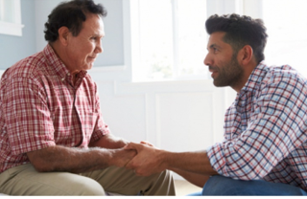
Successful Practices: Wisconsin
GWAAR Marketing Templates include inclusive imagery
LGBTQIA+ focus of the Underserved Families Workgroup for Wisconsin Family and Caregiver Support Alliance
Evening for Family Caregivers event hosted in September by LGBT Center of SE Wisconsin and ADRCs of Kenosha and Racine County
LGBTQ+ Specific Resources through Alzheimer’s Association

Slide 17
Now, it’s your turn!
What are some best practices or lessons learned in your work to connect with LGBTQIA+ care partners?
What questions to you have for Kayla or the group?

Slide 18
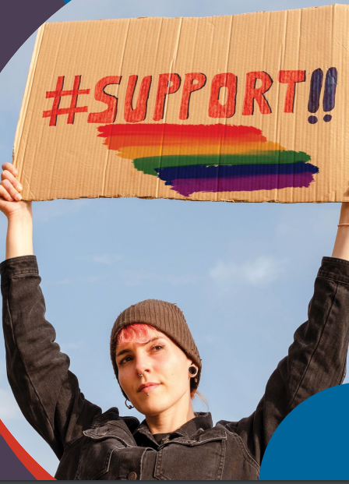
What will you take away?
What’s one change you could advocate for at your agency to become more inclusive and affirming for LGBTQIA+ care partners?

Slide 19
Resources used for this presentation
SAGE Caregiving in the LGBT Community
Diverse Elders Coalition Caring for Those Who Care
SAGE and AARP Prepare to Care: A Planning Guide for Caregivers in the LGBT Community
Family Caregiver Alliance Special Concerns of LGBTQ+ Caregivers
Human Rights Campaign Understanding Disability in the LGBTQ+ Community

Slide 20
Thank you!
Kayla Steinke
Caregiver Support Coordinator
kayla.steinke@milwaukeecountywi.gov
(414) 289-6544 or (414) 309-7179

