Slide 1
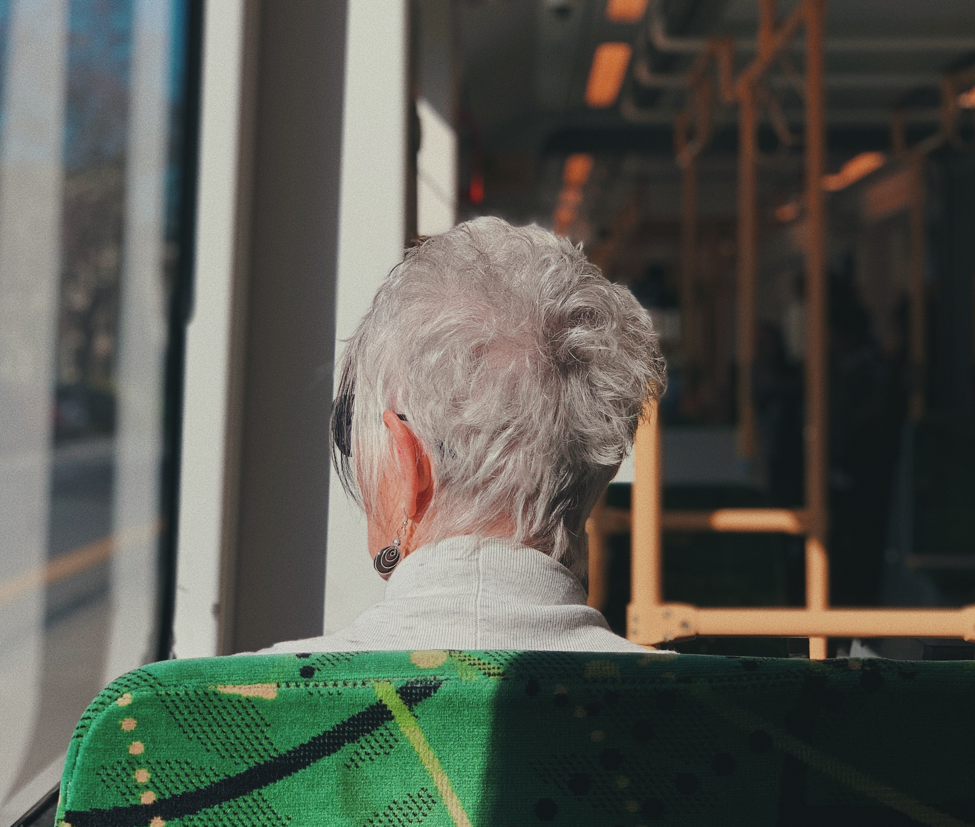
Transportation 101

Slide 2
Introduction
We need to think about transportation as more than a car or a bus. Transportation is the action of transporting someone or something or the process of being transported. This could be a car, bus, bicycle, our legs or mobility devices. Transportation is always evolving. Transportation is important because:
Connects us to the community.
Gives us access and independence.
Is a tool to help reduce isolation and loneness.
Is the backbone network that connects us all to the services and goods we need and want to live a quality life.
Transportation plays a crucial role in enabling individuals to live a quality life for several reasons:
Transportation provides access to essential services;
Empowers individuals with the ability to move freely and independently;
Enables people to maintain social connections and build relationships;
Connect people to job opportunities, enabling them to earn a living;
Provides access to healthcare services;
Is a tool to help reduce isolation and loneness; and
Is the backbone network that supports all we do.
Notes:
Wisconsin has 81 public transit systems in both urban and rural areas.
Note: State funds are combined with Federal grants (5307 and 5311) to administer public transit on an annual basis.

Slide 3
How is our system funded?
Federal Transit Administration
Section 5310 Enhanced Mobility of Seniors & Individuals with Disabilities
Section 5307 Urbanized Area Formula Funding program
Section 5311 Formula Grants for Rural Areas
Administration for Community Living
OAA Title IIIB Supportive Services
Notes:
Title IIIB Supportive Services – Transportation
has to go to a direct service
can be used to transport people, but not meals
Reporting - # of one-way trips, ambulatory or non-ambulatory, general service registration form
Special Considerations
A minimum amount of the expenditures must be spent on the following services:
• 5% for Legal/Benefit Assistance (unless a waiver is received from the State)
• 6% for access to services (transportation, assisted transportation, case management, info & assistance, outreach)
• 7% for in-home services (personal care, homemaker, chore)

Slide 4
How is our system funded?
Wisconsin
85.20 State Urban Mass Transit Operating Assistance
85.205 Paratransit Aids
85.21 County Elderly and Disabled Transportation Assistance
85.215 Tribal Transportation for Elders
85.22 Specialized Transportation Program
Notes:
Title IIIB Supportive Services – Transportation
has to go to a direct service
can be used to transport people, but not meals
Reporting - # of one-way trips, ambulatory or non-ambulatory, general service registration form
Special Considerations
A minimum amount of the expenditures must be spent on the following services:
• 5% for Legal/Benefit Assistance (unless a waiver is received from the State)
• 6% for access to services (transportation, assisted transportation, case management, info & assistance, outreach)
• 7% for in-home services (personal care, homemaker, chore)

Slide 5
Grant | Geographic Area | Eligible Recipients | Eligible Projects | Clients | Type
5310/ 85.22 | Varies | Private non-profits and local public bodies | Human Service Vehicles, operating budgets, Mobility Managers, coordination, and non-vehicle capital | Seniors and Individuals with Disabilities | Annual, Competitive
5307/ 85.20/85.205 | Urbanized Areas (50,000-200,000 and 200,000+) | Municipalities | Capital and operating | Public (must provide complementary paratransit service) | Annual, Formula
5311/ 85.20/85.205 | Rural Areas (population under 50,000) | Municipalities | Capital and operating | Public (must provide complementary paratransit service) | Annual, Formula
85.21 | County | County | County discretion | Seniors and Individuals with Disabilities | Annual, Formula
85.215 | Tribal | Tribal | Tribal discretion | Tribal Elders | Annual, Formula
OAA Title IIIB | County or Tribe | Aging Unit | Aging Unit discretion | Older Adults | Annual, Formula

Slide 6
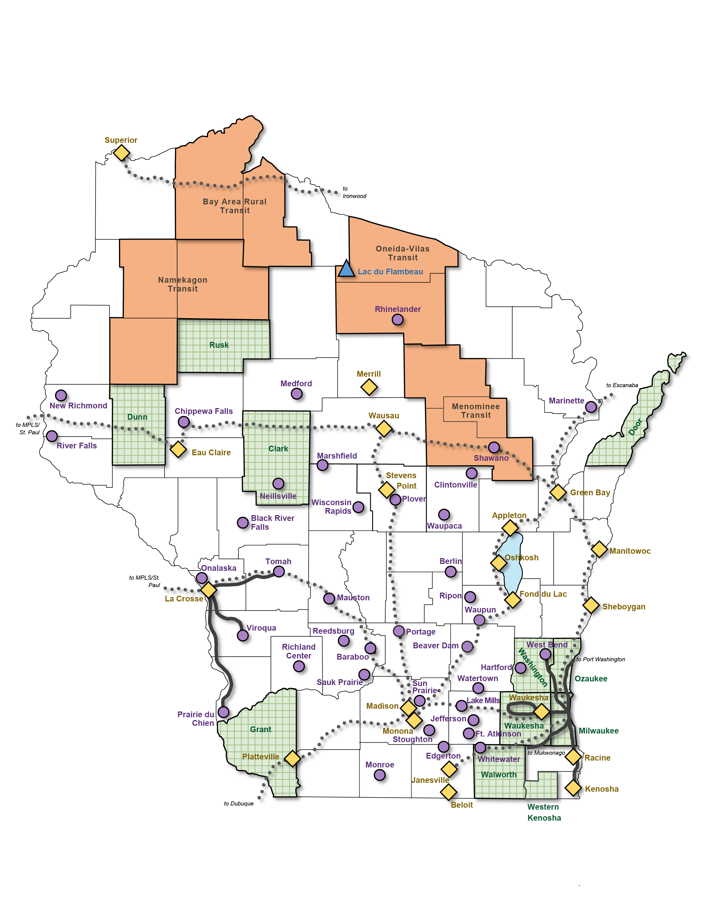
WI Public Transit Systems
Notes:
Wisconsin has 81 public transit systems in both urban and rural areas.
Note: State funds are combined with Federal grants (5307 and 5311) to administer public transit on an annual basis.

Slide 7
Volunteers
Volunteer driver programs in Wisconsin are community-based initiatives that rely on the services of volunteers to provide transportation to people in need. These programs are often operated by local non-profit organizations or government agencies and aim to provide reliable, safe, and affordable transportation to individuals who may not have access to their own vehicles or public transportation options. Types of programs include:
Senior
Disability
Rural
Volunteer driver programs play an important role in helping to address transportation challenges faced by vulnerable populations.
Notes:
Wisconsin has 81 public transit systems in both urban and rural areas.
Note: State funds are combined with Federal grants (5307 and 5311) to administer public transit on an annual basis.

Slide 8
Technical Assistance
What can I do for you?
Technical assistance
Education – Transportation 101 (Columbia and Forest County)
Presentations – Self Determination conference
Advocate - Volunteer driver insurance protections
Grant support – LOS, data analysis, reporting, applications
State and Federal legislation – keep you up to date
Connections - RPC/MPO/WisDOT/FHWA/FTA/WAMM/WIPTA
What can I do for you?
Technical assistance
Education – Transportation 101 (Columbia and Forest County)
Presentations – Self Determination conference
Advocate - Volunteer driver insurance protections
Grant support – LOS, data analysis, reporting, applications
State and Federal legislation – keep you up to date
Connections - RPC/MPO/WisDOT/FHWA/FTA/WAMM/WIPTA
Notes:
Wisconsin has 81 public transit systems in both urban and rural areas.
Note: State funds are combined with Federal grants (5307 and 5311) to administer public transit on an annual basis.

Slide 9
Contact Information
Nick Musson
Transportation Specialist
Older Americans Act Consultant
p. 608 228-8092
Greater Wisconsin Agency on Aging Resources, Inc.
www.gwaar.org

