Slide 1
Title III-D Disease Prevention and Health Promotion in the Older Americans Act
Angie Sullivan MS,CHES
OAA Consultant- Health Promotion Greater Wisconsin Agency on Aging Resources (GWAAR)
Notes:
Hello and welcome to the Greater Wisconsin Agency on Aging Resources webinar on Title III Part D Disease Prevention and Health Promotion requirements of the Older American Act. My name is Angie Sullivan and I am the Older American Act Health Promotion Consultant for GWAAR. I oversee OAA Title III Part D funding and provide technical assistance for 70 counties and 11 tribes in the area of health promotion. Today, I would like to give you an overview of Title III Part D – Disease Prevention and Health Promotion Services – I will discuss service provisions and priorities, allowable vs non-allowable expenses, reporting and how to find health promotion workshops that are high-level evidence based. So lets get started.

Slide 2
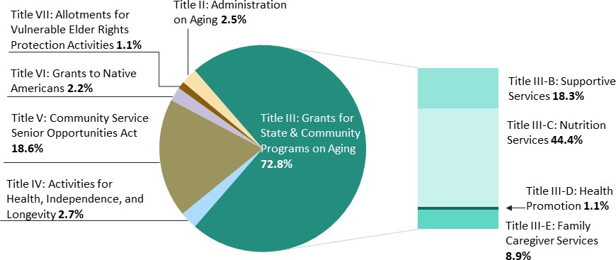
Older Americans Act, FY2022 Discretionary Appropriations
(funding as a percentage of total OAA funding, $2.177 billion)
Source: Explanatory statement submitted by Ms. DeLauro, Chair of the House Committee on Appropriations regarding the House Amendment to the Senate Amendment to H.R.2471, Consolidated Appropriations Act, 2022, Congressional Record, March 9, 2022, https://www.congress.gov/117/crec/2022/03/09/168/42/CREC-2022- 03-09-bk4.pdf#page=401, pp. H2683, H2842, H2877- H2880; email communication with G. Steven Hagy, director, ACL Office of Budget and Finance, April 4 and May 4, 2022; HHS, ACL, Operating Plan for FY2022, https://acl.gov/sites/default/files/about-acl/2022-05/ACL%20Operating%20Plan%20-
%20FY22%20Web%20Version.pdf.
Notes:
This slide show the 2018 discretionary appropriations – notice the red arrow which points to the Title II-D Health Promotion dollars – 1.2% of Title III appropriations which illustrates that the intent of Title III-D dollars to be “seed” money – definite need to partner with health systems, public health departments, extension offices, universities, etc.
How can Older American Act Title III-D grantees afford to implement evidence-based programs given limited funding? Partnerships and collaboration can extend the reach of health promotion programs. Many AU’s, tribes use Title III-D funding to leverage other funds. It is common practice to “blend” funding streams to fund different components of the same activity in order to make a complete program. Depending on the health promotion program, funding sources may include: public health departments, hospitals, foundation giving, universities, extension offices, outpatient clinics, nonprofit organizations, city and parks recreation departments, etc.

Slide 3
Purpose of the Older Americans Act (OAA) Title III-D Program “Health Promotion”
Reduce the need for more costly medical interventions
Established in 1987 to support healthy lifestyles and promote healthy behaviors amongst older adults (60 and older)
Priority is given to serving older adults living in medically underserved areas of the state and those who are of greatest economic need.
2016 – HP Program must be high-level evidence-based

Slide 4
What are evidence-based programs?
Evidence-based
Theory-based
Strong evidence of effectiveness from research
Measurable outcomes
Programs
Replicable/manualized
Protocol for training and technical assistance
Quality improvement/fidelity
Data monitoring and tracking

Slide 5
Advantage of High-Level Evidence-Based programming?
Positively impacting the health of the program participants
Funding
Use limited resources on proven programs
Concentrate efforts on program delivery
Older adults want to invest their time in something proven to work
Development of partnerships and sustainability
Notes:
Implementing an evidence-based program is widely considered “best practice” strategy for community health promotion. Evidence-based programming can add value in many ways.
Positively impacting the health of the program participants is more likely with an evidence-based program
Funders increasingly demand that programming be based on solid evidence
Agency leaders want to concentrate limited resources on proven programs
Program managers can concentrate their efforts on program delivery rather than program development. Allowing them more time to reach a larger population and have a greater impact.
Older adults are savvy and want to invest their time and money in programs that have been proven to work
The demonstrated outcomes of evidence-based programs are attractive to community membe3rs and potential partners, facilitating community buy-in and the formation of partnerships, especially with healthcare/clinical partners

Slide 6
5 Criteria for High-Level Evidence- Based Health Promotion Programming
Demonstrated through evaluation to be effective for improving the health and wellbeing or reducing disease, disability and/or injury among older adults; and
Proven effective with older adult population, using Experimental or Quasi-Experimental Design; * and
Research results published in a peer-review journal; and
Translated in one or more community site(s); and
Includes developed dissemination products that are available to the public

Slide 7
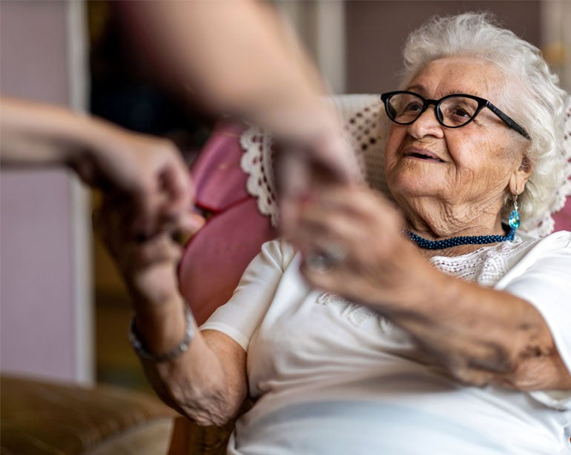
How do I find an eligible Title III-D program?
Evidence-Based Program Search NCOA
WI Aging Unit SAMS Sub-Service List

Slide 8
Caregiver Programs eligible for OAA Title III-D funding
Powerful Tools for Caregivers
AMP for Caregivers
Stress-Busting Program for Family Caregivers
REACH Community & REACH-TX
TCARE Support System (Tailored Caregiver Assessment and Referral)
Notes:
On the GWAAR website under Technical assistance/Health Promotion you will find a link to NCOA’s list of high-level evidence based programs (all programs on this list - AU’s can utilize their Title III-D funds to support the program. The website also contains HP Coordinator Webinar Agendas and Minutes. Please take time to review the website.

Slide 9
Thank you!
Angie Sullivan, CHES
OAA Consultant – Health Promotion
(608) 228-8081
angela.sullivan@gwaar.org
www.gwaar.org

