Slide 1
Resources for Starting and Developing a SHIP Volunteer Program
This project was supported by the Wisconsin Department of Health Services with financial assistance, in whole or in part, by grant number 90SAPG0091, from the U.S. Administration for Community Living, Department of Health and Human Services, Washington, D.C. 20201. Grantees undertaking projects with government sponsorship are encouraged to express freely their findings and conclusions. Points of view or opinions do not, therefore, necessarily represent official ACL policy.

Slide 2
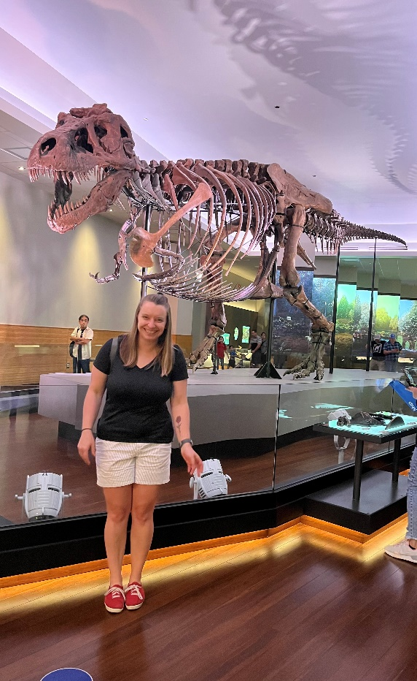
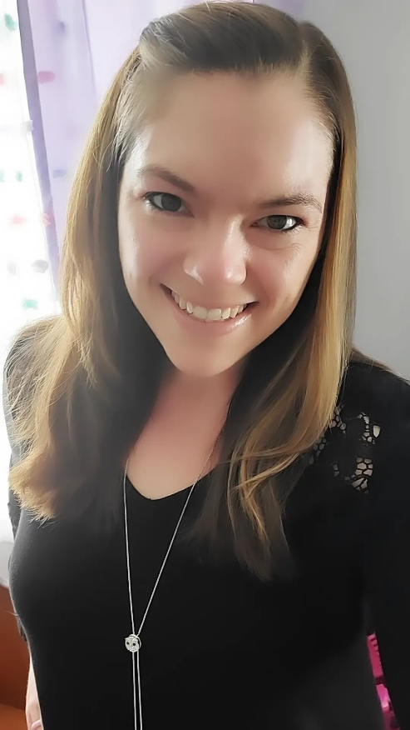
Presented by:
Sam Margelofsky,
state volunteer
program coordinator
samantha.margelofsky@dhs.wisconsin.gov
Alyssa Kulpa, GWAAR Medicare outreach coordinator
alyssa.kulpa@gwaar.org

Slide 3
Poll/Padlet Results
How many volunteers do you have in your SHIP program?
How long have you had a volunteer program?
Do you have a lead volunteer? what are their responsibilities?
Do other staff in your agency recruit/manage volunteers?

Slide 4
Poll/Padlet Results
If you have volunteers, what roles are you using them in?
Have you used the Medicare Minutes in your outreach?
If so, how/where have you had success?

Slide 5
Volunteer Involvement Cycle

Slide 6
Program Needs & Planning
What do you want your volunteer program to look like?
How much time can you dedicate to your volunteer program?
Things to consider before even thinking about recruitment

Slide 7
Define Volunteer Roles
Attracting and Keeping Great Volunteers
“While in the short run most volunteers will agree to do anything that needs doing, in the long run most volunteers will prefer to do work they find satisfying… The opportunity to do ‘good work’… is the key element
Define volunteer roles before recruitment - Important!
Helps to identify the skills needed for potential volunteers
Recruitment then is focused on finding those skills
Volunteers are looking for interesting and productive roles - keep them engaged!

Slide 8
Volunteer Roles
Administrative Support
Information distributor
Counselor
Exhibitor
Presenter

Slide 9
Administrative Support
Tasks:
Copying
General filing
Making outbound phone calls in support of SHIP activities
Locating and reserving training space
Confirming participant attendance
Scheduling presentations and other outreach activities
Fulfiling requests for information and materials
Handling mail and correspondance

Slide 10
Information Distributor
Deliver and disseminate hard copy education and information materials through:
Senior residential facilities
Senior centers and community centers
Health care providers
Agencies that serve Medicare and Medicaid beneficiaries and their caregivers
Health fair/senior fair booths or kiosks
Libraries
Present prepared information materials to inform and educate Medicare and Medicaid beneficiaries, their caregivers, and others at meetings and other events.
Identify other locations that will accept and display SHIP education and information materials.

Slide 11
Exhibitor
Provide general information about the SHIP program and health care at events by:
Transporting kiosk materials and supplies to events
Distribting written information about the SHIP program and its services
Distributing written information about health care benefits
Answering general questions about the SHIP program and its services

Slide 12
Presenter
SHIP volunteer presenters provide presentations using SHIP-approved materials and scripts to audiences that consist of Medicare beneficiaries, their caregivers, and/or other members of the public who want to gain awareness of the SHIP program and the national effort to educate Medicare beneficiaries.
SHIP presentations also include an opportunity for Q & A with the audience about covered topics and information.
These presentations may take place at:
Senior centers and community centers
Health fairs and senior fairs
Medicare education events
Meetings of civic or faith-based organizations
Meetings of health care providers
Meetings of local law enforcement officials
Libraries
Universities and colleges

Slide 13
Counselor
SHIP volunteer counselors:
discuss individual situations with beneficiaries and/or their caregivers.
educate beneficiaries about health care and/or enrollment in a Part D Prescription Drug Plan.
listen carefully to the beneficiary's or caregiver’s account of a situation and determine whether to:
Share information with, or provide an explanation to, the beneficiary or caregiver
Refer the beneficiary or caregiver to a staff person or volunteer who handles complex interactions/benefit specialist or
Refer the beneficiary to another more applicable organization for assistance (such as the SMP, 1-800-Medicare, etc.)
provide their services in person or by telephone and may take place at locations such as your agency, senior centers, Medicare education events, libraries, etc.

Slide 14
SHIP Volunteer Recruitment Planning Worksheet

Slide 15
What is a Medicare Minute?
Short, engaging presentations on Medicare topics presented by volunteers or staff at local sites, typically monthly
Medicare Minute materials are created monthly and are distributed by the SHIP TA Center which include:
Teaching materials
Scripts
Handouts
Medicare Minute | SHIP TA (shiptacenter.org)

Slide 16
How to access Medicare Minutes

Slide 17
Why should I offer Medicare Minute in my community?
Great for your outreach goals of reaching Medicare Beneficiaries
Group and Media Events for STARS data
Encourage participants to be advocates in their health care
Familiarize beneficiaries with your agency
Become known as the local, unbiased Medicare resource
Easy to integrate into current programing

Slide 18
How can Medicare Minute assist in Outreach in my community?
Flexible - It's easy to incorporate into local activities. Only takes 10-15 minutes and only once a month
Topics can be combined to make longer presentations
Many sites looking for consistent, accurate, and easy to understand information for Medicare beneficiaries
Provide education and resources during Medicare Open Enrollment

Slide 19
Where to present Medicare Minute
Libraries
Senior Centers
Congregate meal sites
Senor Residences
Retiree Groups
Card Clubs
Service Organizations
Faith based institutions
Aging and Disability Resource Centers (ADRCs) or Aging Units
Letter to Potential Presentation Sites (shiptacenter.org)

Slide 20
How to recruit volunteer presenters for Medicare Minutes
Ideas:
Bring recruitment flyers to current Medicare Minute presentations; end presentations with an ask for volunteers
Promote the Medicare Minute at local events
Encourage current volunteers to bring potential volunteers to monthly update meetings
Collaborate with local universities to draw students

Slide 21
How to update presenters on new information
Monthly update meetings
In person or virtual
Discuss topic and answer questions
Collect/distribute materials and reporting sheets for data entry
Build camaraderie among presenters and provide them with a peer support network

Slide 23
Resources:
SHIP TA Center Resources:
Volunteer Program Management Manual (VRPM)
SHIP TA Center Role Descriptions
Volunteer Cycle
GWAAR SHIP Volunteer Resources
Under “Recruitment”:
WI SHIP Volunteer Position Descriptions
Recruitment Planning Tool

