Slide 1
Summit 2022 Day1
Respite Care is a short break from primary caregiving duties. It allows the caregiver an opportunity to rest, refresh, and recharge.
MISSION: To promote, support, and expand quality, statewide respite care across the lifespan.
promote, support, and expand quality statewide respite care.

Slide 2
Notes:
Lisa
Announce we have masks and hand sanitizer

Slide 3
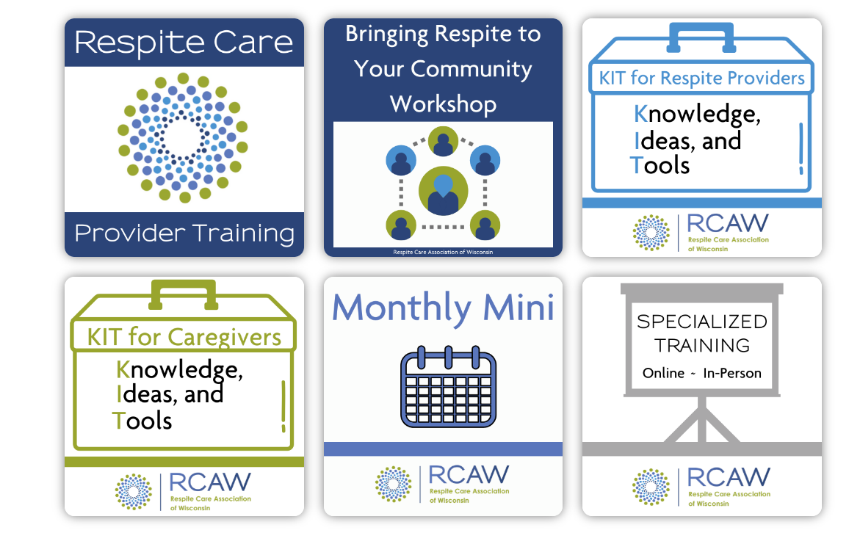
Free training

Slide 4
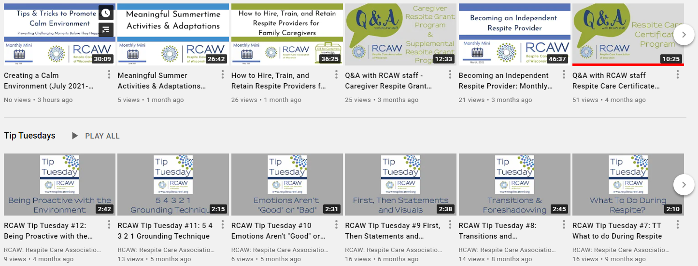
We currently have over 30+ video presentations/trainings on our RCAW YouTube channel. Below is just a screenshot of a few…

Slide 5
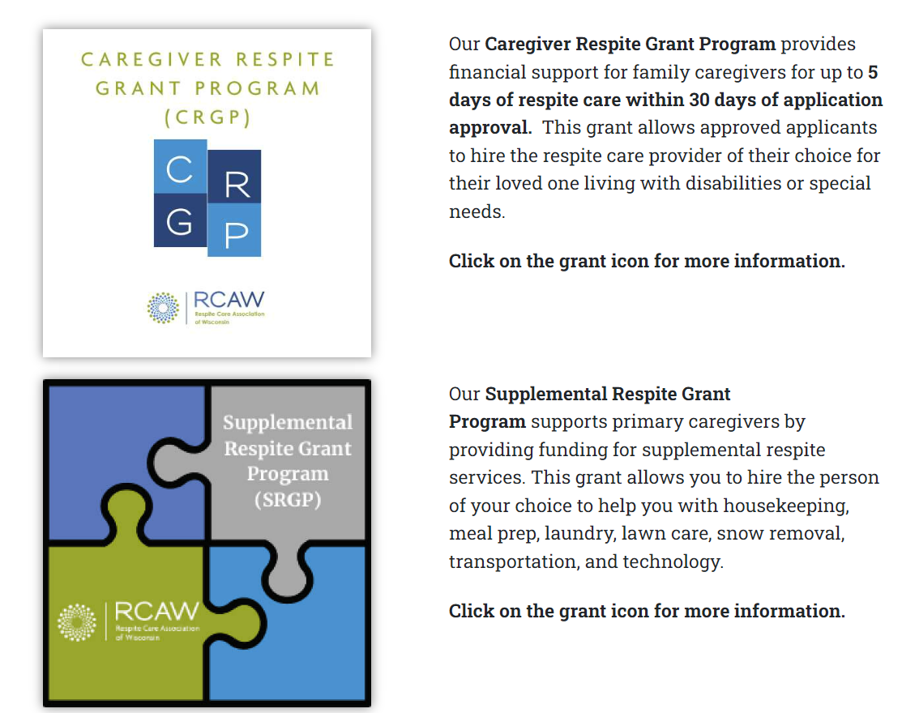
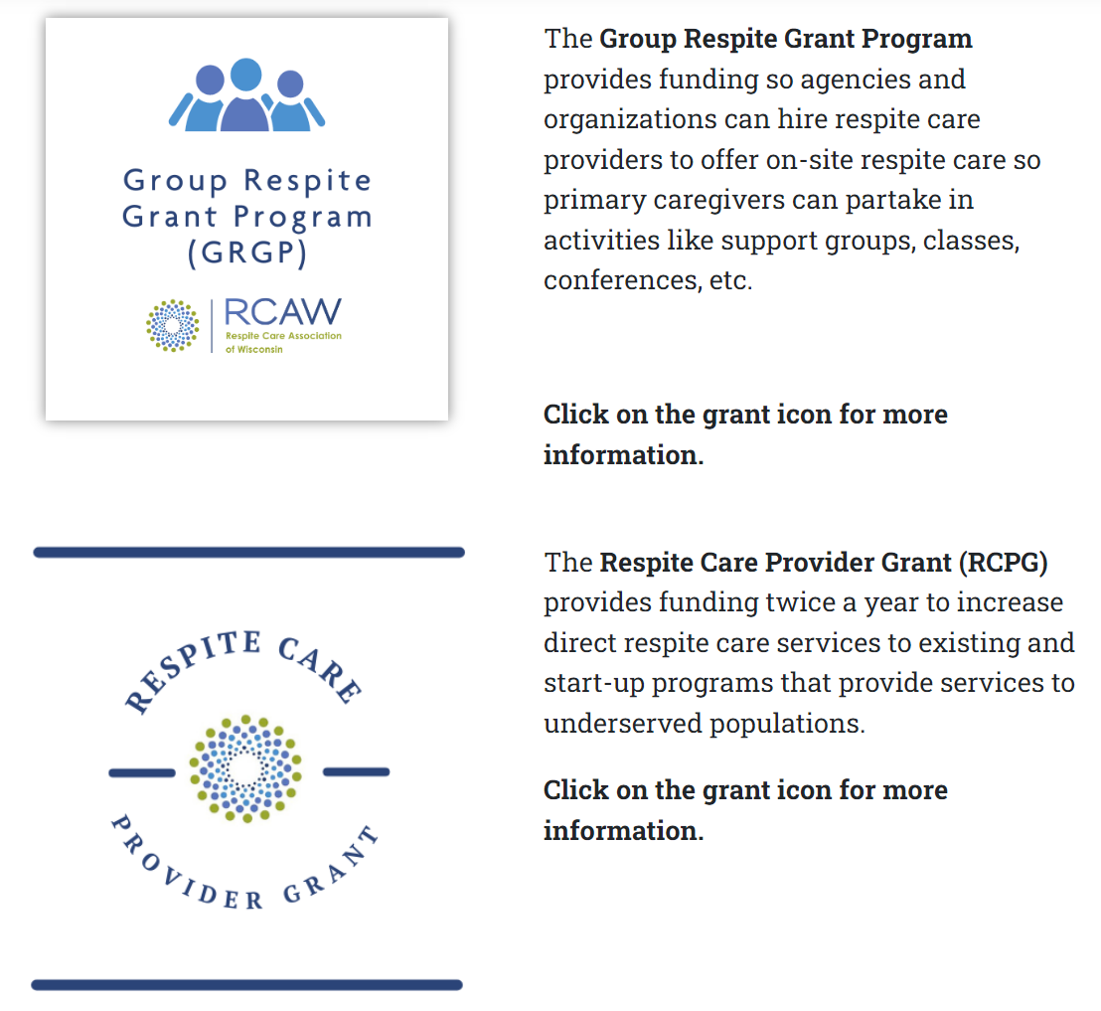
Grant Programs
Notes:
TBD

Slide 6
Free searchable registry
Primary caregivers can filter their search for a provider by choosing county, age of care recipient, and type of respite. The registry lists information for primary caregivers to contact the respite care provider to discuss things, including but not limited to setting up an interview, hourly rate, and asking for a background check.
The registry lists private in-home respite care providers who have completed our free Respite Care Provider Training. The registry also has facility-based environments and agencies that provide respite care.
Notes:
Share feedback from last year’s summit
Make copies as handouts

Slide 7
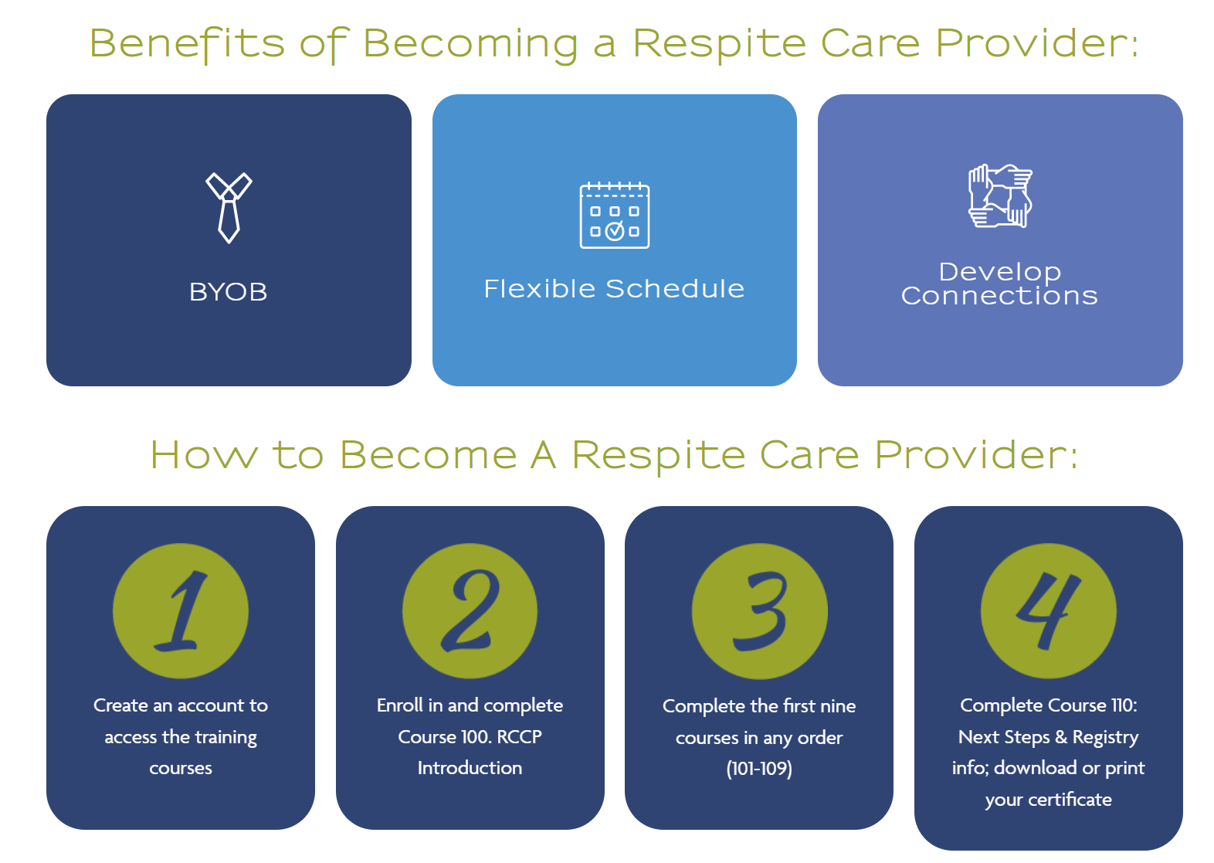
RCAW Milestone Timeline
Registry of trained workers
The registry lists private in-home respite care providers who have completed our free Respite Care Provider Training. The registry also has facility-based environments and agencies that provide respite care.
Notes:
Lisa

Slide 8
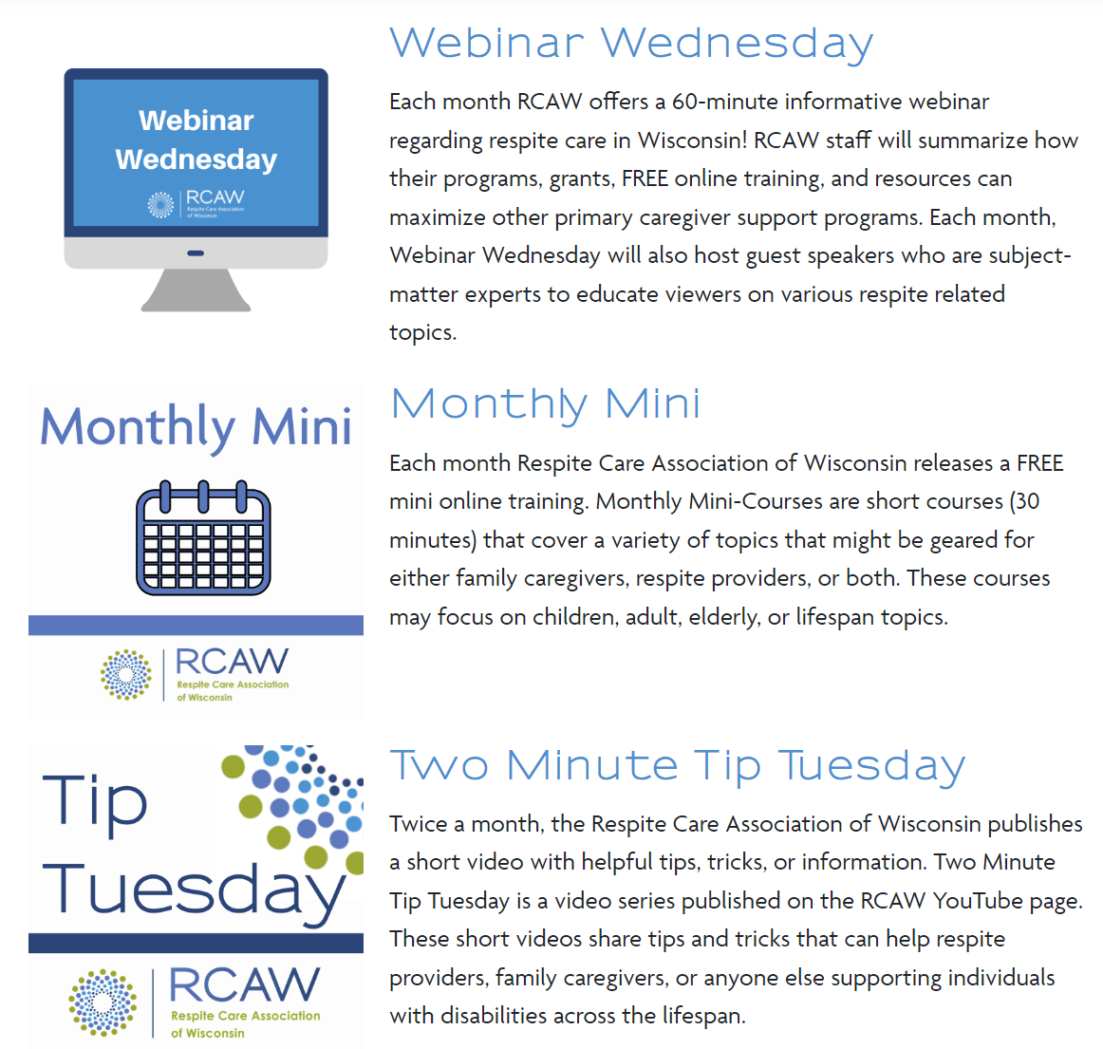
outreach
Notes:
Rachel

Slide 9
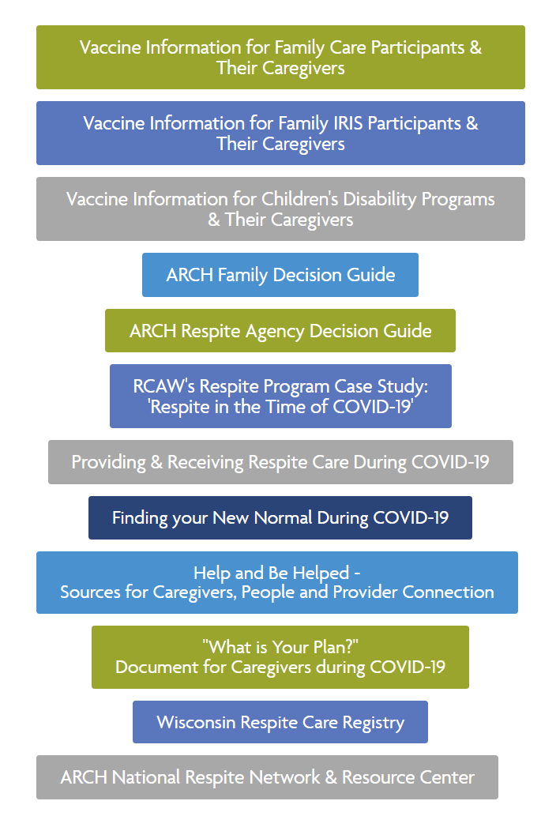
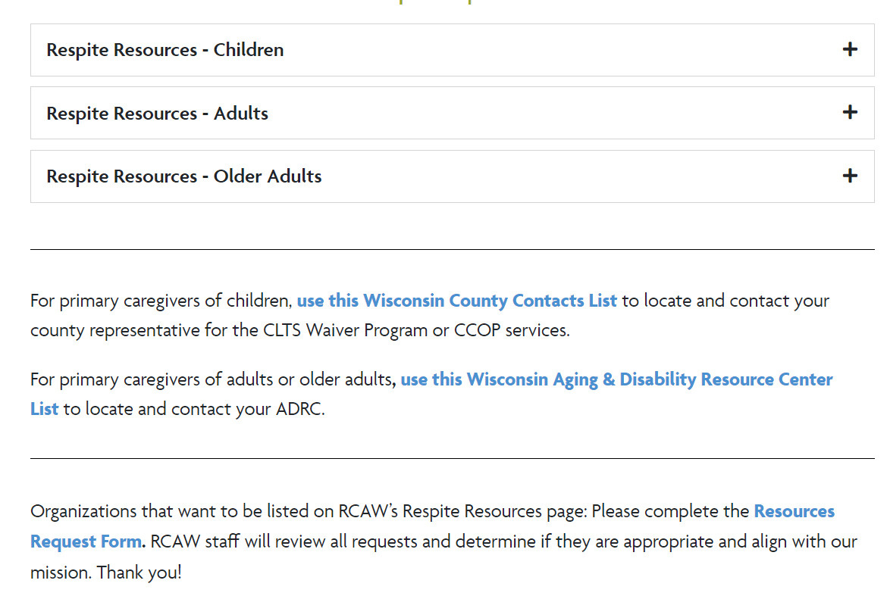
Grant programs
Respite & covid related resources
Notes:
Rachel

Slide 10
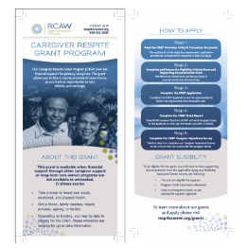
marketing resources order supplies online!
Wisconsin Respite Registry
Grant Programs
Free Training Courses
About Us
Caregiver Respite Grant Program

Slide 11
Workshop Syllabus
Week 1: Needs Assessment, Program Design, and Business Structure (Online Course Module)
Week 2: Program Design and Licensing, Funding & Budgeting Intro (Virtual Face-to-Face)
Week 3: Policies and Procedures, Documentation, Interviews with Respite Programs (Online Course Modules)
Week 4: Professional Guest Speakers – topics vary each workshop, could include insurance, legal information, accounting, and others (Virtual Face-to-Face)
Week 5: Staffing & Volunteers, Recruitment & Hiring, Training, and Program Growth (Online Course Module)
Week 6: Branding & Marketing, Project Presentations & Course Wrap-up (Virtual Face-to-Face)
Registration is limited to 10 people. This will allow for interactions and quality feedback about your specific program. The hope is that your workshop group will become a support for you throughout the process of building your respite program.
There is a need for more respite programs in Wisconsin. Throughout the state, there is funding available to pay for respite care. But in most communities, there are very few, if any, providers. Respite care programs can look like a variety of models. Some use volunteers, and there is no fee to the participants. Other respite care services are paid through waiver funds that are provided by the state.
Respite Care Association of Wisconsin is offering a free six-week virtual workshop so that you can explore the idea of bringing respite to your community. You will walk through the steps with other like-minded individuals that want to build a respite program.
https://respitecarewi.org/wp-content/uploads/2021/02/Bringing-Respite-to-Your-Community-Workshop.pdf

Slide 12
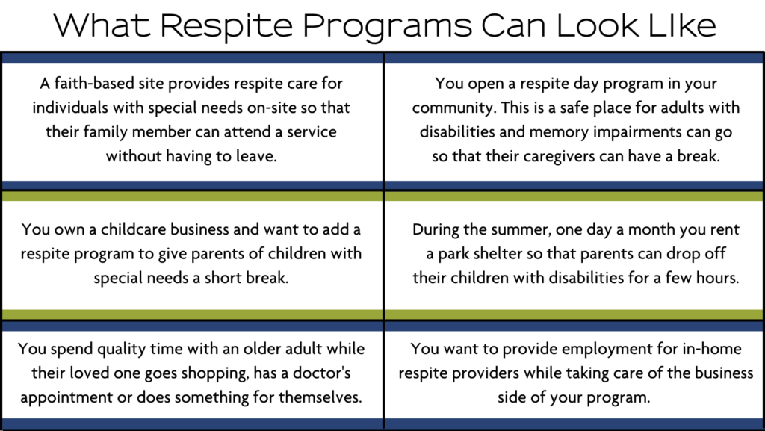
Successful Completion of the Workshop
Along with creating a respite program plan, RCAW wants to continue to support you in your respite program development. Upon completion of the workshop, you will receive:
Access to the RCAW & Direct Course Partnership, giving you access to more than 45 online courses (over 500 hours of continuing education).
Access to funds to cover the costs of training and conferences
An opportunity to receive up to $4,000 for your business to provide respite care from an RCAW start-up business grant for underserved populations.

Slide 13
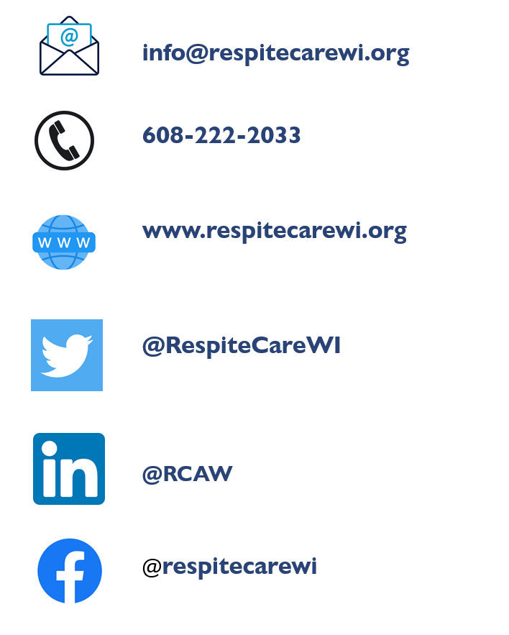
Contact Info
RCAW
Lisa Schneider, Executive Director lschneider@respitecarewi.org
Rachel Watkins-Petersen, Project Manager rwatkins-Petersen@respitecarewi.org
Val Madsen, Training and Development Specialist vmadsen@respitecarewi.org
Leslie Thede, Program Support Specialist lthede@respitecarewi.org
Notes:
Lisa

