Slide 1

Medicare’s Annual
Open Enrollment Period
WHY You Should Review Your Medicare Coverage Each Year

Slide 2
Annual Open Enrollment Period
October 15th – December 7th
Medicare Advantage Plans and Medicare Part D plans can change their plan details each year.
Open enrollment is your opportunity to check your plan and make sure you will have appropriate coverage in the new year.

Slide 3
Medicare
Every year insurance companies can change their formularies, premiums, deductibles and copays? ALL Medicare Part D plans should be reviewed every year!

Slide 4
Medicare
Four Reasons to Check Your Prescription Drug Plan:
Your plan may cost more next year due to changes in deductibles, premiums and co-pays.
Your plan may no longer cover all your medications because insurance companies change their formularies.
Your plan may have put restrictions on some of your medications such as preauthorization, quantity limits and step therapy.
You may be taking different medications now.

Slide 5

Time to review your Medicare Prescription Drug Plan!
So it’s…

Slide 6
Annual Notice of Change
Annual Notice of Change
What is it?
If you have a Medicare plan, your plan will send you an "Annual Notice of Change" (ANOC) each fall. The ANOC includes any changes in coverage, costs, or service area that will be effective in January.
When should I get it?
September
Who sends it?
Your plan
What should I do if I get this notice?
Review any changes to decide whether the plan will continue to meet your needs in the next year. Compare it to your other options.
If you don't get this important document, contact your plan.

Slide 7
How to Choose a Plan?
How Do I Choose a Plan?
Compare plans on the PlanFinder at: www.medicare.gov
Call Medicare at: 1-800-633-4227
Call Medigap Hotline (WI SHIP): 1-800-242-1060
For local assistance: <YOUR CONTACT INFO>

Slide 8

The Medicare Plan Finder
Click “Find Health and Drug Plans.”
Personalize your search to find plans that meet your needs.
Compare plans based on star ratings, formularies, benefits, costs, and more.
Notes:
Visit www.Medicare.gov and click on “Find health and drug plans”.
(Provide attendees with a handout with PlanFinder Instructions.)

Slide 9
The Medicare Plan Finder
The plan finder walks you through multiple steps to achieve your personalized results.
Results are based on the information you enter:
  Zip code – plans vary by county
  Your medications
  Pharmacy preference
  Eligibility for assistance – “Extra Help”
  Retail/Mail order preference

Slide 10
The Medicare Plan Finder
The plan finder walks you through multiple steps to achieve your results based on your medications and other information:
  Zip code – plans vary by county
  Your medications
  Pharmacy preference
  Eligibility for assistance – “Extra Help”
  Retail/Mail order preference

Slide 11
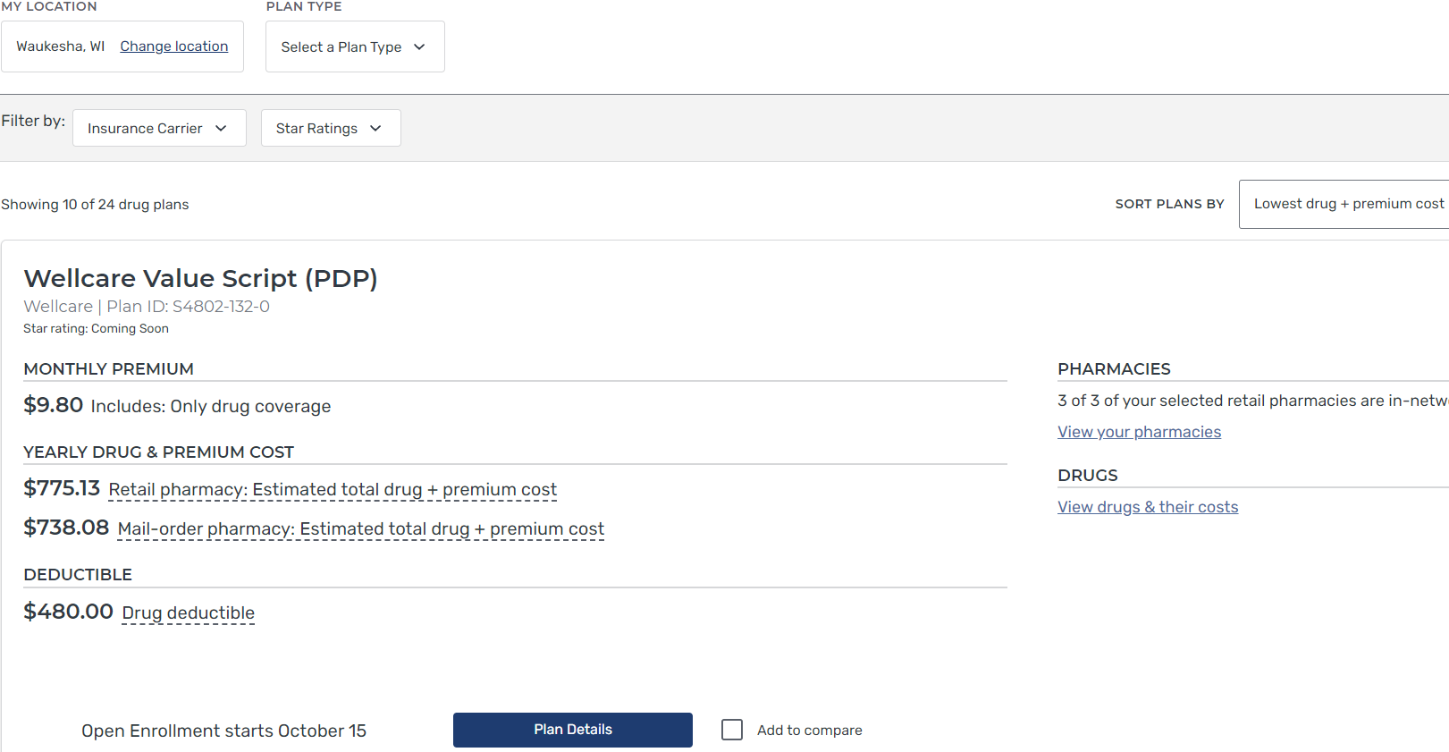
Your Results
Your Results
Results will be sorted by lowest annual cost

Slide 12
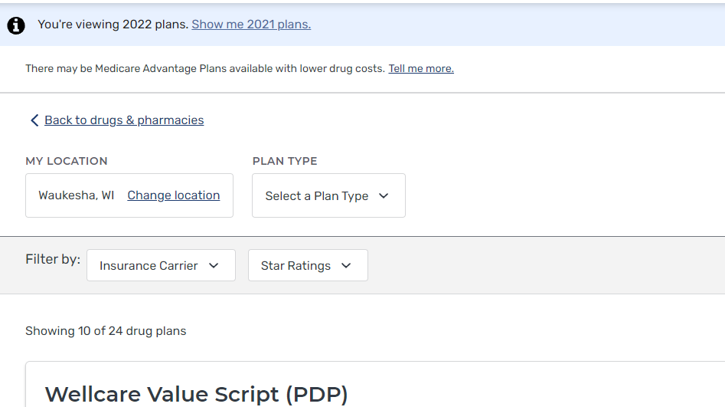
Medicare Plan Finder
Switch between plan years

Slide 13
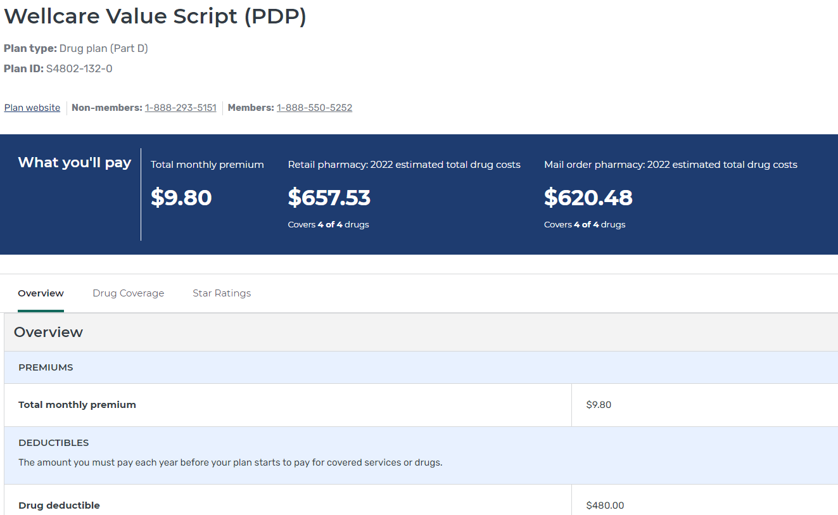
Medicare Plan Finder

Slide 14
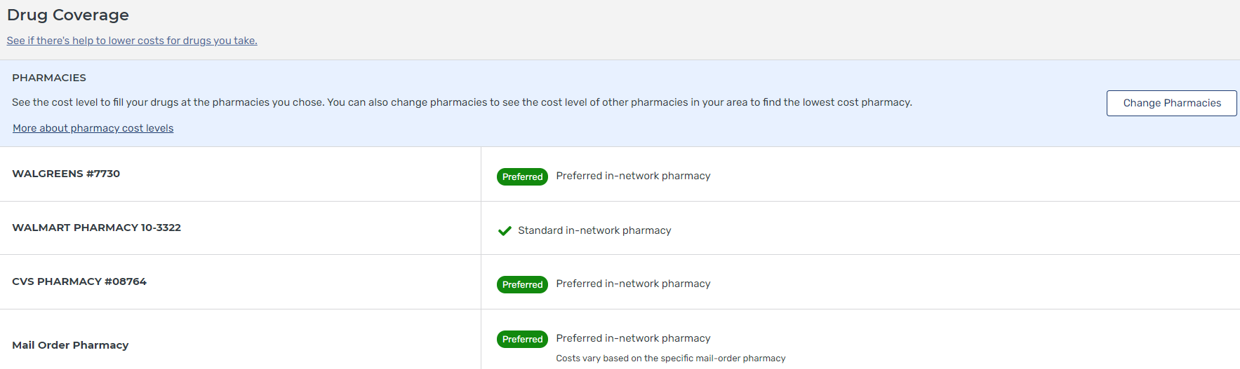
Medicare Plan Finder
Pharmacy information will be displayed next.
You can also change the
pharmacy selection.

Slide 15
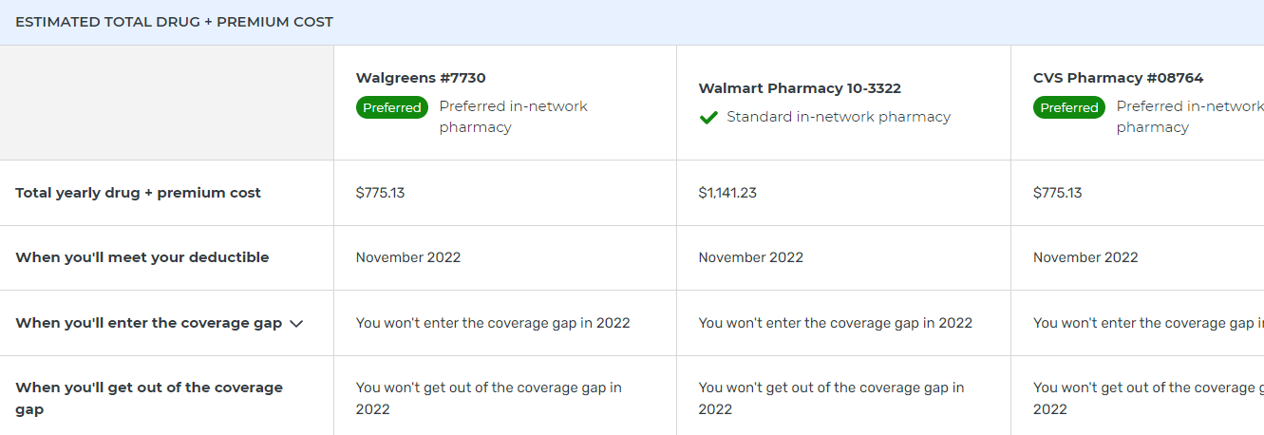
Medicare Plan Finder
Notes:
The estimated total drug + premium costs are shown for each pharmacy. In this simple example, you’ll notice that we do not enter the coverage gap.

Slide 16
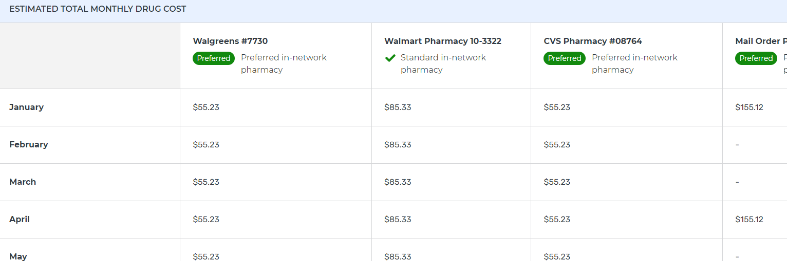
Medicare Plan Finder
Estimated Drug Costs for each month at each pharmacy
Notes:
You can view the estimated drug costs for every month at each different pharmacy, including mail order.

Slide 17
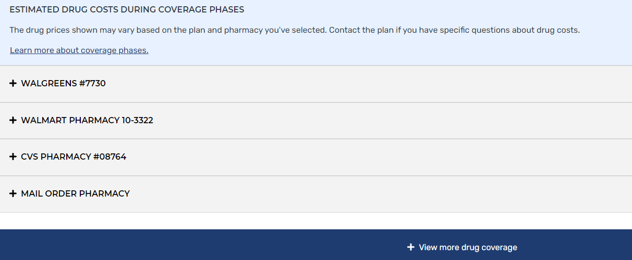
Medicare Plan Finder
Click “ + “
for additional information

Slide 18
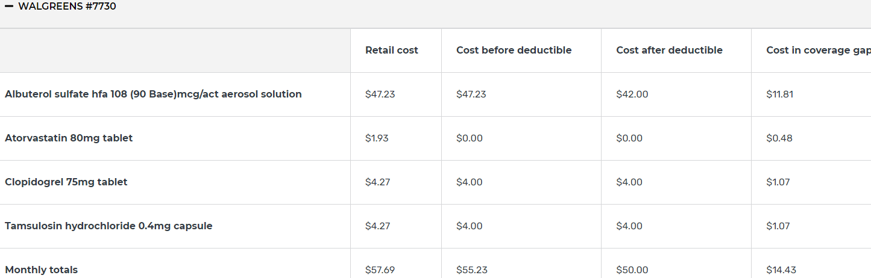
Medicare Plan Finder
This is where you’ll see the Drug Costs in different coverage phases

Slide 19
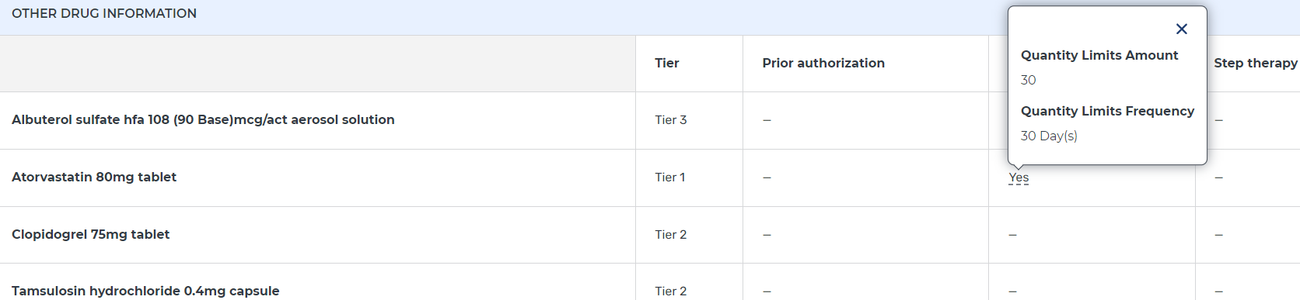
Medicare Plan Finder
Drug restriction information

Slide 20
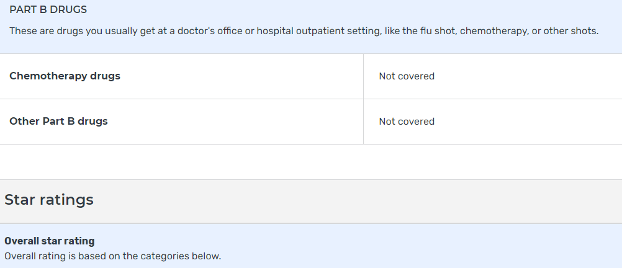
Medicare Plan Finder
As you Scroll down to the bottom of the plan details page, you’ll be able to see the star ratings, which are not there yet this year.

Slide 21
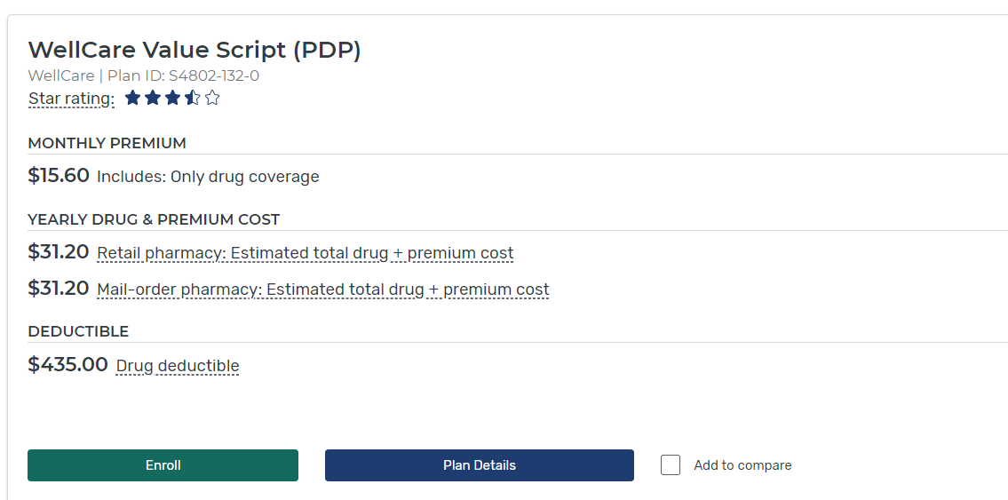
Medicare Plan Finder
To enroll in a plan, click the
Enroll button
and follow the prompts.
Notes:
To enroll in a plan, click the Enroll button. (For this screenshot, I went back into the old plan data so the Enroll button would be activated.)
Be ready to provide your Medicare Number and effective dates;
Information about any other health coverage. Be sure to print the Enrollment Confirmation page!

Slide 22
Additional Considerations
Additional Considerations
Are your medical providers/pharmacy in-network with this plan?
For Medicare Advantage plans, what services are you most likely to use? What are the co-pays for those services?

Slide 23

What if someone needs help with Medicare Costs?

Slide 24
Medicare Related Programs
For Medicare Beneficiaries with limited income and assets
Medicare Related Programs
For Medicare Beneficiaries with Limited Income and Assets
Medicare Savings Plans
  If eligible, your Medicare Part B premium will be paid for you
  Some also have co-pays and deductibles paid as well based on income & assets
Extra Help (Low Income Subsidy)
  Assistance with Medicare prescription drug coverage
  Reduces Part D premiums, deductibles and co-pays based on income & assets
  For more information or assistance contact:
  <YOUR CONTACT INFO HERE>

Slide 25
SeniorCare
WI Prescription Drug Assistance Program
Age 65 and over
$30 Annual application fee
NO Asset limit
“Creditable” coverage
Level of assistance depends on income
May use alone or in addition to Part D

Slide 26
Don’t wait!
Don’t Wait !!!
If you would like assistance with a plan comparison, please contact: <YOUR AGENCY CONTACT HERE>
Or, complete the Prescription Drug Form (have available as handout) and return to: <YOUR AGENCY INFO HERE>

