Slide 1
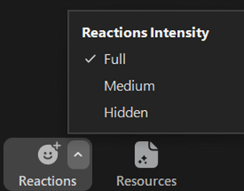
Welcome to the How to Manage a Volunteer Program Webinar!
Access your menu options on the bottom of the screen (desktop) or tap the screen (tablet/smartphone).
Chat: During the Q&A session, send questions in chat to all panelists.
Raise Hand: All participants’ lines are muted during today’s webinar. During the Q&A session, raise your hand to ask a question so the host can help unmute you.
Show Captions: Use this option to show or hide subtitles, view a transcript in a separate Zoom window, and change settings, e.g., language.
Reactions: Click the button to react to the presentation. Tip: Click the arrow to change reaction intensity or hide reactions shared by others.
Resources: Access resources and the survey link for today’s webinar.
Polls: Polls will be enabled by the host when it’s time for you to interact.
Participants: See how many people are on the webinar.

Slide 2
How to Manage a Volunteer Program Webinar March 23, 2023

Slide 3
Welcome!
SMP
State Health Insurance Assistance Program
Senior Medicare Patrol
SHIP

Slide 4
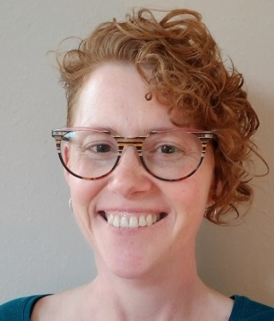
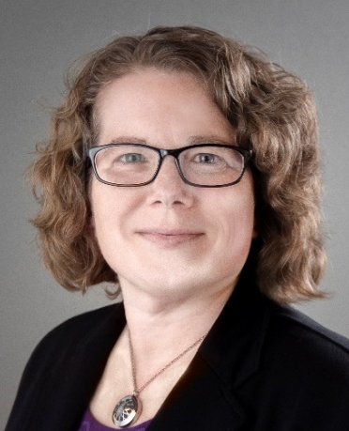
Today’s speakers
Steve McCurley, SMP and SHIP Centers Consultant
Sue Choplin, Event Manager SHIP TA Center
Heather Flory, Training Manager SMP Resource Center

Slide 5
Agenda
Volunteer Management Overview
Role of the Coordinator of Volunteers
Eleven Things to Make Sure Happen No Matter What
Heather Flory
Sue Choplin
Steve McCurley
Resources and Questions

Slide 6
Volunteer Management Overview Heather Flory

Slide 7
Volunteer Risk and Program Management (VRPM)
A volunteer program that is managed well is also likely to have less risk, and vice versa.
Today, we will focus on the concept of a well-run program instead of any specific policies.
ACL encourages you to consider how the volunteer policies and concepts might also apply to other team members.

Slide 8
Check-in Questions
Have you worked for any organizations other than SHIP/SMP that involved volunteers?
Have you ever managed a volunteer program before?
Notes:
Heather
Heather: Zoom poll: yes/no?

Slide 9
More Check-in Questions
Have you ever received any formal training in working with volunteers?
Have you seen the Volunteer Involvement Cycle?
Notes:
Heather
Heather: Zoom poll: yes/no?

Slide 10
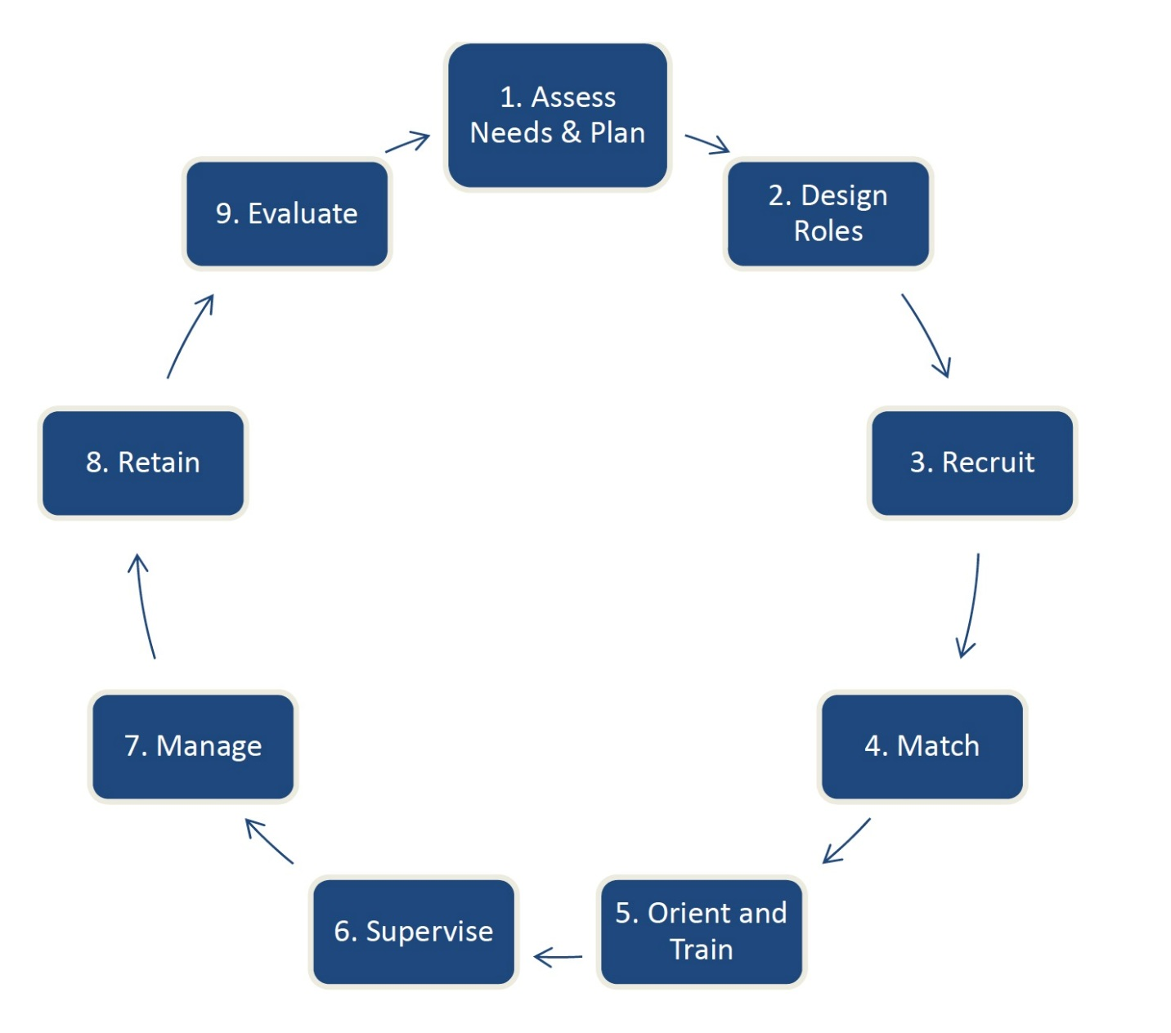
The Volunteer Involvement Cycle

Slide 11
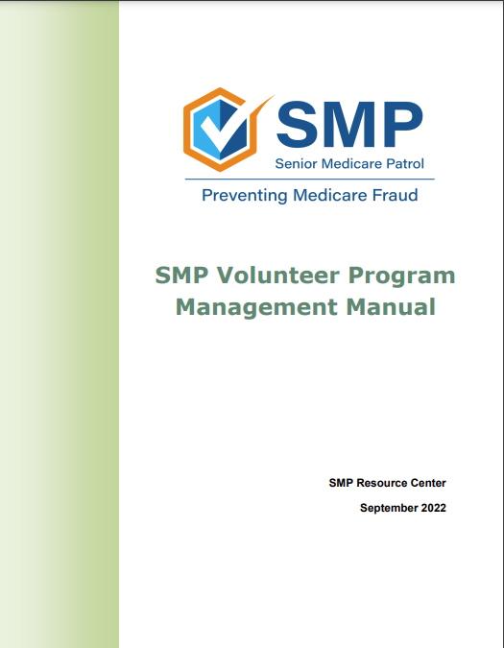
Volunteer Program Management Manual
Notes:
Heather
The Volunteer Program Management Manual is a guide to implementing many of the practices covered within the volunteer risk and program management policies, such as how to recruit, retain, and recognize volunteers, how to address volunteer management problems, how to take corrective action, and how to prevent volunteer program management problems in the first place. It also serves as a guide for being an effective coordinator of volunteers, or CoV for short.
This manual is available in both the SMP and SHIP libraries. There are slightly different versions for SMPs and for SHIPs, but they are mostly the same. Let’s take a look!

Slide 12
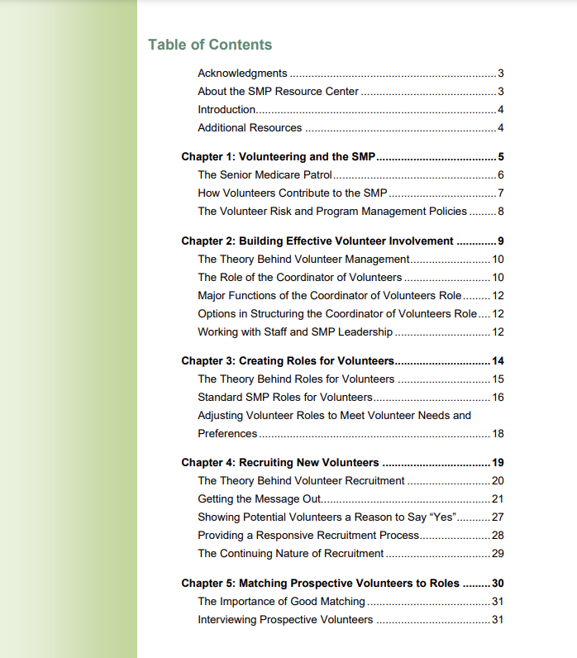
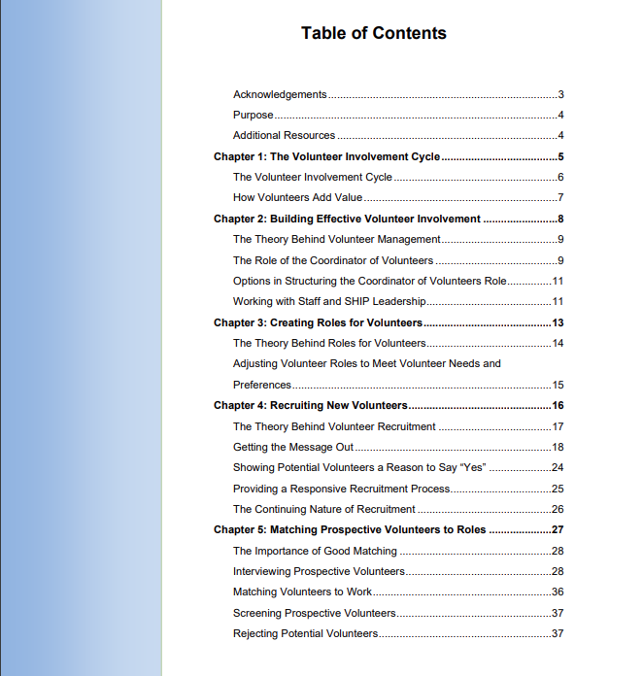
Table of Contents: SMP version = green / SHIP version = blue
Notes:
Heather
Here you can see the first page of the table of contents for both manuals, which shows all of the topics that are included. The SMP version is green and the SHIP version is blue. All of the chapter names are the same for both versions, except for Chapter 1. Most of the information included in each chapter is the same, with some program-specific variation such as role information in Chapter 3.

Slide 13
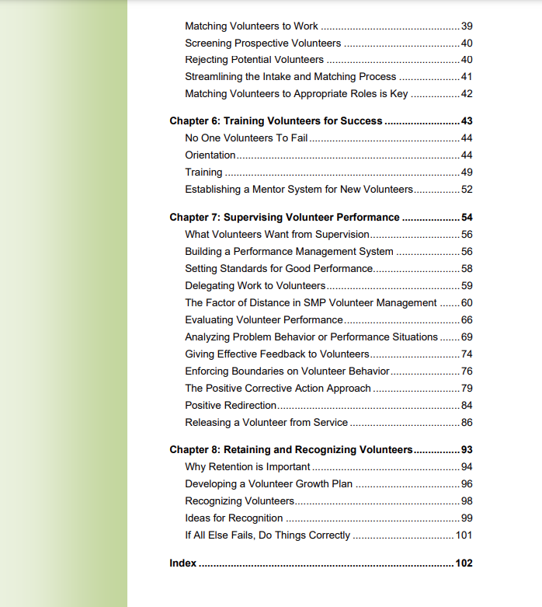
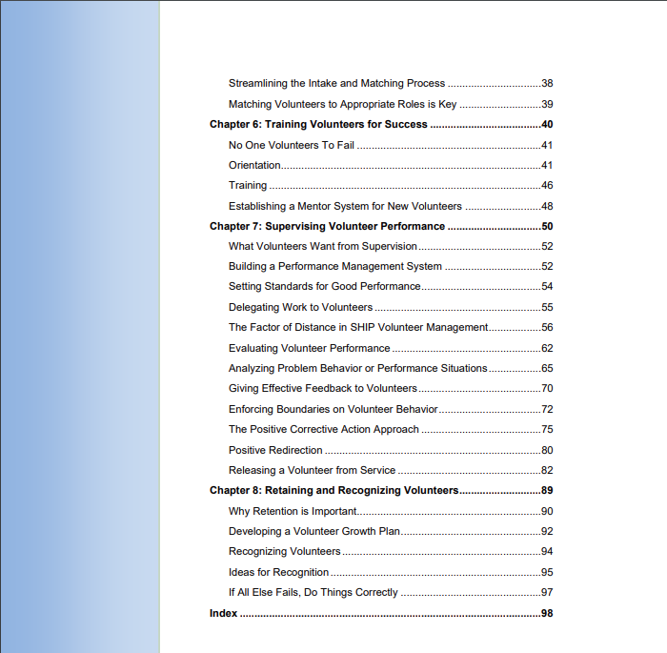
Table of Contents: SMP version = green / SHIP version = blue
Notes:
Heather
Here you can see the remaining chapter topics, which are the same in both versions of the manual. We encourage all of you to read the manual on your own if you haven’t already done so. Today, we’re going to highlight a few key concepts from the manuals, but we won’t go through all of the details.

Slide 14
Role of the Coordinator of Volunteers Sue Choplin
Notes:
Sue

Slide 15
Role of the Coordinator of Volunteers (CoV)
Different structures. Not wrong, just different.
Who is in charge?
See the Volunteer Program Management Manual (p.9-11) referenced on slide 10 for more details.
Notes:
Sue

Slide 16
Poll: How is responsibility for managing volunteer involvement structured in your program?
Single staff person manages all aspects of volunteer involvement
Tasks are divided among program staff along task functions: screening, training, supervision, etc.
Tasks are divided among program staff along geographic lines
Tasks are divided between SMP or SHIP staff and local partner agencies (VHOs)
Other?
Notes:
Heather/Sue
Other: Send comments in chat.
Heather: Zoom poll

Slide 17
Networking
Notes:
Sue

Slide 18
“Volunteer involvement depends upon creating a good system for working with volunteers. A program that has insufficient infrastructure, inadequate staff and leadership support, insufficient budgeting, or other defects in management will fail to attract and keep volunteers.”
Notes:
Sue
Quoted from the Volunteer Program Management Manual Heather mentioned earlier.
Bottom Line: The SMP and SHIP still needs someone to provide overall oversight and evaluation of how well the program is doing and what needs to be done in the future.

Slide 19
Eleven Things to Make Sure Happen No Matter What Steve McCurley
Notes:
Steve

Slide 20
Things to Pay Attention to No Matter Who is in Charge of Volunteer Involvement
OR…
A Cheater’s Guide to the Volunteer Involvement Cycle
Notes:
Steve

Slide 21
1. View the Volunteer Involvement Cycle as an adjustable process, not a straitjacket
Notes:
Steve

Slide 22
2. Emphasize ”word of mouth” recruitment
Notes:
Steve

Slide 23
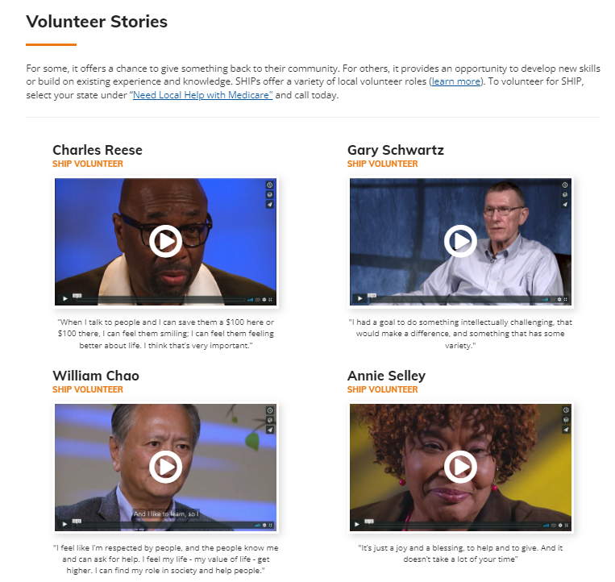
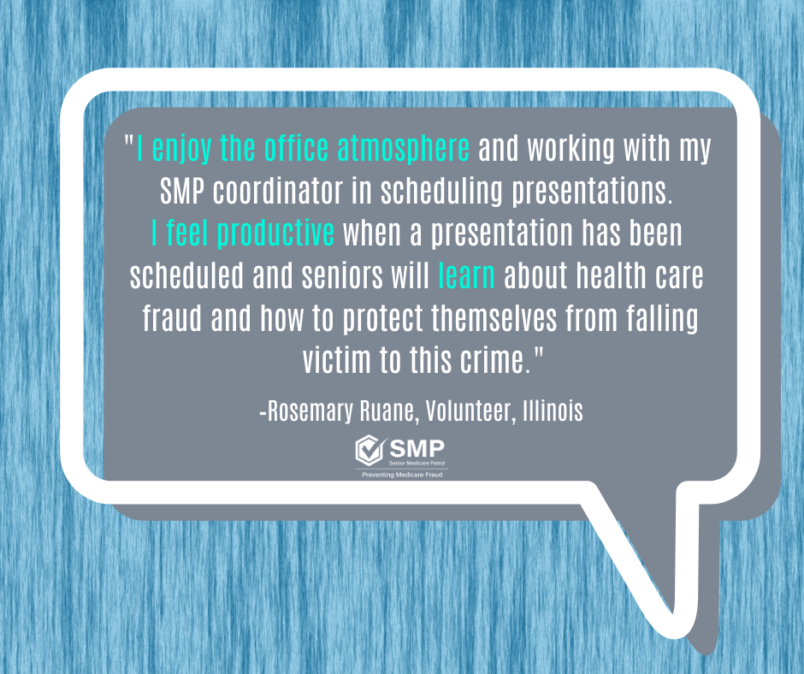
Word of Mouth Recruitment Examples: SHIP and SMP
SMPs: www.smpresource.org > SMP Login > SMP Resource Center Infographics - Volunteering
SHIPs: www.shiphelp.org > Volunteer
Notes:
Steve

Slide 24
3. Continuously check your intake/initial contact system
Notes:
Steve

Slide 25
4. Strive for a volunteer program that is diverse and welcoming to everybody.
Notes:
Steve

Slide 26
5. Keep in mind that interviewing is where you really start to know your volunteers.
Notes:
Steve

Slide 27
6. Monitor screening/ criminal records checks
Notes:
Steve

Slide 28
7. Train everyone who has any responsibility for working with volunteers
Notes:
Steve

Slide 29
Check-in Questions
Do you provide training for program staff who work with volunteers?
Do you provide an orientation for all staff about the volunteer program, whether or not they work with volunteers?
Notes:
Steve
Heather: Zoom poll: yes/no?

Slide 30
Check-in Questions
Do you train local contractors (VHOs) in working with volunteers?
Notes:
Steve
Heather: Zoom poll (yes/no poll): yes/no?

Slide 31
8. Be clear about performance expectations and hold people to them: staff, volunteers, contractors
Notes:
Steve

Slide 32
9. Keep your focus on retention, not recruitment
Notes:
Steve

Slide 33
10. Encourage social interaction, team building, and bonding
Notes:
Steve

Slide 34
11. Communicate, communicate, communicate
Notes:
Steve

Slide 35
We cannot herd cats. We can, however, learn to lead them so that they choose to follow.
Notes:
Steve to Heather
One final thought…
Over to Heather

Slide 36
Today’s webinar resources in the libraries
SMPs
Step 1: Login at www.smpresource.org (click the blue SMP Login padlock).
SHIPs
Step 1: Login at www.shiphelp.org (click the orange SHIP Login padlock).
Step 2: Go to the Resource Library.
Step 2: Search for keyword “manage”.
Step 3: Search for keyword “manage”.
36
Notes:
Heather
The PowerPoint and other webinar resources for today’s event are already available in both the SMP and SHIP Resource Libraries. They’re also available in the Resources section here in Zoom. The recording of today’s webinar will be available in both libraries by the end of the day tomorrow.

Slide 37
Additional resources in the libraries
Volunteer Management Resources
Volunteer Program Management Manual
Volunteer Involvement Cycle
Upcoming Webinars
4/20/23: Recruiting Volunteers for a Knowledge-rich Program
VRPM Resources
SMPs
SHIPs
ACL’s VRPM Policies
Medicare Messenger articles, e.g.:
Serious Tips on Volunteer Onboarding (Dec 2022)
VRPM Resource Groupings entry
VRPM Orientation
VRPM Management Curriculum (TRAX > Available Training)
VRPM Basic Training for SHIPs
Tip: Also search the libraries for soft-skills/communication skills resources and training, e.g., An Introduction to Microaggressions (Jan 2023).
Notes:
Heather

Slide 38
Questions and discussion
This project was supported, in part by grant numbers 90SATC0002 and 90MPRC0002 from the U.S. Administration for Community Living, Department of Health and Human Services, Washington, D.C. 20201. Grantees undertaking projects under government sponsorship are encouraged to express freely their findings and conclusions. Points of view or opinions do not, therefore, necessarily represent official Administration for Community Living policy.
Notes:
Heather

