Slide 1


Creating a Medicare Account
at Medicare.gov

Slide 2
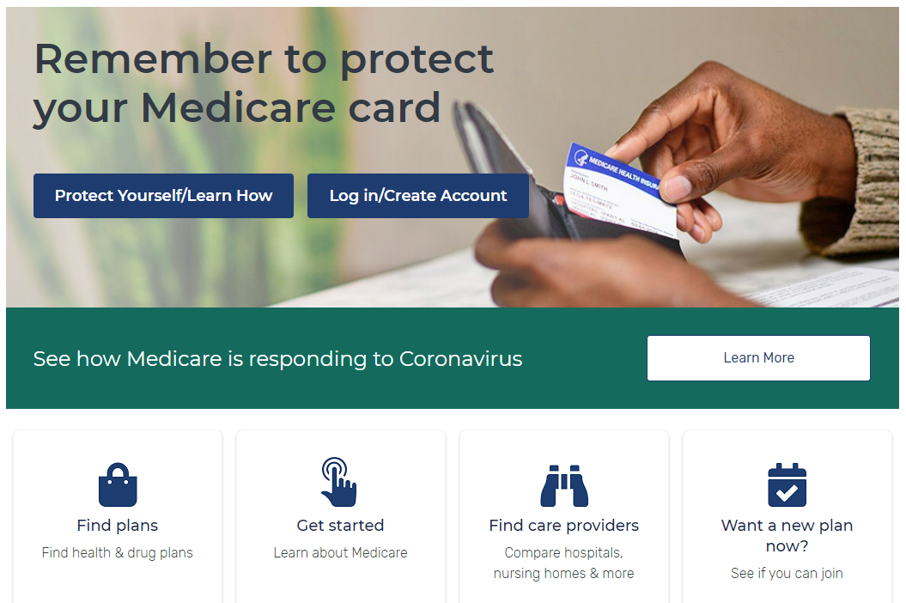
A Few Simple Steps
To create an account, visit the
Medicare.gov home page and click:
Log in/Create Account.

Slide 3
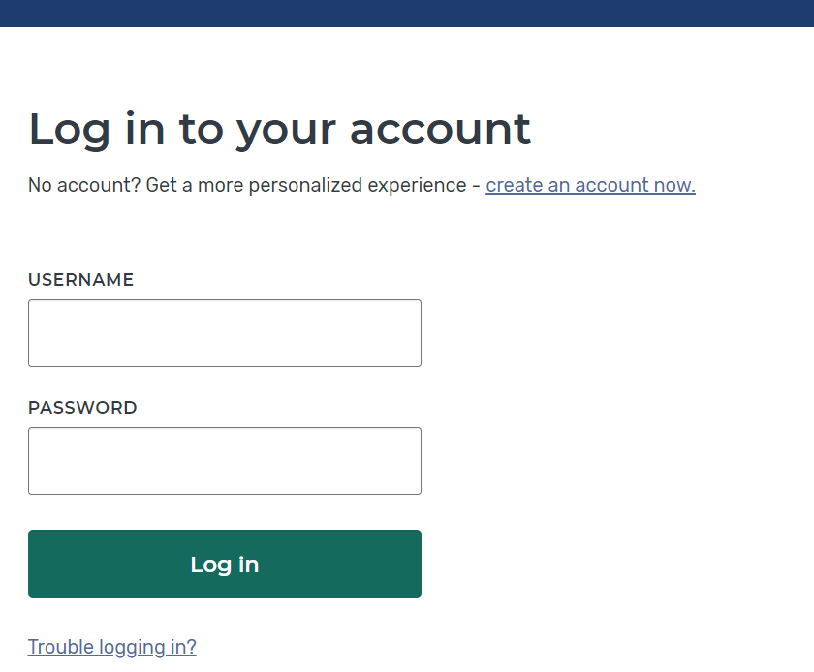
MyMedicare.gov
Click “create an account now”

Slide 4
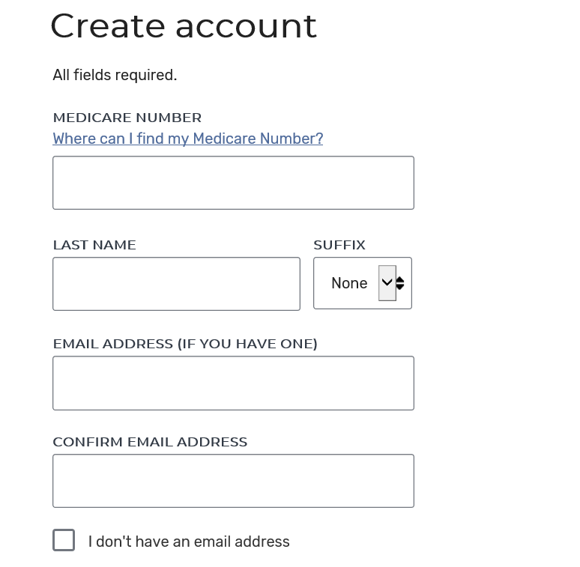
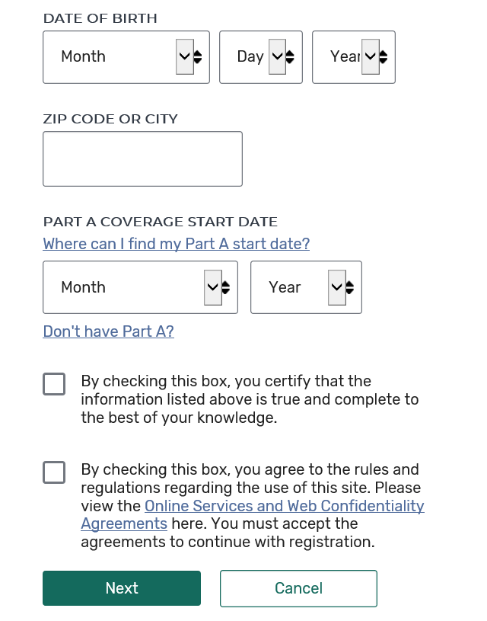
Enter Information
Enter the information requested.
Email address is optional. Check this box if not entering email.
Check both boxes.
Click Next when complete.

Slide 5
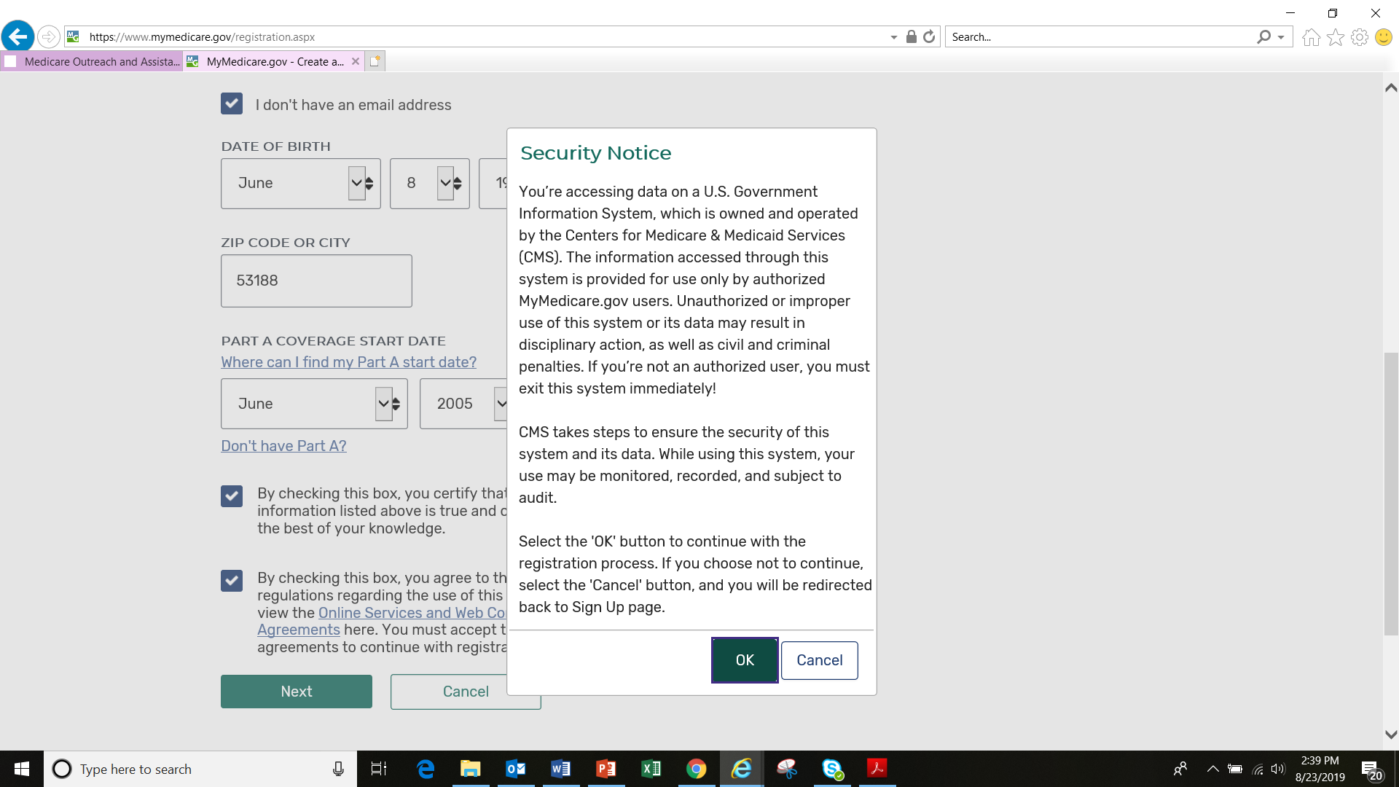
Read the Security Notice and
click “OK” to continue.

Slide 6
You will be asked to create a Username and Password.
Rules for Creating Username and Password
Pick a Username—must be unique
  8 – 30 characters long, no spaces
  Can include letters, numbers and special characters including: @ ! . - _ $
  Don’t use special characters as the first or last character of your username
  It must include at least 4 letters
  Can use your email address
  Cannot contain your Medicare or Social Security number
Next create your Password
  8 – 16 characters long
  Must contain at least one letter and one number
  Must also contain at least one of the following special characters: @ ! $ % “ * ( )
  Cannot contain your username and cannot contain your Medicare number or Social Security number
Notes:
On the following slide you’ll be asked to create a username and password. Here are the rules for creating them.

Slide 7
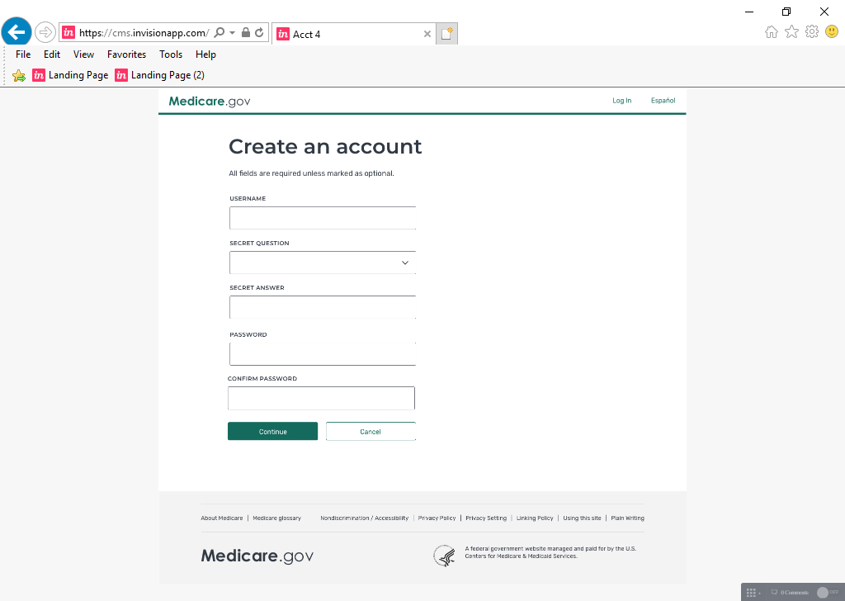
Final Step!
Enter your Username following the rules on previous slide.
Select a secret question and enter your answer. This would be used if you forget your username and password.
Next, enter your Password following the rules on previous slide.
Then Click “Continue”
Notes:
Enter the username you’ve chosen using the rules from the previous slide. Then click the arrow from the secret question box and select a secret question from the drop down menu. You can choose from several questions such as “What is your mother’s maiden name? or “In what city did you first meet your spouse?”. Then enter your answer. This would be used if you forget your username and password, so make sure it is an answer you’ll remember. Next enter the password you’ve chosen following the rules on the previous slide. Then click continue.

Slide 8
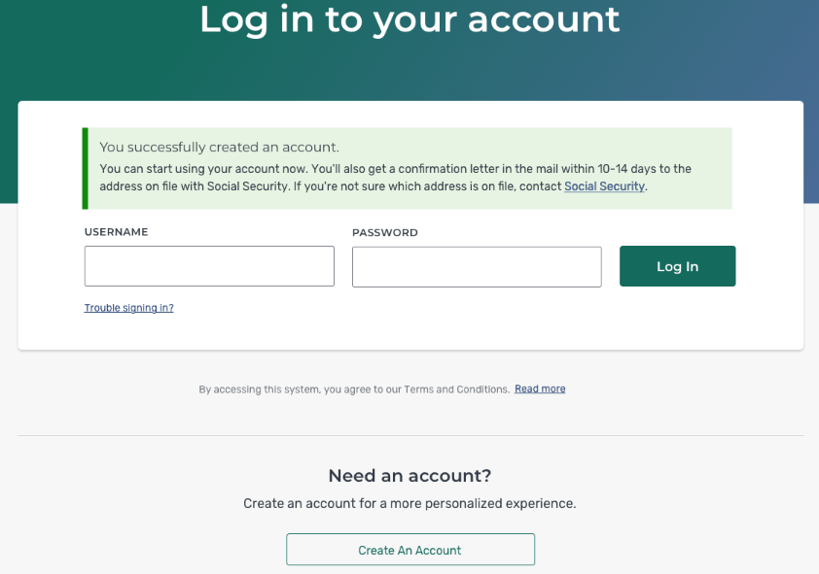
Congratulations!
That’s it!
You will be taken back to the login page where you’ll see a message that your account has been created and you can now login.

Slide 9
Medicare Questions?
Call Medicare at 1-800-633-4227 or visit www.medicare.gov
Wisconsin SHIP Resources:
  Medigap Helpline: 1-800-242-1060
  Medigap Part D Helpline (for ages 60+): 1-855-677-2783
  Find your local Aging and Disability Resource Center on the WI Department of Health Services webpage: https://www.dhs.wisconsin.gov/adrc/consumer/index.htm
This project is supported in whole or in part by grant numbers 2101WIMAA and 90SAPG0091 from the U.S. Administration for Community Living, Department of Health and Human Services, Washington, D.C. 20201.

