Slide 1
Get Ready for Medicare’s Annual Open Enrollment Period
Medicare Outreach Training
August 2021

Slide 2
Agenda
What are we facing this year?
Who’s on your team?
Prepare your outreach plans
Plan Finder Information
Counselor Preparations
Consumer Preparations
Notes:
This is the agenda of what i’ll be going over this morning to help everyone get ready to make sure that ALL the people in your communities have the information and assistance they need for open enrollment this fall.

Slide 3
What are we facing this year?
Still concerns about COVID / Delta variant
People are cautious
Agencies have differing plans
In this changing time, how can we effectively conduct outreach and assistance to consumers in our communities?
Business as usual or not?
Notes:
2021 has been an interesting year as we’ve been coming out of this pandemic—but we’re not completely out of it. So it has an impact on—how we conduct business, AND how people come to hear our information or seek our services.
How you answer these two questions will be different in different counties. So I am posing the questions for you—and for all of us to think about. What IS true for all of us and what IS a consistent theme for all of us is the need to be flexible and the need to adjust to each situation and/or to each consumer who may have differing levels of caution.

Slide 4
Who’s on your team?
Staff available to help?
Volunteers?
Divvy up the work
Capacity building through partnerships
Notes:
It’s important to identify who is on your team as far as doing work leading up to and during Open Enrollment. Are you a team of one or do you have others in your office who will be conducting some of the outreach and/or assistance?
Now’s the time to begin meeting with your team, setting expectations, and making plans.

Slide 5
Prepare Your OEP Outreach Plans
Include various type of activities!
Print Activities
Group Outreach & Other Face-to-face Activities
Social Media
Traditional Media Outreach
Notes:
IN order to reach a wide range of people, you should plan to include different types of activities.

Slide 6
OEP OUTREACH PLANS
Print Activities
Articles for agency newsletter
senior centers & newspapers too
Letters to:
senior housing managers
pharmacies
Direct mail OEP postcard reminder to previous clients
Tip: Encourage them to “tell a friend”
Home Delivered Meal Flyers & Placemats (?)
Target—senior dining and home delivered meal clients
Flyers, posters, table tents
Target locations—libraries, senior dining, senior centers, clinics
Church bulletin blurb
Notes:
Let’s start with looking at some Print activities you can do to help you get the word out.
I recently created some new Open enrollment Flyers, etc.
Materials in other languages—thank you Amanda Higgins (Dodge Co)…for interest in a Spanish version of our OEP articles
I know most of you have heard about the new SHIP logos from our national SHIP TA Center. We have links to the files as well as a Word doc with most of the logos. I will be revising all of our materials to include the new logos after OEP.

Slide 7
OEP OUTREACH PLANS
Group Outreach
Set up Presentations: Senior housing, libraries, senior centers
Are these community partners allowing in person or only virtual?
Workshops
Some EBS run the Plan Finder and then have people come to a group event/workshop to pick up their packet and learn how to understand results and enroll.
Pharmacies and other potential partners:
Host your presentation?
Share outreach materials
Know where/how to refer people
Notes:
LAUNCH POLLS. (ALL 3)

Slide 8
OEP OUTREACH PLANS
Social Media
Facebook
Add posts about OEP.
Consider linking to Part D forms that can be downloaded, completed and sent to your office.
Add locations of presentations and other outreach event details.

Slide 9
OEP OUTREACH PLANS
Traditional
Media
Radio
Sample ads on website
Interview with EBS about OEP
TV
Share info with local news station
Newspaper
Sample Newspaper ad on website
Notes:
Radio—especially in rural areas, it may be easier to do outreach over radio or tv.
TV—consider reaching out to your local news to see if they’d do a story about open enrollment—again might be easier to do in a rural area.
Newspaper
In addition to sharing articles, consider running an ad if your budget would allow.
Or, see if a local reporter would write an article about OEP, interview you to discuss why its important.

Slide 10
Prepare Your Materials
GWAAR Website:
Medicare Outreach and Assistance Resources
Open Enrollment Toolkit
Variety of materials
Customize with your local contact information
Tools for Professionals—
PF Materials being updated
How to set up Medicare account
Guide to Using Plan Finder
Video How to Use MPF
Notes:
Now is a good time to be preparing your materials. WE also have a variety of outreach materials available on the GWAAR website.
SCREEN SHARE to show GWAAR Website, etc. ALSO show new flyers…

Slide 11
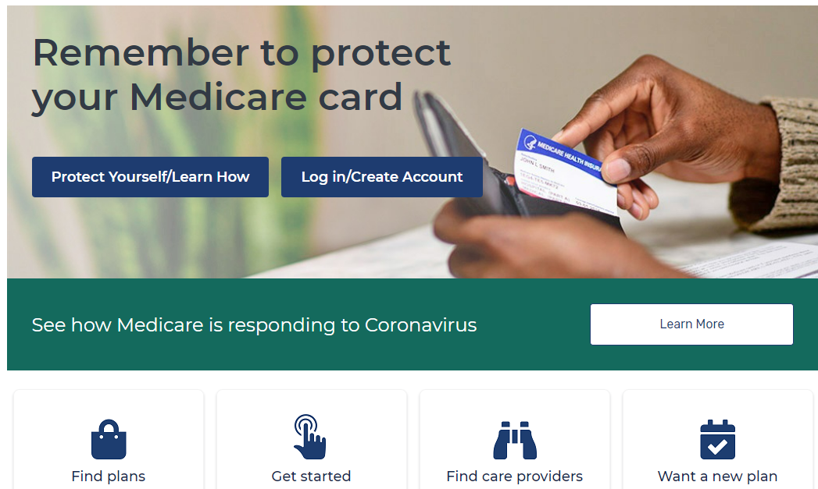
The Medicare Plan Finder
Notes:
Hopefully many of you were able to attend the CMS NTP webinar last week which went over some of the updates to the Medicare Plan Finder. First, a couple things to remember—the images on the Medicare.gov screens do tend to change fairly often. During OEP the Find Plans button should move to a more prominent place on the screen.

Slide 12
Plan Finder Updates
CMS updates to Medicare.gov and Medicare Plan Finder
Access 8/19 NTP Training: https://cmsnationaltrainingprogram.cms.gov/
Several updates already!
Launched “Get Started” section aimed at new to Medicare or soon eligible.
Adding a banner at the top of the site to encourage people to switch browsers if they’re still using Internet Explorer (IE) since IE will no longer be updated/supported.
“Re-style” the look on Medicare.gov and Plan Finder

Slide 13
Plan Finder Updates
2 new updates planned for mid-September:
Logged-in beneficiaries will be able to save their pharmacy preferences and access their saved drug and pharmacies from any of the Medicare screens using a drop-down menu on the “consistent header”.
In-Network pharmacy finder will default to all in-network pharmacies. Will have option to change that and you will access this feature from Details page.
Notes:
The idea is to be able to view and/or make changes and get right back to where you were.
IN-Network…

Slide 14
Plan Finder Updates—already completed
Filters now always display.
They removed the Insulin Savings Model filter.
Plan comparison pages updated. Easier to read.
Improved the printing quality and it looks like the printed results will be better in terms of spacing and layout.
Plan Details page updated. Highlights key cost info.
Show the costs for each drug at each pharmacy.
Layout of this Details page is quite a bit different. You will need to click for more info to be able to see when someone will hit the coverage gap.
Quantity limits: amounts not provided, whereas last year we could hover over to access that.
Notes:
Previously needed to find and click the filters button. I think this is a good idea!
Insulin Savings Model: Plans participating will still be shown but they will be listed with all the others for lowest estimated total cost. I think this is a good thing and would prevent people from accidentally choosing a plan that works great for their insulin meds but ends up costing more due to their other medications.
Printing Quality—printing results improved across the different browsers, they do not recommend any particular browser other than to say that Internet Explorer won’t be supported so don’t use.

Slide 15
Plan Finder Updates
IF logged in and beneficiary’s subsidy level is incorrect, still no way to correct this in the plan finder. Will need to do an anonymous search and enter the correct subsidy amount.
There is still no way to save a drug list unless you are logged in.

Slide 16
Plan Finder
Steps to prepare now:
View CMS NTP Plan Finder Webinar.
Access 8/19 NTP Training: https://cmsnationaltrainingprogram.cms.gov/
Practice running the new plan finder—become familiar with the flow and features.
Practice printing results.

Slide 17
Counselor Preparations
Prepare your Part D form – Sample in GWAAR OEP Toolkit
Plan enough time for Part D sessions.
A few more Plan Finder reminders before OEP:
Use Medicare accounts when possible.
Part B v Part D medications—Meds covered by Part B should NOT be entered in Plan Finder as it will just skew the results.
Off-Label usage of medications
Always Print the Confirmation Page!
Be sure to attend the Fall Medicare Training!!!
First full week of October
Notes:
For more in-depth coverage of the new Plan Finder, Part D issues and other important Medicare updates and details, be sure to attend the Fall Medicare Training!

Slide 18
Beneficiary Preparations
Provide list of Info needed:
Medicare Account information
Medicare number and effective dates
Date of birth
Zip code
List of drugs that includes dosages and quantities
For liquids, get size of bottle (mL, fluid ounces)
Name and address of preferred pharmacy
Name of current Medicare plan (if applicable)
Subsidy information
Sample Part D Forms available on website
Notes:
I believe many of you already do this, but if not, this is something you’ll want to consider. If someone comes in for an appointment, but they don’t have the right materials with them, it may mean another trip to your office, as well as a bit of frustration and worry. To avoid wasted time and all the other issues, provide them a list of items to have ready for the appointment, whether it is in person or on the phone.
The items listed would be what you’d want to be sure they bring along. A customizable Part D form is available in the OEP Toolkit. This is just a sample, please feel free to revise or use one that you have created.

Slide 19
Additional Resources
GWAAR Medicare Outreach and Assistance Resources
GWAAR Open Enrollment Toolkit
SHIP TA Center OEP COVID-19 Toolkit: https://www.shiphelp.org/covid-19/toolkit
CMS.gov: Medicare Open Enrollment Outreach and Media Materials
Videos, ads, flyers and more
Updates for 2022 coming soon
Notes:
For those who may be doing remote or virtual outreach and/or assistance for Open enrollment, I am including the link to the SHIP TA Center’s COVID toolkit that include some helpful resources.

Slide 20
Questions?
Debbie Bisswurm
Medicare Outreach Coordinator, GWAAR
Debbie.Bisswurm@gwaar.org
608-228-8098
Notes:
Well, hopefully this has been helpful as you begin to prepare for that big open enrollment wave. I do strongly encourage you to continue to practice with Plan finder to get used to the updates. Again, once those last updates and completed I will be revising the Plan Finder Guide, and Video so you can use or share with consumers. Watch for information about the upcoming Fall Medicare Training and Please don’t hesitate to reach out to me if I can be of assistance.

