Slide 1



Vanessa Carson
8/20/2021
LINET
(Medicare’s Limited Income NET Program)
LINET is a CMS Demonstration program that provides temporary prescription coverage for Medicare beneficiaries who qualify for Low Income Subsidy (LIS) and have no prescription drug coverage

Slide 2
LINET: Overview
Overview:
CMS demonstration program
Legislation passed 12/20 to make a permanent part of Medicare in 2024
Provides coverage for low income Medicare beneficiaries
Averages ~ 730,000 enrollments per year
Design:
Enrollment Length: Usually about two months
Network: Accepts claims from any pharmacy
Standard Safety Edits: Limited Edits & Prior Authorizations
Retroactive reimbursement available for out-of-pocket expenses during eligible periods
No premiums
Co-Pays: Based on LIS Level
LIS Level | 1 | 2 | 3 | 4
Generic | $3.70 | $1.30 | $0.00 | 15%
Brand | $9.20 | $4.00 | $0.00 | 15%
|2

Slide 3
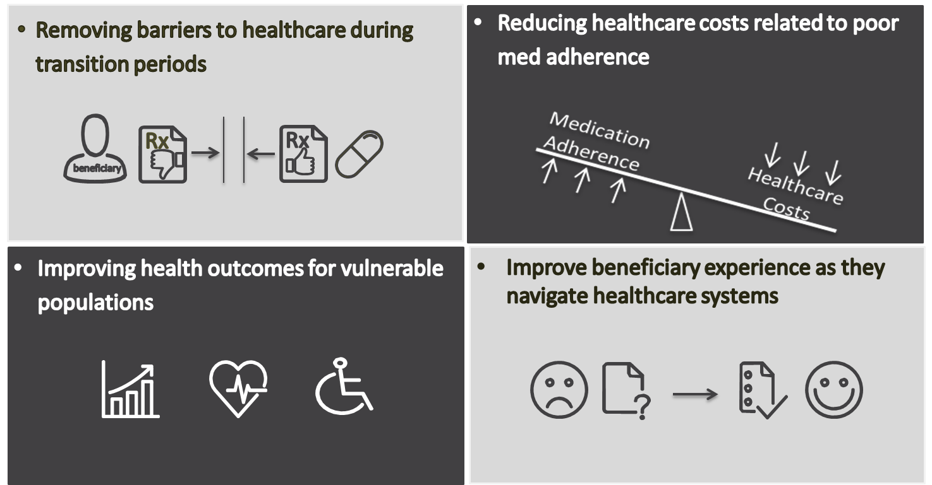
LINET: Program Goals
|3

Slide 4
LINET: Eligibility & Enrollment Overview
Eligibility: Must be eligible for Med D and Medicaid or any type of LIS
Enrollment Methods
  Auto: Enrolled by CMS via communication by state Medicaid
  Point of Sale: initiated at the pharmacy counter by claim submission
    Enrollment Form (new) or Immediate Need
  Retroactive – enrolled by retroactive reimbursement request
|4

Slide 5
LINET: Enrollments by State
State | 2020 Enrollments | % of total
CA | 105,766 | 14.2%
NY | 71,936 | 9.6%
IL | 44,895 | 6.0%
TX | 41,350 | 5.5%
FL | 40,604 | 5.4%
OH | 36,730 | 4.9%
MI | 30,692 | 4.1%
PA | 28,807 | 3.9%
MA | 25,890 | 3.5%
AZ | 21,173 | 2.8%
0
2020 Enrollments
20,000 – 110,000
10,000 – 19,999
4,000 – 9,999
< 3,999
|5

Slide 6

LINET: New for 2021
Covid Impact
LINET Plan Permanence
Enrollment Form
Retroactive Reimbursement

Slide 7
LINET: Covid Impact
LINET COVID Impact
SSA offices closed for in-person visits
  May lengthen the LIS application process
Reduced Point of Sale (POS) enrollments & Calls
  2020 enrollments down 22% from 2019
Claim volumes reflective of enrollments
Extended Days supply for LINET claims
Outreach moved to online & virtual trainings
|7

Slide 8
LINET: Recent Changes
  LINET Enrollment form
Designed for:
  LINET eligible who doesn’t have an “immediate need” for their prescriptions
  Recently eligible for LIS via spend-down
  Applied for LIS and has no prescription coverage
    Enrollment will be contingent on LIS eligibility
Benefits
  Simplifies enrollment
  Can be submitted by beneficiary or SHIPS counselor
  Fast turnaround:
    Once fax is received: takes 3-5 day business to receive a welcome letter
    If additional information is needed – Enrollment team will call
  Beneficiary has confirmed enrollment status before going to pharmacy
|8

Slide 9
LINET: Requesting Retroactive Reimbursement
  Reimbursement Process
  Beneficiaries who have paid out of pocket for prescriptions during eligible periods can request reimbursement in the following manner:
    Complete the reimbursement form included Medicare beneficiaries who have paid out of pocket for prescriptions during eligible periods can request reimbursement.
    Form is also available online at: www.humana.com/LINET
    Direct link to form: https://docushare-web.apps.cf.humana.com/Marketing/docushare-app?file=3792139
    Please include all pharmacy receipts
  Mail or fax to completed form & Receipts to:
  Medicare’s Limited Income NET Program
  P.0. Box 14310
  Lexington, KY 40512-4310
              Fax: 1.877.210.5592
|9

Slide 10
LINET: For More Information
LINET Advocacy Line: 1-866-934-2019
State Health Insurance Assistance Program (SHIPs)
Caseworkers, Ombudsmen and other advocates
LINET Help Desk: 1-800-783-1307
Beneficiaries & Pharmacies
Online: www.Humana.com/LINET
Web Module for Advocates
Program Literature
Email:
  LINET Mailbox: LINEToutreach@Humana.com
  CMS Mailbox: MedicareLINET@CMS.hhs.gov
BIN/PCN: BIN 015599 PCN 05440000
|10

Slide 11
Questions?
|11

Slide 12
Thank you for your interest in
LINET
|12

