Slide 1
Reaching rural and tech-limited beneficiaries
Medicare Outreach training
July 2021

Slide 2
challenges
Large land area to cover
Many individuals in rural areas have difficulty traveling to your office
Increased number of isolated individuals—and at greater distances
Limited or no access to reliable internet
No access to computer
Not comfortable using internet

Slide 3
Strategies
Leverage Partnerships with health providers & other professionals.
Partner with other local businesses / organizations.
Consider options for technology issues.
Partner with large employers.
Know the rural community you are targeting.
Meet people where they are.

Slide 4
Leverage Partnerships with health providers
Local Hospital/Clinics
COVID Vaccine Sites
Pharmacy
Churches
Dr./Dentist
Well-known, trusted
Local transportation/volunteer drivers
Family caregivers/local support groups
Notes:
Leveraging partnerships with other community agencies continues to be a best practices for expanding your outreach!

Slide 5
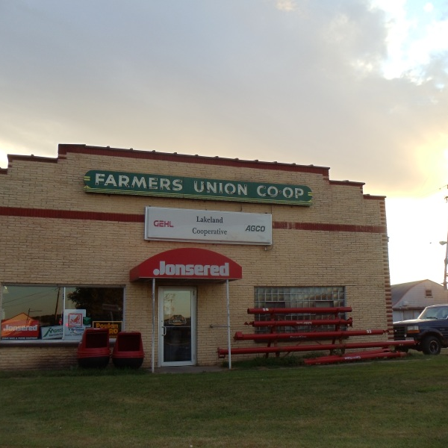
Connect with Local Businesses
Hardware Store
Grocery Store
Farm Co-op
Feed Store
Focus on businesses important to those who may come to town only when necessary.
Notes:
In addition to the usual community partners, think about other local businesses in your area. There are people who will never go to a Medicare presentation, but they’ll go to the grocery store—so see if you can reach them that way.
Not just to post a flyer, etc., but it is also a good idea to connect with the store managers, the employees who see people every day. Make yourself known to them and encourage them to spread the word about Medicare related programs and how you can help.

Slide 6
Technology issues
Where internet access is readily available:
Encourage and train older adults to use technology as it can serve an important role in socialization, connecting to benefits, etc.
Train at your agency, public library, community college or other local partners.
Partnerships with community colleges for rural outreach can help you:
Offer classes, enrollment events using their computer labs, employee retirement seminars, recruit new volunteers
Inform Consumers about Emergency Broadband benefit
Consumer FAQ for Emergency Broadband Benefit
Notes:
For older adults who already have great social or economic needs, technology barriers are exacerbating existing challenges.
The Federal Communications Commission (FCC) has authorized a new Emergency Broadband Benefit.
EBB is a temporary Federal Communications Commission (FCC) program to help eligible families and households who are struggling to afford internet service during the COVID-19 pandemic. It provides discounts on services and devices.
This benefit will provide a discount of $50 per month for eligible low-income households or $75 per month for households on Tribal lands to cover internet bills, as well as provide discounts on some devices. This program can also be combined with Lifeline benefits. The FCC has developed a consumer FAQ, which provides information about eligibility and program details.

Slide 7
Partner with large employers in your county
Connect
Connect with HR. Explain your role and how this information can benefit their employees.
Share
Share information and resources.
Target those nearing retirement and;
Younger employees who help aging parents
Offer
Offer presentations— in-person at factory or virtual.
Welcome to Medicare
Low-income benefit programs

Slide 8
Know your rural community
Personal communication works best.
Earning trust is key---
“RURAL AREAS PREFER LOCAL HELP”
Pay attention to community values & tradition.
Take the time to learn about the smaller communities you serve.
Notes:
So when working in Rural Areas, there are three points I want to emphasize:

Slide 9
Tips for connecting with rural community members
Be aware of transportation issues and options.
Make yourself well-known & visible in the community.
Hold office hours in outlying areas.
Tell people about yourself—build a connection.
Be modest & humble.
Give examples of how you have helped others in the community—(without names or other information that would reveal who you are talking about!)

Slide 10
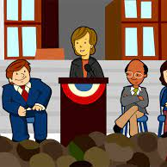
Connect with Trusted Community Leaders
Important to win over key opinion leaders.
Popular business leader
Mayor or other popular local figure
Women’s club leader
Educate them and ask them to pass it on.
Help them understand the impact these programs can have
Give them flyers/brochures
Notes:
Who do people in the community listen to? These are the ones you want to seek out and win over.

Slide 11
Earning trust
Ask a “trusted” community leader to introduce you.
Call people you know from community groups and ask to present at their meetings.
Know the community history and how it may impact people.
Use volunteers from the community—especially the peers of your audience.
Get their “buy-in” and give them a “script” so they know what to say.
Notes:
--winning over those Key community leaders can be a big help!

Slide 12
Meet People where they are
Local Coffee Shop or Barber Shop where older people tend to gather
Attend local functions
Fair
Farmers markets
Church festival
Notes:
Every county has its own unique features. Whether it is a local coffee shop, a barber shop or other location--Make yourself known to the owners and patrons of the places people tend to gather. Again, make sure they know how you/your agency can help the people of the community—tell them about the programs to help people with limited income. See if they are willing to hang a flyer or have your brochures available there.

Slide 13
Outreach Plan Should address your specific rural issues
Face-to-face activities with beneficiaries
Presentations
Health or Senior Fair Exhibit
Church festivals
Face-to-face with community partners
Educate
Share resources
Traditional Media Sources
Other printed materials
Newsletter articles
Brochures, Posters, Flyers
Newspaper
Radio—Ad or talk show
TV—local stations
Community Calendar
Table Tents

Slide 14
Stuff Flyers/Brochures into ANYTHING!
Consider anything that is delivered or picked up!
Home Delivered Meals
Prescription Medication Bags
Grocery Bags
Church Bulletins
Other?
Notes:
And another good way to reach those isolated individuals---consider flyers that can be delivered with a home delivered meal. <On our website—samples of flyers for home delivered meal outreach>
When you connect with the pharmacist, give them a brochure and talk with them about including a small flyer in the prescription bags they hand out—this is an effective thing to do during OEP and we have full page and ½ sheet flyers on the website that can be customized and used for this purpose.
See if a local grocery store would allow you to place flyers in grocery bags.
Church bulletins—another great way to get the message out—a short article or ad.
Think about other things that might be unique to your county.

Slide 15
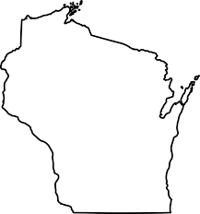
Examples & Promising Practices for rural outreach
Office hours in remote communities
TV interview by popular anchor to promote MSP & LIS
Interview on live local radio program
Partnership with local pharmacies
Bag stuffers at stores on Senior Discount Day
Become a member of local Chamber of Commerce—networking opportunities
Take the time to meet with businesses that serve seniors—pays off over time
Combine exercise, fresh air, and Medicare for a Walk and Talk.
Notes:
Keep in mind these are just examples of some of the things agencies around the state have done. Every county is unique so—find what works best for your county.

Slide 16
Debbie Bisswurm, GWAAR
debbie.bisswurm@gwaar.org
608-228-0898

