Slide 1
STARS Training: Beneficiary Contact Form Adapted for Wisconsin SHIP counselors
May 2021
Notes:
Sue. Introduce topic. This webinar is relevant to all STARS users who enter beneficiary contacts directly into STARS. It is not relevant to users who enter their SHIP data into a proprietary data system other than STARS. We are in broadcast mode. We will pause for selected questions after the demonstration and we will also take questions at the end. The PowerPoint and handouts are already in the Resource Library and STARS Resources Kit. They will also be made available for download within Webex at the end of the webinar today.

Slide 2
Agenda
SHIP beneficiary contacts data entry
MIPPA beneficiary contact data entry will NOT be covered.
Data accuracy points
Accessing STARS resources
System security
Notes:
Today’s webinar will be about direct entry of beneficiary contact data into STARS. If you do not do direct entry into STARS, which may not be applicable to you.
We will not be going in depth into MIPPA BCFs in this webinar. A detailed webinar on this topic will be held next Friday (the 13th!). There are also recordings from past webinars on this topic in our Resource Library.
We will also not be going in-depth into ACL’s initiative to track prescription drug cost changes related to SHIP work in STARS. This is a big topic and was covered in depth on September 11 – recording in our Resource Library.
We will not cover STARS reports and searches. Reports were covered in webinars this summer (SHIP in June and MIPPA in July), and a searches webinar will be held on the 20th. There are also recordings from past webinars on this topic in our Resource Library.

Slide 3
A Note for WellSky Users
These slides were designed by the SHIP TA Center to explain how to do data entry directly into the SHIP reporting system, STARS.
Many Wisconsin SHIP counselors use a different system called WellSky to track casework.
Instructions on how to export data from WellSky to STARS is explained in the WellSky/SAMS Data Entry and Case Tracking Guide and demonstrated in ERI.
WellSky guidance should match STARS guidance.
However, if instructions in these slides contradict guidance on WellSky data entry, follow the WellSky instructions.

Slide 4
STARS Tracking Inbox for Data Entry
All data is entered on a form in the Tracking Inbox
Beneficiary Contact
Group Outreach
Media Outreach
Team Member
Notes:
So, now we will get into beneficiary contacts in STARS. This is the location for all beneficiary contacts in STARS. In your menu bar, you should see “Tracking Inbox” – you will be working under the “Beneficiary Contact” dropdown menu. The Beneficiary Contact Form and Beneficiary Additional Session Form are located here. After an overview of ACL guidance, you will see a demonstration of how to enter a beneficiary contact.

Slide 5
Due Dates for Data Entry
Month Effort Occurred | Data Entry Due Dates for Efforts
January | February 28
February | March 31
March | April 30
April | May 31
May | June 30
June | July 31
July | August 31
August | September 30
September | October 31
October | November 30
November | December 31
December | January 31
Important for accurate reports
See Chapter 1 of STARS Manual
If you miss these deadlines, you can still enter your data
“Better late than never”
Notes:
See Chapter 1

Slide 6
Definition of a Beneficiary Contact
This includes all contacts for the purpose of relaying Medicare and State Health Insurance Assistance Program (SHIP) related information between a properly trained and state certified SHIP team member and a Medicare beneficiary or a representative working on their behalf. Beneficiary contacts may be conducted over the telephone, in person (on site), in person (at home), via postal mail, e-mail, fax, or web-based one-on-one sessions (where technology permits).

Slide 7
When should a Beneficiary Contact Form (BCF) be completed?
Complete a BCF for each contact between a properly trained, screened, and state certified SHIP team member and a beneficiary or their representative when Medicare or SHIP program information is exchanged. Update the form to include additional time spent and topics discussed when there are multiple contacts during the same day.
Notes:
To be considered properly screened and trained, team members must have completed the screening and training required by their state program, be certified by their state program, and have signed an agreement or Memorandum of Understanding (MOU) with their state program or local agency.
To be considered active, properly trained, screened, and state-certified team members must be registered with their SHIP program and must have provided counseling, information, or assistance related to Medicare or other health insurance in the 12-month reporting period.

Slide 8
Do not fill out BCF to document the following
Unsuccessful attempts to reach a beneficiary (e.g., leaving messages on an answering machine)
Individuals reached at public events such as presentations or health fairs, or for questions asked during or after a presentation
Calls or other contact when the only purpose is to schedule an appointment
Calls or other contact when the sole purpose is referral to another agency or program
Unsolicited or mass mailings (email or postal) to SHIP contacts

Slide 9
Multiple Contacts on the Same Day
Same team member, same day
If multiple sessions occur with the same team member and the same beneficiary on the same day, they are considered as the same contact. Only one BCF should be entered to capture the nature of the contact with the beneficiary for that day with that team member.

Slide 10
Multiple Contacts on the Same Day
Different team members, same day
STARS users: If two or more separate team members have contact with the same beneficiary on the same day, then each team member should complete a separate BCF to report their contact.
WellSky users: Complete a single combined record. (Check current guidance.)

Slide 11
Multiple Contacts on Different Days
Same team member, different day
Is the contact about a different issue?
Enter a new BCF.
Is the contact about the same issue?
Add a Beneficiary Additional Session (BAS) to the previous BCF about that issue.
If your data entry system doesn’t allow for BASs, complete a new BCF.
Different team member, different day
How this is handled is nuanced. It depends upon the issue and whether you have access to the original BCF. (Next slide.)

Slide 12
Different team member, different day
If you do NOT have access to view or edit the original BCF for that issue because of your user role (STARS Submitter or Team Member), or if you do not have access because of your place on the STARS organizational hierarchy, enter a new BCF for your first contact with the beneficiary or representative on the issue.
Add a BAS for any subsequent contacts you have with that beneficiary or representative on that issue.
If you DO have access to edit the original BCF for that issue because of your user role (higher than Team Member) and your place on the STARS organizational hierarchy, add a BAS to the original BCF.
The above method is preferred, but it is not wrong to start a new BCF.

Slide 13
Two Beneficiaries Counseled in One Session
When one team member counsels multiple beneficiaries in a single counseling session, such as the members of a couple who are both Medicare-eligible, a BCF should be completed for each person.
The total time of the counseling session should be divided between the two BCFs based upon the approximate time spent on each person.
For example, if the session lasts an hour, 30 minutes might be entered on one BCF and 30 minutes on the other.

Slide 14
Special Use Field (SUF) Fields 1 & 2
Do NOT enter any data into Special Use Fields 1 and 2.
In WellSky, these fields are labeled “Special Use Field 1” and “Special Use Field 2”.
In STARS, these fields are labeled as “Original PDP/MA-PD Cost” and “New PDP/MA-PD Cost”.
Notes:
The firs two Special Use Fields - “Original” costs and “New” costs - will be addressed in a separate webinar on 9/11/2020. When entering multiple topics in field 3, separate them by a space, at a minimum to facilitate searches. Later, use the LIKE search operator to find BCFs with this data in Field 3.

Slide 15
Special Use Field (SUF) Field 3
Use Field 3 (SUF 3) to gather these session details:
Establishing MyMedicare.gov Accounts: Type Create MyMedicare Account in SUF 3
Using MARx: Type MARx in SUF 3
Opioid related sessions: Type opioid in SUF 3
Understanding Medicare and COVID-19: Type covid in SUF 3
Notes:
The firs two Special Use Fields - “Original” costs and “New” costs - will be addressed in a separate webinar on 9/11/2020. When entering multiple topics in field 3, separate them by a space, at a minimum to facilitate searches. Later, use the LIKE search operator to find BCFs with this data in Field 3.

Slide 16
Data Accuracy Pointers

Slide 17
Saving Data - FAQ
Q: “How do I know my data entry was saved in STARS?
A: Saved records have the following elements:
SHIP Reference Number (i.e. “SHIP Case Number”)
Partner Organization automatically filled
Print friendly/PDF buttons
Additional Session/Additional Team Member tabs
To add Additional Session to the Beneficiary Contact form, or
To add Additional Team Members to the Group Outreach or Media Outreach Form
Notes:
One frequently asked question is, “How do I know my data entry was saved?
There isn’t a message on the screen that says you have successfully saved, unless you are sending to SMP, in which case, it tells you whether it sent. ACL has planned an enhancement for the future that will show on screen successful saving text for all records. Currently, there is a brief on screen message showing the record is in the process of saving (but it goes away once the record is saved)

Slide 18
Validation Error: MIPPA Qualifying Topics
In September 2020, validation rules were implemented in STARS to enhance the accuracy of the MIPPA Performance Measures Report.
You will receive an error message and be required to edit your form and resave under the following circumstances:
If MIPPA “Yes” is selected and no MIPPA-qualifying topics discussed are selected.
If MIPPA “Yes” is selected, but the person entered in the “Session Conducted By” field does not have MIPPA selected on the Program field of their Team Member form.
Notes:
We also get frequent questions about the MIPPA validation error message. This is a new feature that was implemented in September of this year. You will get an error message and be unable to save under these circumstances.
If #2 is the case, someone with a user role capable of editing team member forms will need to edit the team member record. Alert your supervisor.
You can find a list of the MIPPA qualifying topics in the appendix of Chapter 4 of the STARS manual.

Slide 19
CMS Duals Demonstration Grants
Affects these states: CA, IL, MA, MI, OH, RI
Wisconsin counselors should NOT select “Duals Demonstration” as a Topic Discussed
X
Notes:
CMS Duals Demonstration Grantees currently include the states listed on the slide: California, Illinois, Massachusetts, Michigan, Ohio, Rhode Island. SHIP Team members in these states conducting duals grant work should indicate this work by selecting the “Duals Demonstration” in Topic Discussed section. There’s a category called Additional Topic Details pictured on the slide showing the check box marked. In addition to selecting duals demonstration when appropriate, team members should indicate all other topics discussed. In addition, add details in the NOTES section to continue supporting specific needs of dual eligible and identifying systemic issues for analysis by ACL and/or CMS. ACL/CMS will use this to capture trends and systemic issues. A few examples of current trends appear in the table. They may include improper billing related to QMB status being added to the MSN OR Medicare Buy-in concerns in data system communication errors among the state, SSA, or CMS.

Slide 20
Beneficiary Contacts are 4 of the 5 SHIP Performance Measures (PMs)
PM 1 – Client Contacts
Percentage of total client contacts per Medicare beneficiaries in the state.
PM 3 – Under 65
Percentage of contacts with Medicare beneficiaries under the age of 65 per Medicare beneficiaries under 65 in the State.
PM 4 – Hard to Reach
Percentage of low-income, rural, and non-native English contacts per total “hard-to-reach” Medicare beneficiaries in the State.
PM 5 – Enrollment Contacts
Percentage of unduplicated enrollment contacts (i.e., contacts with one or more qualifying enrollment topics) discussed per Medicare beneficiaries in the State.
Notes:
PM = Performance Measure

Slide 21
Accurate PM Data Entry Checklist
Date of Session
Without an accurate date, your data can get “lost in space”
Topics Discussed (PM 1): At least one topic in any category
Under 65 (PM 3)?
Receiving or applying for Social Security Disability or Medicare disability = yes and
Age = 64 or younger
Hard to Reach (PM 4)?
Beneficiary Monthly Income = Below 150% FPL or
English as a Primary Language = No, or
Zip code of beneficiary residence meets rural classification
Enrollment (PM5)?
One of the 23 topics ACL has deemed qualifying for this measure are checked (see SHIP PM at-a-glance reference)
Notes:
We have talked about how the data you enter in the BCF and BAS is included in the important performance measures reports. Here are some examples that show how the data you enter is reflected in the performance measures reports, and how it can be reported incorrectly.
We want to make sure you are aware of the impact of your data entry and how it can really benefit your SHIP program as a whole.
If the date is wrong, the data won’t appear in the PM report for the correct time period.
In order to be captured under PM 1, has to have at least one topic discussed.
In order to be captured under PM 3, both bullets have to be true.
In order to be captured under PM 4, at least one bullets has to be true.
In order to be captured under PM 5, at least one of the 23 topics (in at-a-glance reference) has to be checked.
PMs means Performance Measures.

Slide 22
STARS BCF and BAS Topics Discussed Sub-Topics | Qualifying Enrollment Topics from Checklist
Original Medicare (Parts A & B) | Eligibility Enrollment/Disenrollment
Medigap and Medicare Select | Eligibility/Screening Plan Non-Renewal Plans Comparison
Medicare Advantage (MA and MA-PD) | Eligibility/Screening Plan Non-Renewal Plans Comparison Enrollment Disenrollment
Medicare Part D | Eligibility/Screening Enrollment Disenrollment Plan Non-Renewal Plans Comparison
Part D Low Income Subsidy (LIS Extra Help) | Application Assistance Application Submission Eligibility/Screening
Medicaid | Application Submission Eligibility/Screening Medicaid Application Assistance MSP Application Assistance Recertification
Qualified STARS Enrollment topics for SHIP Performance Measure #5
Notes:
(see SHIP PM at-a-glance reference)
Here are the 23 topics I just mentioned that will cause a BCF or BAS to be captured under PM 5 if checked.

Slide 23
Key Resources for Accurate SHIP Reporting
New! SHIP Performance Measures At-A-Glance
Table with forms, fields, and answer for each PM
Definition of rural
Medicare-Eligible Population Data in STARS
Qualifying enrollment topics (PM5)
STARS Manual
Fields affecting Performance Measures reports and the Resource Report are flagged
Chapter 4 (beneficiary contacts) was updated in September with expanded guidance
Notes:
I just want to give a plug for some new-ish resources that are available on our website and in the file transfer today. We recently updated Chapter 4 of the STARS Manual with some more detailed guidance.

Slide 24
Accessing STARS Resources
Webinars
Manual
Job Aids
Notes:
Now I’m going to talk a little bit about the resources that are available on our password-protected website (www.shiptacenter.org). If you enter data directly into STARS, you should be able to see the STARS resources. If you can’t, talk to your supervisor or SHIP Director.

Slide 25
STARS Landing Page
https://stars.acl.gov
Contains link to SHIP TA Center’s STARS Resources page
Contains link to Booz Allen STARS Help Desk
Notes:
Here is the link to the STARS landing page. Anyone with the link can visit the STARS landing page. BUT, only users with credentials can successfully log in.

Slide 26
STARS Resources Page
Notes:
SHIP directors and SHIP administrators approve accounts to log into

Slide 27
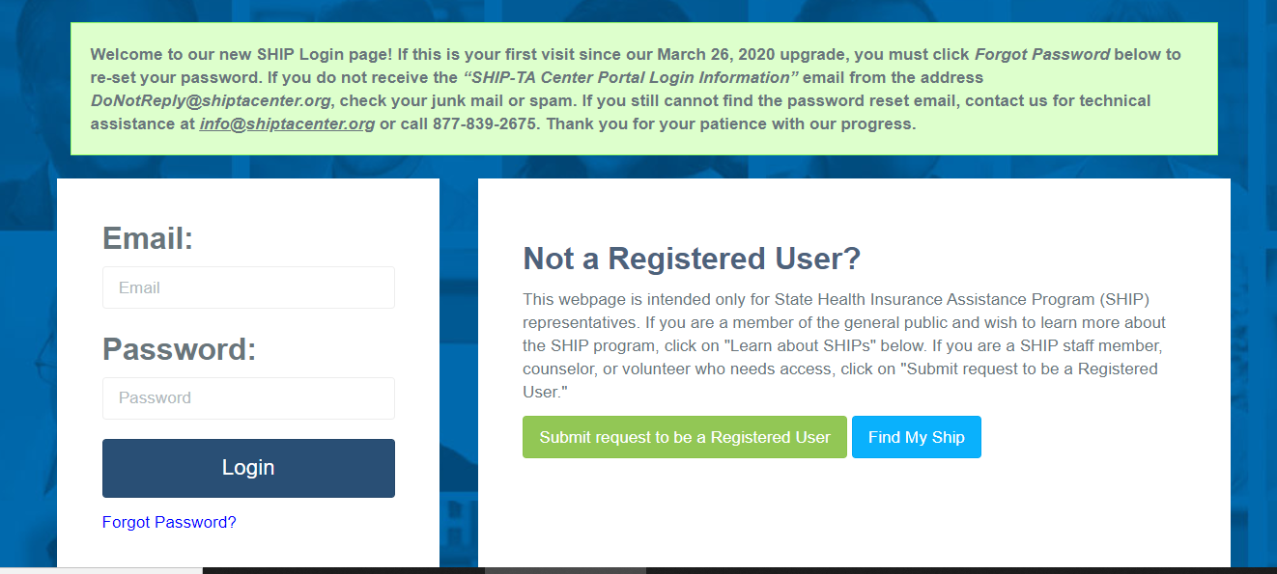
SHIP Login at www.shiptacenter.org
As of March 26, 2020, this is our login page.
A green banner provides tips for first-time users
Notes:
If you don’t have an account, you can request one here (under the login page).

Slide 28
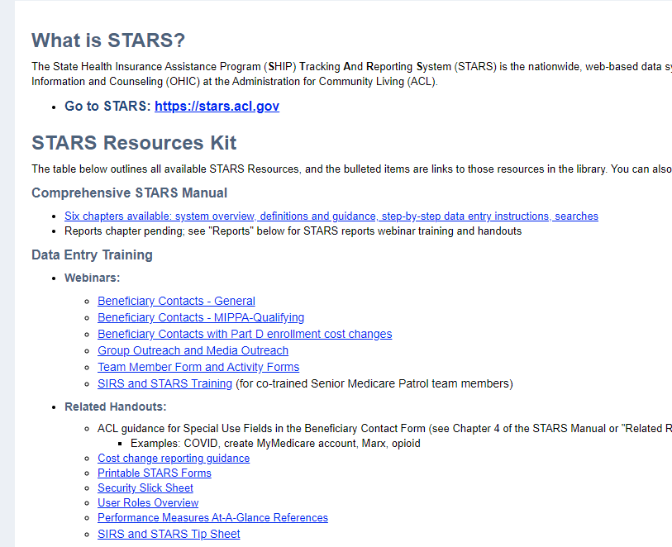
STARS Access and Resources
Notes:
The STARS Resources Kit is now on this STARS menu. Directors and administrators control STARS resources visibility, including access to STARS events.

Slide 29
STARS Manual and Other Resources
STARS Manual:
Chapter 1: Introduction
Chapter 2: User Basics
Chapter 3: Team Member Management
Chapter 4: Beneficiary Contacts
Chapter 5: Group and Media Outreach and Education
Chapter 6: STARS Searches
Handouts, Job Aids and Webinars about:
Performance Measures
Reports
User roles
Recordings of past data entry trainings
Notes:
Chapter 1 covers: Programs that use STARS; Data entry due dates; How to get resources and technical assistance.
Chapter 2 covers: STARS address/landing page; Credentials (usernames and passwords); STARS security; STARS inactivity rules; Entering hours on your own team member form
Chapter 3 covers: Creating and Managing Team Members; Using the Activity Form; CMS SHIP Unique ID; Detailed user role descriptions and the impact of the STARS hierarchy
Chapter 4 covers: Beneficiary Contact Form and the Beneficiary Additional Sessions Form
Chapter 5 covers: Group outreach and education (GOE) and media outreach and education (MOE) forms
Chapter 6 covers: STARS Searches vs. STARS Reports, and how to conduct searches.
Use the job aids, handouts, and PPTs for searches, reports, and user role overview.

Slide 30
Individualized Technical Assistance
For STARS technical assistance, contact the STARS help desk at Booz Allen Hamilton:
boozallenstarshelpdesk@bah.com or 703-377-4424
For questions about STARS training and resources, contact the Wisconsin SHIP director:
michelle.grochocinski@dhs.wisconsin.gov

Slide 31
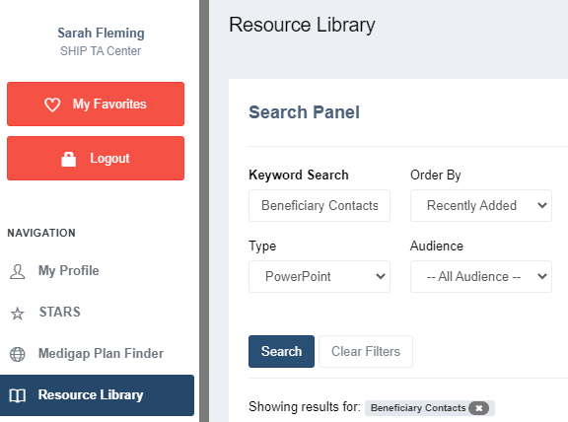
Today’s Resources
Available for file transfer in Webex
In the STARS menu, and
In the Resource Library
Recording added tomorrow

Slide 32
Appendix
The information in the following slides is also in the STARS Manual, Chapter 4. Most of this information was also covered during the demonstration.

Slide 33
Session Conducted By
This section of the form collects information on the person that counseled or worked with the beneficiary
Use the drop down bars to select the correct options
Partner Organization will auto-populate
County will also auto-populate after you enter the Zip Code
Remember: Session location is where you are when counseling

Slide 34
Beneficiary Information
Space to collect both the Beneficiary’s information and/or a Representative’s information as needed
None of these fields are required BUT please enter the name and phone number as often as possible
ACL needs the name and phone number to conduct beneficiary satisfaction surveys

Slide 35
Beneficiary Residence Info
This information is required
Date of Contact
This information is required
Manually enter the date or use the Date Picker tool by clicking on the calendar icon
Notes:
Must use dropdown to select state
must enter zip code
Auto-populates county based on zip code, can choose another county if applies

Slide 36
Time Spent
Enter all the time you spent helping the beneficiary during this contact. Includes:
All time meeting with beneficiary or representative
Any time spent researching, preparing materials, completing paperwork/form, and traveling to meet with the beneficiary.
Enter time in whole hours and minutes
The system will auto-calculate the total time in minutes (required)
Notes:
1.5 hours would be entered as either: 1 hour and 30 minutes or 90 minutes. If the same team member conducts multiple sessions in one day, aggregated the total amount of time spent in all sessions in the time spent field in one form.

Slide 37
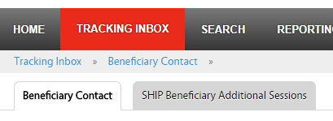
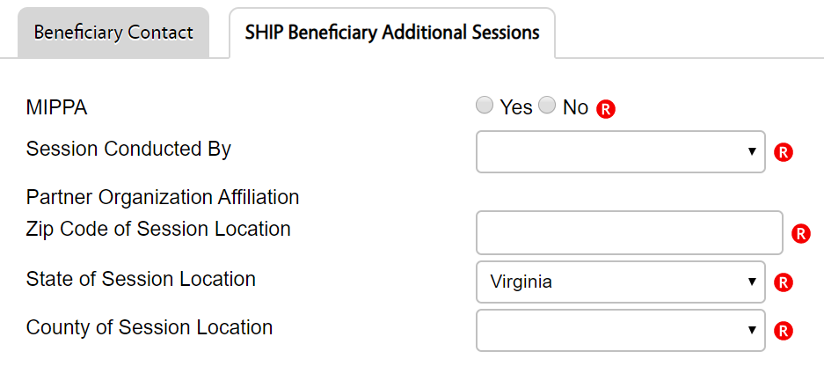
Beneficiary Additional Sessions
Illustrate complexity
No limit; enter as many as needed
Each additional contact counts the same way as a stand-alone contact on SHIP Performance Measures
Note: API feature does not currently support this feature. ACL is working with BAH on a possible enhancement to add this to API.

Slide 38
What if fields I need aren’t on the Beneficiary Additional Sessions (BAS) tab?
Beneficiary demographic information does not appear on the BAS, but the demographics entered on the Beneficiary Contact Form (BCF) are tied to all associated BASs.
Edit the demographic information on the BCF, when applicable.
Status does not appear on the BAS.
Edit the status on the associated BCF when a case status changes from “In Progress” to “Completed.”
Send to SMP is not available through a BAS.
Enter a new BCF if the case evolves into an SMP issue.
Notes:
Sarah

Slide 39
SYSTEM SECURITY
Notes:
This information will be the topic of an entire webinar on September 11, 2020. The STARS Manual also explains this information thoroughly.

Slide 40
PDP/MA-PD Enrollment Cost Change Measurement Overview
SHIP Evaluation results showed that SHIPs strongly desire a way to measure savings to Medicare beneficiaries
ACL Pilot:
Over the last year ACL has conducted a pilot project with a number of SHIPs to test collection of enrollment data.
Counselors in the pilot reported the before and after costs whenever they assisted with a Part D or MAPD enrollment.
Data used comes directly from the Medicare Plan Finder
Data from pilot was encouraging enough for ACL to decide to roll-out these data elements to everyone now
Goal is to provide more detailed information on the work that SHIPs do and the service we provide to beneficiaries
Notes:
Why is ACL doing this?
When the SHIP Program moved to ACL in 2014, a program evaluation was conducted. Many SHIPs asked for a more consistent way to collect and report savings to Medicare beneficiaries based the important work you do. So, ACL conducted a pilot over the past year to look at Part D savings. Thank you to those that participated by reporting the cost of the beneficiary’s plan before and after SHIP counseling located on the Medicare Plan Finder. The pilot results were encouraging and with the STARS system we have the opportunity to collect and report dollars nationally. SHIPs help beneficiaries in many important ways that are weedy, technical and hard to describe, the goal of collecting Part D cost change data is to provide one more benefit of the program and the work you do!

Slide 41
STARS Security
Federal Information Security Management Act (FISMA) moderate
Data encrypted during API transfer
Data encrypted in STARS
Password requirements
Valid for 90 days
Notes:
The Federal Information Security Management Act of 2002 addresses the importance of information security to the economic and national security interests of the US. The act requires each federal agency to develop, document, and implement an agency-wide program to provide security for the information and information systems, like STARS, that support the operations and assets of the agency. This includes those provided or managed by another agency, contractor, or other source, like Booz Allen Hamilton does on behalf of ACL.
There are several FISMA categories. STARS is the FISMA category known as moderate.

Slide 42
PII and PHI
Personally Identifiable Information (PII) | Protected Health Information (PHI)
Information which can be used to distinguish or trace an individual’s identity, such as their name, social security number, biometric records, etc. alone or when combined with other personal or identifying information which is linked or linkable to a specific individual, such as a data and place of birth, mother’s maiden name, etc.”¹ | Individually identifiable health information that is explicitly linked to a particular individual, and health information which can allow individual identification.² PHI includes many common identifiers (e.g., name, address, birth date, Social Security Number) when they can be associated with the health information listed above.
OMB M-07-16 Memo Safeguarding Against and Responding to the Breach of Personally Identifiable Information
Health Insurance Portability and Accountability Act of 1996 website
Notes:
In conducting SHIP work, we collect both Personally Identifiable Information and Protected Health Information. The biggest differences between the two items are:
PII is ANY potentially identifying either on it’s own or when combined with other information = most of information in STARS. STARS is built to house this information securely
PHI is HEALTH information and specifically identifies a person. This sometimes entered in notes/comment field. STARS is built to house this information securely, exercise caution and only enter when necessary or requested.

Slide 43
Tips for Handling Sensitive Data
Use private spaces to ensure sensitive data is safeguarded
Store all hard copies securely in locked filing cabinets or offices with a maintained filing system
Use strong passwords to protect electronic formatted documents and equipment (phones, computers, USB drives)
Do not leave files of documents with PII on desks, printers, personal computers, phones or other devices
Send and forward only encrypted emails with PII
Clear web browser history
Disable auto-fill on web browser

