Slide 1
Medicare Outreach
Tips and Tools to Help You Reach Beneficiaries

Slide 2
Reasons for Outreach
Inform public about:
Medicare-related assistance you can provide
low-income benefit programs
Medicare preventive benefits and health promotion programs
Two federal grants provide funding for Medicare outreach:
MIPPA Grant
SHIP Grant
Notes:
MIPPA funding is for outreach activities related to Medicare Savings Programs (MSPs), Part D Extra Help (Low Income Subsidy or LIS) and also for outreach activities about Medicare preventive benefits.
SHIP Grantees are required to conduct regular outreach on Medicare-related topics including Medicare enrollment, low-income assistance and preventive services.

Slide 3
Role of Medicare Outreach Coordinator
Provide support and assistance
Bi-monthly trainings
Provide resources/materials for outreach
Maintain webpage with resources, trainings and helpful links
Notes:
Part of my role is to provide support to benefit specialists. I do this in several ways.
Provide support and assistance-individually to EBS or agency to help with outreach planning
Bi-monthly trainings
Provide resources/materials for outreach
Maintain webpage with resources, trainings and helpful links
I want to point out that much of what has been developed either as a best practice or as an outreach material, has come from EBSs like you. We learn so much from one another—EBSs around the state are doing this work and often a new idea is created and shared. Sometimes I get a request for something that we don’t have yet, so I can research what is out there—sometimes looking at what our national partners have available, or create something entirely new. So if there is ever something you are looking for that you can’t find, please contact me.

Slide 4
Agenda
Best Practices
Outreach materials for use at local level
How to access materials
Notes:
Today I am going to take a little time to
Share best practices—Ever-evolving!
Review some outreach materials that you can use at your agency
Show you how to access materials and information

Slide 5
Wisconsin’s Best Practices
Four Focus Areas:
Staffing
Community Partnerships
Outreach to Beneficiaries
Training
Notes:
You may already be following an existing outreach plan—and that’s great!
These best practices I’m going to share today were compiled from activities that have been done by EBSs around the state over the past years. They have been found to be effective ways to reach people. But not everything works the same in every county. And don’t be overwhelmed by all of the activities listed. Simply identify places that you can get started and build from there. Find what works best for your community and your agency.
Our best practices are broken into four categories:

Slide 6
Best Practices
1. Staffing:
Provide regular EBS office hours in outlying and rural areas (Under-served neighborhoods).
Dedicate adequate staff hours to ensure availability throughout your service area.
Consider use of volunteers to expand outreach.
Notes:
It is not always easy for people to come to your office, so being available in outlying or rural areas or underserved neighborhoods in a city can help to reach more people. Right now the issue is more about how you can get out to the beneficiaries. Some EBSs have held office hours at locations in another areas of the county.

Slide 7
Best Practices
2. Community Partnerships:
Potential Partners: Any professionals and agencies that come into contact with Medicare beneficiaries
Educate about Medicare and Medicare related programs
Provide resources
Explain when/where to make referrals
Seek opportunities to set up outreach activities/presentations
Notes:
Building partnerships with other professionals and agencies will enable you to “reach” people you might otherwise not come into contact with. These partners then help to extend your outreach. For each community partner—as you begin to develop a relationship, there are several things you’ll want to do:
Meet with them…this may be a phone or virtual meeting for now—but still remains important!
Explain the importance of this outreach and the value of their partnership in helping older adults (Have a story to tell—someone you have helped…)
Provide Resources they can share with older adults

Slide 8
Best Practices
Important Partners Include:
Social Security Admin office
Pharmacies
Libraries*
Churches & Interfaith Programs
Food Pantries
Hospitals & Clinics
Senior Centers/Dining Sites
Senior & Low-income Housing
Notes:
SSA—do they have your resources? Understand your role? Know when to make a referral? I know several counties that have found SS to be their greatest referral source!
Pharmacies—especially during the annual enrollment period—do they know the importance of making a referral—give them examples of why it is important!
Libraries—don’t just drop off the materials, but make sure the reference librarian knows about them and their importance.

Slide 9
Best Practices
Important Partners (cont.):
Employers and union groups
Health Promotion Programs
Other benefit programs
Homestead Tax/AARP/VITA Tax sessions
FoodShare (SNAP)
Low Income Heating Assistance
Stockbox, Hunger Task Force
Public Health
Senior Medicare Patrol
Service Clubs/Community Organizations (Kiwanis, Rotary)
Veterans Administration Office
Notes:
Are there opportunities to share your resources with these programs? Join them at one of their already scheduled events?

Slide 10
Best Practices
Important Partners (cont.):
Be sure to reach out to community partners serving minority and other hard-to-reach populations!
Hispanic/Hmong/Native American/Other community centers
Clinics that serve greater number of target population
Churches that serve target population
Grocery store serving target population
Notes:
Seek out ways to get your message to minorities—especially low-income minorities.
Is there a community center serving them? If you can establish a relationship with a key person at the community center, this will help in getting the word out to that group. Offer your resources and/or a presentation. Be aware of any cultural issues that may affect an individual’s willingness to accept your help. Ask for help or guidance from your contact at the community center.
Each county is unique and you are the experts in your county. Do what you can to become the “go-to” person among any of the community groups in your area.

Slide 11
Best Practices
3. Outreach Directly to Beneficiaries:
Virtual
“Welcome to Medicare” Presentations*
Various times/locations around county
Presentations on other topics throughout county.
Virtual presentations to reach those unable to attend in-person.
Marketing plan: radio, tv, newspaper, newsletter articles
Promote “word of mouth” outreach
Give your card, brochure, etc. to people you have helped and encourage them to share.
Notes:
*Welcome to Medicare PPT available.
What locations and topics are covered?
Is staff time an issue? Consider whether volunteer could do a presentation?
Community newspapers.
Be sure to encourage people you help to spread the word to their friends and neighbors.

Slide 12
Best Practices
Outreach Directly to Beneficiaries:
Incorporate outreach targeting hard-to-reach
Presentations
Consider co-presenting with trusted staff member from the specific community.
Outreach Materials
Find on Medicare Outreach and Assistance page of GWAAR website: Hard-to-Reach Communities
Brochures, inserts, flyers, posters, articles
Media Outreach
Hispanic, Hmong or other Radio stations
Newspaper targeting minority community
Notes:
When setting up presentations—is there a language barrier? Do you need a translator? If you are new to this community you are targeting, it may help to build their trust of you, if they see you working with someone they already know and trust—someone from their community.
W have several outreach materials that may be of help to you in reaching different groups. Check out what is available by going to the website. (Hard-to-Reach Communities.)
If there is something you would like to see but are unable to find, let me know and I’ll see if there is something available and if not, we may be able to create something.
Also, some areas have radio stations that serve the community you are trying to target-- Hispanic radio station or Hmong radio station. Check out what is available in your areas. And there are often newspapers that serve minority communities as well. Find out what is in your area and see if there is potential to do outreach there.

Slide 13
Best Practices
4. Training Colleagues:
All ADRC and Aging Unit staff who work w/ target audience
I & A specialists
Nutrition site managers
Health promotion coordinators--collaboration
Attend Income Maintenance staff meetings
Attend coalition meetings (I-team, Caregiver coalitions, others)
Notes:
Regular training of colleagues—especially due to staff turnover—will help ensure that they are aware of the programs, that they keep them in mind, that they know of any special events you are having. And make sure they know when to make a referral.

Slide 14
Medicare Outreach Materials
MSP/LIS/SeniorCare brochure and inserts
Preventive Services Chart
Posters
Medicare Placemat Prevention and Wellness
Articles for newsletters/church bulletins
Brief Program Descriptions (Help educate community partners about Medicare related programs)
Notes:
In doing your outreach, whether to beneficiaries or community partners, you need materials to share. We have a variety of resources that you can customize and use in your outreach. These can be found on our webpage and I’ll show you how to access that shortly. Right now I’d just like to highlight a few…Two of the trainings I did over the past 6 months may be of particular interest in trying to plan for outreach during this pandemic. If you did not attend those, I’d encourage you to go back and take a look at those for ideas about reaching “hard to reach” beneficiaries as well as conducting effective virtual outreach. I’ll show you where to access those trainings and materials.

Slide 15
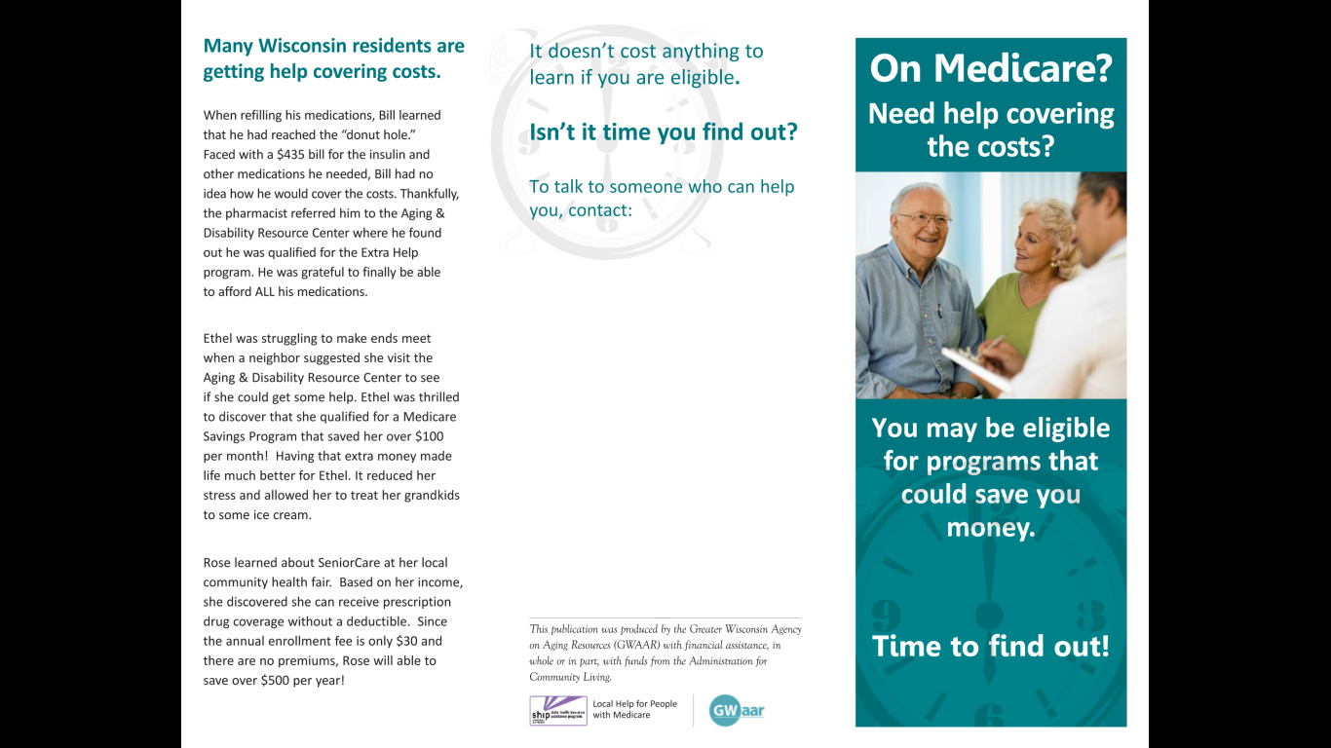
Medicare Outreach Materials
Three-fold brochure
ADD YOUR CONTACT INFO HERE
Notes:
This is a customizable brochure that promotes Medicare Savings Programs, Extra Help, and SeniorCare.

Slide 16
Medicare Outreach Materials
Inside of the three-fold brochure

Slide 17
Medicare Outreach Materials
Eligibility Insert
ADD Contact Info Here

Slide 18
Medicare Outreach Materials
Health Promotion and Preventive Benefits Insert

Slide 19
Medicare Outreach Materials
Medicare Outreach Posters
Highlight the MSP/LIS/SeniorCare benefits
Several versions with photos of people of various backgrounds
Customizable

Slide 20
Medicare Outreach Materials
Poster 1
Poster 2
Notes:
Poster 2 has also been translated to Spanish and is available on the GWAAR website.

Slide 21
Medicare Outreach Materials
Poster 3
Poster 4
Poster 5

Slide 22
Medicare Outreach Materials
Program Descriptions
aka “Elevator Speeches”
Medicare Savings Programs: Help seniors with limited incomes and assets pay for some or all of Medicare’s premiums, deductibles, and co-payments. At a minimum, qualified individuals have the Part B premium paid for them, saving over $100 per month!
Extra Help/Low Income Subsidy: Assist people with limited incomes and assets pay their Medicare Part D premiums, deductibles, and co-payments.
Senior Care: Wisconsin’s prescription drug program for people age 65 and older. There is no monthly premium and the deductible amount is based on the person’s income. Assets are not counted. People with lower incomes often find Senior Care to be more affordable than other Medicare drug plans.
Notes:
Remember—it may help to have others prepared with an “elevator speech” –or a quick way to describe these programs to others.
Use these descriptions to explain the programs to your community partners. By presenting the information in a brief description, they can more easily explain the programs to others.

Slide 23
Medicare Outreach Materials
Program Descriptions (continued)
Medicare Preventive Services: Starting in 2011 Medicare began covering more preventive services and screenings including an annual wellness visit, vaccinations and more than 15 other tests/screenings – all at low or no cost. Preventive health care focuses on preventing disease and maintaining proper health which will help you to live a longer, healthier life.
Health Promotion Classes: Educational programs designed for older people which have been researched and proven effective to help individuals manage their own health and improve their quality of life. Topics include fall prevention, managing chronic health conditions, living with diabetes and other wellness topics.

Slide 24
How to Access the Materials
Demo of GWAAR website:
Go to http://gwaar.org
On top menu bar: Technical Assistance drop down menu
Click on “Medicare Outreach and Assistance”

Slide 25
Questions?
Notes:
I also want to point out that we often look at the number of people who have been reached by outreach in the state of Wisconsin. Its really helpful when we are reporting back to the federal government about what is being done with the grant money that is sent to the state and how we use it to reach Medicare beneficiaries. So remember to keep up with your reporting into SAMS for both your client contacts as well as your outreach activities.

Slide 26
Medicare Outreach
Contacts
Debbie Bisswurm, GWAAR
debbie.bisswurm@gwaar.org
608-228-0898
Michelle Grochocinski, DHS
Michelle.grochocinski@dhs.wisconsin.gov
608-695-2503

