Slide 1
Welcome!
Medicare Outreach Training
April 22, 2021
Promoting your virtual event
Debbie Bisswurm, GWAAR
Notes:
<RECORD to Zoom cloud.> Welcome everyone. Before we begin with our topic today, I want to take a moment to thank everyone who participated in the outreach Survey. The survey results were sent out to everyone—and they are available on the GWAAR website—and they certainly show a variety of experiences over the past year. … The activities, experiences and the comments shared have had an impact on some of our plans for trainings and materials. The topic this morning is directly related to some of the responses from the survey. We also received feedback that benefit specialists would like more opportunities to ask questions of one another and share ideas, so after the training, we will use the remaining time to open it up to for that. Going forward I will try to reserve time for this in all future trainings. Also…I know Michelle Grochocinski shared some information about this during the EBS training last week—she and I have been reviewing Performance Data from the past year…

Slide 2
Promoting Your Virtual Event
Medicare Outreach Training
April 22, 2021
Debbie Bisswurm, GWAAR
Notes:
Several people who responded to the outreach survey indicated that after the time they spent working on a virtual presentation—only a couple people showed up for it. That can be very frustrating, and it really highlights the importance of- finding ways to effectively promote your event.

Slide 3
Virtual Presentation Poll
1. Have you conducted a virtual presentation in the past 12 months?
Yes ___
No ___
2. Do you have any virtual presentations scheduled in the next 6 months?
Yes ___
No ___

Slide 4
Steps to Promote Your Event
Use an attention-grabbing title and/or graphics.
Start promoting your event early.
Final Marketing push
After your event
Notes:
In preparing for this training, I used information from experiencing in Wisconsin and I did a lot of searching of some of our national partner’s as well as other sources to put these steps together. IF you do the same search you will find a wide range in terms of a timeline for promoting an event and it certainly can depend on the type of event and other circumstances, but the steps I include today may be a helpful guide for your planning. —and the truth is, these are steps that you can take not only to promote virtual events, but for in-person events as well. BUT…there are a couple key differences between promoting a virtual event and promoting an in-person event. People can access a LOT of information online. They can do a search and find information. There also may be more competition from other online webinars about Medicare. So it is important to set yourself apart from all of that. Here’s where it is important to emphasize “why” they would want to attend your event rather than another online webinar. You’ll want them to know that YOU provide non-biased, objective information. They can ask questions “live” of the presenter. You are a SHIP counselor. So when people have so many immediate options for online information—taking the time to go through the steps to promote your virtual event will really help to get people interested and to get them to attend the event.

Slide 5
Use attention-grabbing title and graphics!
Step #1
Common Title Examples:
Welcome to Medicare
Medicare 101
Maximize Your Medicare
Consider including a teaser
“Unsure about all the options? Get objective information and ask questions live!”
“Did you know that some people get help with their Medicare Costs?”
“Keep more of your money!”
Notes:
I know—there’s only so much you can do with a Medicare presentation title—and most of you already use great ones such as Medicare 101, Welcome to Medicare, etc. Depending on the type of presentation, you might consider a few other options—such as Maximize Your Medicare or….use NCOA’s campaign title: “Boost Your Budget” if you’re doing a presentation about benefits. But Beyond the title, we can look at the images and graphics. Think about the colors and the font you choose—are they eye-catching? Does it look like you just typed it on a plain page and made that into a flyer? Or are you using something that creates interest? And consider a teaser with your presentation announcement. Here is where it can be important to focus on “why” someone would want to attend Your event!

Slide 6
Notes:
Here is one of the examples from NCOA’s campaign. NCOA has emphasized that these materials and images are intended to be evergreen, so feel free to use them throughout the year.

Slide 7
Notes:
Another image from NCOA. And these images were shared with partners throughout the country for use in your outreach.

Slide 8
Notes:
I’m sharing these in case you didn’t see the different options.

Slide 9
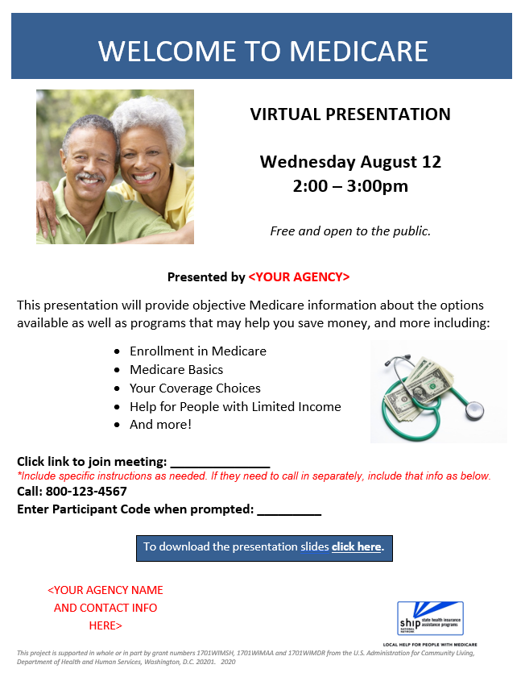
Presentation Flyers
Add images or graphics to create more interest!
Notes:
Again—make those flyers look interesting. You can use this flyer and customize it for your agency. I have a link to it on the last slide and this is also one of the new resources in the “Presentation Resources” heading on the GWAAR website.

Slide 10
Another example: Targeting consumers with limited income

Slide 11
Interested in different images for the flyer? Contact me for additional customizable options.
Notes:
Use different photos to create multiple versions of the same flyer since different images may resonate with different people. Again, I include a link to the flyesr on the last slide in this training, but feel free to contact me if you’d like some additional customizable options.

Slide 12
Change out your graphics for different presentations! This detective works great for OEP!

Slide 13
Start Promoting Your Event Early!
Step #2
Early promotion may include sending out a “save the date”.
Presentation schedule for the year—send out when known.
Know the deadlines to include info on community partner calendars and plan accordingly!
6 weeks before event—outreach to community partners.
1 month before event—post flyers (virtual and physical) in key locations.
Notes:
Once you’ve decided on the type of presentation, the title, and the flyer or announcement, the next step is promoting it. How early you begin promoting your event will depend on how early you set it up. If you set up presentations for the year, it is a good idea to post that information so people can begin to plan for it. Put it on your website. If a consumer has a conflict for your April presentation, but they know you are doing it in June, they can add that date to their calendar. So you can get those “save the date” announcements out there early. Have your flyers ready so you can have them posted at key locations 1 month before the event.

Slide 14
Promoting your event
Direct contact and share flyers/promotional materials with target locations:
Maximize opportunities within your agency—internal staff, agency waiting room.
Community Partners
SSA office, clinics, food pantries, libraries, churches, grocery stores
Ask your partners to spread the word—provide a physical and/or virtual flyer.
Make the most of email marketing!
Notes:
Who are your key community partners? Social Security Admin office, …

Slide 15
Promoting your event
Leverage social media across platforms
Facebook
Twitter
LinkedIn
NCOA Boost Your Budget Social Media Posts

Slide 16
Promoting your event
A few more ideas:
Promote word-of-mouth marketing
Clients you’ve served
Write article about the event for your newsletter

Slide 17
Final Marketing Push - 10 days before event
Step #3
Send reminders to community partners.
Send reminders emails to people who have registered.
Include the presentation link.
Add reminder posts to Facebook and Twitter.

Slide 18
Event Day Reminders
Be prepared (practice before!)
Enter the platform early, be ready to screen share.
Start on time!
If recording, let attendees know how to access it later.
Avoid “death by PowerPoint”—include pauses for Q & A or polls.
Remember: your energy in presenting your topic will affect how interested and engaged your attendees are.
Have a “story” to drive home your point.
Stick to your schedule.
Make sure your contact information is clearly presented.
Notes:
I just want to address a few reminders for your event day. I do have a link to the TIP SHEET for virtual presentations on the last slide. One of the most important things you can do to make sure things go smoothly is to practice your presentation ahead of time. …..To keep people engaged, consider doing a poll, many attendees will be new to this technology. Start with an un-related poll to break the ice. “Do you have a pet in your home?” Share the responses. Then try “What type of pet do you have? Dog, Cat, Fish, Bird, Other”
It’s not about the answers of course, it’s about getting them to engage as well as getting them comfortable with the virtual experience.

Slide 19
After the Event
Step #4
Thank participants for attending
If you have upcoming events scheduled, let attendees know about them and encourage them to tell a friend.
Follow-up with an email that includes any resources you want to share and info about upcoming events. Encourage them to forward to a friend.
Notes:
There are a couple things that you can and should do after your event that can help to promote future events. Remember that word-of mouth (good or bad) will have an impact on future presentations—so be sure to finish on a good note. Thank the attendees for joining you—make sure you answer their questions or if you’re not able to do that online, make it’s clear to them how they can connect with you for more assistance. If they have a positive experience they will be likely to tell others about it, be sure to provide information about upcoming events. Send a follow-up email with a link so they can easily forward it to friends who may be interested.

Slide 20
Resources
GWAAR Medicare Outreach and Assistance Resources Webpage—
New Heading: Presentation Resources
Promoting Your Virtual Presentation TIP SHEET
Virtual Presentation Flyer
Boost Your Budget Presentation Flyer
Tips for Virtual Presentations
NCOA Boost Your Budget Toolkit
SHIP Technical Assistance (TA) Center
Notes:
I have included links to some resources here that I referred to earlier that may be helpful as you plan for promoting your virtual events.
As new materials are created and new links are identified that we want to share with you, I have continued to add them to the website. There are many resources on the website and it is important that all of you are able to find what you are looking for.

Slide 21
Sharing of Ideas…
Notes:
I have always talked about the fact that you are the real experts out there and there is great value in learning from one another. There is no need to re-invent the wheel when so many of you have years of experience. And some of you who may be newer to your position may have some fresh and innovative ideas. I want to point out that Michelle Grochocinski shared a new discussion board option for EBS on the SharePoint website—so that is another potential option for you so please keep that in mind. Now, I’d like to use the remaining time until 10:00 to open it up to all of you. If you have questions you’d like to ask your fellow benefit specialists, now is a great time to do that. Or if you have a new outreach activity that you would like to share, please do so. You can unmute yourself from the ZOOM menu when you are ready to talk.

