Slide 1
Preparing to Train
Notes:
The CMS National Training Program (NTP) provides this as an informational resource.

Slide 2
Does this Scene Look Familiar?
Notes:
Many people have a fear of public speaking but with proper practice and preparation, it can be managed effectively!

Slide 3
Session Objectives
To improve your presentation and get you prepared, this session will help you
Identify traits of good speakers and areas for improvement
Recognize ways to improve your presentation skills
Understand the value of using cleared materials
Identify where to find materials to help build your training
Describe ways to communicate complex topics
Recall strategies to handle question-and-answer sessions
Identify tips that are unique to virtual training
Notes:
We have various levels of comfort and skill when it comes to public speaking. The goal is to help you understand NTP resources and tips to build and deliver your own training presentations .
To help improve your presentation and to help you prepare, this session should help you
Identify traits of poor and great speakers
Recognize ways to improve your presentation skills
Understand value of using cleared materials and trust-worthy sources
Identify where to find materials to build your training
Describe ways to communicate complex topics
Recall strategies to handle question-and-answer sessions
Identify tips that are unique to virtual training

Slide 4
Poll Question 1
On average, how often do you train others about Medicare, or other health insurance options?
a. 3-5 times per week
b. 1-2 times per week
c. 1-2 times per month
d. 1-2 times per calendar quarter (3 months)
3. 1-2 times per year

Slide 5
Lesson 1 Building Presentations

Slide 6
What Do You Think?
What are some ways you begin preparing your training materials?
What are some of the things that have frustrated you about other trainings you might have attended/viewed?
Notes:
Thinking about the trainings you’ve given and attended, how did you begin preparing? Now, what are some of the things that may have frustrated you?
(open chat for audience interaction)

Slide 7
Structuring Your Presentation
Open with a powerful point
Highlight the main points
Close with a meaningful ending
Notes:
When structuring your presentation, not only do you need to keep the audience in mind, but you also need to
Get the audience interested and give them a reason to listen—As you prepare your remarks, think about what’s important to the audience. As you build the introduction, think about your presentation’s importance to the audience. Start the presentation on a positive note.
Highlight the main points—Communicate what belief, action, or behavior you are trying to change. Many times we are educating, so we want to focus on the most important points and not get into the weeds so that the audience can retain the information after the presentation.
End the presentation so the key points don’t get lost—One strategy for building a strong ending is to plan your closing before you plan the rest of your presentation. You can then go back and design your opening so that it sets the stage for your conclusion.

Slide 8
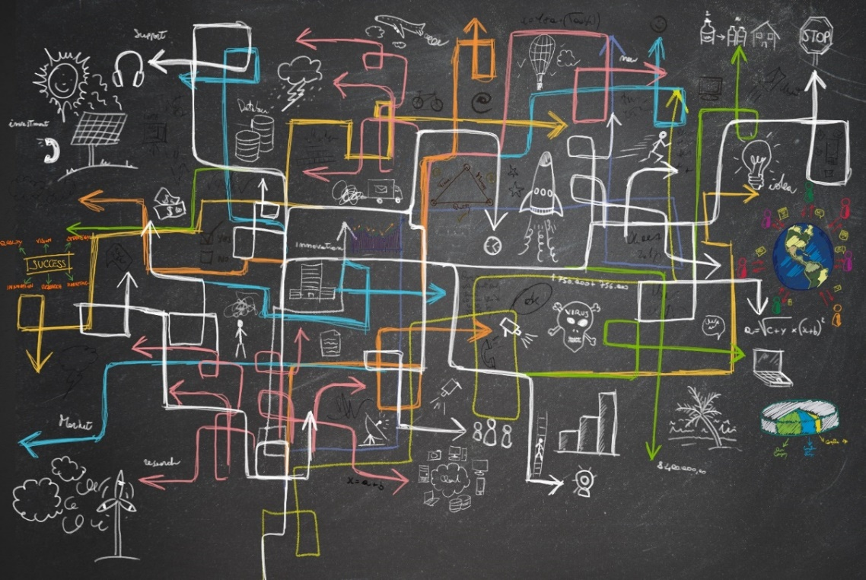
Presenting Complex Topics
Show me
Tie the unfamiliar to the familiar
Reverse pyramid
Plain language
Focus
Notes:
There are many ways to communicate complex topics. Some examples are:
Show me—We are very visual creatures. Our love of images lies with our cognition and ability to pay attention. Images are able to grab and hold our attention easily.
Categorize and tie the unfamiliar to the familiar—Psychologists have identified different strategies that people use to process new information. One common process is categorization. We all classify things into mental categories that help us make sense of the world. For example, Medicare is a federally run program, Medicaid is a federal/state-run program. Another common way to make the unfamiliar familiar is to use analogies, for example, the CMS National Training Program is to State Health Insurance Assistance Programs (SHIPs) as Medicare Learning Network® is to providers.
Reverse pyramid—The term reverse pyramid comes from journalism and refers to putting the essential details first (who, what, when, where and how), followed by the key facts, and, finally, the background. Another way to think about it’s BLUF (Bottom Line Up Front). The key points are placed at the beginning to facilitate comprehension. Traditionally, the reverse has been true: conclusions and recommendations are included at the end.
Plain language—Plain language is audience-focused. What does the audience need to know? State it clearly. Plain language isn’t playful, folksy or “dumbed down.” For more information, see the plain language guidance on the CMS website.
Focus—Important points can get stuck in the weeds. Making the notes section of the presentation available after the presentation is a way to share the details in a way that helps the listener digest the information.

Slide 9
Know Your Audience
Job responsibilities
Age range
Level of expertise
Type of organization
Notes:
There is information you’ll want to know about your audience so that you can tailor your message to meet their needs.
In general terms, it’s helpful to know their:
Job responsibilities—A manager of a group of volunteers may have a slightly different objective for attending the workshop than someone attending as a volunteer. The manager might be thinking about how to best present this material to her staff, as compared to the volunteer who’s at the workshop to absorb as much information about CMS programs as she can.
Age range/generational learning styles—The age of staff, volunteers, and people who get Medicare is diverse. Adults over about 70 tend to learn in a traditional classroom format and process information a little bit at a time. People between about 50 and 70 also prefer a traditional classroom-based learning style, while reflecting on the information and applying it through tactile learning. People roughly in their 40’s-50’s are visual and auditory learners who incorporate technology when possible to apply the information. A good way to present information to them is with case studies where they’re able to think, apply, and solve problems. Adults between about 18 and 40 have a much shorter attention span. Directing them to specific websites is the key to ensuring that they’re able to retain the necessary information they need to know.
Level of expertise about the subject matter—For the NTP workshops, most participants are seasoned professionals.
The type of organization—A professional at a SHIP may have a different perspective than a medical professional. The SHIP professional might be focused on information geared to people receiving Medicare compared to a medical professional who’s looking at the information from a provider standpoint.
On the next few slides we’ll be sharing some more specific information about our audience as an example.

Slide 10
Example: NTP’s Audience’s Level of Expertise
Participants are seasoned professionals
Majority are first-time attendees at the workshops
I know the Medicare Program.
I’m new here
Notes:
Here’s what we know about our NTP workshop audiences based on our research:
Participants are seasoned professionals with an average of about 7 years of Medicare Program experience, but the majority are first-time attendees at the workshops. For the speaker, since a majority of the audience are first-time attendees, you’ll be setting a benchmark for future expectations of the workshop. And since a majority of the audience has experience with the programs, you’ll need to cover the basics quickly, and then provide information to build on their current knowledge.

Slide 11
Type of Organization—2020 Workshop Data
Organization | Percentage
SHIP | 47.1
State or Local Government | 12.3
Plan/Agent/Broker | 3.2
Medical Professional/Health Care Administrator | 4.9
Advocate | 9.7
Federal Government Staff or Contractor | 1.8
Non-profit not included above | 6.6
Other | 3.3
Notes:
We know that most of the people who attend our workshops train other trainers, and they have a great reach into different types of organizations and services. This helps us better tailor our content. You can use this information to highlight and discuss key details about your topic that are meaningful to the kind of work they do.
The audience represents numerous types of organizations that benefit from train-the-trainer and counselor education. State Health Insurance Assistance Programs (SHIPs) make up the largest type of organization at the workshops, accounting for about 47% of the workshop attendees last year. Examples of other types of organizations that attend our workshops include advocacy organizations, state or local agencies, non-profits, and medical professionals.

Slide 12
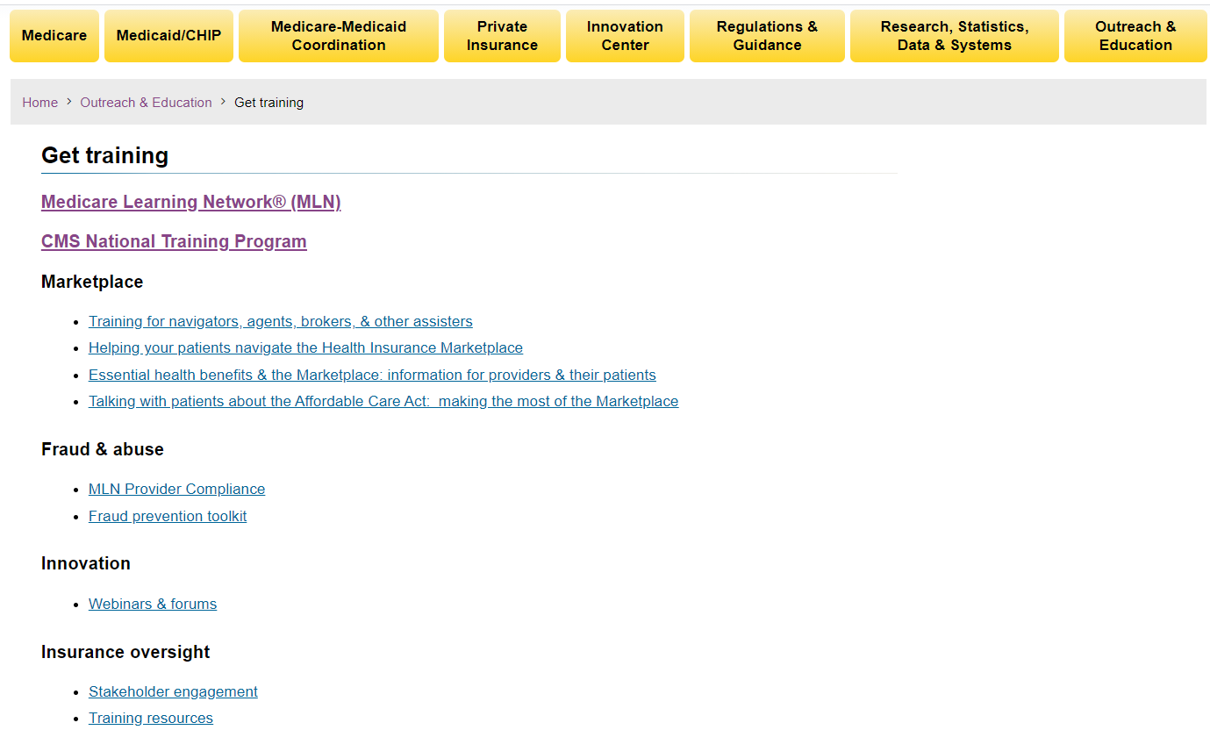
CMS Training Materials By Audience
Notes:
Depending on your intended audience, there are options on CMS.gov to help get you started. The Medicare Learning Network provides training opportunities and materials for a provider audience (with details about billing for example) whereas we (CMS NTP) have materials that are intended for the partner audience.

Slide 13
Using National Training Program Materials
Use prepared and cleared material
Download and adapt slides
Do hide or delete slides for the time allotted
Only add new slides if the material is cleared or you’re providing local information
Don’t change the meaning of the content on the slides
The clearance process sometimes results in text-heavy slides
Familiarize yourself with the material
Study resources at the end of the presentation
Consider adding local information
Notes:
Familiarize yourself with the material—Using someone else’s material requires extra preparation and rehearsal time to review and absorb the information. Study the resources listed at the end, as well as other sources on the CMS.gov, Medicare.gov and other related sites.
Adapt slides—NTP slides have gone through a rigorous review process which includes subject matter expert (SME) and regional office reviews as well as management guidance and approval. When using NTP-prepared materials, slides can be deleted or hid to fit the time allowed or to take out information already covered in other presentations. Since our slides have gone through a review process, they generally shouldn’t be edited or changed. Only add cleared material if necessary. The clearance process may result in text-heavy slides, and we can’t always create engaging graphics. Adding local information may be beneficial to make the topic more salient.

Slide 14
Explore the NTP Website
Videos
Job Aids
Self-paced courses
Embedded videos
Recorded Webinars (Workshop Series)
Includes materials
Learning activities/brain breaks
Casework workbook
Other
Notes:
Either live demo of NTP Website (or use following slides) to show the website locations of activities, videos, job aids and learning activities like Wuzzles and Alphabet Soup

Slide 15
Where to Find National Training Program Materials
CMSnationaltrainingprogram.cms.gov
Notes:
Explain tabs across the top
Helpful Links box
PowerPoints (Training Modules) Spanish Language and English; topics
Tools

Slide 16
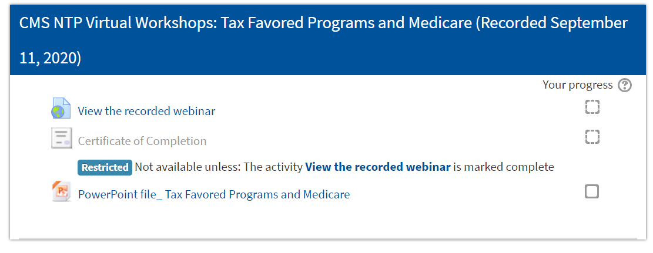
Resources Associated with Recorded Webinars
Notes:
While many of the NTP webinars are based off existing Medicare Modules, sometimes additional materials are developed or adapted to support the specific purpose of that webinar. In those instances, the training materials used in the training can be found within the “view the recording webinar” screen.

Slide 17
Using Resources From Self-Paced Courses
Notes:
Many of the self-paced courses include animations to explain Medicare concepts. Consider using these not only for your own training, but we’ve often shared our screen during live webinars to show some of these animations to provide varying formats within a virtual training.

Slide 18
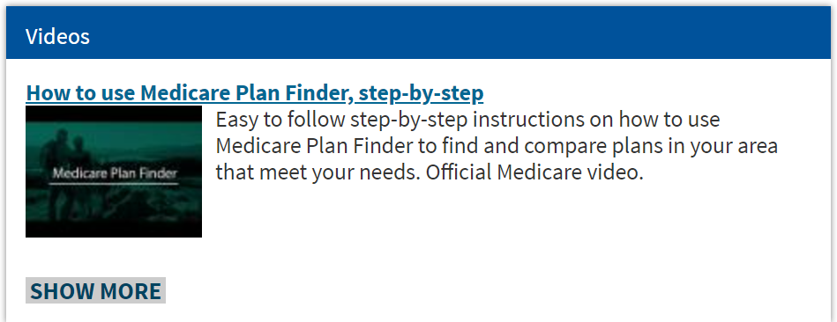
Video Resources
Notes:
The NTP website includes many videos to help supplement your understanding and trainings as well.
Another source of videos that can be helpful is the Medicare & You series that is on YouTube. Be careful when searching YouTube for Program training information because not all of them are from an official, government source.

Slide 19
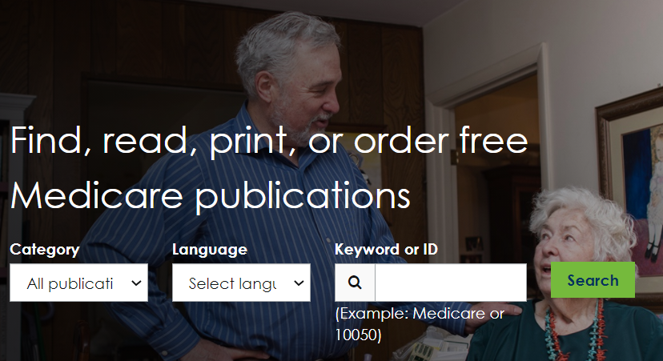
Handouts for Participants
Notes:
Participants like to leave training with some reference materials to help them put their knowledge into action or to serve as helpful reminders. Consider including:
Copy of slides presented
Publications
Job Aids

Slide 20
Medicare.gov Resources
Notes:
The Medicare.gov website is designed for people with Medicare so there are numerous plain language resources that not only can be helpful training tools, but are a major part of educating people with Medicare and their caregivers as well.

Slide 21
Mail You Get About Medicare
Notes:
It helps if you can take something abstract and make it concrete.
Actual examples of mail from Medicare that may generate questions or common training scenarios is a great resource and training tool.

Slide 22
Research, Statistics, Data, & Systems on CMS.gov
Consider using CMS.gov tools to get up-to-date statistics
Notes:
As Medicare.gov is focused on people with Medicare and their caregivers, CMS.gov is focused for partners and researchers, so its content revolves around a lot of policy and data.
Consider adding current statistics or data points to your trainings. Many times you can drill down data points to a local or specific population level which helps engage your varying audiences.

Slide 23
productordering.cms.hhs.gov
Notes:
When doing an in-person event, if you need bulk handouts of Medicare publications, you can use the product ordering website to get those resources free of charge.

Slide 24
Poll Question 2
Have you ever ordered materials from the CMS Product Ordering website?
a. Yes
b. No
c. Not yet, but I will

Slide 25
Lesson 2 Delivering Your Training

Slide 26
What Do You Think?
What are the characteristics of a good speaker?
What are the characteristics of a poor speaker?
Notes:
Thinking about the people you’ve heard give work-related presentations, what did those speakers do well? Now, what did the speakers not do well?
(open poll/chat for audience interaction)

Slide 27
Participant Comments about Poor Speakers
“Listening to someone read the slides is a waste of my time.”
“It seems she never read the materials before.”
“The speaker was way too loud and overly excited.”
“He clearly had no knowledge on the subject.”
“He needed to speak more clearly and speak up.”
Notes:
At past NTP workshops, we asked workshop participants to provide feedback about our speakers. Many of the speakers these comments were about don’t present regularly. Many of these negative comments relate to being inexperienced and unprepared.
It’s helpful to mindful of some of these common pitfalls so we can prepare appropriately.

Slide 28
Things People Might Notice About Virtual Presentation Mistakes
“The background of the camera image was distracting.”
“The speaker kept shuffling their notes.”
“She kept bouncing in her seat.”
“He was fidgeting throughout the webinar.”
“The camera angle wasn’t set correctly.”
Notes:
Here are some negative comments participants might point out from a virtual training experience.

Slide 29
Participant Comments about Good Speakers
“They made complicated information easy to understand.”
“He absolutely knows his subject.”
“I loved her examples!”
“The speakers interacted well together.”
“He presented his information in a conversational manner.”
Notes:
But, audiences also recognize good presenters. Here’s some of their positive feedback, which indicates positive traits of a good presenter.

Slide 30
Positive Things People Might Notice About Virtual Presentations
“I like how she smiled and interacted with the audience through the camera.”
“He spoke loudly, clearly and at a good pace.”
“I liked the mix of videos, speaking, and the poll questions.”
Notes:
Virtual presentations can have some challenges in feeling interactive, but there are tools and methods to help. Here are some positive things an audience might notice about good virtual presentations.

Slide 31
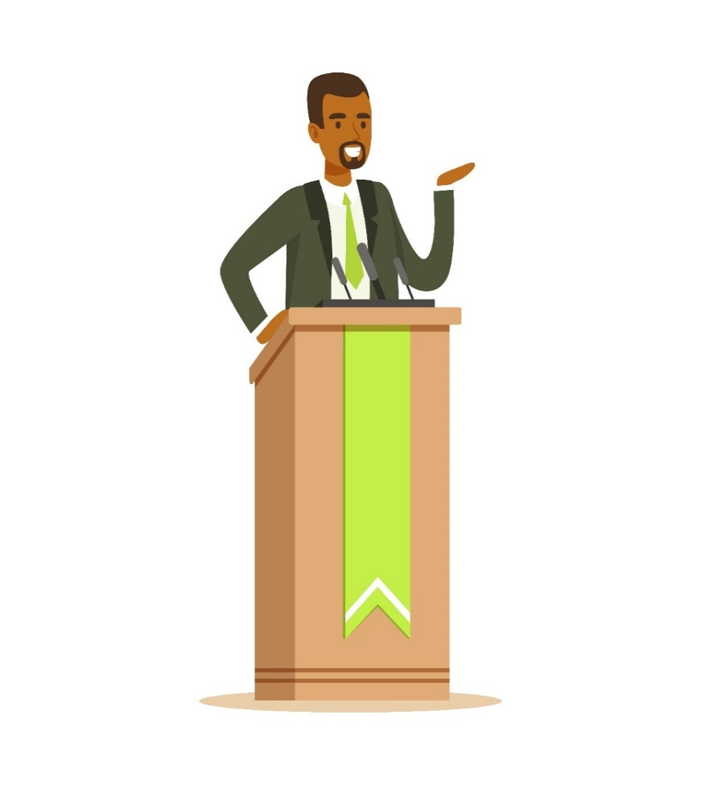
Practicing Your Presentation
Practice, practice, practice
Mirror (virtual; live camera)
Audio or videotape
Live audience
Learn the material
Go deeper
Anticipate questions
Have backup plans for technology considerations
Notes:
Practice—Public speaking requires training and practice. Hopefully, this training and the accompanying worksheet help you develop an action plan to become an A+ presenter.
Learn the material—Take the time to learn the subject. You should know more about your topic than your audience. Confident speakers develop their expertise by knowing their topic thoroughly. Study the subject on which you’re presenting to become well-versed in this area. Read and know more than just the speaker notes in the presentation. The work you put in researching the topic will be noticed and appreciated by your audience. As you learn about the topic, think about what questions the audience might have. This will help you make sure the question-and-answer session goes as well as the presentation itself.
Things don’t always go as planned! Consider taking screen shots for any live web or computer demonstrations

Slide 32
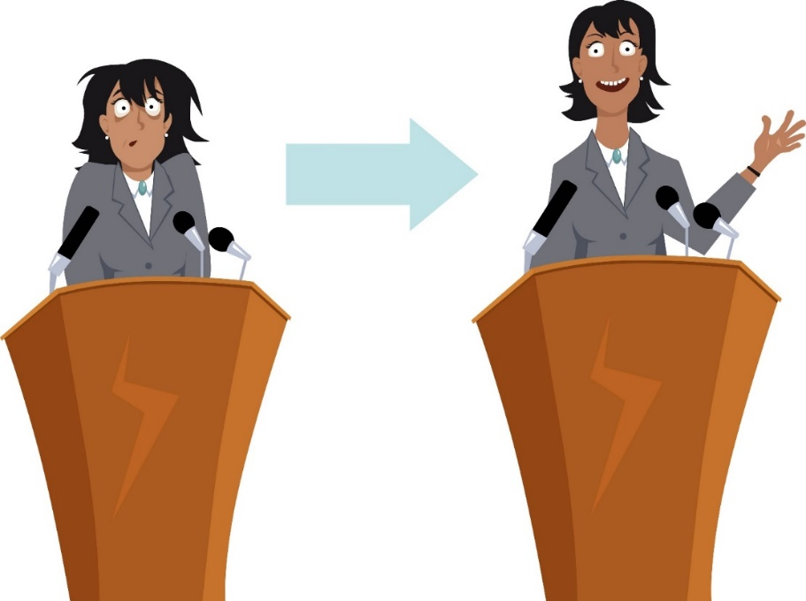
Gaining Confidence
Be prepared
Practice often
Know the transitions
Get feedback
Breathe
Focus on content
Don’t expect perfection
Notes:
These tips can help build your confidence:
Know the transitions—Transitions are the glue that holds the presentation together, making your key messages clearer and more memorable. Knowing the transitions helps you have a clear path to get back on track if you temporarily lose your place in the presentation.
Get feedback—Both positive and negative feedback can improve your delivery. Negative reviews help identify areas for improvement. Watch yourself giving a live presentation on video. Where did the audience seem interested and engaged?
Breathe—In the 30 seconds before you begin speaking, take three slow, deep breaths through your nose. As you breathe out, say silently to yourself, “relax.” Take a few moments during the presentation, like between sections, to take a deep, relaxing breath.
Focus on content—Become an expert on the subject. While you want to present the highlights for your audience, knowing the details will help boost your confidence and put you in the right frame of mind for answering questions. If you aren’t an expert, invite one to be in the room to help answer questions.
Don’t expect perfection—We are all human. As the French writer Voltaire once wrote: “Perfect is the enemy of good.”

Slide 33
Delivering Your Presentation
Speaker Do’s
Stay within the time limit
Read the audience’s reaction
Create “conversations”
Use voice and body language to
impact the message
Are authentic
Notes:
A few observations about how to deliver your presentation so that you are effective:
Respect time—Going over time limits can be interpreted as disrespectful to your audience, and to other speakers. Your audience most likely has a printed agenda, and they expect you to stick to it. Moreover, audience members may have other presentations they want to attend, or they’re looking forward to a scheduled break. Adjust your presentation to the time limit. A good rule of thumb is one PowerPoint slide per minute. Allow about 15% - 25% of the time for questions/discussion. So, if you have 60 minutes to present, plan for about 40 slides or less of content.
Read the audience’s reactions—If the audience looks confused, slow down and reiterate what was said, but in a simpler, direct way. Do audience members lean forward as if falling asleep or cross their arms or legs, creating a barrier between you and the audience, signaling they aren’t open to hearing the message? This is telling of the reception to your presentation and should be “listened” to. Are they participating in the chat or Q/A box if presenting virtually. This can be an indicator of a virtual audiences’ reaction.
Invite discussion—Allow time for questions. Consider having pre-planned questions for discussion and leaving opportunities for people to share their experience. Questions can be asked of the audience during the presentation and you can ask them to respond with a show of hands. For virtual presentations, you can use polling or invite participants to type responses in the chat box.
Realize that nonverbal communication is important—Nonverbal signals can increase trust, clarity, and interest to your presentation. When you practice your delivery, think about how facial expression, tone of voice, posture, and gesture can effect your message. These skills also apply if you’re using a webcam for a virtual delivery.
Be authentic—Use your own personal style and way of communicating within the CMS culture. Think about how you’d tell your friends something that happened to you today, and what gestures you would naturally use. Let your personality come through in a professional manner.

Slide 34
Delivering Your Presentation (Continued)
Speaker Don’ts
Read from notes
Display low energy
Have distracting mannerisms like
shuffling notes
Don’t project
Don’t make eye contact
Aren’t prepared
Can’t manage their nervous energy
Haven’t considered their (virtual) training environment in advance
Notes:
Speaker Don’ts:
Read from notes—Listening to someone read a presentation is frustrating. People say, "If all they were going to do is read their presentation, I could’ve read it myself.“ Using notes is better than reading since the speaker can have normal voice inflections and make more effective eye contact.
Display low energy—One of the most desired traits in a presenter is enthusiasm. Conversely, a boring delivery—when there’s a low monotone voice, dull facial expression, and overall lethargy—is one of the most disliked traits. Increase your energy level. Speak expressively, smile sincerely, move naturally, and enjoy the moment.
Have distracting mannerisms—Certain habits that you may not be aware of can distract the audience from your message and jeopardize your credibility. Distracting mannerisms include using fillers, like “you know,” “um,” etc., moving your hands, pacing back and forth, jingling change or keys, gripping the lectern, bouncing in your chair, adjusting your hair or clothing, fidgeting with your notes, a pen or bobbing your head.
Don’t project—In a large settings, always use a mic and confirm that the audience can hear you. Scan the far corners of the room when you ask if people can hear you. To project, stand up straight, and take a deep breath.
Don’t make eye contact—Lack of eye contact can communicate a lack of sincerity. It can also lead to an assumption that the speaker isn’t well informed. One way to have good eye contact is to glance at different audience members long enough that they feel as if you’ve been talking to them. This will normally be the length of a phrase, or a short sentence. Imagine that you’re having a one-on-one conversation with that person. Look for their reaction to what you’re saying. Most people will nod or smile. If virtual, looking conversational at the camera lens can help engage learners.
Aren’t prepared—Preparation is key. Preparation will make you feel more confident and will lessen the need to read your presentation.
Can’t manage nervous energy—Walk around purposefully. This will help your adrenaline work for you. Picture yourself as a success. Remember, you’re NOT nervous…you’re enthusiastic.
Haven’t considered their virtual training environment in advance—When you’re camera is on, what’s in the background? Does it project a professional image? Have you considered possible noises and disruptions and made arrangements to reduce the risks or mitigate?

Slide 35
Taking and Answering Questions
Establish set time for questions
Manage time
Assign co-presenter to Q/A
Restate the question
Audience hears the question
Speaker confirms understanding
Think before answering
Don’t be afraid to:
Research a question
Take the conversation off line
Notes:
Questions allow for clarification and consolidation of learning.
Manage time—In large group presentations, it’s best to save the questions until the end of the presentation so that the presentation stays on time and on track.
Restate the question—Paraphrase the question back to the questioner if the audience didn’t hear it. However, recommend that people wait for a microphone before asking a question. This allows the other audience members to engage in the discussion. Make sure the whole audience has heard and understood the question. When replying to a question, direct the answer to both the questioner and make eye contact with other members of the audience. Keep your responses focused. To avoid going into too much detail, check back with the questioner to see if you’ve answered his/her question.
Think about your answer—Don’t start responding to a difficult question before you’ve thought about the answer. Repeating the question and asking for clarification will help create some space for your thoughts. Useful strategies for gathering your thoughts include searching for an appropriate visual aid or simply pausing for a moment or two to think.
Research a question—Presenters don’t have to know all the answers. “That’s a great question, I need to research it” is much more positive than “I don’t know .” If you have invited SMEs, reach out to them. A presentation is a two-way process and it’s important to show that you’re learning from your audience as well. Take note of the question and say you’ll get back with the answer. The “Ask It Basket” is another way to handle questions where you don’t know the answer to a question. Write down the question on a sticky note and place it in the “Ask It Basket” so that they can be answered later after you have had time to research the answers offline.
Take the conversation offline—Occasionally, questions will be too much of a diversion to answer in front of the whole audience. Respond positively and suggest that they best be addressed after the presentation. If you feel that you’ve answered the initial question, announce that you’ll take another question. If an audience member persists, suggest that you might continue discussion after the presentation.

Slide 36
Virtual Training Environment
To minimize distractions, consider the following
Place electronic devices on silent
Host the live event from a quiet area in your home
Place “do not disturb” sign on the door
Notify others around you of your meeting
Have a bottle/glass of water near by
Place yourself on mute when you’re not speaking
Have a neutral background
Turn off instant messaging
Have pen and paper close by
Print slides in case technical issues arise
Test the resources you plan to share to ensure links are working
Notes:
Delivering training from home or virtually can present additional challenges. Be sure to consider your virtual environment and make appropriate adjustments.

Slide 37
Virtual Training Tips
Practice using the technology
Use cleared materials to create engaging presentation
Keep slides simple (text and visuals)
Share detailed resources for download
Avoid long videos
Reduce image resolution to avoid “lag time”
Notes:
For learners who log on early, use the time to keep them engaged until the session starts—instead of straying away to do other things. There could be exercises, polls, and word puzzles programmed on a loop. They can help prepare learners for the content and for activities within the presentation. The facilitator can use pre-training time to check technical things like sound or closed captioning.
Links to short YouTube videos on how to use the webinar platform could be shared as a resource.
Finally, those pre-session moments can be a useful time for the trainer to connect with their group by sharing some information about themselves and their team.

Slide 38
Virtual Training Tips (continued)
Involve participants every 4 minutes
Use multiple strategies
Text chat
Breakout rooms
Whiteboard
Polls
Quizzes
Notes:
Slide design is important for all training, but it’s especially critical for virtual training. It’s important to use simple text on slides and the right visual. Another thing to consider is make sure participants will have access to resources. It may be good to give a screenshot of the information and providing additional resources as a download or emailed after the session.
Another way to engage participants is with text chat, polls, and whiteboards. Be careful with the use of webcams and long video clips because depending on bandwidth, they may not work well. Reducing the resolution of images will also help in decreasing “lag time” problems.
Involve the participants early and often. When the training isn’t face-to-face, the trainer is competing for attention with everything else going on around the participants and on their screen. According to ATD, an organization that specializes in online training, try to involve the participants every 4 minutes. You can use such tools as “show of hands,” text chat, online breakout rooms, shared whiteboard, polls, quizzes, photo share, stretch breaks, etc.

Slide 39
Complete the Worksheet
Notes:
This slide is provided as a tool to help translate the concepts discussed in this presentation into action.
For the skills and approaches for presenting that we discussed, rate your current skill or comfort level. The rating is on a 1 to 10 scale, with 1 being the lowest, and 10 being the highest rating. Based on the areas you scored the lowest, write down one or two things you will do to improve based on what you learned from the presentation.

Slide 40
CMS National Training Program (NTP)
Stay connected.
Visit CMSnationaltrainingprogram.cms.gov to view NTP training materials and to subscribe to our email list.
Contact us at training@cms.hhs.gov.
Notes:
Stay connected. Visit CMSnationaltrainingprogram.cms.gov to view NTP training materials and to subscribe to our email list. Contact us at training@cms.hhs.gov.

