Slide 1
Conducting effective virtual presentations
Debbie Bisswurm, Medicare Outreach Coordinator
Greater Wisconsin Agency on Aging Resources
June 2020
Notes:
Hello everyone, I am Debbie Bisswurm, and I want to welcome you to our training today on the topic of conducting effective virtual presentations.
I am muting the lines to reduce background noise. If you have any questions, please use the chat box on the lower right side of your screen.
This webinar is being recorded and will be available on the GWAAR website in the next day or so.

Slide 2
When you can’t be there in person…
A Virtual Event: Online event that involves people learning and/or interacting in a virtual environment/location rather than a physical location.
As with any presentation, you’ll have some decisions to make: who, what, when, where, and how?
We’ll look at things to consider for these questions as well as some additional tips and tools to help you along the way.
Notes:
One of the greatest challenges we’ve faced with this pandemic is not being able to be physically present with people. And although some things are beginning to open up, it may be some time before we are all able to do face-to-face group presentations. And even when we are able to do those group presentations, I think we’ll find that it makes sense to continue to have some form of virtual presentation included in outreach plans going forward—it may help us to reach those who either cannot or choose not to come out to a public presentation.
Although you won’t physically be with your audience, to get started with a virtual presentation, ;you’ll still have to address some of those basic questions: who what when where and how.

Slide 3
Agenda
Things to Consider
Promoting Your Event
Presenter Tips
Tools
Notes:
You’ve all participated in webinars and some of you have been conducting webinars or virtual presentations. As more agencies begin to do this, I hope you will be willing to share your experiences. Everyone can learn so much from one another! Whether you have or haven’t done virtual presentations, I think you’ll find some things here today that will be helpful for you to think about. So our agenda this morning is to start out with some things you’ll need to consider when setting up your virtual presentations. I’ll share some ideas for promoting your event, and then I’ll go over some presenter tips as well as tools that may also be of help.

Slide 4
Part 1: Things to consider
1. Who? –Your target audience
2.: What? –Your Presentation Topic
3. When?
4. Where and How? —Your Presentation Platform
Notes:
Some of the things you’ll need to consider for your virtual presentation are very simple, and some are more complicated. Again—who are you presenting to? This is your target audience. What—you presentation topic. When—well this is obvious, but there are things to think about with this. And another very significant thing to consider is where and how you will be conducting your virtual presentation—you presentation platform. (My graphic includes the WHY…but I think we’ve already addressed the reasons we are doing this.)

Slide 5
1. Who?
Who are you targeting with this event?
Medicare beneficiaries
Only those who call for info?
Open to Public?
Through your agency? Senior Center? Library?
Community Partners
Social workers, SSA staff and other local professionals
Notes:
In answering the question about who you are targeting, is the presentation meant for a particular group or is it open to the public? This of course will determine how you promote the presentation, which we’ll talk about shortly.
While you’re outreach primarily targets people with Medicare, and your presentations are primarily geared to that audience, consider also your outreach to community partners.
Virtual meetings and presentations can also be a great way to make sure your community partners remember that you are there and how to refer people to you. If you haven’t already, I encourage you to connect with your community partners this way as well.

Slide 6
2. What?
Determine your topic
Welcome to Medicare / Medicare 101
Entire series at once or break into several sessions
Annual Open Enrollment Period
Other Outreach
Low-income benefit programs
Preventive Services
Notes:
What is it you are looking to do with this presentation? Is it taking the place of your Medicare 101 or Welcome to Medicare sessions? Do you already have a presentation prepared or are you using the Welcome to Medicare PPT—Remember that is available to you on the GWAAR website. Or are you doing it on another topic? As you become more comfortable doing a virtual presentation, you may consider adding different topics. Let people know about the low-income benefit programs and how they can get assistance. Tell people all they need to know about the annual open enrollment period.

Slide 7
3. When?
Do you plan to do this monthly?
Benefits of doing on a regular schedule
Always on the same day or vary it to give people options?
Different times of day?
Notes:
The answer to this question may seem simple as you look at your calendar—but it is an important thing to think about. The day of the week and the time of day may determine who is available to attend. There are certainly benefits to doing presentations at regular times—such as the first Wednesday of every month at a particular time. But there are also benefits to offering presentations at other times. Mornings, afternoons, evenings. Some people’s work schedules may not allow them to attend if you always do in the afternoons—and although they could watch a recorded version, they may want to attend live.
And certain groups may have a specific time that they were used to meeting, and in those situations it may work best to offer your presentation at that time.

Slide 8
4. Where and How? Your Presentation Platform
Facebook Live
ZOOM
Go To Meeting
Microsoft TEAMS
Google Meet
YouTube Live
Adobe Connect
Notes:
REFER TO MY Notes DOC ON THIS! An important step in your planning will be determining which platform you will use. Different platforms have different features, so you’ll want to check those out so you can use one that will work best for you. Many of these are available for download free—but to use all of the presentation features you may want or need to purchase the product. For this webinar, I am using Adobe Connect, which is an advanced webconferencing….
If you find a platform that seems to work well for you and your agency and the people you serve, you might want to stick with that. Alternatively, and this is an idea I heard on a national webinar and it makes sense—if you use different platforms, you may be able to reach different people.

Slide 9
Features to Consider for your Platform
How many people can attend?
Is Closed Captioning available?
Do participants need to download an app to join? Is this an issue?
IF the platform allows, do you want to open the event for questions at the end?
Less control. Possible background noise.
Alternatively, use chat box
Will you be recording the presentation?
Notes:
There are many details and features that you can learn about with each of these platforms, I only mentioned a few just to give you an idea about those platforms. To help you get a better idea of more of the features of the platforms, I have included a document created by the National Council on Aging that provides a list of pros and cons, as well as links to additional information about how to use each platform. This resource is available in the files section of your Adobe Connect screen. You can click on that to download, either now or at the end.
These are some of the features you may want to consider…
One of the best ways to learn about a platform though is to just go in and try it out. You can set up a practice webinar with some of your co-workers.

Slide 10
TEAMS Platform Example
Notes:
Here’s a look at the TEAMS platform. This is what it looks like when you share your screen, in this case I am sharing the Welcome to Medicare PowerPoint. As you can see, you have the option to keep your video on so the participants can continue to see you as you present.
When you promote this event, you can post the link to this event on your website or send out in an email to interested callers.

Slide 11
ZOOM Platform Example
Notes:
Here’s a look at the Zoom platform. It obviously allows you to share your screen, share your slides, etc. You have the option to keep the participants muted, so there are no interruptions.
Again, when you promote your event, you can post the link to this event on your website or send out in an email to interested callers.

Slide 12
Additional Considerations
Always the same platform? Several platforms.
Teleconference!
Some may not have internet access
Some platforms will allow a call-in option. If not, you may want to host a separate teleconference.
Consider partnering with another agency to co-host.
Libraries make great partners!
Post your recording on your website after. Post a link to the recording on your Facebook page.
Notes:
Here are a few other things you may want to be thinking about—not only about the platform, but your presentation overall. Will you always use the same platform or try different ones to reach people. Remember that some people may not have internet access or may be more comfortable simply calling in to a teleconference so that is a good option to have.
Consider partnering with another agency—this can help to increase the number of people you reach.
And again, you’ll want to check out how the recording works for the different platforms—as it will be good to post your recording on your website and/or Facebook page afterwards.

Slide 13
Part 2: Promoting Your Event
Post Information and links on your agency website.
Make sure agency staff know about event.
Community Partners—post on bulletin boards and website. Ask to share widely.
Social Media—Facebook, ask community partners to share on their Facebook pages.
Partners can go to your page and to share a post, scroll through to the post and click to share on your own page.
Local Social Security Admin office—great referral source!
Flyers to local Grocery, library and other locations frequented by people with Medicare
Notes:
So once you know your platform –you want to be sure you’ll have some participants! Here are a few ideas about promoting your event.

Slide 14
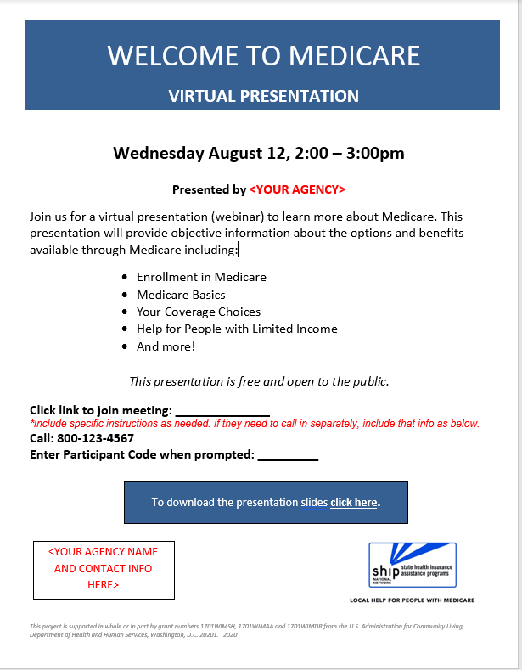
Sample Announcement
Notes:
This is only a sample that you could use as a template. There are no actual live links on this page. You can revise this to meet your needs, add your logo, contact information, and then add the links to your webinar. This is available for download in the files section of this Adobe Connect page.

Slide 15
Part 3: Presenter Tips
Consider length of presentation.
Practice on the platform before event.
Have the link to presentation handout available for download before event.
Decide if you’ll be recording the presentation. Let attendees know!
Go into the platform early enough! And begin on time. Have presentation ready to go.
Explain how to ask questions—chat box or comments section. Be sure to monitor.
Stay on schedule.
Consider number of links, don’t overwhelm—make sure it is clear to them who they can contact for help.
Include your contact information on the last slide, and verbally remind people.
Notes:
READ Through list! These tips and a few others are listed on a tip sheet that you’ll find in the files section of the Adobe Connect page.
**I also recommend taking a few minutes after your presentation to make some notes about what went well, and what you might want to do differently for your next virtual presentation while those things are still fresh in your mind.

Slide 16
Part 4: Additional Tools
Presentation Announcement--Sample
NCOA Tools for Reaching a Remote Audience
Presenter Tip Sheet
Welcome to Medicare 2020 PPT
Customize with your local contact information.
GWAAR website: https://gwaar.org/granttee-trainings-and-information
Notes:
Here is the list of tips and tools I have referred to. Again, you can find these resources in the files section of the Adobe Connect page. You can download these from there.
They will also be available, along with the recording of this webinar on the GWAAR website on the Medicare Outreach and Assistance Trainings webpage, and I have it linked here.

Slide 17
Sharing of experiences
Notes:
Several agencies have shared what they learned from the virtual presentations they have done so far. (Read Comments.)

Slide 18
Sharing –Common Points
Practice, practice, practice!
Make sure people know how to ask questions.
Provide the handout to make it easier for people to follow along.
Bring energy to your presentation!
Be sure to record so it can be shared/viewed later.
Notes:
After hearing those experiences, I just want to highlight a few of the common points that were shared.

Slide 19
Questions?
Notes:
I want to especially thank those agencies that have done the virtual presentations and shared their experiences with me. I hope this information has been helpful to you. Before I end the webinar, I’m going to check the chat box again for any questions.

Slide 20
Contacts
Debbie Bisswurm, GWAAR
Debbie.Bisswurm@gwaar.org
608-228-0898
Phoebe Hefko, DHSHefko, DHS
Phoebe.Hefko@dhs.wisconsin.gov
(608) 267-3201
Notes:
As always, please reach out to me if I can be of assistance with any Medicare outreach ideas or resources. Have a great rest of the day everyone.

