Slide 1
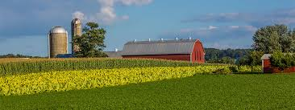
Medicare Outreach in Rural Wisconsin
EBS Training
February 2018
Debbie Bisswurm, GWAAR
Notes:
Many parts of Wisconsin are considered rural. Even for those of you who work out of a city, you likely have parts of your service area that are considered rural.
And rural areas pose challenges when it comes to conducting outreach--So I want to take a little time this morning to go over some ideas that may help.

Slide 2
Common Characteristics in Rural Areas
People tend to know their neighbors
More trusting of people or “brands” they know
More likely to value affordability
Strong sense of community/shared community values
Community history is important
Be aware of issues of concern or interest
Major business closing
History of tornado or flood activity
Other big events affecting the community
Notes:
First—it is helpful to note some of the Common Characteristics in Rural Areas--Not that these aren’t true of people in urban areas, but it is more likely you’ll see these characteristics in a small community or rural area.
Those of you who are from rural areas or have worked there for a while are certainly aware of these and other characteristics—but it is helpful to think about them in terms of your messaging and interactions with people.
For example—when you receive new Medicare information—are there ways that you can present the information that will be more well-received based on what you know about your community?

Slide 3
Facing the challenges
Increased number of isolated people
Limited transportation
Large land area to cover
Ratio of “Time Spent : People Reached” is low
Notes:
When we talk about Facing the Challenges--The biggest challenge—and probably most obvious—is that in a Rural Area, the people you are targeting with your outreach are quite spread out geographically--compared to an urban area—where you can reach a large number of people more quickly. There are more geographically isolated people.
Limited Transportation is an issue
And there is more distance to cover--- it is likely more difficult for some people in your service area to get to you, which highlights the importance of getting out to them with your message.
And the reality is that the RATIO of time spent to people reached is lower….

Slide 4
How do you get your message out—especially to the isolated?
Notes:
I have spoken with some EBSS who are from counties that span a huge geographic area—which makes it very time consuming and all the more challenging to reach beneficiaries who are isolated!
It requires much more planning. And because staff time and resources are limited, it is important to try to coordinate that outreach in a way that it will be most cost effective in terms of gas mileage and time!
During the last training I reviewed Best Practices for Outreach. Consider how those translate to your particular area. You may find that some things work and some things don’t’—you may find different ways to accomplish some outreach activities.
But in order to make sure you are reaching all corners of your county or service area, you will need to look at a combination of types of outreach activities.

Slide 5
Create and Manage Your Outreach Plan
Face-to-face activities with beneficiaries
Presentations
Health or Senior Fair Exhibit
Face-to-face with community partners
Educate
Share resources
Traditional Media Sources
Other printed materials
Newsletter articles
Brochures, Posters, Flyers
Notes:
I encourage you to have an Outreach Plan for the year. This will help guide your work—and as you juggle the responsibilities of the day to day work with clients, it is much easier and more likely to get accomplished if the activities are put into a calendar. That way, at a glance you can easily check whether you are incorporating different types of activities throughout the county.
Make sure your plan includes….
The plan can be revised if new opportunities pop up--

Slide 6
When Working in Rural Areas
Personal communication works best
Earning trust is key
Pay attention to community values & tradition
Notes:
So when working in Rural Areas, there are three points I want to emphasize:

Slide 7
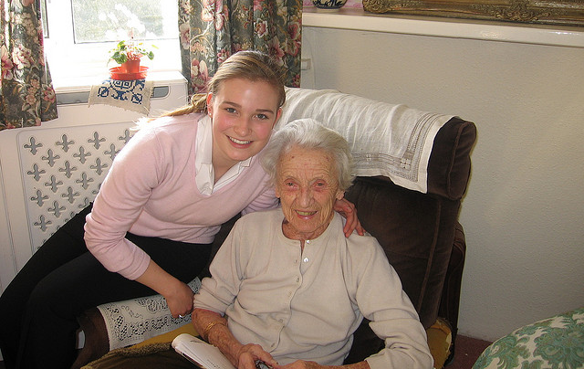
Personal Communication
Meet with people whenever possible—getting out to the isolated
Time consuming, yet effective!
Offer presentations throughout service area
Check with others in your agency who may be visiting isolated people and share your information.
People receiving home-delivered meals
need an annual visit
Notes:
And it doesn’t necessarily need to be you doing all the visiting—is someone in your office going out to make a home visit? Or for those in your office who may have phone contact with people, make sure they know about MSP/LIS and know to encourage people to call you when they need help.

Slide 8
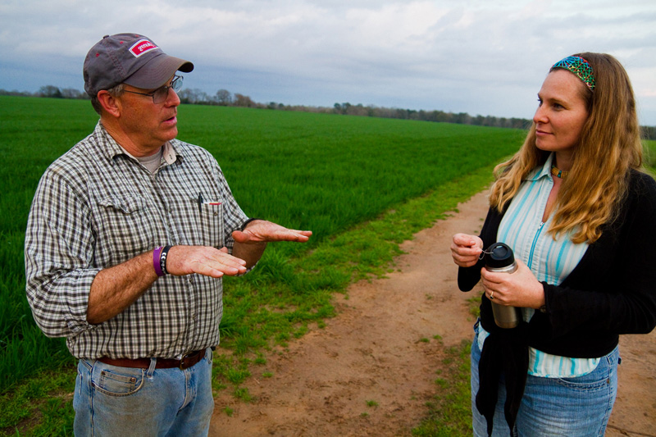
Make yourself well-known and visible in the community
Hold office hours in outlying areas
Tell people about yourself—build a connection
Be modest & humble
Give examples of how you have helped others in the community—(without names or other information that would reveal who you are talking about!)
Notes:
More ideas about personal communication— (list above)

Slide 9
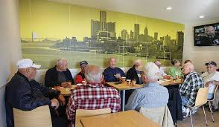
Connect with Trusted Community Leaders
Important to win over key opinion leaders
Popular business leader
Mayor or other popular local figure
Women’s club leader
Educate them and ask them to pass it on
Help them understand the impact these programs can have
Give them flyers/brochures
Generate positive word-of-mouth from these local sources of authority
Notes:
Who do people in the community listen to? These are the ones you want to seek out and win over.

Slide 10
Earning
Ask a “trusted” community leader to introduce you
Call people you know from community groups and ask to present at their meetings
Know the community history and how it may impact people
Use volunteers from the community—especially the peers of your audience
Get their “buy-in” and give them a “script” so they know what to say
Notes:
--winning over those Key community leaders can be a big help!

Slide 11
Community Values & Tradition
Appeal to what is valued: Dependability, Affordability
Many hold traditional values regarding work and family
Many will value self-sufficiency
Acknowledge that value of self-sufficiency in your message:
“These programs are a benefit of the taxes you’ve paid for years.”
Emphasize the benefit of these programs to the greater community
Notes:
I touched on this earlier, but want to emphasize it again here. Pay attention to the values and traditions of the communities you work in.
In terms of your messaging—and your approach. --Does it fit with these values..
And when discussing the benefit programs, Be sure to reassure people that your work with them is confidential!
and the help these programs can provide may allow people to spend more of their money in the community.

Slide 12
Leverage Partnerships
Local Hospital/Clinics
Pharmacy
Churches
Dr./Dentist
Well-known, trusted
Local transportation/volunteer drivers
Family caregivers/local support groups
Notes:
Leveraging partnerships with other community agencies continues to be a best practices for expanding your outreach! Connect with other professionals who may have contact with isolated individuals.
Leave brochures/flyers at offices.
There may be a pastor or designated staff from a church who visits the homebound. Share information with them to share with others.
Transportation/drivers. Especially, the home delivered meals drivers—they may be the only person a homebound individual sees during the day.
Share information with caregiver and support group leaders
Reporting issue—oh and here’s an important reminder—lets say you meet with a group of volunteer home delivered meal drivers to tell them about MSP and LIS—that is great outreach and should be captured in your PAM reporting!

Slide 13
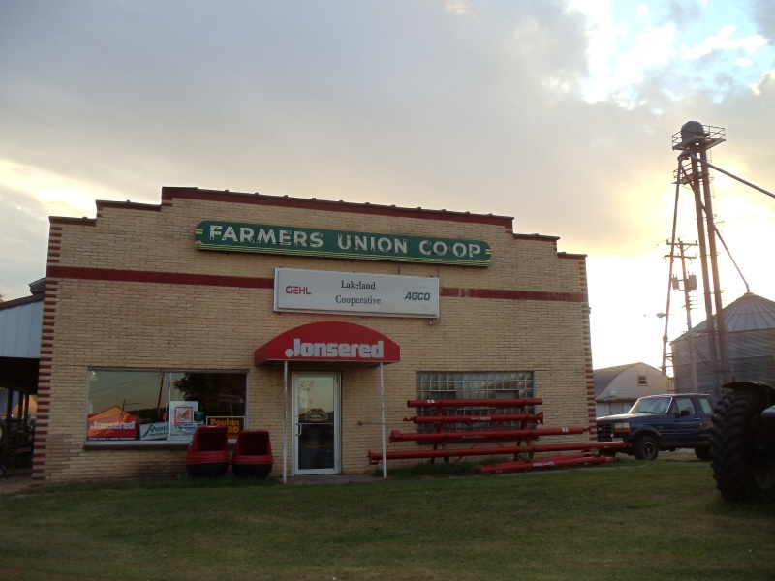
Connect with Local Businesses
Hardware Store
Grocery Store
Farm Co-op
Feed Store
Focus on businesses important to those who may come to town only when necessary
Notes:
In addition to the usual community partners, think about other local businesses in your area. There are people who will never go to a Medicare presentation, but they’ll go to the grocery store—so see if you can reach them that way.
Not just to post a flyer, etc., but it is also a good idea to connect with the store managers, the employees who see people every day. Make yourself known to them and encourage them to spread the word about Medicare related programs and how you can help.

Slide 14
Other Possibilities…
Local Coffee Shop or Barber Shop where older people tend to gather
Notes:
Every county has its own unique features. Whether it is a local coffee shop, a barber shop or other location--Make yourself known to the owners and patrons of the places people tend to gather. Again, make sure they know how you/your agency can help the people of the community—tell them about the programs to help people with limited income. See if they are willing to hang a flyer or have your brochures available there.

Slide 15
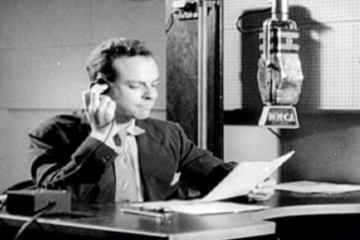
Traditional Media Sources
Newspaper
Radio—Ad or talk show
TV—local stations
Community Calendar
Notes:
Traditional Media is often a good way to reach isolated people. For those who just don’t get out into the community very often, the Newspaper, Radio or TV can bring your message right into their home.
Some agencies have been able to develop a relationship with a local radio station and have been successful with a range of activities. One example is having the EBS interviewed by the radio show host. And another good example was an agency that was interviewed by a popular TV anchor talking about how the low-income benefit programs help people.
Check to see if anyone in your office has a connection to a local tv or radio personality? If not, you can still reach out and tell them about what you do. Local tv and radio are always looking for “good stories”.
Consider also those free local papers that are delivered to the door.
Once you have developed a relationship it will be easier to get your message out there in the future.

Slide 16
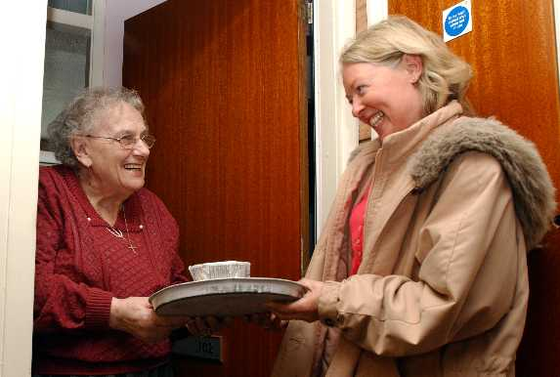
Stuff Flyers/Brochures into ANYTHING!
Consider anything that is delivered or picked up:
Home Delivered Meals
Prescription Medication Bags
Grocery Bags
Church Bulletins
Other?
Notes:
And another good way to reach those isolated individuals---consider flyers that can be delivered with a home delivered meal. <On our website—samples of flyers for home delivered meal outreach>
When you connect with the pharmacist, give them a brochure and talk with them about including a small flyer in the prescription bags they hand out—this is an effective thing to do during OEP and we have full page and ½ sheet flyers on the website that can be customized and used for this purpose.
See if a local grocery store would allow you to place flyers in grocery bags.
Church bulletins—another great way to get the message out—a short article or ad.
Think about other things that might be unique to your county.

Slide 17
Highlights from Around the State
ADRC—Central WI
Local grocery stores & pharmacies (outreach materials)
Farmers Markets
Barron, Rusk Washburn Counties
Created an ad targeting farmers
Bag stuffers at Gordy’s Market during Senior Discount Day
Kenosha County—
Partnership with rural food pantry/social service agency. Became weekly staff outreach site targeting low-income rural individuals
Pharmacy partnership: Walgreens Senior Day
Sawyer County—lack of social events so—create one
Hog Fest
Style Show
Bingo on the Road
Notes:
Keep in mind these are just examples of some of the things agencies around the state have done. Every county is unique so—find what works best for your county.

Slide 18
Debbie Bisswurm, GWAAR
debbie.bisswurm@gwaar.org
608-228-0898
Phoebe Hefko, DHS
Phoebe.Hefko@dhs.wisconsin.gov
(608) 267-3201
Remember to check out the resources available on the Medicare Outreach and Assistance page at www.gwaar.org

Slide 19
Questions?
Notes:
Are there any questions or comments from anyone on the line?
Also—please note that the Medicare outreach trainings are being done bi-monthly. The next two will be done as webinars separate from the EBS trainings. The next training will be done on April 25 at 9am. Our topic at that time will be Medicare’s preventive services and partnerships with health promotion programs. Webinar details will be sent out prior to that date.

