Slide 1
Promoting better health
For people with Medicare
Debbie Bisswurm, Medicare Outreach Coordinator &
Angie Sullivan, Health Promotions Specialist
Greater Wisconsin Agency on Aging Resources
February 2020
Notes:
Hello everyone, I am Debbie Bisswurm, Medicare Outreach Coordinator, and I am joined by Angie Sullivan, GWAAR”s Health Promotions Specialist.
Our session today will focus on Promoting Better Health for People with Medicare—and we will be sharing some tools and strategies for conducting outreach regarding Medicare’s preventive benefits as well as for developing and maintaining a valuable partnership with your local health promotion programs.

Slide 2
Training Objectives
Conduct outreach to promote Medicare Preventive Benefits.
MIPPA Grant
SHIP Grant
Promote increased awareness of Health Promotion programs.
Encourage connection with Health Promotion programs to reach more people.
Notes:
Both SHIP and MIPPA grants provide funding that supports outreach to promote Medicare’s preventive benefits and health promotion programs. We often focus much of our attention on the financial benefit programs—which is very important. But financial health is a part of a person’s overall health—and the two are tied closely together…Taking advantage of preventive benefits can end up saving people money in the long run. WE know that some people with lower incomes avoid medical appointments due to the cost. Many are not aware of all the benefits available to them.
So we want to be sure people are informed about Medicare’s Preventive Benefits.
We want to Increase awareness of Health Promotion programs.
And we want to encourage the connection between these programs at the local level so we can ultimately reach more people.

Slide 3
Agenda
Part 1: Medicare’s Preventive Services
Common Problems/issues
Materials for Outreach
Outreach Strategies
Part 2: Health Promotion Programs
HP Classes—brief definitions
Part 3: Collaboration
Questions
Notes:
I am going to start off this session talking about the Preventive Services; issues to be aware of; materials available to help you do your outreach as well as some strategies. Angie will provide some information about the Health Promotion Programs and the different classes that are available to people, and then we’ll talk about opportunities for collaboration.

Slide 4
Part 1: Medicare Preventive Services
Welcome to Medicare Preventive Visit
Yearly Wellness Visit
Additional screenings/tests/services
Notes:
Medicare covers many preventive services starting with the Welcome to Medicare visit, and includes a Yearly Wellness Visit and additional screenings and services that are focused on preventing disease and maintaining health.

Slide 5
Welcome to Medicare Visit
Remind People that this is NOT a physical!
Visit Includes:
Height, weight, and blood pressure
Body mass index
Simple vision test
Review of potential risk for depression and level of safety
Discussion about advance directives if you choose
A written plan regarding screenings, shots, and other preventive services needed
Notes:
During the first 12 months that people have Part B, they can get a Welcome to Medicare preventive visit. This visit includes a review of their medical and social history related to their health, as well as basic measurements of height, weight, blood pressure, a simple vision test, assessing safety risk, and a discussion about advanced directives. It also includes education and counseling about preventive services including certain screenings, shots or vaccines—like the flu or pneumonia shot) and referrals for other care if needed. (But it is important for people to know that this is NOT a physical. Medicare does not cover a routine physical.) So, when people are scheduling their appointment for this service, it is important that they ask for it by name—the Welcome to Medicare visit. People do not pay anything for this visit if the doctor accepts assignment.
BUT—if other tests or services are done during this visit—the Part B deductible and co-insurance may apply.

Slide 6
Yearly Wellness Visit
Not a physical!
Visit Includes:
Review of medical and family history
Develop list of current providers and prescriptions
Record height, weight, blood pressure
Create list of risk factors and treatment options
Detection of cognitive impairment
Establish schedule of screenings for appropriate preventive services
Offer personalized health advice
Notes:
Once people have had Medicare Part B for longer than 12 months, they can get a Yearly Wellness Visit. (Again, NOT a Physical.) The focus of this visit is to develop or update their personalized prevention plan based on their current health and risk factors, and it includes a review of medical and family history, again taking those basic measurements of height, weight and blood pressure as well as assessing for cognitive impairment.
The beneficiary will be asked to fill out a “Health Risk Assessment” as part of this visit—to help in developing or updating the personal prevention plan.
Again, people pay nothing for the Yearly Wellness Visit if the doctor accepts assignment. BUT if additional tests or services are done, the Part B deductible and co-insurance may apply.

Slide 7
Additional Preventive Services
Detailed information about Medicare Part B covered preventive services can be found in the Medicare & You Handbook as well as on the Medicare.gov website!
Preventive Services Chart on GWAAR website can be used as a handout for your clients.
Notes:
The complete list of preventive services covered by Part B are listed in the Medicare and You handbook. (in the 2020 book it starts on page 30.)
Most of those preventive services and screenings are also covered in full by Medicare, but for some of them, the Part B deductible and co-insurance do apply.

Slide 8
Common Issues
Yearly Wellness Visit must be asked for by name.
The screenings/tests must be coded as “preventive” not “diagnostic” for full coverage, otherwise deductible and copay may apply.
“Covered in full” may not apply to all services.
Other issues discussed at an appointment can be billed separately and charge for “office visit” may apply.
When in doubt, beneficiary should ask!
Notes:
There are a few issues that are important to be aware of—you might get questions from people who think they’ve been billed improperly:
Again, The Yearly Wellness visit as well as the Welcome to Medicare must be asked for by name.
Screenings, etc must be coded as “preventive” not diagnostic for full coverage. Otherwise deductible and copay may apply.
If the person brings up other issues during their Yearly Wellness Visit, that are not part of the Yearly Wellness Visit, those may be billed separately and they may be charged for an “office visit”.

Slide 9
Preventive Services: Materials for Outreach
Brochure Insert—Health Promotion/Prevention
Preventive Services Chart
Medicare Placemat & Home Delivered Meal Flyers—featuring Prevention and Wellness
Articles to Customize
Medicare’s Yearly Wellness Visit
Keep Your Heart Healthy
Never Too Old to Immunize
Other prevention topics
Notes:
There are a variety of materials on the GWAAR website that may be helpful in doing your preventive services outreach. I list just a few of them here:
Brochure Insert—Prevention & Health Promotion
Preventive Services Charts—I have one that would work well at doctors offices/clinics for their waiting rooms—has a Prevention & wellness word search on the back and for all of these, you can include your contact info.
Placemats highlighting Preventive services that can be used at dining sites and other locations. Also a related Flyer that could be sent out with Home Delivered Meals.
A variety of newsletter articles on Prevention topics.

Slide 10
Brochure Insert Can be used alone or as an insert. Add your agency contact info.
Notes:
IN case you haven’t seen it, I just want to point out what the Brochure insert looks like. This is a 2-sided piece, with the Preventive Benefits highlighted on one side and the Health Promotion programs highlighted on the other.

Slide 11
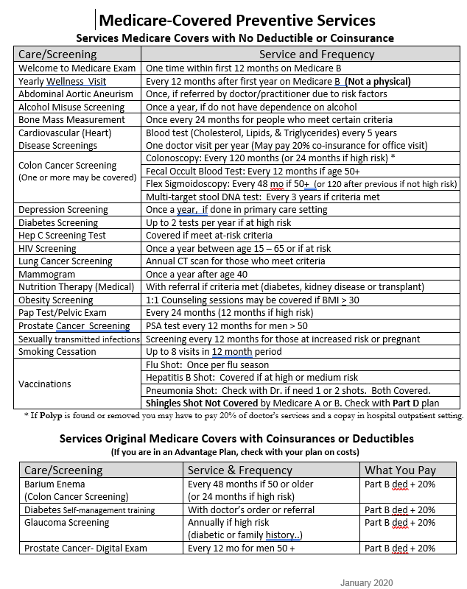
Preventive Services Charts Add your agency contact info.
Notes:
So here is a look at the Preventive services chart which includes the Service or Screening and how often they are covered by Medicare. The main part of this chart has the services that are covered in full and the lower smaller section has the services listed that still have the Part B deductible and coinsurance that apply.

Slide 12
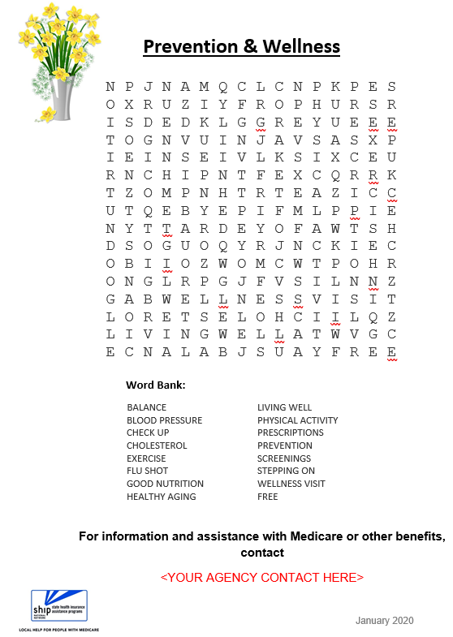
Preventive Services Charts Add your agency contact info.
Notes:
And on the backside of the chart is a Prevention and Wellness Word Search and you can add your agency contact information to encourage people to contact you for info and assistance with Medicare and other benefits.

Slide 13
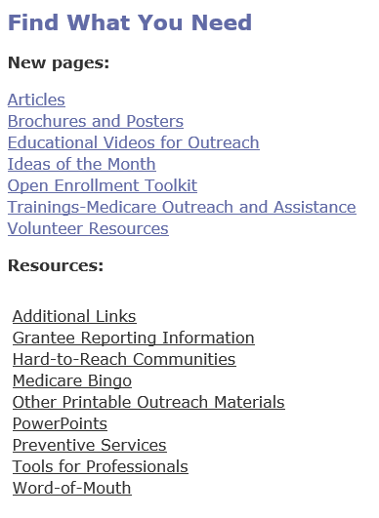
Where to find resources
Medicare Outreach and Assistance Page of GWAAR website: https://gwaar.org/medicare-outreach-and-assistance-resources
Notes:
You can find these resources on the Medicare Outreach and Assistance page of the GWAAR website.
Under Additional Links you’ll find a link to CMS Preventive Services materials as well as a link to the Wisconsin Institute for Healthy Aging (or WIHA) webpage that lists the workshops available in Wisconsin.
And if you click on Preventive Services, you’ll get a drop down list of all the materials I’ve talked about and many more.

Slide 14
Outreach Strategies
Add Info to your website.
Facebook Posts regarding Preventive benefits and HP programs.
Include Preventive Benefits info in your Medicare presentations.
Add Preventive Services & HP materials to existing “packets”.
Welcome to Medicare Presentations
All other Outreach Targets:
Senior Centers, Clinics, Meals on Wheels, Dining Sites, Libraries, etc.
Create new partnerships.
Health Promotion Coordinators
Health care professionals
Local public health departments
Caregiver or other coalitions
Notes:
As far as outreach strategies there are several things you can do, and some of them take very little extra effort or time from what you are already doing.
Add some Prevention and HP info to your website. (Links to articles, etc.)
Consider Facebook posts on this topic.
Add this information into your Medicare presentations and also into your existing packets. This is an easy way to get the info out without adding a lot of extra time.
Create new partnerships—Doing outreach on this topic gives you an valuable opportunity to connect with other health care professionals, public health departments, caregiver coalitions and of course, health promotion coordinators. So with that, I am going turn it over to Angie--

Slide 15
Part 2: Health Promotion Programs
What is Self-Management Education?
Refers to programs that help people who have ongoing health conditions learn how to live life to the fullest.
For many people, this means lives with less stress, more energy, and a greater ability to do the things they want.
Why Evidence-Based Matters?
Interventions that have been proven in scientific studies to be effective in preventing disease and improving health.
High-Level evidence based programs are those that have undergone randomized control trials and are ready for wide distribution.
Notes:
Good Morning. As an OAA Consultant in the area of health promotion, I provide technical assistance to 70 counties and 11 tribes on evidence-based self-management programs. I’m going to give a brief overview of what evidence –based self-management programs are and why they are important to the health of our communities. Self-management programs help people with chronic (or ongoing health conditions) with tools to understand and manage their condition. Evidence-based can be defined with one word…Research. The interventions have been proven to be effective in preventing disease and improving health. They have undergone randomized control trials and have been implemented in a community setting. To use Title III-D dollars – programs must be high-level evidence based. You can refer to GWAAR’s website for a listing of evidence based programs.

Slide 16
Who should take Stepping On?
Course Content:
Are 60 or older
Live in their home or independent apartment
Are able to walk without the help of another person
Does not use a walker, scooter or wheelchair most of the time indoors
Is cognitively intact
Understands the language used by the Stepping On Facilitator
Simple balance and strength exercises
The role vision plays in keeping our balance
How medications can contribute to falls
Ways to stay safe when out and about in one’s community
What to look for in safe footwear
How to check your home for safety hazards
Notes:
I’m going to talk about a few of our most popular evidence-based programs being implemented at Aging Units/ADRC’s around the state. The most popular class that is implemented by over 50% of Aging Units/ADRC’s is the fall prevention program Stepping On.

Slide 17
Benefits
31% of participants who complete the course are less likely to fall
Help others by sharing what has worked for you
Become more aware of fall hazards and learn how your fall risk can be reduced
Course Structure
7 weeks, 1 x week for 2 hours
Home Visit (optional)
Booster Session 3 months after final class
To find a class near you:
https://wihealthyaging.org/workshops

Slide 18
Living Well with Chronic Conditions
Is an evidence-based workshop for people with on-going health problems such as arthritis, obesity, high blood pressure, heart disease, depression and others.
Offered in both English & Spanish.
Meets 2 ½ hours, once a week, for six weeks in a community setting.
Provides participants with tools to better navigate life’s ups and downs and increase their health knowledge.
Notes:
Research confirms that LW participants experience significant, measurable health improvements and quality of life. The small group 10-12 people) is highly participative, where mutual support and success build the participants’ confidence in their ability to manage their health and maintain active and fulfilling lives.

Slide 19
Healthy Bowels, Healthy Bladder Program
A program that helps older women build the skills and confidence they need to avoid or improve symptoms of incontinence (bladder and bowel leakage).
3 sessions, each lasting 2 hours, every other week for one month
Limit of 8-12 women fosters trust & privacy
Lead by a female facilitator
Engages women to work together to set and meet personalized goals
Incorporates social interaction, tasteful humor, and fiber-filled snacks
Improves bladder symptoms for 71% of participants and bowel symptoms for 55%!
Notes:
New program in 2019.

Slide 20
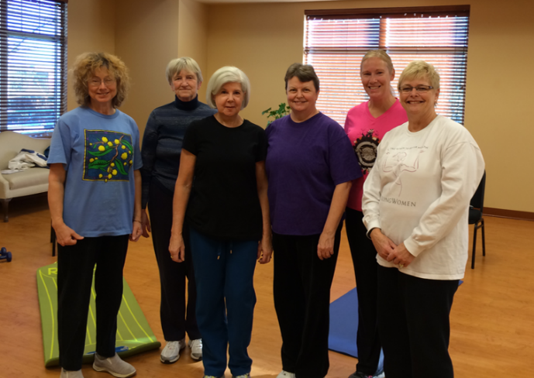
StrongBodies
StrongBodies is an exercise program for middle aged and older men and women.
Each class includes progressive weight training, flexibility and balance exercises.
Classes meet 2 x week for 1 hour for 12 weeks.
Find a program near you https://fyi.extension.wisc.edu/strongwomenwisconsin/county-programs/
Notes:
Over 16,000 participants in Wisconsin. Unlike the other evidence-based programs that I mentioned – most participants continue with the program for several years not just the 12 weeks.

Slide 21
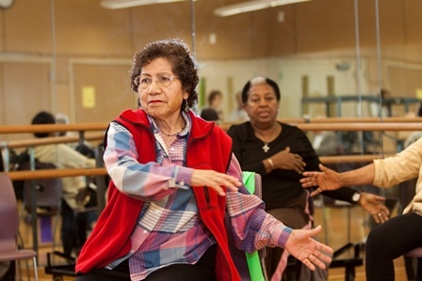
Health Promotion Coordinators
Less than half of counties have a Health Promotion Coordinator
Teach and/or coordinate health promotion classes
Seek out and foster partnerships
Recruit and train additional class leaders
List of HP Coordinators & Evidence-Based programs: https://gwaar.org/health-promotion-for-professionals
Notes:
When a county does not have a health promotion coordinator often times the responsibilities fall to the Aging Unit/ADRC Director or Supervisor. Many AU/ADRC will partner with local public health, hospitals, UW-extensions to combine resources to offer my evidence based programs to the older adults in their communities.

Slide 22
Part 3: Collaboration
Contact your local HP Coordinator or AU Director
Meet to discuss partnership opportunities
Share target audience
Explain your role
Share your outreach materials
Learn about HP classes offered in your service area
Notes:
Since we share a target audience, its obvious that this partnership with Health Promotion just makes sense. There are people participating in these programs who you may not meet directly in your work—so this can become a way to get your information to them.
The first step in this collaboration is to reach out to you local HP coordinator. Again, if your county does not have a HP coordinator, reach out to your Director to discuss connecting with the HP Programs.
Set up a meeting and start out by explaining your role. Share outreach materials about Medicare’s Preventive benefits—and you can share some of your other materials as well. Take the time to learn about the HP classes offered in your service area.

Slide 23
Next Steps
Offer to meet with HP Class Leaders to share info and resources
Offer to share HP Class flyers/promotional materials in your outreach
Share outreach ideas
Health fairs/vendor booths
Presentations
Maintain communication
Notes:
As far as the next steps, In addition to meeting with the coordinator, if your county is set up where they have class leaders in addition to a Coordinator—I would encourage you to try to meet with those class leaders as well—tell them about your role, and how you can assist people, and about the benefit programs and how those programs can help people. During the HP classes, there may be a resource table near their meeting room where you could share your brochures and other materials. Although the format of some of these programs does not allow for you to just come in and share info—there are specified times when information can be shared—for ex: their final session can be an opportunity for information like this to be shared.
*Take brochures or flyers about the HP classes. Offer to hand those out in your outreach as well. You and the HP Coordinator can also share ideas with each other about any potential outreach activities that you become aware of—letting each other know of health fairs coming up in your community, or other things like that. Perhaps you could do back-to back presentations for a special event. And then be sure to maintain communication. That is key to a partnership!

Slide 24
Questions?
Notes:
We hope this information has been helpful in getting you interested in connecting with your local Health Promotion programs. Before we end, do we have any questions?

Slide 25
Contacts
Debbie Bisswurm, GWAAR
Debbie.Bisswurm@gwaar.org
608-228-0898
Angie Sullivan, GWAAR
Angela.Sullivan@gwaar.org
608-228-8081

