Slide 1
Expanding Your Outreach Using Medicare Minutes
EBS Webcast
December 2019
Notes:
Good morning everyone. As the Medicare Outreach coordinator for GWAAR, I am continually looking at ways to increase the amount of outreach—and the effectiveness of the outreach—being done around the state. So this morning, I want to take just a few minutes to talk about the Medicare Minutes program.
I also want to point out that—a couple days ago you were sent an announcement regarding the See a Need/Take the Lead initiative of the Self Directed Volunteer Program. That is a project that can help your agency implement the Medicare Minutes program and I’ll talk a little more about that later in this session.

Slide 2
Background
Outreach Goal: Inform people about Medicare and the related benefit programs so they can make informed decisions about their health care options and access assistance when needed in order to maintain or improve the quality of their lives.
Medicare Minutes
We have over 1,161,000 Medicare beneficiaries living in WI. Looking at 2018 data, we reportedly reached about 4% through group outreach or around 66,000.
Expanding the use of Medicare Minutes throughout Wisconsin may be an effective way to reach more people.
Notes:
Along with ALL the other important things your agencies do, both SHIP and MIPPA grantees are required to do outreach related to Medicare—and the goal of that outreach is …
This data comes from what is entered into SAMS and extracted to the national SHIP Tracking and Reporting System.

Slide 3
What are Medicare Minutes?
Presentation model to educate Medicare beneficiaries.
SHIP Technical Assistance Center.
They are short, engaging presentations on timely topics.
Presentation topics and materials are provided monthly and include:
Script for public presentations.
Teaching materials for the presenter.
Handout for the public—customize with local contact info.
Because these materials are easy to use, you are encouraged to seek volunteers who would be interested in making monthly presentations in the community.
Medicare Minutes
Notes:
Many of you are probably familiar with the Medicare Minutes, but some of you may not be so I want to provide a little overview.
Medicare Minutes—is a great program—that has the potential to significantly increase the number of people you can reach! It is a presentation model for educating Medicare beneficiaries. The Medicare Minutes are made available to every state SHIP (State Health Insurance assistance Program) through the national SHIP Technical Assistance Center-- and Phoebe Hefko (from DHS) sends these out to agencies each month. They are also linked from the Medicare Outreach and Assistance Page of the GWAAR website.
They are short, usu 5 – 10 minute presentations on timely topics. The presentation topics and materials provided each month include: script…teaching materials for the presenter…handout for the public—customize.

Slide 4
Why use Medicare Minutes?
Increase the number of people reached by your agency.
Can be presented by volunteers (or staff) at local sites.
Keep volunteers engaged.
Help more people become familiar with your agency.
As their source of objective Medicare information
Easily incorporated into existing programing.
Can be used on their own OR to fill in time between events.
Medicare Minutes
Notes:
So why would you want to use Medicare Minutes at your agency? (Again, the national SHIP provides them to all state SHIPS and our WI SHIP program makes them available to any agencies receiving MIPPA or SHIP funding.
And it’s a great way to educate Medicare beneficiaries and increase the number of people you can reach.
They are usually presented by volunteers or staff at local sites—a great way to keep volunteers engaged!
It will help more people become familiar with your agency—and view your agency as their main source for objective Medicare information.
Easily incorporated into existing programing. These can be used on their own, they can be grouped together for a longer presentation, or they can be used to fill in time between other events. (When I was doing outreach, a local senior center offered me a 15 minute time slot before a wii bowling event—the Medicare Minute presentations would work great in those situations.)

Slide 5
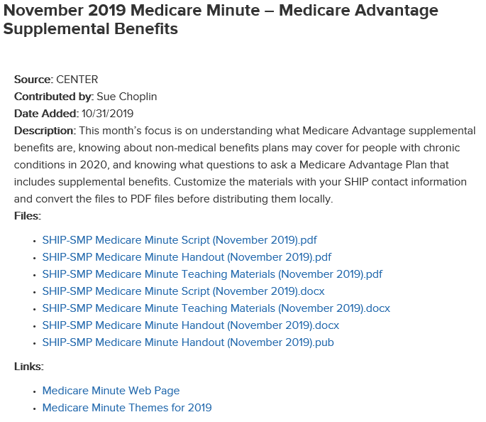
Medicare Minutes
Notes:
Here’s an example of the Medicare Minutes for this November. It includes a description of the topic for the month, and then the script, teaching materials, and handouts are provided as a pdf---as well as an easily customizable word document. With each Medicare Minute, there are links to the Medicare Minutes web page and you can take a look at the themes/topics for the year. I also have a link to the Medicare Minutes web page from the GWAAR website.

Slide 6
Different Ways to Use Medicare Minutes
Volunteers—Ideal way to use Medicare Minutes!
Each volunteer may present monthly at multiple locations
Monthly update meetings for volunteers—review materials, ask questions, share feedback.
Staff
Saves time since scripts/materials are prepared for them.
Or consider using scripts for an article in your agency newsletter.
Medicare Minutes
Notes:
So ideally, the most effective way to use the Medicare Minutes program is to have volunteers do the presentations. Even one volunteer going out to a few locations each month to read the short script can have an impact! And think of the impact you can have if you have several volunteers going to several locations each month!
The agencies I talked with that are doing Medicare Minutes have monthly update meetings for the volunteers, where they may meet with the EBS, review the materials, ask any questions and share feedback.
The scripts could also be used by you or other staff members who would like to do a presentation. It’s super easy—you don’t have to spend time creating a presentation and handouts—because the materials are all there ready to go. The scripts also can be used as the basis for a newsletter article. There really are a number of ways these Medicare Minutes can be useful to you.

Slide 7
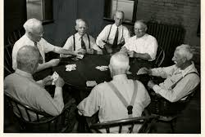
Medicare Minutes work great with groups that meet regularly:
Support groups
Social clubs
Other common locations:
Libraries
Senior Centers
Meal sites
Senior Apartments
Retiree groups
Church / Faith based groups
Medicare Minutes
Notes:
Since the topics and materials are provided monthly, the Medicare Minutes work great with those community groups that meet regularly—such as support groups, social clubs, as well as other locations that may host educational programs.
You can start small—do you know someone who has a monthly card club, book club or other social activity—see if they would be comfortable sharing information about Medicare by reading a short script to the group each month. It can start as simply as that and build from there. As they become more comfortable with the presentations, they may be comfortable taking on additional locations—they may even have suggestions for new locations.

Slide 8
Medicare Minute Volunteers
Primary Role:
Volunteers read script --they don’t do counseling.
Refer people to benefit specialists for more info or counseling.
Recruitment
Recruit from other presentations (Welcome to Medicare)
Promote at health fairs, etc.
Online recruitment sites
Tips on Medicare Minute website
Self-directed volunteer model: See a Need, Take the Lead
Respond to the needs of agency
Address some volunteer’s desire for autonomy
Medicare Minutes
Notes:
Let’s focus on the volunteers: If you already have a volunteer program at your agency, this is again a great way to keep those volunteers engaged. Some of you may have had volunteers to help during OEP. We often hear that if vol are not kept busy they may drift away. Being a Medicare Minutes volunteer gives them something to do each month. The scripts are easy to understand/easy to use. And the primary role of the volunteer is to read the script and hand out materials. The volunteers do not do counseling. They refer people to the benefit specialists for more information or counseling. If you don’t have volunteers at this time—here are a few points about recruiting for this:
Recruit from other presentations
Promote at health fairs, etc.
Online recruitment sites
Tips on Medicare Minutes website
I also want to again mention that this may be a great opportunity to use the self-directed volunteer model—for delivering and organizing these presentations. Although the script and handouts are provided, this self directed model can help recruit for a volunteer to be the lead contact—schedule presentations, and recruit other volunteers. And the purpose of this volunteer model is to address both the needs of the agency and the desire some volunteers have for more autonomy over their volunteer work. As noted in the letter sent out a couple days ago—contact Carrie Diamond with questions about that opportunity.

Slide 9
Find Medicare Minutes:
SHIP TA Webpage:
https://portal.shiptacenter.org/center-services/medicare-minutes/
Or link from GWAAR Medicare Outreach and Assistance webpage under Additional Links:
https://gwaar.org/medicare-outreach-and-assistance-resources
Medicare Minutes
Notes:
The Medicare Minutes are stored on the SHIP TA Center’s website in their Resource Library. I include the link on the slide here. I also have a link to the Medicare Minutes on the GWAAR website on the Medicare Outreach and Assistance page. You can find it under Additional Links.

Slide 10
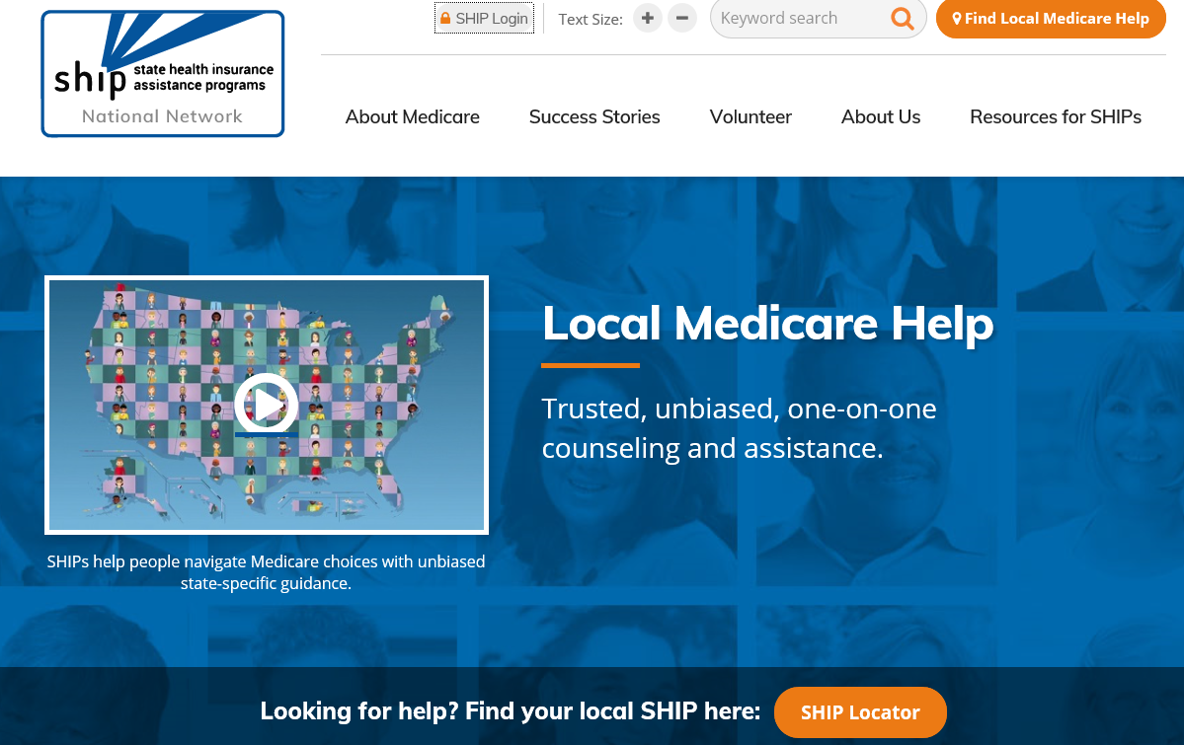
Find Medicare Minutes
Notes:
This is the National SHIP Home page. Anyone can access this site and there is a lot of helpful information for both consumers and professionals. In order to access the Medicare Minutes, you will need to login to the SHIP TA site. Click the SHIP login button at the top of the page.

Slide 11
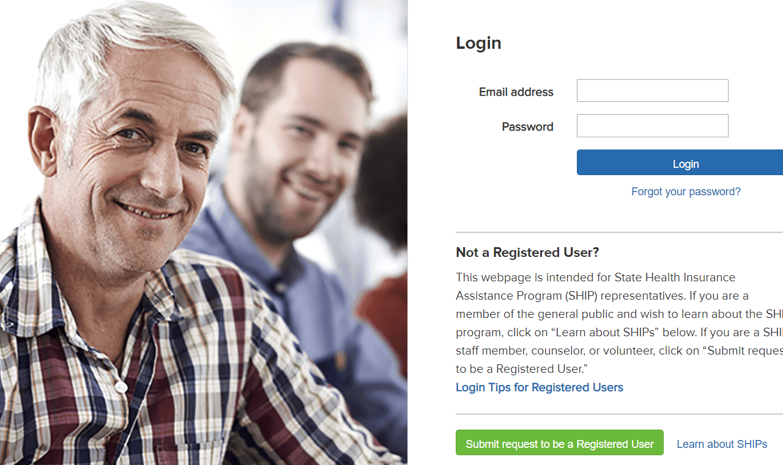
Notes:
If you do not have a login set up for the SHIP Technical Assistance (SHIP TA Center), there is a link to register on the SHIP TA site. Just go to that login page and follow the prompts. For those of you who are not yet registered, I really encourage you to get set up with this so you can access these materials.

Slide 12
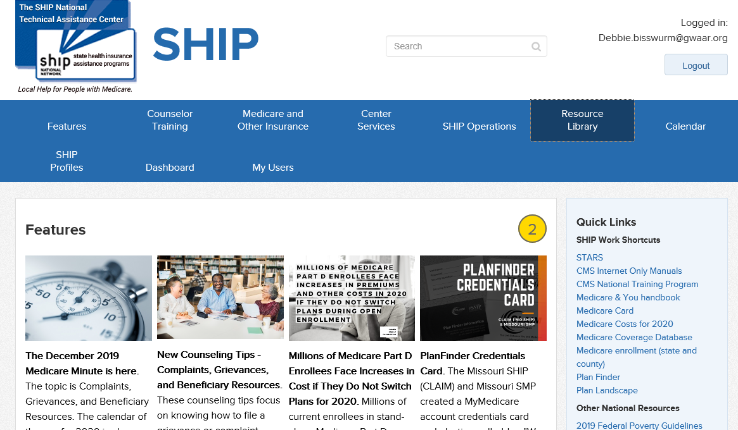
Find Medicare Minutes
Notes:
Once you are logged in, you will be on the home page for the SHIP Technical Assistance center where you’ll have access to a variety of materials. The most recent Medicare Minute is usually located in the Features section. You can also access the Medicare Minutes by going to the Resource Library.

Slide 13
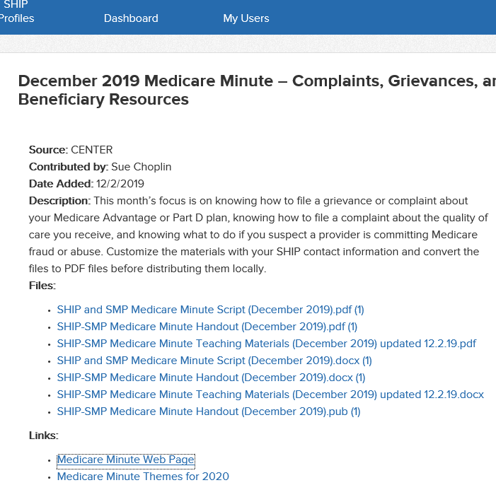
Access more topics
Notes:
When you click on that link, you’ll come to the page with the Medicare Minutes topic and materials for the month. Again, if you have viewed the current materials but would like to view more topics or get additional information, you can click the link to the main Medicare Minutes Web Page.

Slide 14
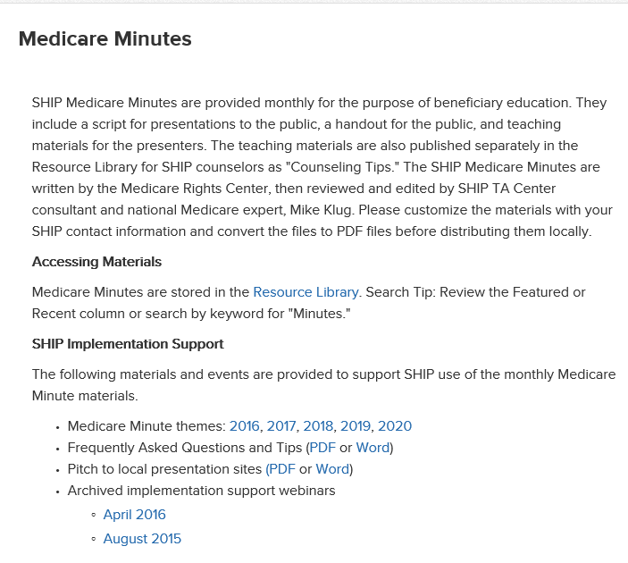
Notes:
Here you’ll find helpful information about the program as well as Frequently Asked Questions and Tips. They also provide a “pitch” you can use to help you explain the Medicare Minutes program to potential presentation sites.

Slide 15
Questions?
Medicare Minutes
Notes:
Before, I end this morning, are there any questions?

Slide 16
Contacts:
Debbie Bisswurm, GWAAR
debbie.bisswurm@gwaar.org
608-228-8098
Phoebe Hefko, DHS
Phoebe.Hefko@dhs.wisconsin.gov
(608) 267-3201
Medicare Minutes
Notes:
Since the Medicare Minutes program can make it really easy to do presentations, I am hopeful that many of you will consider incorporating it into your outreach plans—in one way or another. If this is something you’d like to do but still have some hesitation, please reach out to me. I am happy to work with you and help you find ways to get started with Medicare Minutes in your community.

