Slide 1
2019-21 Wisconsin State Budget Briefing

Slide 2
State of Wisconsin Biennial Budget Process
Joint Finance Committee:
- Public Hearings
- Vote on each section
- Send to full legislature.
April 2019 -- ???
WI Dept’s Submit Budgets: Fall 2018
Gov reviews agency requests & proposes Exec. Budget: Feb 2019
JCF Budget sent to Assembly, Senate for debate & amendment, then Conference Committee.
Passed & sent to Governor.
Gov reviews Budget passed &
signs, vetoes, or vetoes in part
Sent back to legislature
Budget becomes law
Goal: June 30, 2019

Slide 3
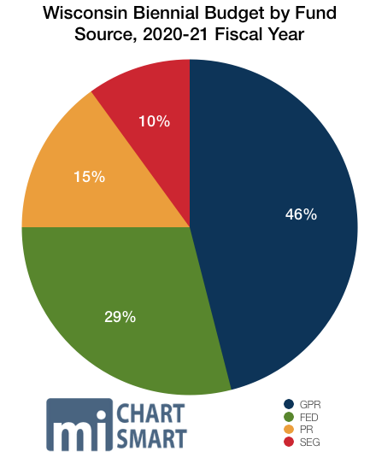
Wisconsin Budget: Revenues
General Purpose Revenues (Income taxes, sales taxes)
Federal Funds (including 60% Medicaid Match)
Program Revenue (Fees, Court costs, etc.)
Segregated Funds (gas tax, etc.)

Slide 4
2019-21 State Budget Expenditures by Function
Source: 2019-21 Governors Executive Budget

Slide 5
Sources: Executive Budget and Budget in Brief (Wisconsin Policy Forum)
State General Fund Spending Increases by Area (In Millions), 2019-2021

Slide 6
Budget Issues affecting Older Adults
Taxes & Homestead Credit
Medicaid Expansion
Health Care Coverage
Prescription Drugs
Mental Health
Children’s Long Term Support
Oral Health / Dental Care
Dementia Care Specialists
ADRC’s/Elderly Ben Specialists
Oversight of Assisted Living
Ombuds for Long Term Care
Personal Care Services
Family Care Services
Nursing Home / ICF Rates
Caregiver Task Force (EO # 11)
Minimum Wage
Family Leave
Transportation
Homelessness & Housing First
Automatic Voter Registration
Healthy Aging
Shared Revenue / Fair Deal

Slide 7
Taxes & Shared Revenues
Low & Middle class Income tax credit & Income tax reductions
$1000/10% nonrefundable credit for lower/middle wage earners ($80K / $125K)
Small decrease in lowest (4%) tax bracket on 1st $11,760 taxable income
Restore indexing on Homestead tax exemption & expand eligibility up to HH incomes of $30K (160,000 new filers, increase for 100,000 current claimants)
$40M Increase in Community Aids
Partial repeal of Manufacturers credit & full taxation of capital gains
Fair Deal Proposal
Allows + 2% in local bonding
Expands levy limit
No adjustment for MKE services
WI Minimum Wage by $1 to $8.25 in 2020/+75¢ next 3 yrs, index to inflation in 2024.

Slide 8
Health Care
Medicaid Expansion
138% of poverty (some dual eligible)
Increase federal match to 90%
82K+ covered (incl. caregivers)
$325M in add’l Medicaid Revenue
Restores DHS Waiver Authority
Pre-existing condition protections, no lifetime limits + essential services
$45M Community Health Benefit
Mental Health rate
5 Regional Crisis Stabilization Ctrs
Develop mental health consultation program incl. geriatric psychiatry
Electronic Health Info Exchange
Dental Care MA rate (50/50 or 30/5)
Licensure of Dental Therapists
Maintains SeniorCare Prescription Drug Benefit (CMS approval)
$250,000 Healthy Aging Grants

Slide 9
Long Term Care
Children’s LTC expansion
1.5% MA rate personal care
1.5% MA rate for CNAs I TaNH’s
2.5% MA rate for SNF/ICFs
1% add’l NH increase b/o acuity
$14.7M add’l for direct care workers
Caregiver Task Force NO funding
Dementia Care Specialists statewide + 27 positions (no add’l in MKE)
Adds 3 Board on Aging & LTC ombudsman to oversee LTC services for older adults
Adds 12 positions to Division of Quality Assurance to oversee Assisted Living facilities
Expands FMLA to employers of 25+ & expands definition of relatives
$3.75M for homelessness prevention
NO ADRC or EBS expansion or formula change for MKE County

Slide 10
Veterans & Corrections
Ends transfer of funds from Veterans Homes to the Veteran’s trust fund by switching to $15.8 million in state funds in the budget’s second year.
Continue funding for veterans peer-run respite in Milwaukee
Geriatric Population in Corrections: No changes in budget
Close Lincoln Hills & Copper Lake / new state secure juvenile facility in MKE

Slide 11
Transportation
Increases gas tax by 8¢ gal.
Eliminates minimum markup
Local Roads & Highways
10% General Transit Aids (+$13.8M)
21% Specialized Transportation Aids (+$6M)
10% Paratransit Aids
Creates Transit Capital Assistance Fund to replace public transit vehicles
NO NEMT reforms
Allows local referendum for inter-municipal transit services

Slide 12
Joint Committee on Finance
Senate | Assembly
Alberta Darling (R) co-chair | John Nygren (R) co-chair
Luther Olsen (R) vice-chair | Amy Loudenbeck (R) vice-chair
Howard Marklein (R) | Shannon Zimmerman (R)
Dewey Stroebel (R) | Terry Katsma (R)
Thomas Tiffany (R) | Mark Born (R)
Devin LeMahieu (R) | Mike Rohrkaste (R)
Jon Erpenbach (D) | Chris Taylor (D)
LaTonya Johnson (D) | Evan Goyke (D)

Slide 13
Get Involved!
Attend / Testify at Hearings
Submit Budget testimony to Joint Committee on Finance at: BudgetComments@legis.Wisconsin.gov
Attend town halls with local legislators / call your representatives, esp JCF
Follow your state senators and representatives on social media (FaceBook/Twitter) and subscribe to e-newsletters
Find your legislators online here: http://legiswisconsin.gov
Sign-up for the SENIOR STATESMAN training – Wed April 24th – Fri April 26th
Attend AGING ADVOCACY DAY on Tuesday, May 14th!

