Slide 1
Videos for Medicare Outreach
Ebs training
April 2019
Notes:
Good morning and welcome to today’s training on the topic of Using Videos for Medicare Outreach. The lines are currently muted to reduce background noise, but I will open the lines for questions at the end. In the meantime, if you do have any questions, please feel free to use the chat box on the Adobe Connect page, and I’ll try to monitor that as I am talking.

Slide 2
Why Video Outreach?
Videos are a great platform, and these days, often chosen as a preferred platform for viewing messages.
Quickly reach large number of people
Many people respond to this format and often share with friends/family
Keeps message consistent
Something people can review later to help them learn/understand the information
Notes:
As a little background into why we are providing this—we are always looking at new ideas and/or new ways to conduct outreach that will help to either get the message out to more people or to get the message out in a new way that may resonate better with some people. So when the Medicare Outreach and Assistance survey was sent out in December, we included a question to gauge interest in video outreach and we received several responses that this was, in fact, something some EBSs thought would be helpful. Many people, especially today, really enjoy watching videos and learning from them. Some of the benefits of doing outreach with videos are that,
Videos can help you reach a broader audience. They can be shared in-person with a group as part of your own presentation or sent out in a way that you can quickly reach larger numbers of people (as an unlimited number can be viewing it at once).
Also, Many people respond well to this format—again, especially today people like to watch videos.
It is also another way to continually provide a consistent message.
And, depending on how you use the videos, It may be something the people can click on to view at a time that is convenient for them.

Slide 3
What videos are available?
SHIP Outreach for Beneficiaries
CMS Medicare & You: Understanding Your Medicare Choices
Part of a You Tube series created by CMS
Coming Soon:
Notes:
So, We have created a new webpage that is now linked from the GWAAR Medicare Outreach and Assistance page. It is titled Educational Videos for Medicare Outreach. ON that page I have included some videos—and you might use each of them a little differently.
The first video is targeting Medicare beneficiaries to let them know what the SHIP is and how they can get assistance from WI SHIP Counselors, since the WI SHIP number is listed at the end.
The second video was created by CMS and is part of their You Tube series based on the Medicare & You book.
And lastly, we will soon be doing the recording for a Welcome to Medicare educational series. This will be a recorded training—so it will have a voice presenting the information on the slides and it will go through a comprehensive Welcome to Medicare program. It is based on the Welcome to Medicare Presentation PowerPoint that is on the GWAAR website. It will be broken into 6 parts, so people will be able to select which part they would like to listen to. The links to the Welcome to Medicare recordings will be added to the GWAAR website when they are completed and I will send out an email to all EBSs when that happens.

Slide 4
How can I use the videos?
Include the videos on your agency website
Include video link from agency Facebook page or other social media
Send video link in email to interested callers
Send link to community partners (partner education)
Use with your own presentation (before or during)
Play video on waiting room monitor
Notes:
There are several different ways that the videos can help with Medicare outreach and education in your communities.
You can include the videos on your agency website.
Include a link to the video from your agency Facebook page
Send a video link in an email to interested callers
Send a link to community partners as part of your partner education
Use a video with your own presentation—either before, during or after.
And lastly, some agencies may be able to play a video on a monitor in their waiting room.

Slide 5
Include on Your Agency Website or Facebook
Add videos to your agency’s website. You will need to follow your agency’s website guidelines. Contact your webmaster for instructions.
Include link to the videos on Facebook
Be sure to have a description of the video such as:
“Click on the video below to learn about the Wisconsin State Health Insurance Assistance Program, or SHIP, a public service for people with Medicare. The Elder Benefit Specialists at the <YOUR AGENCY NAME> are SHIP Counselors available to answer your Medicare questions. Call us at <YOUR NUMBER HERE>.
“Click on the link below for an educational video from the Centers for Medicare and Medicaid, “Medicare & You: Understanding Your Medicare Choices”
““Learn more about Medicare by following the link below. If you have questions or would like to attend a Welcome to Medicare session, please contact <YOUR AGENCY INFO HERE>.
Notes:
So the first idea, including a video on your agency website, can be accomplished in a couple of ways. You may be able to embed the video directly onto your website, or you may simply link to the videos from your website. Either way, you will need to follow your agency’s website guidelines. Contact your agency’s webmaster for instructions.
You might also consider including a link to videos on your agency Facebook page. Since many seniors use Facebook this can be a great way to share the videos with them, and they in turn can share them with others.
When you add a video to your website or Facebook, as with anything else, you’ll want to include a description that gets people interested in the video and tells them what it’s about. With the first video, since it talks about the WI SHIP program and basically advertises the services of SHIP Counselors, your caption is an opportunity to let people know that you as elder benefit specialists are SHIP Counselors.
The second video provides consumers with basic information about their Medicare options. Again, adding a description is always a good idea.
Once the Welcome to Medicare series is complete, you may want to consider having a link to this series on your website. It will provide another opportunity to educate people in your community about Medicare. ***I have a TIP SHEET for using videos for outreach, and on that TIP SHEET I have examples of Captions or descriptions that you can customize and use on your website. You can also use those descriptions in an email if you send out a link that way.

Slide 6
Email link to Callers
If emails are sent out to interested callers, the video links can be included. Consider the Medicare & You video as a way to educate people with some basic information about Medicare. This will provide them some basic knowledge before they meet with you.
Once the Welcome to Medicare is complete, you could send this out to interested callers as well.
To avoid bounces, place a still image of the video with a play button over it and then link the video to your website or the GWAAR website.
Notes:
So, the next idea for using videos for outreach is to include a link to a video in an email.
If emails are sent out to interested callers, this may be a great place to include a link to one of the videos. Consider the Medicare & You video as a way to educate people with some basic information about Medicare. This may help to provide them some basic knowledge before they meet with you.
Once the Welcome to Medicare series is complete, you could send this out to interested callers as well. (Or a portion of it.)
When you send emails out with a link included, to avoid bounces, place a still image of the video with a play button over it and then link the video image to your website or the GWAAR website.
I think everyone knows what we mean when we say bounce, but to be sure, if an email “bounces” it means it never actually got to your intended recipient, and the way we include links can sometimes cause that to happen. So that last tip is provided to help avoid bounces.

Slide 7
Send link to Community Partners
Educating community partners is an important part of Medicare outreach.
These videos can help provide a more complete picture of your services.
Consider sharing different videos depending on the community partner. (Or include both in an email.)
May lead them to view you as a reliable source for objective information.
May increase their referrals to your agency.
Notes:
(CHECK CHAT BOX)
There may be times that you want to educate community partners about Medicare or about the services you provide.
We always talk about the importance of outreach to community partners. Including a link in an email to them can be a great way to share information with them and also allow them to share it with others.
These videos can help them have a more complete picture of what you do and the help you provide, and may encourage them to share your resources more readily.
Consider including the SHIP video when you want community partners to understand all the ways that you can help people with Medicare.
The CMS Understanding Your Medicare Choices video will help them to gain a basic understanding of Medicare, and may help them to view you as a reliable source for objective information. This may in turn help increase referrals to you.

Slide 8
Use with your own Presentations
Show video before your presentation as introduction to your role as SHIP Counselor.
WI SHIP Information for Beneficiaries
Show as part of your presentation to provide basic information. May help to build confidence/trust in you and your agency.
CMS Understanding Your Medicare Choices
Once the Welcome to Medicare series is complete, show sections of the series, followed by discussion/answering questions.
Notes:
Videos can also be used along with your own presentations.
You can use them to help your audience understand the WI SHIP prior to giving your own presentation. This can be an introduction of who you are and what you do before you begin your topic. * the WI SHIP video would be appropriate for this.
Show as part of your presentation to provide basic information. May help to build confidence/trust in you and your agency.
* The CMS Understanding Your Medicare Choices video would work for this.
Once the Welcome to Medicare series is complete, you could show sections of the series, followed by discussion or a question & answer period.

Slide 9
Play on Waiting Room Monitor
Consider a TV screen/monitor in your agency waiting rooms
Great way to educate people while they wait.
Be sure to have your Medicare materials available in the waiting room for them to take.
Notes:
I know this is not necessarily something that is an option for all of you, but some agencies have a TV monitor in their waiting rooms where they are able to provide information and play videos. This can be a great tool for outreach and education.
Think of those people who are just sitting there waiting for their appointment. IF you have a Medicare video playing on the monitor, all they have to do is look up to learn about how SHIP Counselors can help them, or gain a basic understanding of Medicare.
Be sure to have your Medicare materials available in the waiting room for them to take.

Slide 10
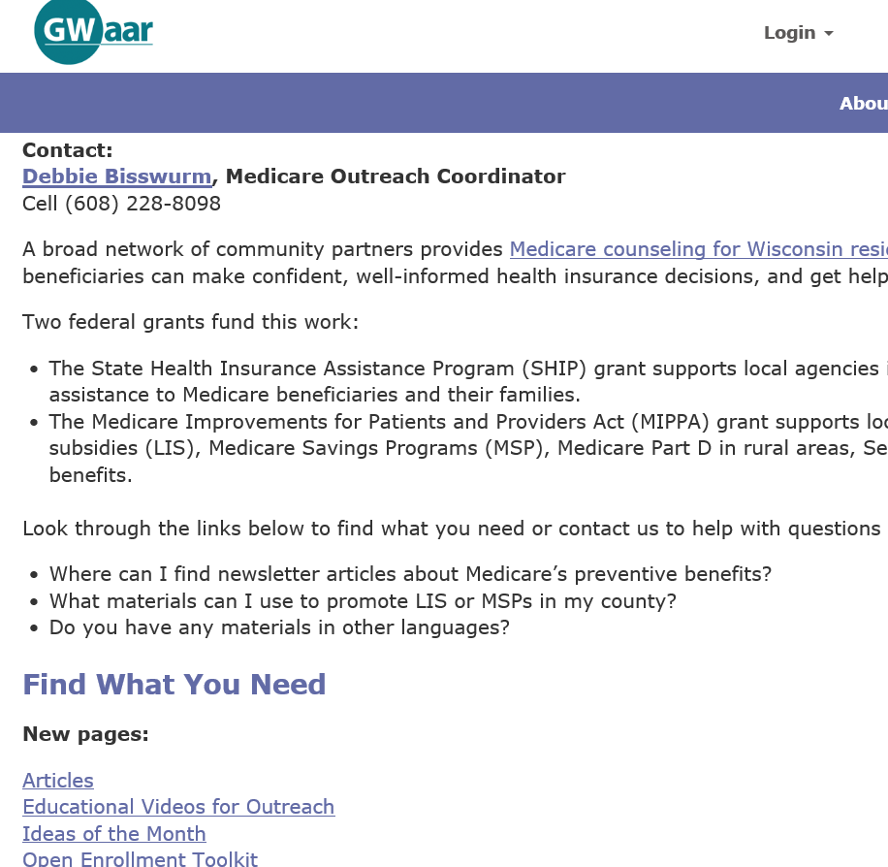
Where to find the videos
GWAAR Website: Medicare Outreach and Assistance Page
https://gwaar.org/educational-videos-for-medicare-outreach
Or link from the main page
Notes:
I assume some of you may have already discovered the videos on the GWAAR website. To find them, go to the GWAAR website, click on Medicare Outreach and Assistance Resources. Scroll down under “New Pages”. Click on Educational Videos for Outreach. That will bring you to the new page.

Slide 11
Where to find the videos
Notes:
Right now we have the two videos there that I have discussed today. We include some tips on how you might want to share them. Our description is directed at all of you as professionals. But again, if you plan to include a link to the videos on your website, you’ll want to include a caption or description directed at consumers.
(SHARE SCREEN AND GO TO GWAAR WEBSITE.)

Slide 12
How to report this outreach
SAMS/STARS
Group Outreach and Education Form—presentations
Media Outreach and Education Form—email, website, Facebook, etc.
Type of Media
Estimating numbers reached through videos
Not required for Media Outreach and Education
To include a general estimate:
TV, Radio, Newspaper outlets—use estimated population in broadcast/circulation area.
For Facebook or other social media—use the number of followers and/or “likes”.
Notes:
Please remember if you use the Medicare-related videos for outreach, these activities should be reported in your STARS or SAMS reporting. IF you put a video on a thumb drive and use it as part of a presentation, you would report this as a Group Outreach and Education activity. If you use the videos in an email, your website, or Facebook, it can be reported as a Media Outreach & Education activity. The “type of media” you select will depend on how you use the video of course.
When entering this information into STARS or (for benefit specialists) the SAMS assessment forms, you may wonder how to estimate the numbers reached through your video. It is difficult or impossible to determine exactly how many people you reached through these methods. So please note: You are not required to report how many people you reached through media outreach and education. (This is an optional box on the Media Outreach and Education Form.) If you’d like to include a general estimate for any types of media outreach, you can follow these rules of thumb: When dealing with television, radio or newspaper outlets, use the estimated population in the broadcast or circulation area. When using Facebook or other social media, use the number of followers and/or “likes.”
And for videos used on your agency website, you can use your website analytics to determine the number of visitors to a page during a certain time frame. Again, for Media outreach, that estimate is OPTIONAL.

Slide 13
Questions?
Notes:
At this time, I am going to open up the phone lines (*5), for any questions. So please go ahead, if anyone has questions—or if anyone has a TV monitor in their agency waiting room and would like to share any information about how that works.
The PPT is available for download from the Adobe Connect screen. I also created a TIP SHEET for using videos for Medicare Outreach and that is also available on the Adobe Connect screen.

Slide 14
Contacts:
Debbie Bisswurm, GWAAR
debbie.bisswurm@gwaar.org
608-228-8098
Phoebe Hefko, DHS
Phoebe.Hefko@dhs.wisconsin.gov
(608) 267-3201
Notes:
I want to thank all of you for participating in the training today. All of the materials, as well as the recording, will be uploaded to the GWAAR website, on the Medicare Outreach and Assistance page under Trainings, within the next day.
And with that, I am going to end the webinar at this time. (CLICK ON MEETING, AND SELECT STOP RECORDING.)

