Slide 1
Senior Medicare Patrol and SHIP/MIPPA Outreach Next Steps in Building Partnership
Debbie Bisswurm, Medicare Outreach Coordinator
Ingrid Kundinger, Senior Medicare Patrol
Greater WI Agency on Aging Resources,
Notes:
DEBBIE
Good morning everyone. Before we begin this morning I want to take a minute to point out that—as most of you are probably aware—last week an email was sent out to let you all know that since the federal poverty level guidelines for 2019 have come out, all of the materials on the Medicare Outreach and Assistance page of the GWAAR website have now been updated and are available for you to download and use. In case anyone missed that email, I just wanted to make you aware of that. If you do have any questions about the materials or are unable to locate something, just call me or send me an email.
Over the past months you’ve all heard about the Senior Medicare Patrol program and have heard from Ingrid Kundinger, GWAAR’s SMP coordinator. But this morning we would like to talk a bit more about the next steps in building a partnership between the work that you all do , and the Senior Medicare Patrol program.

Slide 2
Importance of Partnerships
Community partnerships remain one of the most effective ways to expand the reach of your outreach.
WI SMP program provides another way to reach Medicare beneficiaries in your service area.
As the SMP program grows in WI, so will your opportunities to get your message to more people through collaboration.
Notes:
DEBBIE
I have spent a lot of time during out trainings talking about the importance and the value of community partnerships. These remain one of the most effective ways to increase the number of people that your reach.
WI SMP program provides another way to reach people with Medicare in your service area because—you share a target audience. And it is possible that some people may go to their outreach events, or come into contact with the SMP volunteer that might not go to your outreach events or hear your message. So by partnering, we can get your info out there more.
And of course, as the SMP program grows in WI, so will your opportunities grow for more collaboration.

Slide 3
SMP Snap Shot: First 6 months
Program Launch: materials, helpline, website
15 Group Education Events across the state
9 Community Outreach Events
42 individual interactions with or on behalf of Medicare beneficiaries
Began work to establish a partnership with the Great Lakes Inter-Tribal Council to work with the 11 Federally recognized tribes
Received 3 volunteer applications for screening and processing
A great start, but so much more to do, especially with volunteer recruitment!
Notes:
INGRID—
The first six months of the SMP grant at GWAAR was busy. Lots of behind the scenes things happened to launch the program and set-up the foundation to build a strong program.
From June – December, 2018, the WI SMP provided outreach and group education in 16/72 counties.

Slide 4
SMP Next Steps
Over the next 6 months we will be continuing to recruit and train volunteers.
Our ultimate goal is to have a volunteer in each county who can:
Provide local presentations;
Distribute materials;
Attend Senior Health Fairs and Wellness Expos to share information.
As we have more volunteers trained across the state, we will be more available to attend events and provide presentations, which means reaching more Wisconsin Medicare beneficiaries.
Notes:
INGRID

Slide 5
Benefits of SMP Partnership
Increase your SHIP/MIPPA outreach by creating new opportunities to share your information.
May help to keep “your” volunteers engaged so they remain interested in volunteering for you.
Potentially provides new volunteers who could help you during next year’s open enrollment.
Notes:
DEBBIE—So, what do you get out of this partnership?
Increase your SHIP/MIPPA outreach by creating new opportunities to share your information—I know you all want to increase the numbers that you reach so here’s another way to do so.
This partnership may also help you to keep any volunteers that you already have, engaged throughout the year so they remain interested in volunteering. We often hear that a common reason people stop volunteering is that they feel they weren’t needed, or were not needed enough. Or if they volunteer only during the fall they may drift away during other times of the year to find something else to do.
This may also provide new volunteers who could help you during next year’s open enrollment.

Slide 6
Communication with Volunteers Statewide
Newsletters
Share information about low-income benefit programs and reminders to refer people to EBS if they need assistance.
Statewide or regional meetings
Share announcements about upcoming outreach events.
On-going education and best practice sharing
Volunteer recognition
Notes:
DEBBIE
There will be several ways that we’ll be able to communicate important information with the SMP volunteers throughout the state. We may want to provide an update or share information about the benefit programs, or open enrollment. We have several ways that we’ll be able to do that:
Newsletters, --we can add an article or a little blurb into the newsletter that will be read by all SMP volunteers around the state.
Statewide or regional meetings

Slide 7
The Ideal Local Partnership
A solid relationship between benefit specialists and SMP volunteers in your county.
Sharing of outreach materials.
Sharing info about outreach opportunities:
Senior health fair / exhibit
Farmers market /
Maintain regular communication to facilitate sharing of info and materials.
Consider co-presenting to a group and explore opportunities for further collaboration.
Notes:
DEBBIE
While we are still building this program in WI, the Ideal local partnership between you and the SMP volunteers would include:
A solid relationship between YOU and SMP volunteers in your county
Sharing of outreach materials between the two programs
Sharing info about outreach opportunities:
Senior health fair / exhibits
Farmers markets
Maintain regular communication to facilitate sharing of info and materials
Consider co-presenting to a group and explore opportunities for further collaboration

Slide 8
Steps to Develop the Partnership
Find out who is your local SMP volunteer.
Contact the volunteer to introduce yourself.
Meet to discuss partnership opportunities.
Educate about:
Your role
Medicare programs for people with limited incomes; MSP & LIS
Preventive benefits
Notes:
DEBBIE –So while that is the “ideal” that we hope everyone can get to, we need to start with the first few steps:
Find out who your local SMP volunteer is** So for now….
Contact the volunteer to introduce yourself
Set up a meeting to talk about partnership opportunities
During the meeting, educate them about
Your role (and give examples of how you help people)
Medicare programs for people with limited income—MSP, LIS
Preventive Services
Be sure to listen to their SMP info as well.

Slide 9
SHIP/MIPPA Materials to Share
MSP/LIS/SenCare Brochures
Prevention and Health Promotion Inserts
MSP/LIS/SeniorCare Inserts
Preventive Services Handouts
Brief Program Descriptions (For their reference only)
AND…Take their SMP materials so you can share with beneficiaries you meet as appropriate.
Notes:
DEBBIE
During your meeting you’ll want to have some materials available that you can share with the volunteer. Here are a few things that would be particularly helpful to share:
Brochure & inserts etc.—Give them a supply of these so they can hand these out to their participants and/or have them available for people.
Preventive Services Handout—Give a supply of these as well. Tell them a little about the preventive services, …
Brief Program Descriptions—This is something that you can give them just as a reference for the volunteer. It is not meant as a handout for outreach. It is intended to give a little more description about some of these programs. In order for someone to help spread the word about programs such as MSP and LIS they need to know how to describe them.
Certainly if you have your EBS brochures or other agency brochures, you can share those as well. And be sure to let them know how and when to refer people to you.
AND—take their SMP outreach materials so you can share them with people you work with.

Slide 10
Volunteers Needed!!!
Simple ways you can help SMP:
Share the opportunity with current volunteers.
Include a brief blurb (provided by SMP) in your newsletters.
Use the updated “Welcome to Medicare” presentation, which includes slides about the WI SMP program*.
Share the quarterly SMP “The Scoop” Newsletter with those who might be interested.
Current volunteer roles we are recruiting for:
Information Distributor, Exhibitor and Presenter
Notes:
DEBBIE
There are a few things that you can do to help the SMP program in terms of both getting volunteers and getting information out:
Share this opportunity with your current volunteers. We already talked about the value of keeping volunteers engaged.
Include a brief blurb—provided by SMP—in your agency newsletters
Use the new Welcome to Medicare PPT presentation—which includes slides about the WI SMP program. I’ll talk more about that in the next slide.
Share the quarterly SMP newsletter: The Scoop, with those who might be interested.
Current volunteer roles being recruited for:
Information Distributor
Exhibitor
Presenter

Slide 11
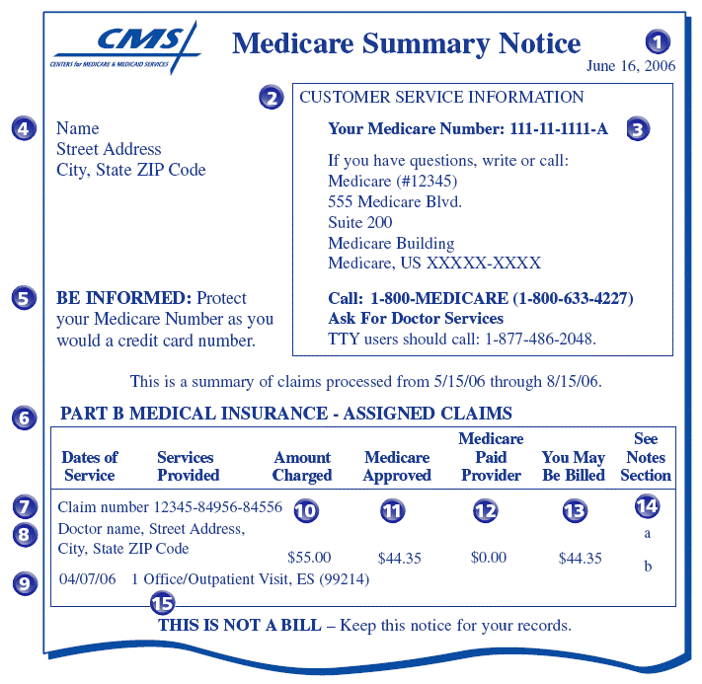
Words of Caution
Always review your Medicare Summary Notice!
This is not a bill. Sent quarterly.
Check name, address, Medicare number for accuracy.
Did you receive the service?
Be sure claim is processed and paid. If item is denied, call doctor’s office to make sure claim was coded properly. If not, office can resubmit.
If denied, you have appeal rights. Appeal deadline is 120 days.
Notes:
DEBBIE—AS I just mentioned, a new Welcome to Medicare presentation PowerPoint was created last year. It is available on the GWAAR website and has now been updated to reflect 2019 numbers, but also with additional information related to Senior Medicare Patrol. We encourage you to use this information during your Welcome to Medicare sessions so that people are educated about the importance of protecting themselves and preventing Medicare fraud when they are first going on Medicare. It’s great if you are using the new PPT, but even if you are using your own PPT for these sessions, you can copy slides (or the information from the new slides) into into your own. Several slides talk about “Words of Caution” for people to keep in mind.
This particular slide (or at least a version of it) is one that I think a number of EBSs have used in the past. It highlights the importance of ALWAYS reviewing the Medicare Summary Notice. You want to let people know that the MSN is sent quarterly to people with Medicare.
It is not a bill.
Check name, address, Medicare number for accuracy.
Did you receive the service?
Be sure claim is processed and paid. If item is denied, call doctor’s office to make sure claim was coded properly. If not, office can re-submit.
And if a claim is denied—let people know about their Appeal rights as well.

Slide 12
Words of Caution
Three Steps to Prevent Fraud
Step 1: Protect Yourself and Others from Medicare Fraud
DON’T
DO
Don't give out your Medicare number except to your doctor or other Medicare provider.
Do treat your Medicare card and number like your credit card.
Do watch out for identity theft.
Do be aware that Medicare doesn’t call or visit to sell you anything.
Do be cautious of offers for “free” medical services.
Do pass it on!
Notes:
INGRID—The Wisconsin Senior Medicare Patrol has a few more words of caution.
There are three steps they suggest to prevent fraud:
Step 1: Protect Yourself and others from Medicare Fraud.

Slide 13
Words of Caution
Step 2: Detect Medicare Fraud & Abuse
Always review those Medicare Summary Notices (MSNs) !
Access your Medicare information online at www.MyMedicare.gov.
Create a Personal Health Care Journal:
Record doctor visits, tests and procedures in the journal and take it with you to appointments.
Compare your MSNs and other statements to your journal to make sure they are correct.
Notes:
INGRID—Step 2: Detect Medicare Fraud by reviewing your Medicare Summary Notices and comparing them to your personal health care journal.

Slide 14
Words of Caution
Step 3: Report Suspected Medicare Fraud and Abuse
Call the provider.
Gather information and documentation.
Contact WI Senior Medicare Patrol (SMP):
Call Toll-free: 1-888-818-2611 (Free and Confidential!)
To report suspected fraud/abuse.
For training, speakers, and/or materials.
To volunteer with the SMP program.
Notes:
INGRID—And Step 3: Report any suspected Medicare fraud.
Call the provider to discuss any concerns you have about a bill, etc.
Be sure to gather your documentation—personal healthcare journal/statements, etc.
Contact WI SMP for help!

Slide 15
What can you do NOW?
If you have volunteers who help you during open enrollment, it may be helpful to provide another volunteer opportunity for them.
The SMP Team would like to send you a message to forward to them, informing them about SMP and inviting to be a volunteer.
You do not have to share the volunteers name/info, simply pass along the message from SMP to them.
They will be invited to volunteer and could do so as much or as little as they want—no pressure.
Notes:
INGRID
If there is someone that you are already working with or who you know, looking for a volunteer opportunity, please consider the SMP volunteer opportunities we’ve discussed. I would like to make it as easy as possible for you to share the information, so I am open to any ideas you may have.

Slide 16
Questions

Slide 17
Contacts
Debbie Bisswurm, GWAAR
debbie.bisswurm@gwaar.org
608-228-0898
Ingrid Kundinger, GWAAR
Ingrid.kundinger@gwaar.org
(608) 243-2885
Notes:
Thank you for joining us today. Again, we hope this training has been helpful to you.
Please fee free to contact Ingrid or me anytime.

Slide 18
Brief Program Descriptions
Medicare Savings Programs: Help Medicare beneficiaries with limited incomes and assets pay for some or all of Medicare’s premiums, deductibles, and copays. If qualified, at a minimum you would save over $100 per month!
Extra Help/Low Income Subsidy: Assist people with limited incomes and assets pay their Medicare Part D premiums, deductibles, and copays.
Senior Care: Wisconsin’s prescription drug program for people age 65 and older. There is no monthly premium and the deductible amount is based on the person’s income. Assets are not counted. People with lower incomes often find Senior Care to be more affordable than other Medicare drug plans.
Notes:
These are the brief program descriptions I was talking about. Again, by presenting the information in a clear, brief way, they can more easily explain the programs to others.

Slide 19
Brief Program Descriptions
(continued)
Medicare Preventive Services: Medicare covers a wide range of preventive services and screenings including a yearly wellness visit, vaccinations and more – all at low or no cost. Preventive health care focuses on preventing disease and maintaining proper health which will allow you to live a longer, healthier life. Take advantage of these preventive services.
Health Promotion Classes: Educational programs designed for older people which have been researched and proven effective to help individuals manage their own health and improve their quality of life. Topics include fall prevention, managing chronic health conditions, living with diabetes and other wellness topics.
Notes:
Again, these are just brief descriptions that may help people talk about the programs.

