Slide 1
Sharing your message Face-to-FAce
Ebs statewide training
December 2018
Notes:
Good Morning everyone. Its good to be here again to talk about the Medicare outreach being done around Wisconsin. I know you all do outreach to some extent, some more, some less, some media outreach, some group outreach—but today I want to focus on the face-to-face types of outreach activities (or group outreach) and look at some ways to possibly increase the number of people you reach through those activities.

Slide 2
Outreach Goal
To ensure that people are informed about Medicare and the Medicare-related benefit programs so they can make informed decisions about their health care options and access assistance when needed in order to maintain or improve the quality of their lives.
Notes:
The goal of our outreach is to make sure that people are informed about Medicare and the Medicare related benefit programs so they can make informed decisions about their health care options and get help when they need it to maintain or improve the quality of their lives.
In order for people to get the benefits—they have to know that the benefits exist. And when people have questions or complications, they need to know where to go for assistance. The outreach you do helps to get the message out.

Slide 3
Face-to-face activities may be the most effective way to motivate people to take action.
Provides people an opportunity to ask questions about next steps to get assistance.
Face-to-face can build trust and confidence in the message.
Notes:
All types of outreach are important, newsletter articles, flyers, radio ads—since different people respond to different types of outreach. So of course it’s good to have a variety of outreach activities. However, we are particularly focused now on face-to-face activities since they tend to be a very effective way to motivate people to take action…

Slide 4
How do we know how we are doing? “SHIP PM2 Rating”
The success of Medicare outreach is evaluated based on data entered in the national SHIP tracking and reporting system called STARS (formerly SHIP NPR).
The SHIP performance measure (PM) 2 rating takes into account the data entered into STARS Group Outreach Events form (formerly PAM categories 1,2 and 3).
These are face-to-face activities.
The rating compares the total number of people reached through activities in those categories to the total number of Medicare beneficiaries in the state.
Notes:
So the question then is “how do we know how we are doing?”
Booths/exhibits, Enrollment events, and Interactive presentations to public. (These relate to the former PAM categories 1,2 and 3.)
… and the we can break it down by county.

Slide 5
Rating Scale:
Percentage of total number of Medicare beneficiaries reached by face-to-face activities:
> 14.4% Excellent
> 7.7 % Good
3.4 – 7.7% Average
2.5 – 3.4% Fair
< 2.5% Low
Notes:
This is the rating scale that is used to determine how the states are doing with face-to-face outreach.
And again, it is based on the percentage of beneficiaries that are reached through that group outreach.

Slide 6
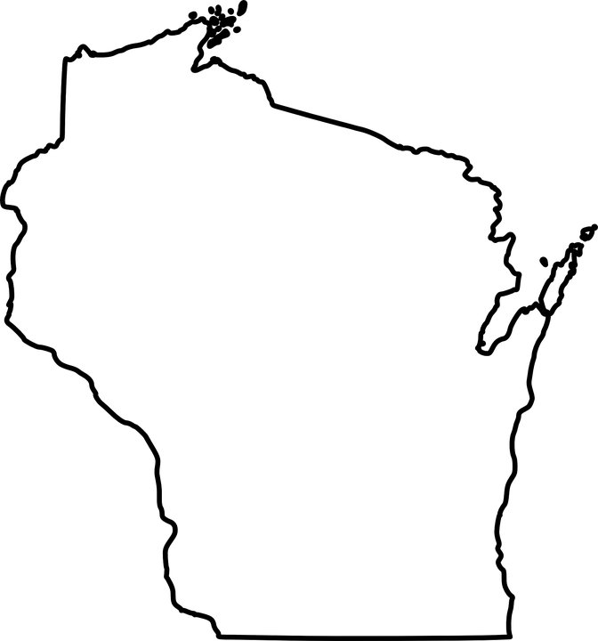
Wisconsin Statewide numbers
Total Number Medicare Beneficiaries: 1,087,383
Number beneficiaries reached via face-to-face activities: 65,574 which is 3.88%
Rating: Average
Need > 7.7% for a Good rating which would be: 84,449
So we need to reach almost 20,000 more beneficiaries for a Good rating.
*These numbers are based on the PAM data reported statewide during the one-year period between April 1, 2017 and March 31, 2018.
Notes:
These numbers are based on the PAM data reported statewide during the one-year period between April 1, 2017 and March 31, 2018. These reflect the most recent PM2 rating.

Slide 7
Numbers By County
Your county’s PM2 data will be shared with you via email this month.
You are encouraged to explore ways to increase the number of people reached through group outreach.
For those already reaching the target for “good” rating—why not strive for “excellent”!
Notes:
Over the past months I have spoken with most of you, but I want to be sure everyone has the data on their county, so I will be sending out an email with your county’s PM2 rating over the next week or so.

Slide 8
MIPPA grant activities
64 of Wisconsin’s 72 counties opted to participate in the MIPPA grant this fall.
The MIPPA grant focuses on outreach activities that target low-income or rural beneficiaries; and address the topics of Medicaid, Medicare Savings Programs (MSP), Extra Help (LIS), and/or preventive services.
Be sure to answer “yes” to the MIPPA question at the top of the Group / Media Outreach and Education forms if your county receives MIPPA grant funds.
From October 1, 2017 – September 30, 2018 Wisconsin conducted 902 outreach events about MSP / LIS and 964 events about Medicare preventive benefits. County-level MIPPA outreach data are not currently available. Stay tuned for new report options in SAMS and STARS over the coming months.
Notes:
I want to take a minute to share some information about the current MIPPA grant.

Slide 9
Steps to Increasing Face-t0-Face Outreach
Review your existing plan.
Review WI’s best practices for Medicare outreach and assistance.
Develop a month by month outreach plan.
Implement the plan.
Review plan annually—update/revise as appropriate.
Notes:
Ok, so once we know how we are doing, we can start looking at ways to improve our rating statewide.
Listed here are 5 steps that can help you to increase the number of people you reach through face-to-face—or group—outreach.

Slide 10
1. Review Your Existing Plan
What face-to-face outreach activities do you do on a monthly basis?
How many people do you typically reach at these activities?
How can you increase that number? (Advertise? Flyers?)
List special events (Health Fairs/Senior Expos) scheduled.
Other presentations or face-to-face outreach that you’ve done over the past years.
Notes:
The first step again is to review your existing plan. Some of you may actually have a written outreach plan for the year. Others may have things that you do regularly but not necessarily a written plan. Either way, it is important to take a look at what you currently have been doing.

Slide 11
2. Review WI’s Best Practices for Medicare Outreach and Assistance
Best practices encompass a wide range of activities—Review the face-to-face activities and consider what might work in your service area.
Many agencies have found several types of activities effective to reach larger numbers:
Health Fairs/exhibits
County Fairs, Farmers Markets
Large group presentations (Employer/retiree/union groups, Presentations at libraries/senior centers)
Are there others at your agency who may be able to take on some of the activities listed?
If staff time or expertise is limited, consider reaching out to the Medigap Helpline or Disability Drug Benefits Helpline for help. These agencies are often willing to provide a guest presenter if you can supply a venue and an audience.
Keep in mind—best practices are intended as a guide. Find what works best for your agency and service area.
Notes:
The second step is related to the Idea of the Month for December that was included in the BENSPECtrum newsletter—and that is to take a look at the best practices for Medicare outreach and assistance. I’m hoping many of you have taken the time to review them.

Slide 12
Examples from around the state
Brown County
Medicare Minutes—volunteers
Employer outreach
Milwaukee County
Collaboration with Health Promotion Classes
Weave message into other agency outreach activities
Maximize community partnerships
Marquette
Monthly presentations at 6 dining sites—Medicare Minutes
Booth at larger Events—County Fair and Caregiver luncheon
Notes:
Brown Co: Tina Brunner’s comments.
Medicare Minutes—and the volunteers who present them—are a huge part of their success. For the volunteer program to be successful you need to keep them engaged on a regular basis and the Medicare Minutes provides that opportunity. (former Social Security, Former nurses, insurance companies..) Sept/Oct is their biggest outreach months. Senior Fair is that month. They do a lot of Employer outreach during that time because employers have their “fairs” where they are providing the next year’s insurance options, etc to their employees and they like to have the Brown Co staff there to share Medicare info. They go to large and some small employers as well. (WPS, Oneida Tribe, NWTC…)
Milwaukee Co: Milwaukee Co Department on Aging suggests “weaving” your message into all other agency events.
Marquette Co: Colleen Sengbusch– monthly presentations at their 6 dining sites. Often use Medicare Minutes--helps save time preparing for the presentations, since they are all ready-to-go. Also reaches many people each year by having a booth at the County Fair and the Caregiver luncheon.

Slide 13
Medicare Minutes
Different topic each month
Script for presentations
Training materials (for presenter)
Handouts
Find Medicare Minutes at:
Webpage: https://portal.shiptacenter.org/center-services/medicare-minutes/
Or link from GWAAR website Medicare Outreach and Assistance Page under Additional Links
Notes:
And since the Medicare Minutes provide a really good opportunity for expanding face-to-face outreach, I want to be sure everyone is aware of what they are and how they can make it easier to do presentations. ….
The script is very clear and can be read in only about 5 minutes, which makes for a nice, brief presentation. This is something that could easily be done regularly at senior centers, or at Rotary, Kiwanis meetings, or to other groups.
Be sure to customize the materials with your local information.
Medicare Minutes at SHIP TA center website—you will need your login credentials. If you do not have a login for the SHIP TA, you can contact Phoebe Hefko to set you up.

Slide 14
Notes:
This is a screenshot of the Medicare Minutes page of the SHIP TA Center’s website. IF you scroll down on this page you can see the Medicare Minutes for each month and you can click on that to access the related materials.

Slide 15
2019 Medicare Minutes Topics
Month | Topic
January | What’s New in 2019?
February | Medicare Enrollment and Election Periods
March | Medicare Coverage of Emergency/Urgently Needed Care
April | Medicare Coverage of Hospice Care
May | Part B vs. Part D
June | Original Medicare and Medicare Advantage Standard Appeals
July | Medicare Savings Programs
August | Medigaps
September | Fall Open Enrollment Period
October | Part A-covered Services
November | Accessing Supplemental Benefits
December | Complaints, Grievances, and Beneficiary Resources
Notes:
I included the list here of all the topics that are scheduled for 2019.

Slide 16
Past years Medicare Minutes Topics
 | *2017 | **2018
January | What’s New in 2017? | What’s New in 2018?
February | Part D Special Election Periods | Medicare Coverage of Preventive Services
March | Medicare Coverage of Hospital Stays | How Medicare Works with Federal and Military Benefits
April | How Medicare Works With Current Employee Coverage | Explanations of Benefits (EOBs) and Medicare Summary Notices (MSNs)
May | Medicare Savings Programs | Part D Appeals
June | Medicare and Medicaid | How to Afford Your Drug Costs
July | Medicare and the Health Insurance Marketplace | Durable Medical Equipment (DME)
August | Common Medicare Open Enrollment Notices | Medicare Coverage of Home Health Care
September | Open Enrollment Period | Medicare’s Open Enrollment Period
October | Protecting Yourself from Enrollment Fraud | Medicare Coverage of Mental Health Services
November | Discharge Appeals | Original Medicare and Medicare Advantage Providers
December | Troubleshooting Medicare | Speaking with your Doctor
Notes:
And here’s a quick look at the topics covered over the last two years. Again, the scripts for these topics and all the related materials can be found on the Medicare Minutes website.
I encourage you to consider these resources to help you with presentations. (Keep in mind, not every presentation needs to be an hour or hour and a half long full Medicare presentation. These topics and materials work great for a short presentation. And it may enable you to do more and reach more people by keeping them brief.)

Slide 17
3. Develop Month by Month Outreach Plan
Add your regularly scheduled activities for each month.
Consider local opportunities already planned:
Health Fairs/Senior Expo
Flu Shot Clinics
County Fairs & Church festivals/events
Employer health and wellness fairs at larger employers in your county
Create new opportunities for face-to-face activities.
Promote the events to maximize attendance.
Notes:
For the third step—if you do not already have an outreach plan, it is good to develop one. Planning it out month-by-month throughout the year will help you to stay on track. OF course schedules change and new opportunities may come up, so try to be flexible and adjust as necessary.

Slide 18
4. Implement the plan
Utilize others from your agency where possible.
Remember—Medigap or DRW Helpline staff.
Utilize volunteers where possible.
Continually seek new opportunities for group outreach.
Ask those attending your presentations if they belong to other groups that may be interested in a presentation.
Be flexible—you may need to make schedule changes throughout the year as new opportunities are presented.
Notes:
The 4th step is of course to implement your plan.
Remind: If you need assistance—stretched too thin to take on more outreach—contact Medigap Helpline staff or DRW and request presentations in your county/service area.

Slide 19
5. Review plan annually
Go through the process of reviewing the plan—what worked and what didn’t—each year.
Revise as necessary.
Notes:
The final step is also important and that is to review the plan annually.

Slide 20
Resources to assist you:
WI Best Practices for Medicare Outreach and Assistance
Available on the GWAAR website at: https://gwaar.org/medicare-outreach-and-assistance-resources
Medigap Helpline staff: 1-800-242-1060
Disability Rights WI (DRW): 1-800-926-4862

Slide 21
Questions?

Slide 22
Contacts:
Debbie Bisswurm, GWAAR
debbie.bisswurm@gwaar.org
608-228-8098
Phoebe Hefko, DHS
Phoebe.Hefko@dhs.wisconsin.gov
(608) 267-3201

