Slide 1
Cooking For 1 or 2
Meal Preparation & Healthy Eating Ideas
Grace Johnson, Dietetic intern 2018

Slide 2
You Are Not Alone
Nearly one third of older adults living outside nursing homes live alone
Half of all American adults have 1 or more diet-related chronic disease (obesity, heart disease, high blood pressure, and Type 2 diabetes)
People living alone are more likely to suffer from poor nutrition….WHY?
Less fruits and vegetables
More ready-prepared meals
Notes:
https://www.ioaging.org/aging-in-america

Slide 3
How does living alone effect nutrition?
Inadequate cooking skills
No partner to grocery shop with
Increased cost of food
Lack of motivation to cook meals
Social isolation or loneliness
No family to cook for - less of a priority
Cooking meals is a “Nurturing Task”
When you are alone, you are less likely to feel the need to nurture yourself

Slide 4
Why do I need a healthy diet?
Healthy eating patterns will help prevent and manage chronic diseases
Your body requires vitamins and minerals from a variety of foods
You may be eating less as you get older, making it difficult to get the vitamins and minerals you need
YOU DESERVE IT!
So… choose Nutrient Dense foods!

Slide 5
What are Nutrient Dense Foods?
High in important vitamins, minerals, and protein
Naturally lean or low in solid fats
Little or no added fats
No added sugars
No refined starches
No sodium

Slide 6
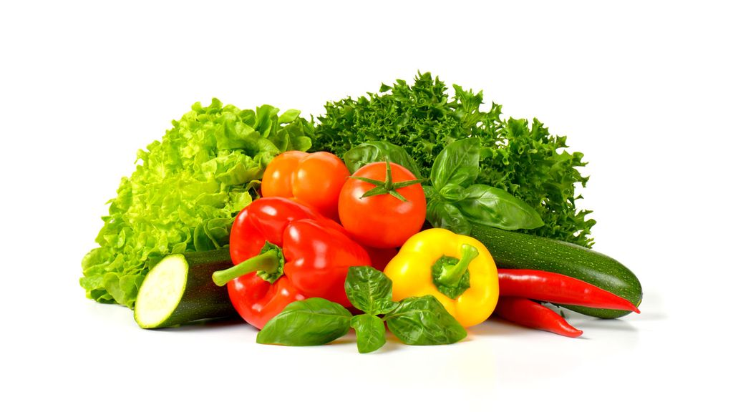
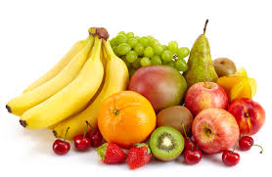
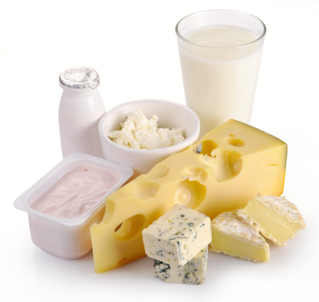
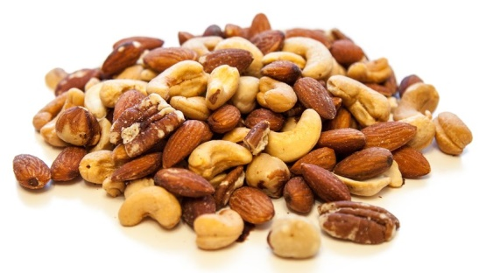
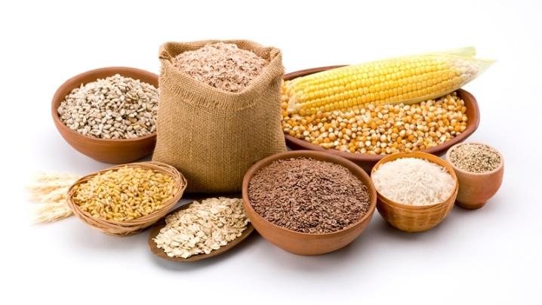
Choose a Variety of:
Vegetables
Fruits
Fat-free or Low-fat dairy
Lean protein
Whole Grains
Oils

Slide 7
Eating out
Disadvantages
Cost
High in calories, fat and sodium
Low in fruits and vegetables
Large portions
Weight control/special diets
Advantages
Someone else cooks for you
No clean up required
Eat foods you wouldn’t normally prepare
Social activity

Slide 8
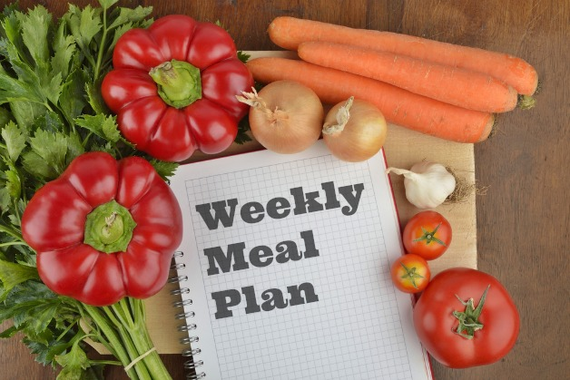
Planning ahead
Plan weekly menus
Shop with a grocery list
Keep small freezable containers and freezer bags on hand
Use a crock pot

Slide 9
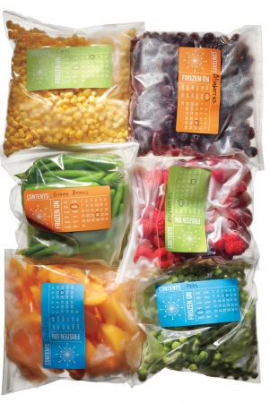
Tips for one or two
How using a freezer can save you time and money:
Prepare regular sized recipes and freeze the leftovers
Buy family size packs of meat to save money, and freeze in smaller quantities
Freeze breads and rolls in single servings
Use frozen fruits and vegetables
Purchase fresh fruits and vegetables and freeze for later
Don’t forget to label and date your leftovers! Save for 3 months

Slide 10
More tips for one or two
Reduce waste by purchasing these items in smaller quantities:
Milk in ½ gallon or quart sizes
½ dozen eggs
Small loaves of bread, English muffins, or bagels
Small size cans of vegetables or fruits
Individually quick frozen meat

Slide 11
Make meals nutrient dense
Veggies added to your eggs
Try: spinach, tomatoes, mushrooms, peppers
Fruit mixed in with yogurt and cereals
Peanut butter spread on toast
Tuna topped on salad
Black beans in ground beef for tacos or burgers
Greek yogurt in fruit smoothies

Slide 12
High protein Snacks
Hardboiled egg
Veggies with hummus
Mixed nuts
Cottage cheese and peaches
Greek yogurt and granola
Tuna and crackers
Cheese and crackers
Peanut butter with apples
Protein bars or protein shakes

