Slide 1
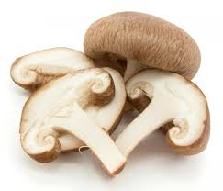
September 2015 Mushrooms
Beneficial Bites

Slide 2
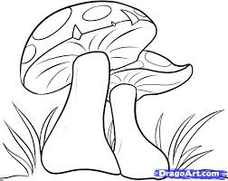
Outline
What Are They and How Do They Grow?
History of Mushrooms
Health Benefits
Selection, Storage, and Cooking
Fun Facts

Slide 3
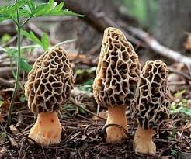
What Are They and How Do They Grow?
Mushrooms are a fungi found in soil, wood, or other decomposing material
Not a plant; mushrooms do not need soil or sunlight to grow
Many different varieties
Grown in 3 stages: composting, spawning, and fruiting

Slide 4
History of Mushrooms
Mushrooms have been eaten since prehistoric times
In ancient Egypt, only pharaohs were allowed to eat mushrooms because they were believed to give immortality
In Ancient Rome, the word used for mushrooms meant “food of the gods”
Many cultures believed mushrooms could give superhuman strength
China is believed to be the first to commercially grow mushrooms and is the leader in mushroom cultivation today
70% of American mushrooms are grown on the East Coast

Slide 6
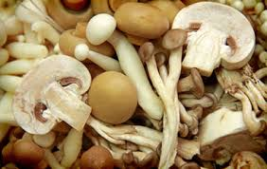
Health Benefits
Rich in phytonutrients that enhance immune system, are anti-cancer, and anti-inflammatory
Protects against cardiovascular disease
May be a good source of vitamin B12 and vitamin D
Good source of copper and potassium

Slide 7
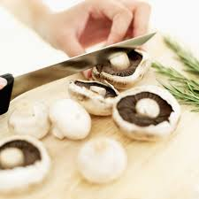
Selection, Storage, and Cooking
Choose fresh, bright colored mushrooms
Avoid mushrooms with slimy spots or wrinkles
Store properly in the refrigerator
The best way to clean mushrooms is with as little water as possible!
Wipe with a damp cloth; too much water will cause mushrooms to get soggy
To use in cooking simply clean and cut off spongy bottom of stem
Don’t eat wild mushrooms unless you know
what you are looking for

Slide 8
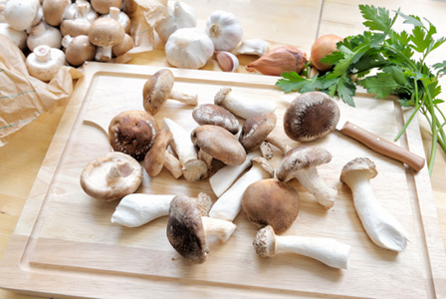
Fun Facts
Regular consumption of oyster mushrooms has been shown to reduce LDL cholesterol
Pennsylvania is the largest producer of mushrooms in the United States
Discoloration of mushrooms is a reflection of the reduction of nutrients
One Portobello mushroom contains more potassium than a banana
Mushrooms are more closely related to human DNA than plant DNA
The antibiotic, penicillin, was developed from a mushroom-like fungus

Slide 9
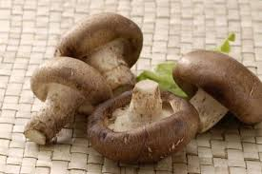
Thank you!
Beneficial Bites

