Slide 1
Reaching Wisconsin’s Medicare Beneficiaries
Ebs Statewide training
December 2017
Debbie Bisswurm,
Medicare Outreach Coordinator
Greater Wisconsin Agency on Aging Resources, Inc.

Slide 2
Providing Outreach and Assistance
Current Medicare outreach and assistance activities in WI
Share Best Practices statewide
Provide information and materials for use at local level
Notes:
AS you know, you all have an impact on Wisconsin’s Medicare beneficiaries through the outreach and assistance you provide. What I want to do this morning is first, provide a quick snapshot of where we are at with those activities here in WI (and this is based on the information that is entered into the SHIP NPR system) …and then spend some time looking at Best Practices.** I also want to highlight some materials and show you how to access additional materials that may be of help to you in your work.
In your role as an Elder Benefit Specialist, you juggle many responsibilities. In addition to your 1:1 work with clients, some of you are able to find time to do a fair amount of outreach. Others may struggle to find the time for outreach—because of the focus on the current clients. My hope is to make it a little easier for you by sharing some ideas and resources on a regular basis, as well as through the materials that you can find on our website.

Slide 3
Numbers of People Reached by Wisconsin SHIP through Face-to-Face Outreach Methods
Over 72,000 Wisconsin residents were reached by the Wisconsin SHIP through face-to-face outreach methods between October 2016 and September 2017.
Notes:
First, let’s take a look at where we are at with our work in Wisconsin. This chart breaks down the outreach activities completed by SHIP over the past year by category. These numbers again are based on what is entered into the SHIP NPR database. A few agencies have had some success with Dedicated Enrollment events, but by far, the primary ways that people are reached face-to-face is through Booths and Exhibits or Presentations. I think it is helpful for us to keep this picture in mind as we look at best practices and consider whether there may be a way for us to expand any of those numbers going forward.

Slide 4
People Reached by Wisconsin SHIP through Mass Media Methods
An estimated five million people were reached by the Wisconsin SHIP through mass media efforts between October 2016 and September 2017.
Notes:
Obviously mass media allows us to reach greater numbers of people. As you can see from the chart, the majority of our mass media outreach happens through Print Type activity. (That may include Newsletters, articles, mailings). But some folks, especially in rural areas have had success reaching people through radio. And you can see that TV and other electronic media are also being done by some. Its good to take the time to think about those people you don’t see through your face-to-face outreach, and consider what might be the best way to reach out to them.

Slide 5
Wisconsin’s Best Practices Four Focus Areas:
Staffing
Community Partnerships
Outreach to Beneficiaries
Training
Notes:
While I am sure you all have a plan for your outreach, it may be helpful to review the best practices—which have been developed through the work of partners around the state over the years. *The Complete Best Practices list is available on the webpage. Some of you have seen these before, and for some of you this may be new. Even if this is something you have seen before, I encourage all of you to set aside some time at least once a year to review it. Some of you may do everything on the list, some of you may do other activities that are not on the list. If there is something that you do that has worked well—please share it. (You can always call me or send me an email) We can all learn from each other’s experiences.
Another thing that is really important to keep in mind is timing. You know there are times of the year that are busier than others. By looking at the complete list of Best Practices each year, you may be able to make a plan for the best way to fit them in throughout the year.

Slide 6
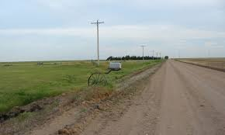
Staffing
Provide regular EBS office hours in outlying and rural areas (Underserved neighborhoods)
Dedicate adequate staff hours to ensure availability throughout your service area
Consider use of volunteers to expand outreach
Notes:
It is not always easy for people to come to your office, so being available in outlying rural areas or underserved neighborhoods in a city can help to reach more people. Some EBSs will hold office hours at a senior center in another area of the county.

Slide 7
Community Partnerships
Potential Partners: Any professionals and agencies that come into contact with Medicare beneficiaries
Educate about Medicare and Medicare related programs
Provide resources
Explain when/where to make referrals
Seek opportunities to set up outreach activities/presentations
Notes:
Building partnerships with other professionals and agencies will enable you to “reach” people you might otherwise not come into contact with. These partners then help to extend your outreach. For each community partner—as you begin to develop a relationship, there are several things you’ll want to do:
Meet with them…Visit your outreach target
Explain the importance of this outreach and the value of their partnership in helping older adults (A story to tell—someone you have helped…)
Use Programs Descriptions to explain the programs in simple terms
Provide Resources they can share with older adults

Slide 8
Important Partners Include:
Social Security Admin office
Pharmacies
Libraries
Churches & Interfaith Programs
Food Pantries
Hospitals & Clinics
Senior Centers/Dining Sites
Senior & Low-income Housing
Notes:
SSA—do they have your resources? Understand your role? Know when to make a referral? I know several counties that have found SS to be their greatest referral source!
Pharmacies—especially during the annual enrollment period—do they know the importance of making a referral—give them examples of why it is important!
Libraries—don’t just drop off the materials, but make sure the reference librarian knows about them and their importance.

Slide 9
Important Partners (cont.)
Other benefit programs
Homestead Tax Credit/AARP/VITA Tax sessions
FoodShare (SNAP)
Low Income Heating Assistance
Stockbox, Hunger Task Force
Hispanic/Hmong/Native American/other local community centers
Public Health
Notes:
Are there opportunities to share your resources with these programs? Join them at one of their already scheduled events?

Slide 10
Important Partners (cont.)
Veterans Admin office
Employers and union groups
Senior Medicare Patrol
Service Clubs/Community Organizations (Kiwanis, Rotary)
Notes:
And here are a few more community partners you may want to consider in your outreach

Slide 11
Other Partners?
Homeless shelters?
What is unique to your service area?
Notes:
You are the experts in your county. So each of you may have your own ideas about locations you may find seniors or disabled adults.
What about all the homeless shelters? Church fish fry? Local government officials—aldermen & others? Do they know about you and how you can help people?
In a rural community—consider places like a local coffee shop where seniors meet.

Slide 12
Outreach Directly to Medicare Beneficiaries
“Welcome to Medicare” Presentations
Various times/locations around county
Other presentations on Medicare related programs at various locations throughout county
Marketing plan/advertise: radio, tv, newspaper
Promote “word of mouth” outreach
Notes:
What locations and topics are covered?
Is staff time an issue? Consider whether volunteer could do a presentation?
Community newspapers.
Be sure to encourage people you help to spread the word to their friends and neighbors.

Slide 13
Training Colleagues
All ADRC and Aging Unit staff who work w/ target audience
I & A specialists
Nutrition site managers
Health promotion coordinators--collaboration
Attend Income Maintenance staff meetings
Attend coalition meetings (I-team, Caregiver coalitions, others)
Notes:
Regular training of colleagues—especially due to staff turnover—will help ensure that they are aware of the programs, that they keep them in mind, that they know of any special events you are having. And make sure they know when to make a referral.

Slide 14
Medicare Outreach and Assistance Resources
Resources for your Outreach
MIPPA brochure (inserts)
Preventive Services Chart
Posters
Medicare Placemat Prevention and Wellness
Articles for newsletters/church bulletins
Brief Program Descriptions (Help educate community partners about Medicare related programs)
Notes:
In doing your outreach, whether to beneficiaries or community partners, you need materials to share. We have a variety of resources that you can customize and use in your outreach. These can be found on our webpage and I’ll show you how to access that shortly. Right now I’d just like to highlight a few…

Slide 15
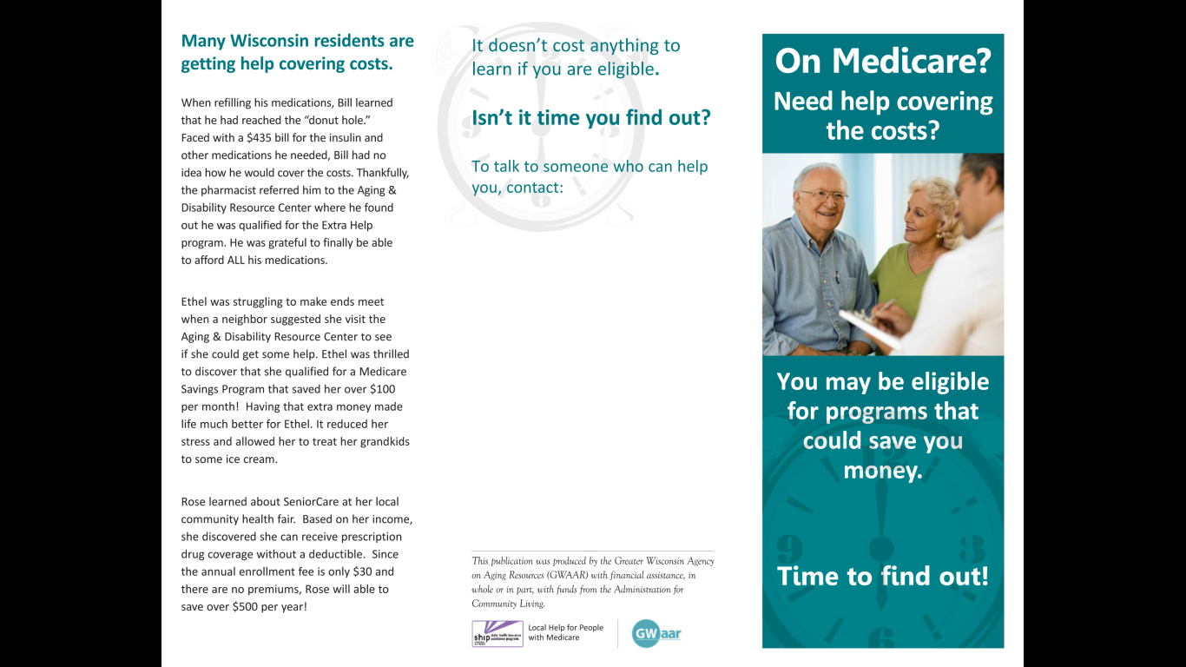
Three-fold brochure
Your Agency Contact Info Here
Notes:
This is a customizable brochure that promotes Medicare Savings Programs, Extra Help, and SeniorCare.

Slide 17
Eligibility Insert

Slide 18
Health Promotion and Medicare Preventive Benefits
Insert

Slide 19
Medicare Outreach Posters
Highlight the MSP/LIS/SeniorCare benefits
Several versions with photos of people of various backgrounds
Customizable

Slide 20
Poster 1
Poster 2
Notes:
Poster 2 has also been translated to Spanish and is also available on the webpage.

Slide 21
Poster 3
Poster 4
Poster 5

Slide 22
Program Descriptions
aka “Elevator Speeches”
Medicare Savings Programs: Help seniors with limited incomes and assets pay for some or all of Medicare’s premiums, deductibles, and co-payments. At a minimum, qualified individuals have the Part B premium paid for them, saving over $100 per month!
Extra Help/Low Income Subsidy: Assist people with limited incomes and assets pay their Medicare Part D premiums, deductibles, and co-payments
Senior Care: Wisconsin’s prescription drug program for people age 65 and older. There is no monthly premium and the deductible amount is based on the person’s income. Assets are not counted. People with lower incomes often find Senior Care to be more affordable than other Medicare drug plans.
Notes:
Remember—it may help to have others prepared with an “elevator speech” –or a quick way to describe these programs to others.
Use these descriptions to explain the programs to your community partners. By presenting the information in a brief description, they can more easily explain the programs to others.

Slide 23
Program Descriptions (continued)
Medicare Preventive Services: Starting in 2011 Medicare began covering more preventive services and screenings including an annual wellness visit, vaccinations and more than 15 other tests/screenings – all at low or no cost. Preventive health care focuses on preventing disease and maintaining proper health which will help you to live a longer, healthier life.
Health Promotion Classes: Educational programs designed for older people which have been researched and proven effective to help individuals manage their own health and improve their quality of life. Topics include fall prevention, managing chronic health conditions, living with diabetes and other wellness topics.

Slide 24
Finding the Resources
GWAAR website:
Go to http://gwaar.org
On top menu bar: Technical Assistance drop down menu
Click on “Medicare Outreach and Assistance”
Notes:
If website has gone live…demonstrate how to access the resources by going to the GWAAR website, accessing our webpage and pointing out some of these resources. Again, remind them that the materials can be customized to include their agency’s contact information.
Please keep in mind we will be “tweaking” the website over the next few weeks to make it more user friendly—easier to find things. During that time, if you are looking for a resource and are unable to locate it, please send me an email or give me a call and I can help you with that.

Slide 26
Contacts
Debbie Bisswurm, GWAAR
debbie.bisswurm@gwaar.org
608-228-0898
Phoebe Hefko, DHS
Phoebe.Hefko@dhs.wisconsin.gov
(608) 267-3201

Slide 27
Questions?

