Slide 1
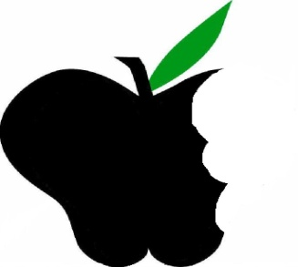
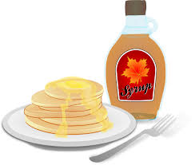
April 2015 Pure Maple Syrup
Beneficial Bites

Slide 2
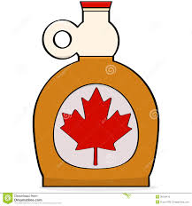
Outline
What is Maple Syrup?
History and Production of Maple Syrup
Health Benefits
Use and Storage
Fun Facts

Slide 3
What is Maple Syrup?
Made from the sap of the Sugar Maple
Sap is collected through the tapping of trees
It takes 40 gallons of sap to make one gallon of maple syrup!
Blended pancake syrup only contains 1% actual maple syrup
Beneficial Bites
Notes:
See next slide for pancake syrup vs. pure maple syrup food labels

Slide 4
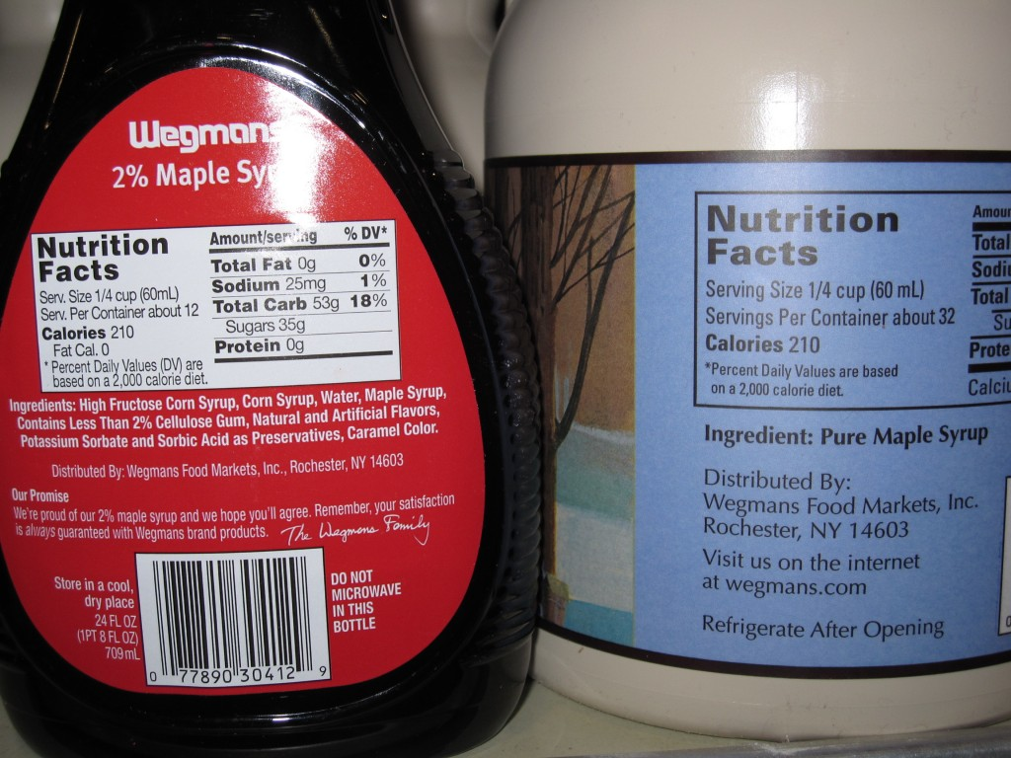

Slide 5
History of Maple Syrup
Maple sugaring has been around since the 1500’s
Tribes in North America had a tradition of sugaring following the spring thaw
Native Americans and European settlers began boiling maple sap in the 1700’s
Maple syrup industry began in the United States during the Civil War
Technological advances were finally made in the 1970’s with updated tapping and tubing processes

Slide 6
Processing
Tapping trees:
Sap flow does not begin until after a hard freeze followed by multiple warm days (in the 40’s)
Sap flows for 3-4 weeks
Making syrup:
Syrup is made by removing water from sap
Sap contains 98% water and 2% sugar
An evaporator is used to boil the sap and produce maple syrup
The boiling process is time consuming!

Slide 7
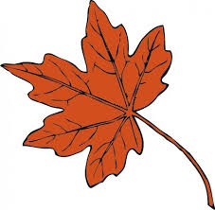
Health benefits
Provides small amounts of iron, calcium, zinc, manganese and potassium
A natural sweetener! Use as an alternative to sugar in recipes.
Contains small amounts of polyphenols– great for reducing inflammation!
Provides concentrated energy with 50 calories in 1 tablespoon

Slide 8
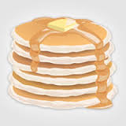
Uses of Maple Syrup
Use as a substitution for sugar in recipes. Just follow these conversion tips:
1. Substitute sugar for equal amounts syrup.
2.Decrease the quantity of liquid ingredients by half.
**Maple syrup is not just for sweets. Try in
marinades, dressings, and other unconventional
ways!

Slide 9
Storage
Best if stored in refrigeration
Will keep up to one year if stored in the freezer
Beneficial Bites

Slide 10
Fun Facts
Wisconsin has a Maple Syrup Producers Association
The Sugar Maple is the Wisconsin state tree
Maple sugaring has important cultural significance in Wisconsin
In the United States, syrup must be made almost entirely from maple sap to be labeled as "maple".
Quebec, Canada produces ¾ of the world’s maple syrup

Slide 11
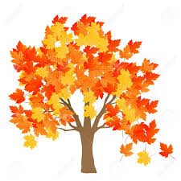
Thank you!
Beneficial Bites

