Slide 1
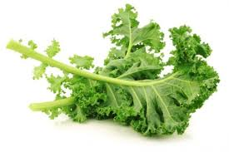
March, 2015
Beneficial Bites

Slide 2
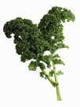
Outline
What is Kale and How Does It Grow?
History of Kale
Health Benefits of Kale
Storage and Cooking
Fun Facts

Slide 3
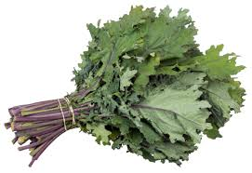
What is Kale and How Does It Grow?
A large, leafy vegetable with large green, blue/purple, or red leaves
Belongs to the mustard family and related to broccoli, cauliflower, cabbage, Brussels sprouts, collards, and kohlrabi
There are many varieties of kale
Kale is hardy and can withstand cold temperatures

Slide 4
History of Kale
Kale is a descendant of wild cabbage
Thought to have originated in Asia Minor and brought to Europe around 600 BC
Kale was the most popular vegetable eaten by peasants in the Middle Ages
English settlers brought kale to the United States in the 1700’s
Cultivation of kale was encouraged during World War II in the UK since this plant was easy to grow and provided important nutrients needed to supplement rations

Slide 5
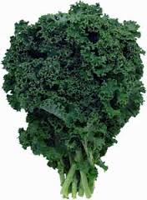
Health Benefits of Kale
Kale is low in calories, but packed with nutrients
Kale is being studied for its cancer-fighting properties
Kale is high in iron, vitamins A, C, and K, antioxidants, omega 3 fatty acids, and fiber
Kale supports your body’s natural detoxifying process by being high in fiber and sulfur, aiding your liver in cleansing the body

Slide 6
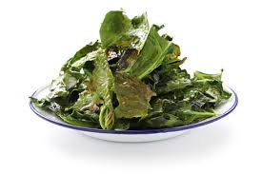
Storage and Cooking
Choose kale with firm, deeply colored leaves and hearty stems
Smaller leaves will be more tender and have a milder flavor
Store unwashed kale in a plastic bag with most air removed in refrigerator for up to five days.
The longer kale is stored, the more bitter it becomes
Kale freezes well and has a sweeter taste after it is frozen. Use frozen kale in smoothies, soups, and stir-fries

Slide 7
Fun Facts
Kale is used in a traditional Netherlands dish called borenkool, which is a mix of kale, mashed potatoes, and sometimes bacon, served with sausage
Ornamental kale is often grown and can be a variety of colors. Ornamental kale is also edible
Kale is Vermont’s state vegetable
There are over 50 varieties of kale

Slide 8
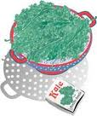
Thank you!
Beneficial Bites

