Slide 1
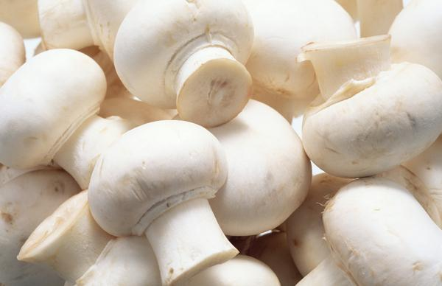
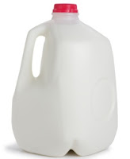
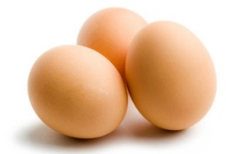
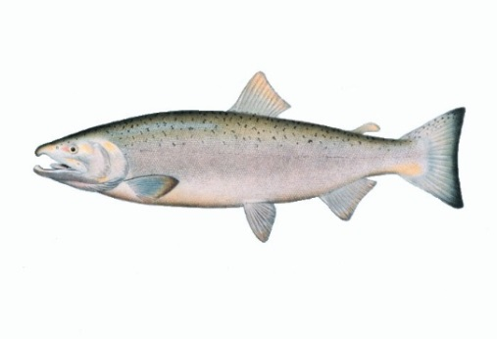
Vitamin D
The Sunshine Vitamin
What is Vitamin D?
How Much Vitamin D is Recommended?
Where Does Vitamin D Come From?
What Makes Vitamin D So Great?
What Happens if You Do Not Get Enough?

Slide 2
Vitamin D The Sunshine Vitamin

Slide 4
3 oz. =
27 IU of Vitamin D

Slide 5
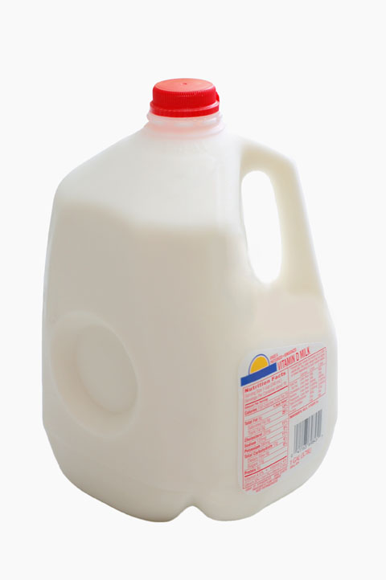
1 cup (8 oz.) =
120 IU of
Vitamin D

Slide 6
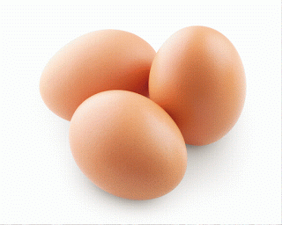
1 egg = 44 IU
Vitamin D

Slide 7
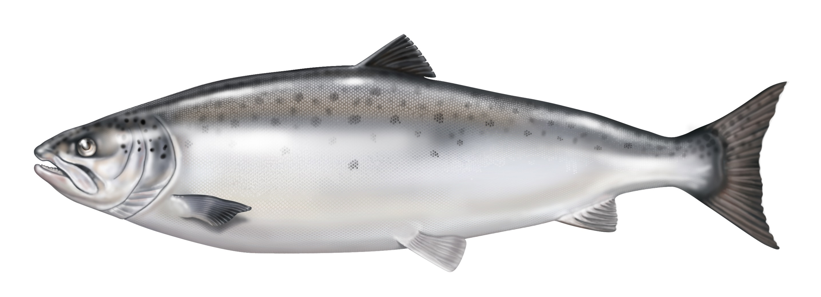
1 serving = 920 IU of Vitamin D

Slide 9
WHAT IS VITAMIN D?
Vitamin D is a prohormone vitamin that dissolves in fat and is absorbed in the gut.
There are 2 forms: vitamin D and vitamin D3
Vitamin D: Found in plants and must be converted to an active form for use in the body
Vitamin D3: Found in animal products and is an active form that is easy for the body to use

Slide 10
WHAT MAKES VITAMIN D SO GREAT?
Vitamin D allows the body to absorb calcium and phosphorus which helps maintain bones and teeth.
Helps to maintain a good immune system
Aids in the function of the blood vessels
Helps with heart muscle health
Works to reduce inflammation
Helps to reduce insulin resistance

Slide 11
WHERE DOES VITAMIN D
COME FROM?
Sunshine: 5-10 minutes for 2-3 times a week
Foods:
Fish
Fortified cereal and milk
Egg yolks
Liver
Mushrooms
Cheese

Slide 12
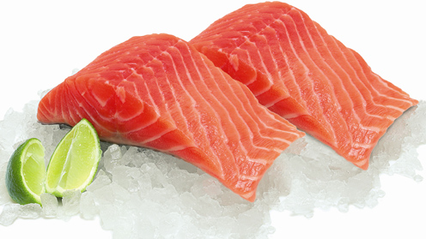

Slide 13
HOW MUCH VITAMIN D IS RECOMMENDED?
For men and women 51-70 years old:
The recommended daily amount is 600 IU per day
For men and women 71 years old or older:
The recommended daily amount is 800 IU per day
Amounts may vary based on what is recommended by your doctor.

Slide 14
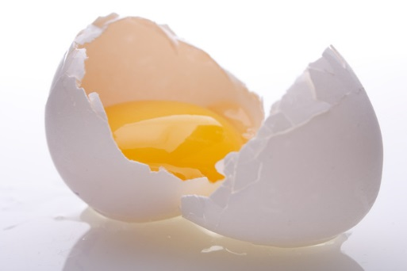
WHAT HAPPENS IF YOU DO NOT GET ENOUGH VITAMIN D?
Not consuming enough Vitamin D makes your bones get soft which causes them to feel painful and break easily.
Other symptoms are weak muscles which can cause a high risk of falling.

