Slide 1
AFCSP 101
How to coordinate your
Wisconsin Alzheimer’s Family Caregiver Support Program

Slide 2
Learning Objectives
Program purpose and intent
Eligibility requirements
Allowable use of funds
Assessing client needs
Enrolling participants
Method of payment
Paperwork and reporting
Best Practices
Reference to location in Administrative Rule – Chapter DHS 68
DHS 68

Slide 3
Program Purpose and Intent

Slide 4
Program Purpose
1985 – Created by the State of Wisconsin
2016 – income limits were increased, additional respite funding was appropriated, and Tribes began to receive AFCSP funding
The AFCSP provides support services to people living with dementia and their unpaid family members and friends who provide care for them.

Slide 5
Program Intent
DHS 68.01(1)
Provide a diverse array of community services to persons with dementia (PWD) and their caregiver(s) in order to:
Prevent or delay institutionalization
Enhance quality of life
Provide assistance to family and unpaid caregivers
Priority is given to people living in private homes
Educate the public about dementia and importance of early diagnosis

Slide 6
Eligibility Requirements

Slide 7
Who Qualifies?
DHS 68.07
Eligibility Requirements *
Written diagnosis of Alzheimer’s disease or related dementia - see list DHS 68.02(6m)
Annual income $48,000 or less – Alzheimer’s related expenses can be deducted
Lives in the community or “residential facility”
DHS 68.02 defines this to include a CBRF or Adult Family Home
Preference given to persons living in a home setting
* Cannot be enrolled in Family Care
Exception – if the person is receiving the non-nursing home level-of-care they can still access AFCSP (policy memo dated 4-12-18)

Slide 8
Allowable Use of Funds

Slide 9
What can AFCSP pay for?
New limitation on spending as of June 2016
40% of allocation must be spent on “respite” or direct services. In addition to the usual types of respite, the 40% can also include:
transportation costs
adaptive equipment and technology
expenses related to keeping caregivers socially engaged with others

Slide 10
What can AFCSP pay for?
Respite
In home respite
Adult day programming
Short term at an Adult Family Home, CBRF or other facility
Housecleaning, mowing and shoveling
Shopping, meal preparation, money management
Personal care (bathing, grooming, dressing, eating)

Slide 11
What can AFCSP pay for?
Adaptive Equipment and Assistive Technology
Mobility aids
Bathroom aids: grab bars, raised toilet seat
Adaptive aids for eating
Safety devices: door and bed alarms, fridge/cabinet locks
Lift chair, audio monitor
Safe transfer equipment: gait belt, lifting aids, transfer pole
Home modifications: ramps, railings, widen doorways

Slide 12
What can AFCSP pay for?
Recreation and Social Activities
Books, games, puzzles, crafts
Costs associated with activities in the community for the PWD or their caregiver such as:
classes
group activities
entertainment (movies, concerts)

Slide 13
What can AFCSP pay for?
Transportation
To medical appointments
To participate in recreational or social activities
Includes specialized transportation
Includes assisted transportation

Slide 14
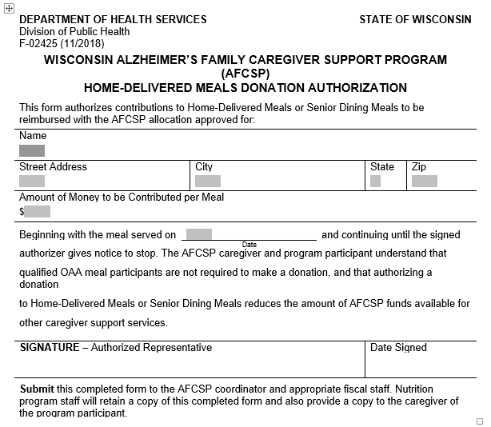
What can AFCSP pay for?
Prepared or Congregate/Home Delivered Meals
If age 60+ must sign form acknowledging understanding that donations are voluntary
If under age 60, must pay full cost of the meal
Refer to policy memo dated 1-7-19 (found on GWAAR website)

Slide 15
What can AFCSP pay for?
Caregiver Counseling (not covered by health insurance)
Professional individual counseling
Group therapy
Therapeutic Services (not covered by health insurance)
Speech, occupational, physical
Recreation, music, art
Massage, aromatherapy, pet, etc.

Slide 16
What can AFCSP pay for?
Education and Training (For the PWD and/or their caregiver)
Individual instruction on daily care (bathing, eating, mobility, etc.)
Fees and expenses related to attending classes such as Powerful Tools for Caregivers or other events related to dementia and/or caregiving
Books or DVDs
Online Classes (such as Teepa Snow or Oshkosh Dementia classes)
Registration and travel expenses associated with attending an Alzheimer’s or Caregiver Conference

Slide 17
What can AFCSP pay for?
Other goods and services necessary to maintain the individual as a member of the household
Personal supplies (incontinence pads, briefs, OTC medications)
Emergency response system, Safe Return, GPS monitor
Yard fencing to protect against wandering
Most reasonable requests made by the caregiver to address a need identified using the Caregiver Needs Assessment

Slide 18
Developing New Programs or Expanding Services
Starting or expanding Dementia Friendly Communities activities
Starting or expanding a Project Lifesaver or Music and Memory program
Contracting with organizations that serve people with dementia to expand hours of operation, improve services and activities, and market to new audiences
Establish a new caregiver coalition or collaborate with other agencies to hold caregiver events or classes

Slide 19
Outreach to Families in Need of Support
Outreach to community, non-profits and faith-based service agencies
Promote AFCSP to home care organizations, hospitals and clinics
Seek referrals from partner organizations, i.e. caregiver coalition
Advertise AFCSP program and promote upcoming events
Purchase radio, television, newspaper or internet advertising

Slide 20
Raise public awareness of dementia and services available through AFCSP
AFCSP funds may be used to purchase items needed to provide the following types of outreach
Presentations in the community about dementia or caregiving
Educational series, such as Lunch-n-Learn presentations
Donate Alzheimer’s Disease or caregiving books to local libraries
Participate in caregiving and Alzheimer’s Disease/dementia trainings and conferences

Slide 21
Support groups for people with Alzheimer’s disease and/or their caregivers
Costs associated with facilitating support groups
Staff time to plan and facilitate
Snacks and supplies
Respite care or transportation that enables caregivers to attend
Materials used or shared during support groups, such as books and DVDs about caregiving or Alzheimer’s disease
Marketing materials, speaker fees and supplies

Slide 22
Administration Costs*
Cost to attend caregiver coordinator trainings
Fees associated with becoming a Powerful Tools for Caregivers leader or other caregiver support class leader
Fees associated with staff attending Educational Conferences
Fees associated with any dementia or caregiver-related training for staff approved by the administering agency
Staff time not working directly with clients
Data entry
Fiscal reports

Slide 23
Caregiver Needs Assessment

Slide 24
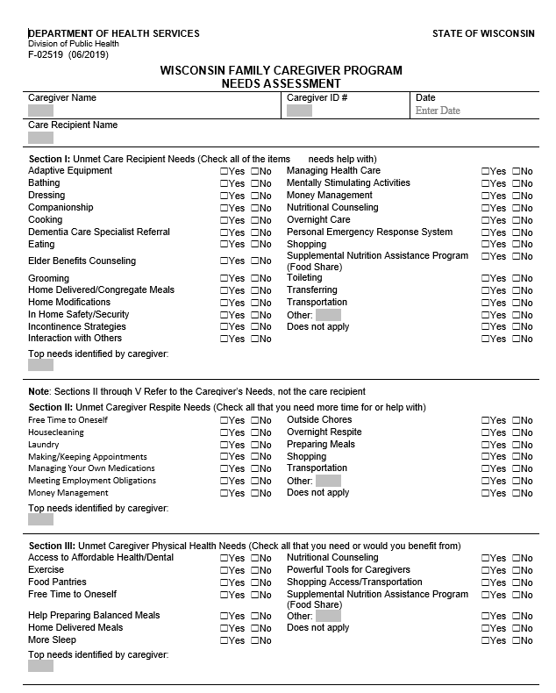
Caregiver Needs Assessment
Complete for all caregivers who are being enrolled
This is a TOOL to help determine the most urgent needs of the caregiver
Ensures full scope of services are being offered
See Building Interviewing Skills for a Successful Needs Assessment for help with interviewing techniques

Slide 25
Caregiver Needs Assessment
Include all areas in your discussion with the family
Unmet needs of Care Recipient
Unmet Caregiver Respite Needs
Unmet Caregiver Physical Health Needs
Unmet Caregiver Emotional Health Needs
Education and Resource Needs
Do not have to ask each question, but do address each section

Slide 26
Caregiver Needs Assessment
Find the Needs Assessment under Enrollment Forms
Refer to Supplement and Best Practices documents for help (under Program Management Resources)
Enter information into REDCap system
See Webinar and User Guide for help (under Data Collection – SAMS & REDCap)

Slide 27
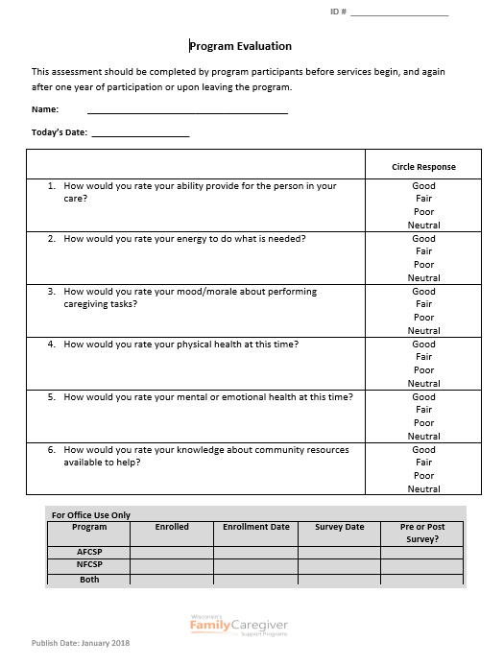
Caregiver Program Evaluation
Rates how the caregiver feels about their caregiving role – before and after services are in place
Complete before services begin
Re-evaluate after one year or when they are no longer utilizing services, whichever comes first
Enter data into REDCap
Find the Program Evaluation form under Enrollment Forms

Slide 28
Customer Satisfaction Survey
Rates how well agency staff handled their situation
Give survey to participant after resources/services are set up
Include a self-addressed, stamped envelope (request envelopes from Lynn Gall at DHS)
They will complete and mail survey to DHS in Madison

Slide 29
Enrolling Participants

Slide 30
How to enroll a new participant
Use AFCSP Worksheets to Determine Eligibility
Diagnosis – must be signed by a qualified health professional
Alzheimer’s or other condition resulting in “irreversible dementia”
Lives in the community – includes Adult Family Home, RCAC, CBRF and Assisted Living
Not enrolled in Family Care - non-nursing home level of care is an exception
Verify household income (individual and spouse)
Deduct Alzheimer’s-related expenses if needed
If clearly exceeds the $48,000 limit, refer to NFCSP

Slide 31
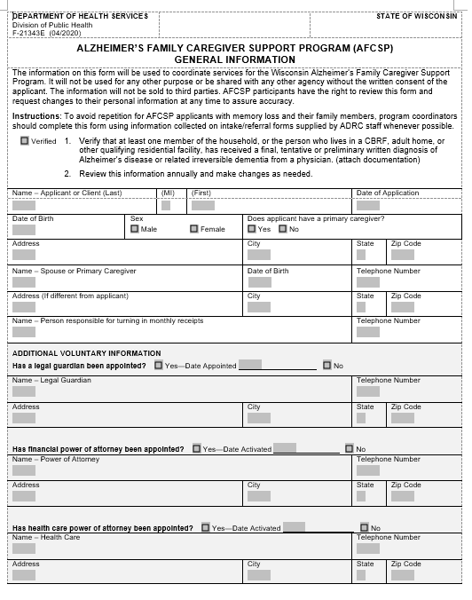
General Information
Name of person with dementia
Birthdate
Address
Phone number
Caregiver name and information
Powers of Attorney
Guardianship

Slide 32
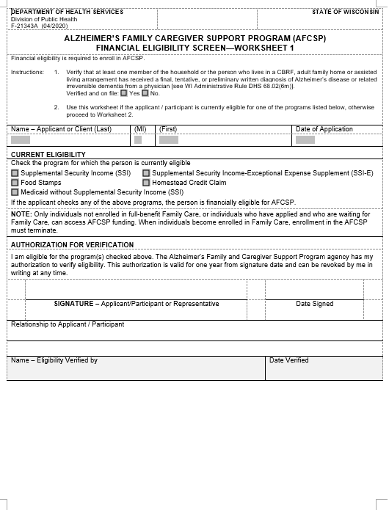
Worksheet #1
Check for other program enrollment:
SSI/SSI-E
Food Stamps
Homestead Credit Claim
Medicaid
If the participant is eligible for any of these programs, they are financially eligible for AFCSP and do not have to complete worksheet #2.
** A service plan still needs to be completed**

Slide 33
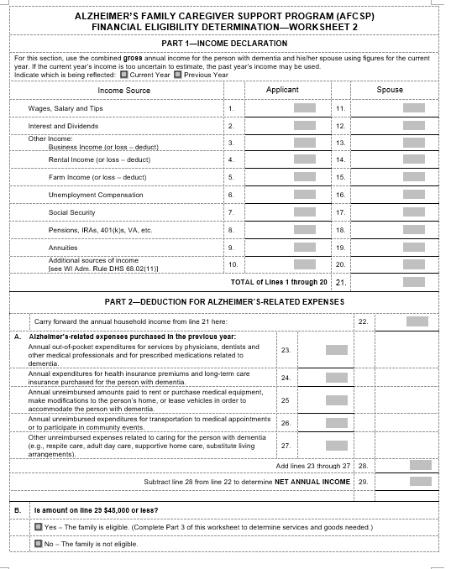
Worksheet #2 – Part 1
Declare Gross Annual Income for household
Social Security
Wages
Interest/Dividends
Unemployment
Pensions
Annuities
*Choose current year or previous year
*Household income = PWD and spouse

Slide 34
Worksheet #2 – Part 2
Deduct Alzheimer’s related expenses to reduce income if necessary**
Medical visits and medications
Health and long term care insurance
Medical equipment expenses
Transportation to medical appointments
Other expenses related to care
**ONLY for the person with dementia
**ONLY non-reimbursed expenses

Slide 35
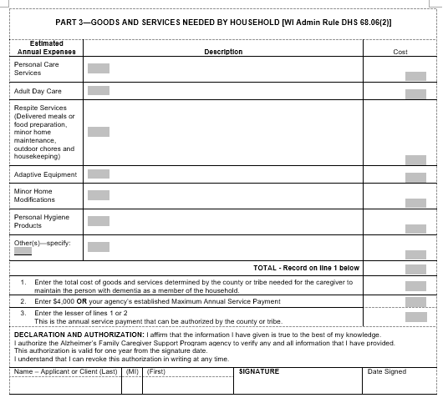
Worksheet #2 – Part 3
Develop Service Plan
Based on Needs Assessment results, create a plan that addresses all needs
All services and resources listed would be considered “approved” for them to purchase
If they determine later that they would like something different, they should get approval from you first
Dream big – include all available services/resources even if there isn’t enough money to cover it all

Slide 36
Worksheet #2 – Part 3
Calculate cost of each service for the year, for example:
4 hr home care/wk x 52 weeks = 208 hours
208 hours x $22/hr = $4,576
Door locks = $50
Fence for yard = $1,850
Record total cost for the year = $6,476

Slide 37
Worksheet #2 – Part 3 cont.
Determine the annual service payment
Enter total cost (in our example, $6,476)
Enter your agency’s maximum annual service payment (for example, $2,500)
The lesser amount will be the amount of funding the family qualifies for.

Slide 38
Method of Payment

Slide 39
Paying for Goods and Services
Payment Options
Directly to the service provider
Directly to the household to reimburse for expenses incurred
The primary caregiver cannot be paid for providing care
Extended family members and friends may receive a stipend to help cover costs associated with providing occasional respite
Set a uniform reimbursement rate/stipend for non-professional respite providers

Slide 40
Paying informal respite providers
All financial arrangements should be between the primary caregiver and the informal respite provider
Agency should make payment to the primary caregiver to reimburse them for what they paid the informal respite provider
Consider using a fiscal intermediary
Refer all questions regarding taxes to their accountant
Sample policy available

Slide 41
Follow Up and Assistance
Financial eligibility and the Service Plan (Part 3) must be reviewed and updated at least once every 12 months
Offer assistance setting up respite services or ordering equipment, especially for new participants
Follow up to make sure caregivers are benefiting from services being provided
No limitations on number of respite hours – Only limited by maximum payment allowed

Slide 42
Paperwork and Reporting

Slide 43
Paperwork and Reporting
Submit Annual Budget to the State by November 30
Number of households to be served
Amount to be spent in the various categories
How you plan to distribute funds – households, agencies, etc.
Your agency maximum for each family ($4,000 or less)
Any limitations your agency has
New programs or expanded services
Wait list policy
Community outreach planned for the year

Slide 44
Paperwork and Reporting
Submit Fiscal Report to the State in mid-March
Number of households served
Number not enrolled but benefitted indirectly (support groups, etc.)
Number on waiting list
Amount spent on various services – must equal total allocation
Explanation for any unspent funds

Slide 45
AFCSP and SAMS
There is not a requirement to enter data into SAMS at this time but your agency may choose to do so
You may view a webinar on how to make AFCSP entries in SAMS here: Online Webinars
Refer to SAMS AFCSP Services Reference Sheet for more assistance found here – look under Documentation and Forms

Slide 46
Best Practices

Slide 47
Best Practices – Managing the Program
Have one person (or agency) administer both NFCSP and AFCSP
Review AFCSP budget and workplan with fiscal staff and director every quarter to ensure funds are spent fully each year
Offer the full range of services – families must be able to self-determine what supports they need most
Regularly educate all of your agency staff about AFCSP

Slide 48
Best Practices – Marketing and Outreach
Submit articles about caregiving and dementia to newsletters – yours and coalition partners
www.gwaar.org > Technical Assistance > Family Caregiver Support > Marketing Toolkit > Articles
Create a marketing plan utilizing statewide marketing materials
www.gwaar.org > Technical Assistance > Family Caregiver Support > Marketing Toolkit
Contact radio and TV stations to be included on morning “talk shows” to speak about caregiving-related issues, dementia and services available through AFCSP

Slide 49
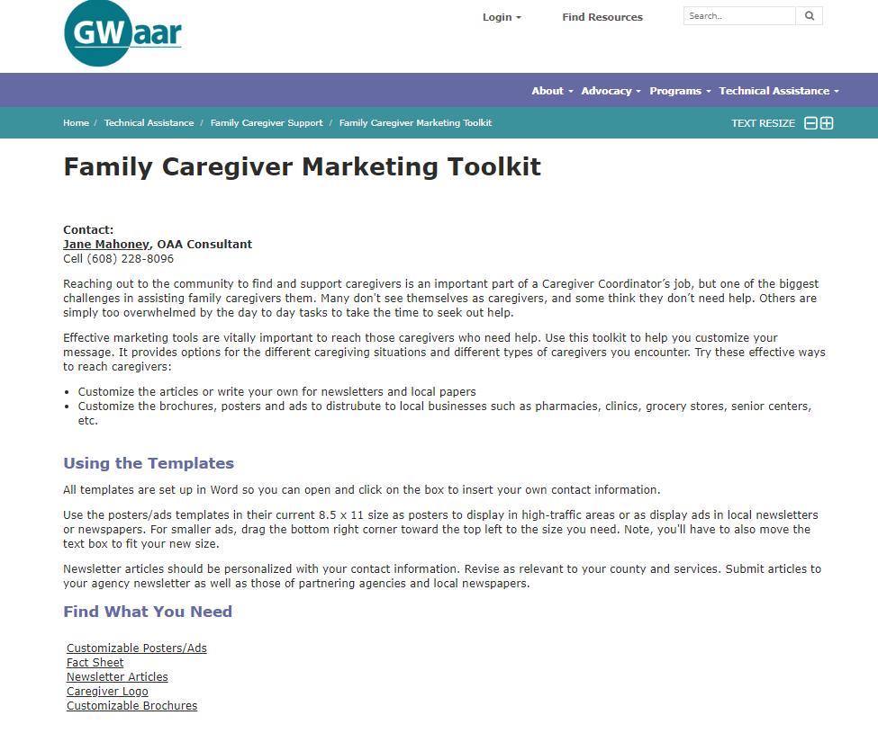
Customizable – insert your contact information

Slide 50
Best Practices – Working with Clients
Meet with as many family members as possible, not just the primary caregiver
Conduct a home visit if possible
Encourage caregivers to invest in things that can be used for the duration of providing care (classes, home modifications, etc.)

Slide 51
Best Practices – Partnering with Others
Educate caregiver coalition members about AFCSP and where to refer potential participants – Provide brochures for their clients
Work closely with Alzheimer’s Association/Dementia Alliance, Memory clinics, and other dementia programs in the community
Meet with community organizations that serve families living with dementia to ensure referrals are being made

Slide 52
Questions?
Please contact for questions:
Bryn Ceman:
Bryn.ceman@gwaar.org
608-228-8096
Lynn Gall:
lynn.gall@wisconsin.gov
608-266-5743

