Slide 1
Marketing MIPPA in Rural Wisconsin
MIPPA Training Call
February 4, 2016
Presented by Jane Mahoney and Debbie Bisswurm
Notes:
Debbie – slides 1-2

Slide 2
Marketing in Rural Areas can be challenging
Increased number of isolated people
Limited transportation
Large land area to cover
Ratio of “Time Spent: People Reached” is low
Message needs to be adjusted
Notes:
Debbie

Slide 3
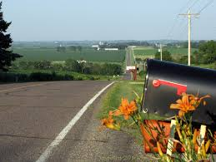
Use what you know to reach your rural audience
Learn what will appeal to people in rural areas and develop your marketing plan around that
Time invested in the beginning will be worth it in the end
Notes:
Jane – slides 3-7

Slide 4
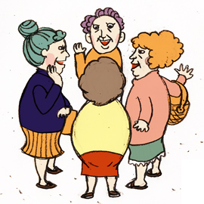
Rural people tend to:
Know their neighbors
Trust their neighbors
Have a strong sense of belonging to their community
Word of mouth is very effective in rural communities
Notes:
Jane

Slide 5
Personal Communication Works
People living in rural areas respond best to a personal message. They want to know who the message is from, if that person is trustworthy, has the same values and understands their needs. They are less likely to listen to a message from an unknown source.
Notes:
Jane

Slide 6
Content of Message
Use words that resonate to rural people:
Affordability
Reliability
Capture meaning that is valuable to rural people:
Dependability
Traditional
Value-based
Notes:
Jane

Slide 7
Biggest Challenge in Rural Marketing
Delivery of Message
How do you get your MIPPA message to people who are isolated?
Notes:
Jane

Slide 8
Traditional media sources tend to work well for people in rural areas
Newspaper – free local papers that are delivered to the door
Radio – find the stations older people listen
Ads
Talk shows
TV – local cable station
Community Calendar – newspapers, radio, TV
Notes:
Debbie – slides 8-12

Slide 9
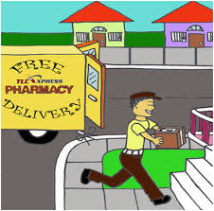
Stuff flyers/brochures in anything that is delivered or picked up
Home delivered meals
Prescription drug bags
Grocery bags
Church bulletins
Other things that are delivered or picked up
Notes:
Debbie

Slide 10
Connect with other professionals who have contact with isolated individuals
Clergy
Pharmacy
Transportation
volunteer drivers
Family caregivers
Clinic
Eye doctor/dentist
Notes:
Debbie

Slide 11
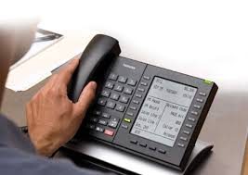
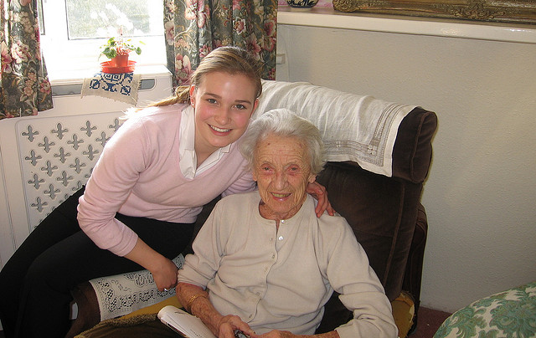
Call or visit people who are isolated
Time consuming yet effective
Check with others in your agency who might also be making home visits with isolated people and share information (people receiving home delivered meals need an annual visit)
Notes:
Debbie

Slide 12
Promising practices from MIPPA grantees for message delivery
Connect with local churches –
leave fliers there or put in bulletins
ask for whoever visits “homebound” members to take brochures along
Advertise at movie theater – in the ads that run before the movie starts
Capitalize on “senior citizen discount day” at the theater, McDonalds or other places
Live radio show. Check with radio station to see if they do local live talk radio.
Make MIPPA the theme of the month for local support groups – emphasis on the caregiver - “someone you know is probably on Medicare”
Notes:
Debbie

Slide 13
Three truths about rural outreach
People respond best to personal communication
Presenters need to earn trust in order to be heard
People connect with tradition, values and community support
Notes:
Jane – slides 13-17

Slide 14
1.) Personal communication works best
Get out of the office and meet with the people
Make yourself well-known and visible
Have regular office hours in rural communities
Visit senior apartment complexes
Go where the people are – coffee clutch, senior groups
Offer home visits for those who have difficulty traveling
Notes:
Jane

Slide 15
Find a personal connection
Tell them about yourself - use a shared experience/idea to connect with your audience
Share examples of other people’s experiences with what you are “selling” (no names, of course)
Give a live “demonstration” or spell things out clearly
Walk through Planfinder together
Include real dollar amounts – “what would you do with an extra $104.90 each month?”
Notes:
Jane

Slide 16
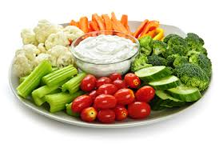
Be personable by offering something for free
Offer a meal or snack
Hand out usable “give-aways”
Appeal to their need for social activity/entertainment
Notes:
Jane

Slide 17
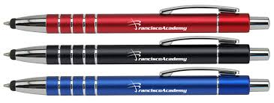
How MIPPA grantees have used personal communication
Become a member of the Chamber of Commerce to take advantage of their networking opportunities
Give-away ideas:
Hot/cold packs
Flashlight key chains
Pens
Coasters
Put MIPPA information in gift bags for community events –attach candy to bring attention to it
Bring flyer’s to Car Winterization for Seniors event or “55 Alive” program
Use “visuals” to call attention to your message, i.e. wear pink for breast cancer awareness
Notes:
Jane

Slide 18
2.) Earn trust in order to be heard
People will listen better to someone they know and trust rather than an “expert” from out of town
Appeal to their values and beliefs
Call on people you know from community groups and ask to present at their meeting – you’ll have an “in”
Use volunteers from the community – especially the peers of your audience – give them a “script” so they know what to say
Notes:
Debbie – slides 18-21

Slide 19
Gain trust from community leaders
Winning over key opinion leaders is key to reaching rural communities
Educate them and ask them to pass on the information
Generate positive word of mouth, starting from local sources of authority
Notes:
Debbie

Slide 20
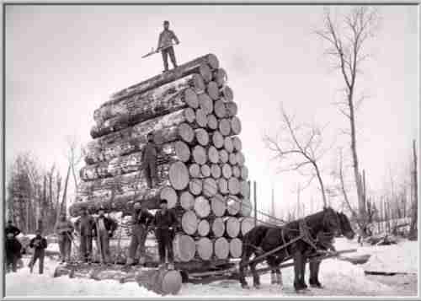
Earn trust by understanding their community
Learn about the history of the community
Understand their values
Get to know how they learn and respond
Ask for their perspective
Be modest/humble
Notes:
Debbie

Slide 21
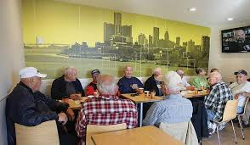
Talk to people who are already respected in the community
Hardware Stores
Feed Store
Famer’s Co-op
Bait Shop
Mechanic Shop
Beauty Shops
Bars/Supper Clubs
Coffee Shop (or wherever retirees gathers for coffee each morning) Organizations for a “cause”
Notes:
Debbie

Slide 22
3.) People connect with tradition, values and community support
Align the message with broader meaning and values
“There are strong advocates in your community who spoke out to save Senior Care. Be sure to share the value of this program with your friends and neighbors!”
Pride runs strong in rural communities. Acknowledge this value.
“I know self sufficiency is important to you. You paid your taxes all those years - you have earned this benefit!”
Reassure them that your work with them is confidential
Notes:
Jane – slides 22-23

Slide 23
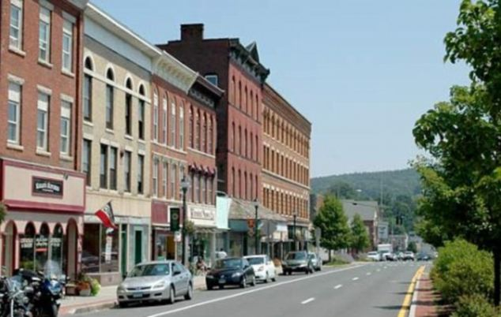
People have a strong sense of community support
Show how their “buying into” your service is good for the whole community
“I know your community values healthy living. Preventive health care benefits not only you, but it is also a good step towards a healthier community”
“The money you save with a Medicare Savings Program can be spent in your community.”
Notes:
Jane

Slide 24
Promising Practices from MIPPA Partners
Partner with Farmers Market Nutrition Program events
Connect with Hunger Coalition and rural food pantries
Send information with home delivered meals
Brochures or posters in grocery stores, gas stations, post office, laundromat, library and any business in small communities
Connect with Public Health – flu shot clinics, foot clinics, blood pressure checks
Local health fair or other fairs, celebrations and small-town events – go where the people are
Mailings
Notes:
Debbie – slides 24-25

Slide 25
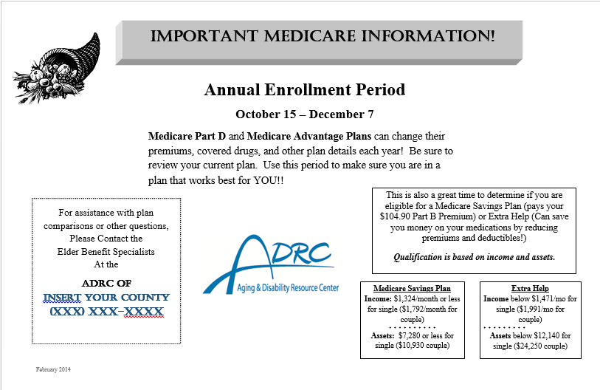
Promising Practices from MIPPA Partners
Send info in monthly statements for senior dining
Grocery Store and Pharmacy bag stuffers
Place articles in newsletter and newspapers - especially free papers
Placemats at church or local fish fry
Presentation to ADRC Advisory Council – they know rural folks
Presentation to Service Clubs (Rotary, Lion’s Club, Kiwanis, Optimists)
Encourage Word of Mouth
Notes:
Debbie

Slide 26
Examples of good rural partnerships from MIPPA grantees
Senior Apartment Complex managers
Social security office
Hospital and clinic patient services (whoever helps patients pay bills)
AARP Volunteer Tax Aides
Senior Medicare Patrol
Churches/Faith Community leaders
Senior social groups
Businesses in small towns – hang fliers in windows and talk to store owners
Large businesses – employees may have relatives living in rural areas
Partnership with other agencies who work with rural folks
Veterans Administration
Notes:
Jane – slides 26-end

Slide 27
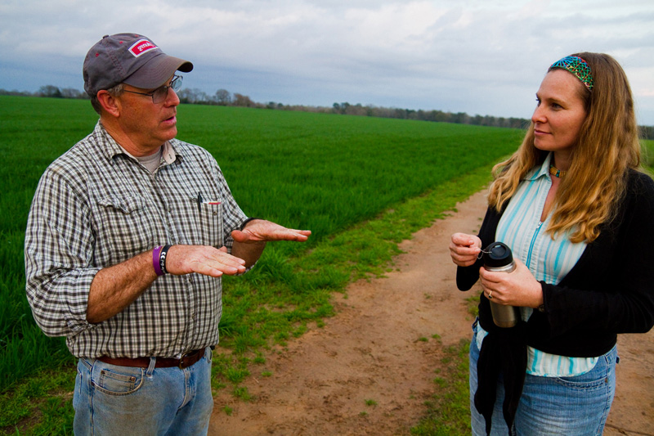
Prepare for work in rural areas
Learn about the community’s history
Be modest/humble
Help people feel comfortable
Dress in simple clothes
Learn local terminology
Have respect and understanding
Share who you are
Make connections
Ask for their perspective
Allow plenty of time – don’t rush

Slide 28
You know you are in rural Wisconsin when…
Someone in the grocery store offers you assistance and they don’t work there.
You have a lengthy telephone conversation with someone who dialed a wrong number.
You measure distance in hours.
You know several people who have hit a deer more than once.
You install security lights on your house and garage, but leave both unlocked.
You design your kid’s Halloween costume to
fit over a snowsuit.
Driving is better in the winter because the
potholes are filled with snow.

Slide 29
Discussion
Sharing ideas
Questions

