Slide 1
How Stigma Affects Benefit Program Enrollments
Notes:
Debbie

Slide 2
Learning Objectives
Understand why people choose not to apply for benefits
Define stigma
Learn common false perceptions about financial assistance programs
Brainstorm ways to overcome stigma
Notes:
Debbie

Slide 3
Data from 2013 about SNAP
Only about 2-in-5 older adults likely eligible for SNAP were enrolled in the benefit.
5,179,179 older adults were missing out on the benefit.
In 2013 alone, older adults missed out on $403 million to help them pay for groceries.
Notes:
Debbie
NCOA recently did a national training on barriers to MIPPA enrollments and included this data about the SNAP program. **
So once people are aware of the programs that can help them, what is stopping them from enrolling in these programs?

Slide 4
Big Question: “Why don’t people sign up for benefit programs?
Work associated with gathering information
filling out paperwork
finding transportation
Stigma
External
Internal
Other?
Notes:
Debbie
Two main reasons identified for why people are not signing up for MSP and LIS

Slide 5
What is Stigma?
A set of negative and often unfair beliefs that a society or group of people have about something
A mark of disgrace or infamy; a stain or reproach, as on one's reputation
Stigma prevents people from seeking help
Notes:
Debbie
Stigma can be powerful – difficult to overcome
Stigma can be invisible and unidentified – makes it harder to overcome if you aren’t aware of it
Stigma is often passed from generation to generation

Slide 6
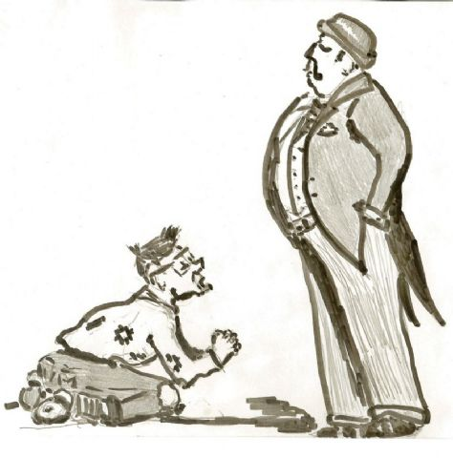
How are poor people perceived?
Lazy?
Unkempt?
Mentally ill?
Old people?
Unemployed?
“less than”
Other?
Notes:
Jane
So, What sort of stigma do people who sign up for benefits have? Lazy…unkempt… “Benefits was refered to as “welfare, especially by those in the older generation.
I was reading about stigma and found that during the dirty 30’s, poor people were seen more as down on their luck – a farmer who, through no fault of his own, lost his crop and his income. Now, poor people – those who are on “welfare” are more likely to be thought of as lazy.
“poor people” have a lot of stigma, and poor people are the ones that get help from the government
It is no surprise that a person who thinks (or once thought) that people on “welfare” are lazy would not want to apply for MSP or LIS.
But who are the people who enroll in “benefit programs?”

Slide 7
Who Are the Poor?
Notes:
Jane
So while the general population links people on welfare with lazy people who refuse to work, in actuality, the largest group of people receiving benefits is children followed by working adults. Unemployed adults makes up a very small percentage of the poor. Perceptions are often wrong.

Slide 8
Public money spent on benefits in the US
Notes:
Jane
And for those who may think the US spends too much on public benefits, this chart shows that the Percentage of Gross Domestic Product spent on public family benefits in the US is one of the lowest of developed countries. (Put simply, GDP is a broad measurement of a nation’s overall economic activity.)

Slide 9
Internal Stigma
Comes from feelings of personal shame or embarrassment.
“I don’t want to be one of those people with the card.”
“Other people need these benefits more than me.”
“I was always taught you live with what you’ve got.”
“My neighbor could find out I’m getting help with food or fuel”
“Welfare isn’t for me, it’s for young moms who pop out kids.”
“I don’t need any handouts.”
Notes:
Jane
Where does Stigma come from?? Two types of stigma have been identified. The first type is internal stigma - comes from the inside – This is what people believe based on how they were raised, what they have been told. Internal Stigma includes thoughts within a person that are hard to change. It is the voices inside your head talking negatively. Often the stigma the person feels is not even real – but is just as damaging.

Slide 10
External Stigma
Comes from previous experiences or perceptions
“They’re going to take my house away!”
“It’s not worth the time to only get $18.”
“I don’t trust the Medicaid’s quality of care because it’s on a budget.”
“I don’t want to deal with the social services department.”
Notes:
Jane
Stigma also comes from experiences that happened to them or someone they know. Oftentimes these are false perceptions or made-up stories – like “fish tales.” Here are some examples.

Slide 11
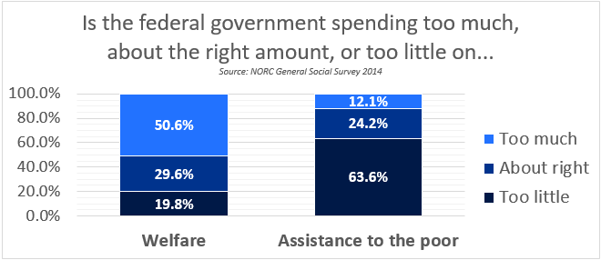
Welfare versus “Welfare”
Notes:
Jane
I found this to be an interesting survey that is a good example of how stigma affects people.
When referred to as “welfare” over half of respondents felt too much governmental money is being spent. When referred to as “assistance to the poor” over half felt too little was being spent.
In 2014 a Texas congresswoman suggested “welfare” be replaced with “transitional living fund”
Debbie will take it now.

Slide 12
Choose words carefully
SNAP vs. Food Stamps
Entitlement Program vs. Welfare
Extra Help vs. Low Income Subsidy
Benefit vs. Welfare
Limited Income vs. Low Income
Financial Assistance vs. Government Aid
DISCUSSION
Notes:
Debbie
SNAP=supplemental nutrition assistance program
The words we choose have a great impact on how people feel about these programs.
Be very conscientious of how you describe the programs

Slide 13
Discussion on other ways to describe programs (added after webinar)
In regards to Food Share - You get this much on your card every month but you don't have to spend it each month. You can let it grow and use it to buy food for a family gathering.
Just give it a try. You don't have to stay on it if you don’t want to.
Tell the person what $16 of groceries can buy - milk, bread, eggs, coffee, etc.
In regards to MSP - When presenting at Medicare ABCD’s tell them that when their premium starts to be deducted from their Social Security check, they may find that receiving MSP would be very helpful!

Slide 14
Use phrases that are affirming
You have earned this benefit
This program was created for your situation
You have paid taxes all your life
This program may help you maintain your independence
Programs give you more flexibility in spending
DISCUSSION
Notes:
Debbie
Again, how we describe the programs can affect how people feel about them.
Use stories/examples to show how the program has helped other people out
Debbie – medication needed to stay independent and healthy

Slide 15
Ways to Fight Internal Stigma
Offset the undeserving narrative
Focus on economic landscape instead of individual problems
Correct misconceptions
Notes:
Jane
It is important to recognize that a person’s hesitancy to apply is based on some hard core, long term ideas about “receiving help.”
Undeserving Nature: There is often an aversion to anything that looks like some form of unlimited public assistance that is not tied to work. You might remind them that by paying Medicare taxes while they were working, money for these programs was set aside, so they did in fact work to gain these benefits.
Economic Landscape: It might be easier for them to think of this as short term to help them after a hard economic recession.
Have you ever put money aside for a hard time? The Government has set aside these programs knowing that hard times come to people.
Correct Misconceptions:
“I don’t want to be one of those people with the card.” – no one but you will know what kind of card it is
“Other people need these benefits more than me.” -
“I was always taught you live with what you’ve got.” - Again, remind them of the “rainy day” account.
“My neighbor could find out I’m getting help with food or fuel” - your neighbor may also be getting help. Last year over 230,000 households get help with energy and in April, almost 260,000 people got food share.
“Welfare isn’t for me, it’s for young moms who pop out kids.” – there are many other programs that young moms wouldn’t even qualify for. And what do you mean by “welfare?”
“I don’t need any handouts.” You can live without them, but how well? If you are unable to get medication and medical treatment, how will that affect your life and the life of those who love you? LIS to help afford medication that keeps them out of the ER
You may not be able to talk them into applying very easily. The best you can do is empathize with how they are feeling, then begin painting new pictures of what it means to get help.
But in the end, always be respectful of where people are at. They don’t HAVE to accept the benefit. Maybe they will think about it and apply later on.

Slide 16
Ways to Fight External Stigma
Provide person-centered assistance
How could you use an extra $100/month?
Demonstrate the value of a benefit
This is what $18 worth of groceries looks like
Provide excellent service
– Remove stigma of “social services”
Give facts
Doctors don’t know what insurance you have
DISCUSSION
Notes:
Jane
Provide person-centered assistance
How could you use an extra $100/month? – do something for grandson/wife
Buy something they have been wanting
Fix house or equipment that has been “let go”
Demonstrate the value of a benefit
This is what $18 worth of groceries looks like
Provide excellent service – remove stigma of “social services” staff
Introduce them to your staff
Create a beautiful space to meet clients in
Give facts
Doctors don’t know what insurance you have
Respond honestly and non-judgmentally to stories they say they have heard
Educate!! Have facts about LIS, MSP – normalize their use
Possible responses to negative comments that reflect stigma:
Are you sure that is the truth?
Point out that the comment may be based on faulty perceptions
Reflect on positives, ignore negatives
The extra money allowed for the person to make home repairs or have a surgery that prevented a worse condition
Have you met ____________ (in Social Services)? Give fact about how that person has done something good in the community
Share a story – “My grandma found out about LIS and was able to save that extra money to buy a (lift chair, new winter coat, new stove, etc). She is so much happier now and her hip doesn’t hurt so much/she can cook more and eat healthier/ go out in winter
Again, align yourself with them – you’ve heard those stories, too – and start giving real facts/data about

Slide 17
Discussion on other positive ways to talk about benefits(added after webinar)
Approach from an empowerment side of things – help them look at the bigger picture. How could this extra money help you with a situation in your household. Get them thinking about what they could save money on. Ask them what they would use the money for.
When screening for MSP explain that it is a 2 for 1 program. First you save money on the Medicare part B premium and also on the Medicare part D costs. The $120 saved on the part B premium can be used to pay the electric bill, etc. Money saved can pay for gas, cable bill, taxes, etc.

Slide 18
Ways to Fight Stigma through Policy Change
Improve enrollment process
Automate the SLMB+ eligibility renewal in CARES?
Notes:
Jane
Fighting stigma can start at home – on the ground with the people you work with every day, but it needs to also happen on a larger platform. Improving the enrollment process is one thing that has been discussed in our Medicare Task Force meetings.
In Wisconsin they are looking at automating the SLMB+ eligibility renewal in CARES. Currently this must be done manually and it means people are not always screened and/or fall off the rolls unnecessarily.
.

Slide 19
Closing
Do what you can to fight stigma!
Share things that work with others
Most importantly, educate people about available programs but respect individual’s choice
May choose to enroll at a later date
Notes:
Deb
Again, it is important to meet people where they are at. Some people really value "self-sufficiency". I am sure you have encountered the individual who is likely qualified, but feels they are doing fine and wants to remain self-sufficient. They do not want to depend on anyone, especially the government. Going on a government program may effect that person's self-esteem. You may be able to "talk them into it" in the office, but when they leave they may become depressed about it. So whenever someone like that is encountered, I think we need to encourage grantees to honor and respect the individual's values and wishes.
Help them to make an educated decision about getting help.
Tell them about the woman who tried to do it "on her own" and got to the point that she couldn't afford one of her medications so she simply stopped taking it. She ended up in the ER and will be MORE dependent now. So in those situations the feeling that should be conveyed is, "I understand and respect how you feel, but keep these programs in mind and contact us if you ever get to that point".

