Slide 1
Medicare Marketing Guidelines
(How to Tell if an Insurance Agent is a Hero or Villain)
August 2019

Slide 2
Background
Rules that insurance companies must follow when selling Medicare Advantage plans, Part D plans, cost plans, employer/union-sponsored group Adv and Part D plans, and Medicare-Medicaid plans (with some exceptions).
Also apply to plan representatives (insurance agents and brokers)
Meant to prevent plans from presenting misleading information about a plan’s cost or benefits.
Also contains rules for how plan representatives may contact and market to beneficiaries.

Slide 3
Communication vs. Marketing
Communication includes activities and materials that provide information to current and prospective enrollees.
Marketing is a type of communication that includes activities and materials used by plans to influence a beneficiary’s decision-making process when selecting a plan.
Plans are required to submit marketing materials to CMS for review.

Slide 4
Examples
GothamChoice PPO sends a letter to plan enrollees that tells them they can get their flu shot with a $0 copay.
Communication, because it is only provides information to current enrollees and is not meant to steer them toward a particular plan.
A billboard says that GothamChoice offers $0 premium plans in Gotham City.
Marketing, because the intent is to encourage individuals to enroll in a GothamChoice plan.

Slide 5
Marketing Materials
Must follow certain rules so that they are not misleading or inaccurate. Plans cannot:
Cannot suggest their plan is preferred by or from Medicare or the Department of Health and Human Services
Can use Medicare in plan name as long as it follows the plan name (e.g., UHC Medicare Complete) and the usage does not suggest that Medicare endorses that particular plan
Say they will keep a beneficiary enrolled even if the beneficiary fails to pay premiums
Use the word “free” to describe a zero-dollar premium
Can say that plan has a zero-dollar premium or use the word “Free” when describing mandatory, supplemental, and preventive benefits provided with no cost-sharing for all enrollees

Slide 6
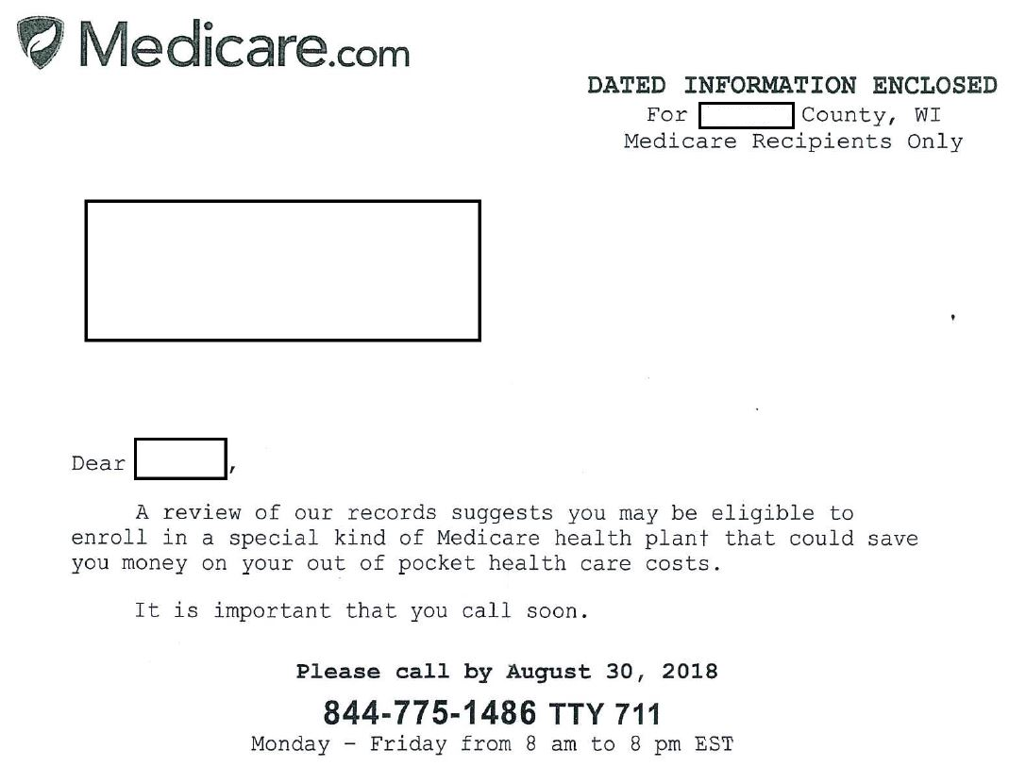

Slide 8
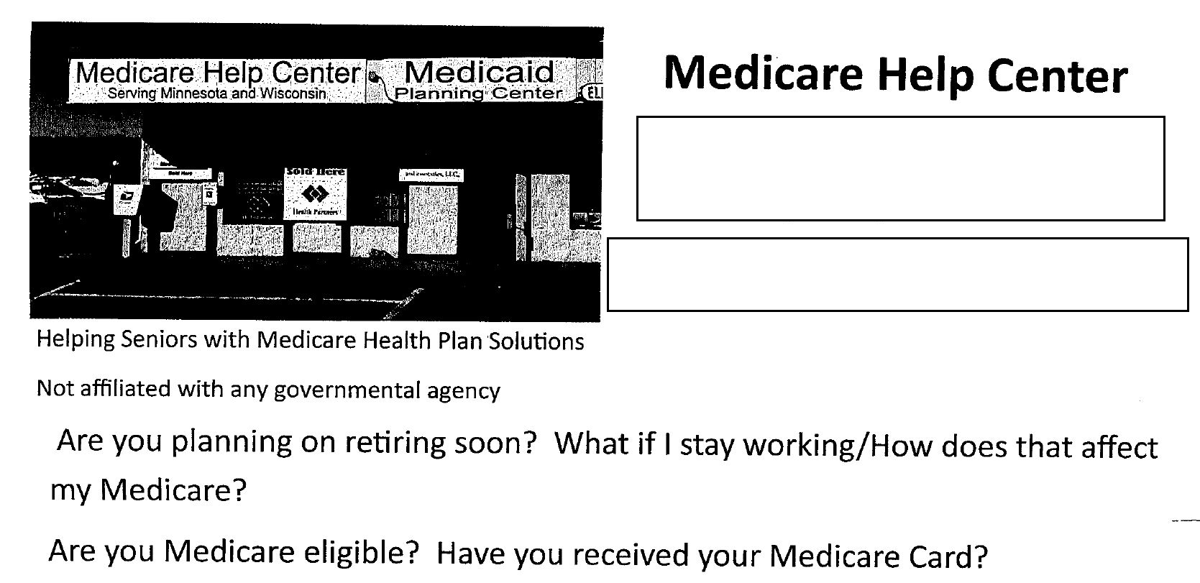

Slide 10
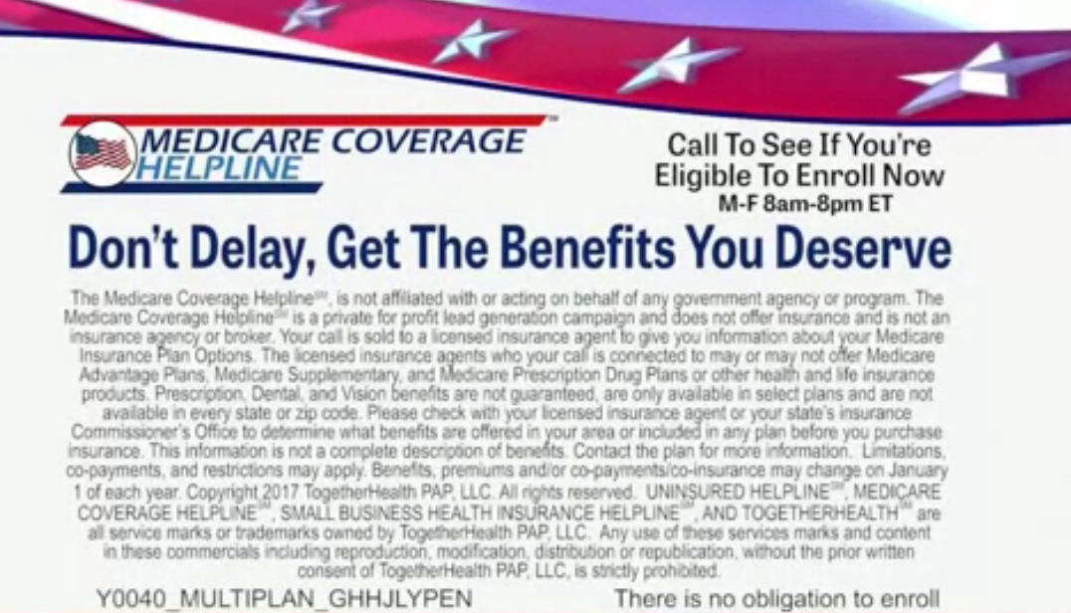

Slide 11
Educational Events | Marketing Events
Explicitly advertised as educational | Designed to steer or attempt to steer potential enrollees toward a plan or set of plans
Held in a public venue (not at home or in one-on-one settings) | Must have invitations that say, “A sales person will be present with information and applications”
May include communication activities and distribution of communication materials | Can discuss specific plan information with beneficiaries and hand out enrollment applications
If for current enrollees, can provide plan-specific information | All talking points and presentations must be submitted to Medicare for approval before use
If for prospective enrollees, cannot include plan-specific information | Cannot require a beneficiary to provide contact information to attend the event
Cannot distribute marketing materials or enrollment applications | Give beneficiaries a health screening or give the impression they only want to enroll healthy people
Cannot provide information about plan costs
Cannot display or attach plan representative contact information to materials unless requested by beneficiary

Slide 12
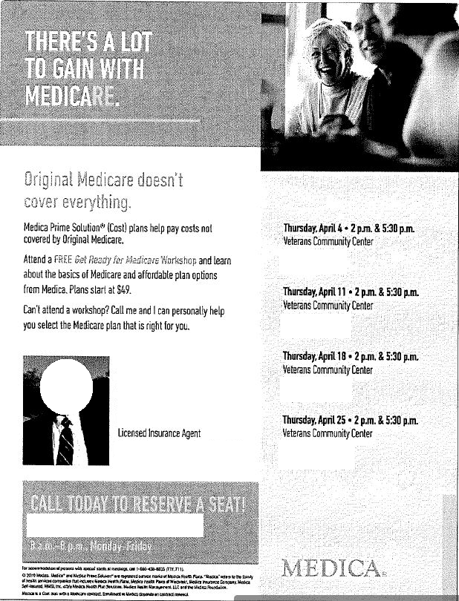

Slide 13
Marketing Timing
Plans cannot begin marketing for Fall Open Enrollment (October 15 through December 7) until October 1 each year.

Slide 14
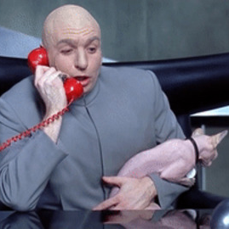
Contacting Beneficiaries During Fall OEP
Plans are allowed to send a beneficiary unsolicited mail and email, but email must have an opt-out option
Unless an individual is currently enrolled in an insurance company’s plan or has given permission, plans are not allowed to:
Contact individuals by phone, text message, or social media
Visit individuals
Leave promotional materials at an individual’s home
Approach individuals in public to market the plan

Slide 15
Contacting Beneficiaries By Phone
Agents CAN: | Agents CANNOT:
Call current plan enrollees | Make unsolicited calls
Call individuals who submit enrollment applications to provide guidance related to enrollment | Call based on referrals
Call former enrollees to discuss why they disenrolled | Call to market a plan or product to an enrollee who is in the process of disenrolling or has already disenrolled
Call individuals who have given permission for a plan agent or broker to contact them | Call an individual who attended a marketing event, unless the individual gave permission
Return phone calls and messages from individuals or plan enrollees | Call an individual to ask if they received mailed information

Slide 16
Electronic Communication With Enrollees
Leading up to Fall OEP, plans can send the Evidence of Coverage, formulary, and provider and pharmacy directories to current enrollees
Plans can provide materials via email or other electronic means if they:
Have prior consent from the enrollee
Provide a way for the enrollee to opt out of electronic communications and receive hard copies
Provide instructions for how to access electronic materials
Ensure that the enrollee’s contact information is up to date
Deliver materials in a timely manner

Slide 17
Where To Contact Beneficiaries
Plans CAN:
In health care settings, provide marketing information in common areas (e.g., cafeterias, conference rooms, community rooms)
Come to a beneficiary’s residence if the beneficiary scheduled an appointment
Mail information, including marketing content
Place ads in newspapers, online, or on TV
Plans CANNOT:
Approach prospective enrollees in public areas
Post plan-specific information in the waiting rooms or treatment areas of health care settings
Go door-to-door or visit a beneficiary without a scheduled appointment

Slide 18
Gifts and Meals
Plans cannot give gifts to beneficiaries in exchange for signing up for their plan
Can use gifts for promotion
Value cannot be more than $15 and cannot be cash
Gifts cannot be health benefits
Raffle prizes OK as long as the cost does not exceed $15 per expected attendee
Plan may serve light snacks at marketing events, but these snacks cannot add up to a meal
Meals may be served at educational events as long as the meal is not worth more than $15

Slide 19
Medicare Advantage OEP Jan. 1 – Mar. 31
Plans CAN: | Plans CANNOT:
Conduct marketing activities that focus on other enrollment opportunities (e.g., turning 65/IEP, 5-star plans, LIS/Extra Help SEP) | Send unsolicited materials advertising the opportunity to make additional enrollment changes or reference the Adv OEP
Send marketing materials that are requested by a beneficiary | Specifically target beneficiaries who are in the Adv OEP because they enrolled in an Adv plan during Fall OEP
Have one-on-one meetings with a beneficiary if scheduled by beneficiary | Promote activities that intend to target the Medicare Advantage OEP as an opportunity to make further sales
Provide information on the Adv OEP through a call center if the beneficiary requests this information

Slide 20
Appointments with Plan Representatives
Beneficiary may schedule an appointment in home or a public place
Must complete scope of appointment form that indicates topics to be discussed during appointment
Plan representative cannot tell beneficiary about products or plans that fall outside of this scope without prior permission

Slide 21
Tips for Clients during Fall OEP
No need to make a decision immediately!
Read current plan’s Annual Notice of Change or Explanation of Coverage to learn about changes
Contact plan to request a copy if not mailed
Contact plan with any questions and ask for confirmation of the benefits in writing

Slide 22
Ms. Lane, an agent with Metropolis Health Plan, is giving a sales presentation and wants to provide some food for her guests.
What can Ms. Lane provide?
A. A sit down meal offered in a separate room, before or after the promotional portion of the event
B. A buffet dinner
C. Snacks such as cheese and crackers
D. None of the above

Slide 23
At a marketing event on Dec. 1, an agent provided factual information on the MA/MA-PD plans available from Metroville Health Plan, and said that, compared to all other plans in the area, Metroville has the largest network of doctors. At the end of the presentation, the agent told beneficiaries that if they do not enroll today, they will likely lose their opportunity to do so.
Are these actions appropriate?
A. Yes. The agent highlighted a key aspect of the plan as well as informed beneficiaries that they could miss their chance to enroll.
B. Partially. While the agent provided a factual comparison of other plans’ networks, the beneficiaries could have felt pressured into enrolling.
C. Partially. The agent did not qualify their statement regarding the provider network but rightfully informed that beneficiaries the AEP deadline was approaching.
D. No. The agent made unsubstantiated absolute statements and also inappropriately pressured beneficiaries into enrolling.

Slide 24
A client tells you that residents of her senior apartment complex were visited by insurance agents selling a particular company’s Advantage plans. The residents had not requested these visits, but let the agents into their apartments after the agents said they had been sent by their doctor. The agents enrolled the residents into an Advantage plan and also attempted to sell life insurance policies.
What are the problems with this scenario?

Slide 25
A client in her initial enrollment period had original Medicare and a Prescription Drug Plan lined up and wanted to learn more about Medicare supplements. She met with an agent who enrolled her in an Advantage plan but told her that it was a supplement.
What are the problems with this scenario?

Slide 26
A client tells you she was called by an Ares Health Care insurance sales agent who told her that he was working with low income people to help them get some new benefits they are eligible for, called “Extra Help.” The client told the agent she was not interested. However, the agent showed up at her door the next day and told her that he was from Medicare, so she let him in. The agent told her that the Ares plan would cover her prescriptions and that her doctor was part of the Ares Health Care network. The client told him that she didn’t want to change plans, but that she was interested in Extra Help.
A week later, the client went to pick up her prescriptions and found she’d been switched to an Ares plan. The Ares plan did not cover her prescriptions. She tells you that she never agreed to enroll in an Ares plan, just that she wanted to sign up for Extra Help.
What do you tell your client?

Slide 27
How can the Wisconsin Senior Medicare Patrol help?
Education
Referrals

Slide 28
SMP Education
Will update our current educational message to include information about Medicare marketing guidelines
Will include Medicare marketing guidelines information at upcoming outreach events
Facebook posts providing information and reminders

Slide 29
SMP Referral Process
For suspected marketing violations, SMP referrals go to the CMS SMP liaison
If an insurance agent is involved in the violation, SMP also submits complaint to the WI Office of the Commissioner of Insurance (OCI)
Examples of complaints handled by CMS SMP liaisons include:
Part C and Part D marketing violations by agents, brokers, or plans
Agents, brokers, or plans conducting business after they have been asked to cease and desist
Misleading advertising
Materials that look like they are being sent from an official government source
Materials that imply private fee-for-service plans function as Medicare supplement plans
Offering incentives to enroll

Slide 30
CMS SMP liaison complaint examples, continued
Adverse selection (also known as “cherry picking”)
Selecting or denying beneficiaries based on their illness profile or other discriminating factors, such as:
Retaining only healthy members
Excluding beneficiaries with certain profiles
Enrollment complaints
Enrollment of beneficiaries in a plan without beneficiary consent
Disenrolling (removing) a beneficiary from Original Medicare without his/her knowledge
Falsely telling a beneficiary that his/her physician or hospital accepts the plan
Misrepresentation of the plan’s:
Physician-to-patient ratio
Physician qualifications
Access to care
Service area
Providers available

Slide 31
CMS SMP liaison complaint examples, continued
Phishing scams
Unsolicited emails purporting to be a valid Part C or Part D plan or service
These emails often entice an individual to visit a fraudulent website and provide sensitive personal information
Marketing insurance products that do not exist

Slide 32
More information = stronger referral
Copies of mailings received
Copies of email received, including attachments
Agent name, company name, and phone number

